Slide 1
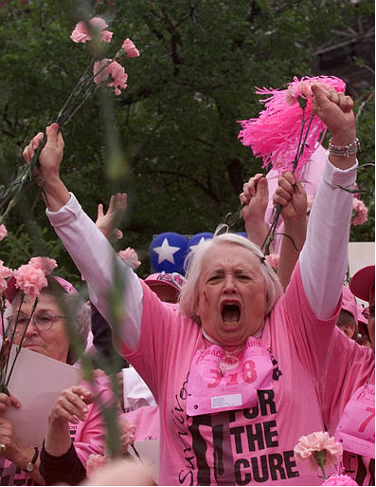
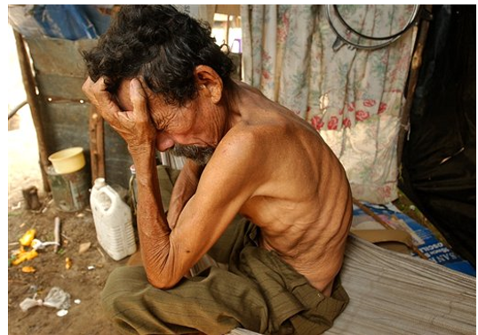
Images of Cancer in the Associated Press:
Blaming Victims, Celebrating Survivors
Jo Anna Grant & Heather Hundley
Communication Studies
Abstract
The AP labels those with cancer as victims or survivors. We used content & discourse analysis to examine 296 AP photos, captions, & titles of cancer victims & survivors from 1995-2005. The AP marginalized foreigners & centered U.S. women & cancer survivors through four strategies: (1) disproportionate frequencies, (2) demographic profiles, (3) portrayals of responsibility, & (4) the depiction of agency.
Results
Disproportionate Frequencies
AP depictions showed a disproportionate number of women with cancer, even though men are more at risk (National Cancer Association, 2005).
Demographic Profiling
Women are shown more often having cancer than men but men are more at risk. Women are most often shown as survivors (82%), while children are most often portrayed as victims. U.S. superiority was evident when juxtaposing these shots with pictures of powerless, international victims..
Portrayal of Agency
Victims did not visually or verbally enact their own agency. They were shown as passive, while survivors were portrayed as active and healthy.
Conclusions
Though cancer is an indiscriminate disease, the AP’s coverage is not. It visually reifies stereotypes of non-US nations and peoples, over-portrays US women survivors, and blames those with certain cancers for their own diseases, while celebrating the strength of those with other types of cancer. In these ways the AP reasserts colonialism’s power structures. as
Sample
Ten years of the AccuNet/AP (2005) database, representing about 2% of all AP photos, provided 296 photos with headline, caption & location information of cancer “victims” & “survivors” from Aug. 1995-July 2005.
Mary McNally celebrates along with other breast cancer survivors during the Susan G. Komen Race for the Cure, Fort Worth, TX (Steinman, 2003)
Methods
Quantitative Content Analysis
We coded the photos & their attached texts for manifest content.
Discourse Analysis
Using a cultural studies perspective, we sought to understand how the AP constructs victims & survivors, as social identities for those with cancer.
References
AP. (2007, Ap). About AP: Facts & figures.http://www.ap.org/pages/about/about.html
Barker, A. D. & Jordan, H. (2003). The government & cancer medicine: The cancer advocacy movement. In D. Kufe, R. Pollock, R. Weichselbaum, R. Bast, T. Gansler, J. Holland, & E. Frei III, (Eds.), Cancer Medicine 6th ed. Lewiston, NY: BC Decker Inc.
Portrayal of Responsibility
Cancer victims were more often associated with blaming the US government & corporations. But for lung cancer, the victims themselves were to blame.
Nicaraguan farmer Celestino Juarez, suffered from the effects of the insecticide Nemagon which has been banned in the US since 1978 (Felix, 2005)

