Slide 1
Using MailMan
Basic Concepts

Slide 2
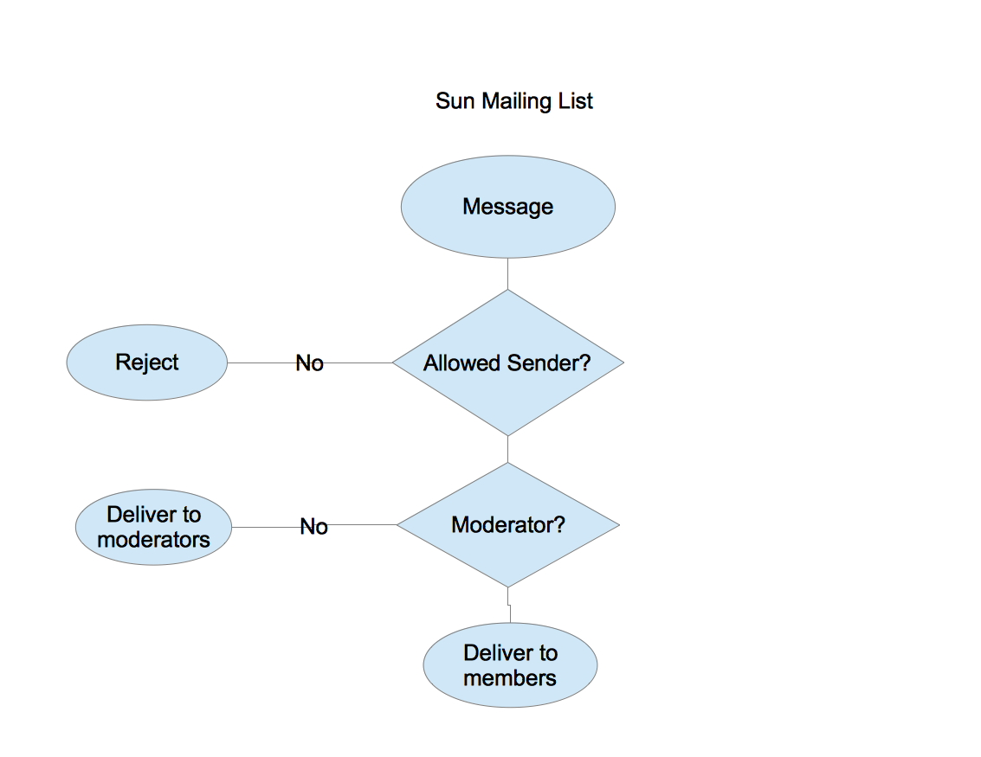
How it works
Notes:
Allowed sender - Checks allowed senders, disallowed senders, allowed domains, disallowed domains
Moderator - Checks moderators
A blank allowed senders or moderators means allow.

Slide 3
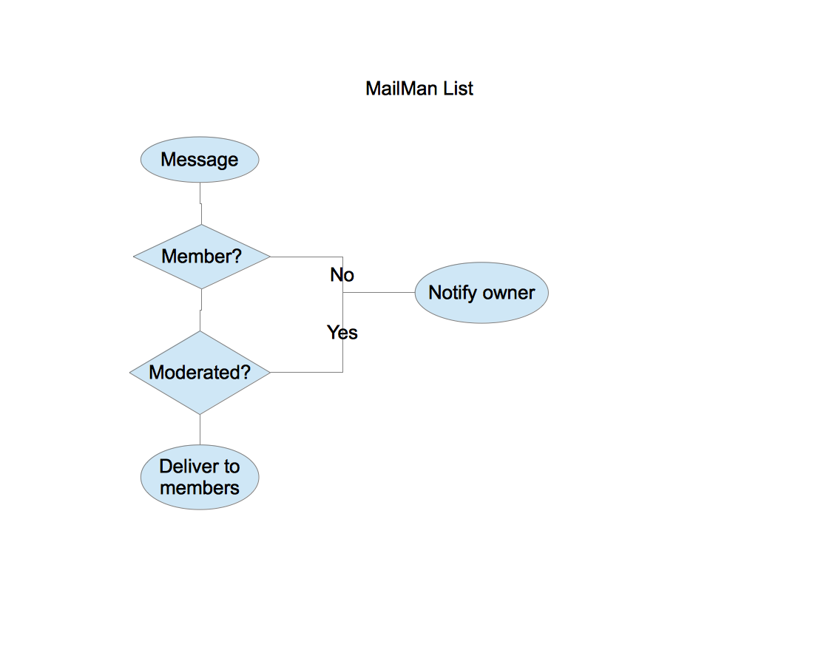
How it works
Notes:
Member - Checks members list.
Moderated - Checks mod flag for member.
You can change this behavior.

Slide 4
Managing a list
MailMan management page:
https://lists.csusb.edu/mailman/admin/<list>
Notes:
Replace the name of your list where <list> is shown.

Slide 5
Adding members
Click on Membership Management…
Click on Mass Subscription

Slide 6
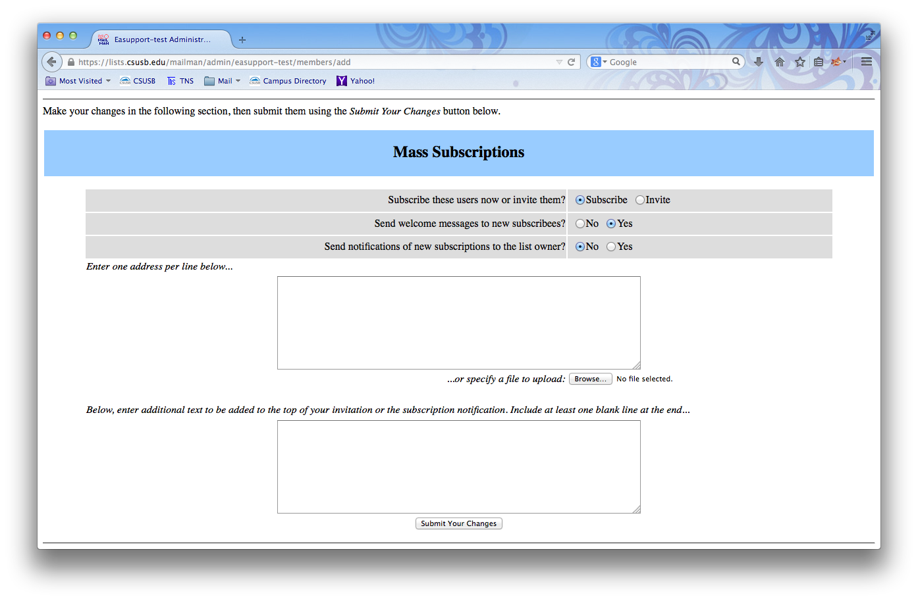
Notes:
You can chose to notify the new subscriber or the list owner.
You can enter one address per line or upload a file.

Slide 7
Removing members
Click on Membership Management…
Click Mass Removal

Slide 8
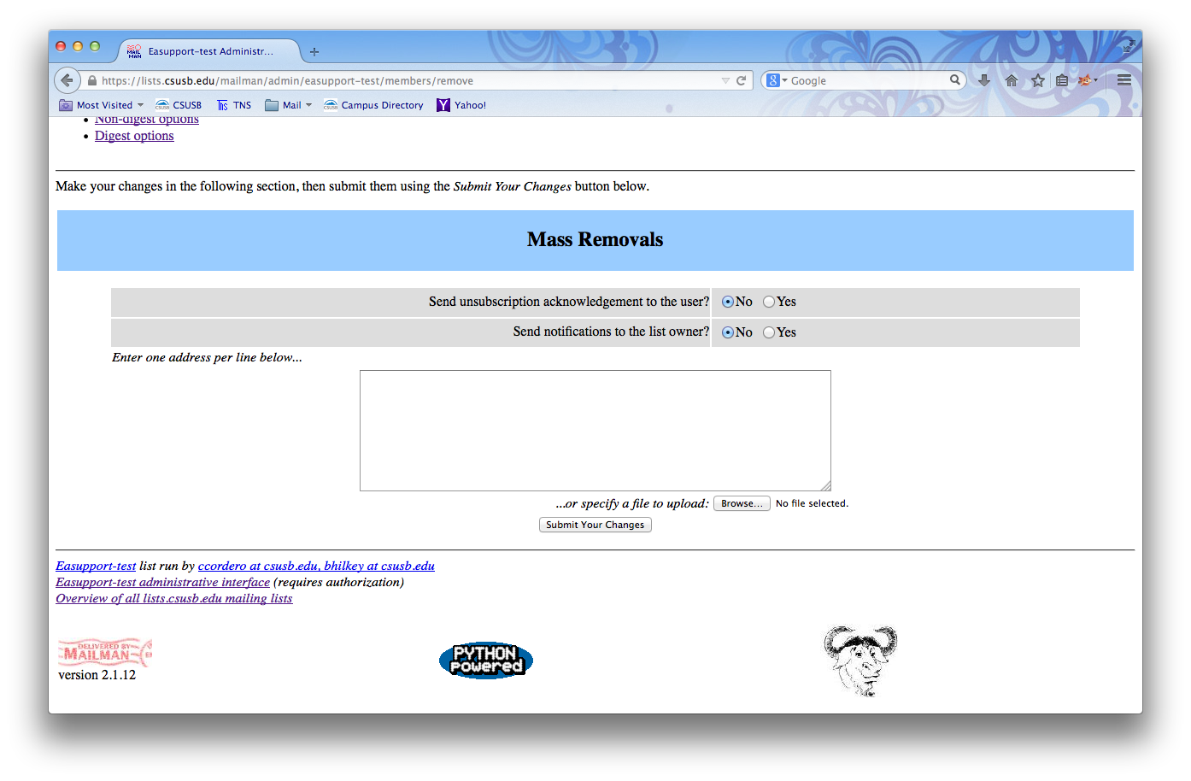
Notes:
You can notify the user or the list owner.
You can enter one address per line or upload a file.

Slide 9
Changing MailMan behavior
Click Privacy options…
Click Sender filters
Notes:
Change member and non-member filters.

Slide 10
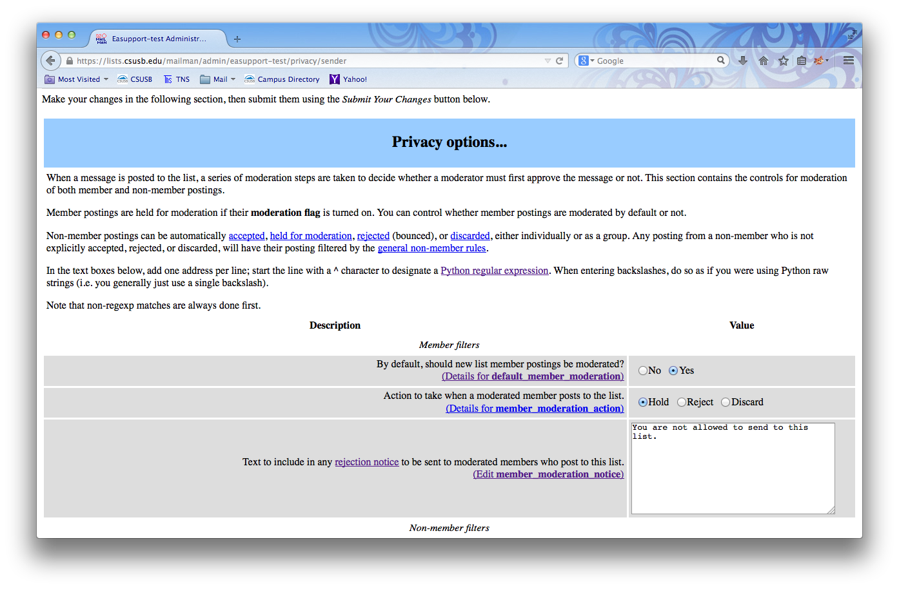
Notes:
If default_member_moderation is set to Yes, new members will have the mod flag set.
You will have to unset the mod flag in “Membership management…” if you want a member to be allowed to send.

Slide 11
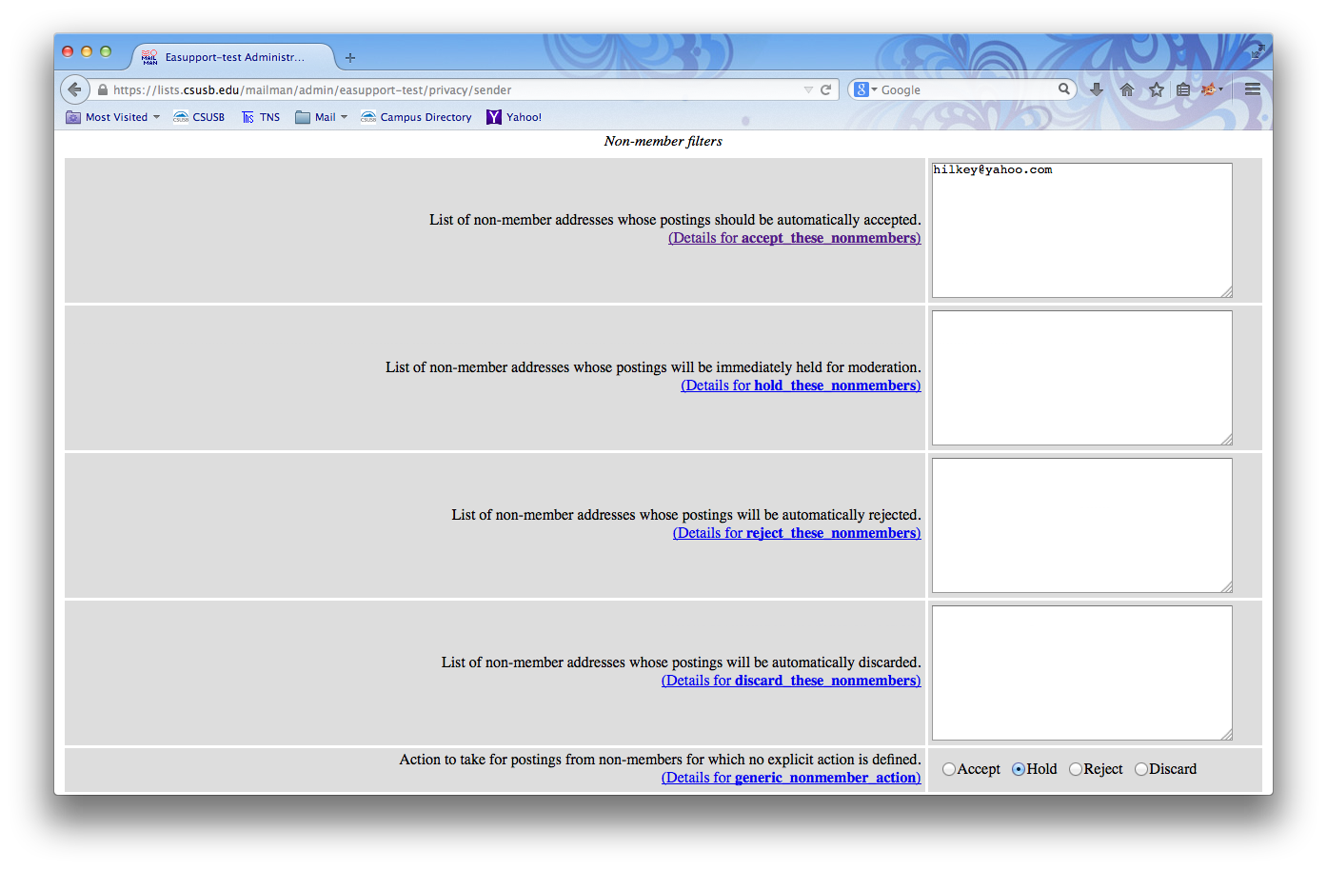
Notes:
You will have to add non-members to accept_these_nonmembers to allow specific address to send.

Slide 12
Mailing list types
Announcement list
Discussion list
Public list
Notes:
Announcement list - Only specific addresses can send to and announcement list.
Discussion list - Only members can send to a discussion list.
Public list - Anyone can send to a public list.

Slide 13
Announcement list
Only specific addresses can send to an announcement list.
Member filters
default_member_moderation: Yes
member_moderation_action: Reject
Non-member filters
generic_nonmember_action: Reject
Notes:
If you set member_moderation_action or generic_nonmember_action to Hold you will get a notification from MailMan.

Slide 14
Discussion list
Only members can send to a discussion list
Member filters
default_member_moderation: No
Non-member filters
generic_nonmember_action: Reject

Slide 15
Public list
Anyone can send to a public list.
Member filters
default_member_moderation: No
Non-member filters
generic_nonmember_action: Accept

Slide 16
Questions?

