Slide 1

How is CSUSB Doing So Far with GI2025?
Muriel C. Lopez-Wagner
May 10, 2018
GI2025 Collaboration, Coherence, and Commitment

Slide 2
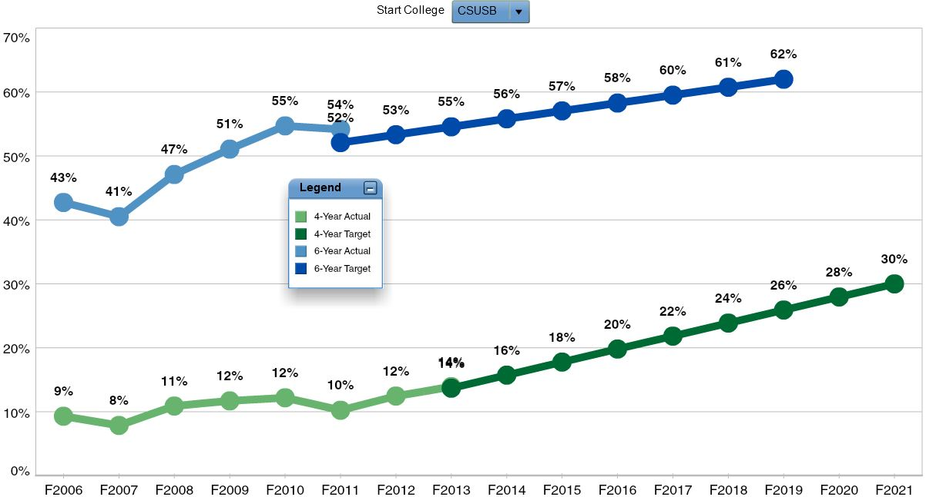

First-Time, Full-Time, First-Year Cohorts

Slide 3
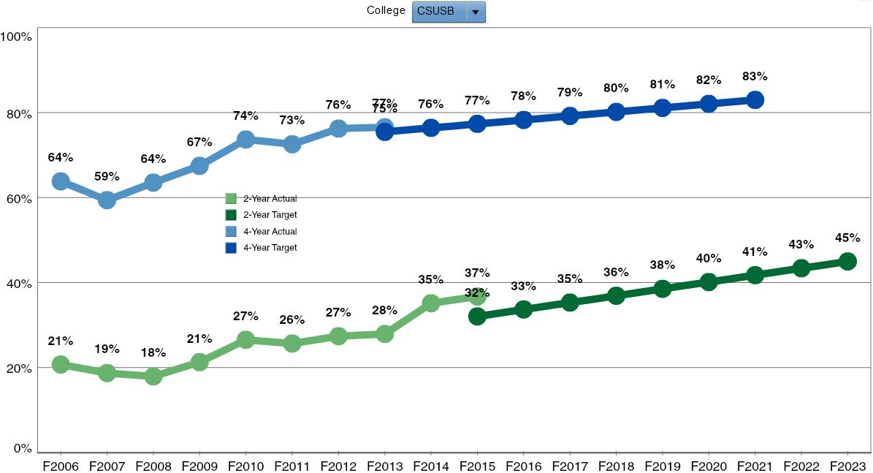
Transfer Student Cohorts

Slide 4
Intent vs. Action
“How many years do you expect it will take you to graduate from CSUSB?” (Fall 2017 FTF Survey)
F17
W18
S18
15 + units
44% (12)
52% (14)
59% (16)
< 4 years
n=27
8%
< 15 units
56% (15)
48% (13)
41% (11)
4 years n=712 76%
15 + units
37% (260)
46% (328)
45% (322)
< 15 units
63% (452)
54% (384)
55% (390)
> 4 years n=153 16%
15 + units
22% (34)
33% (51)
36% (55)
< 15 units
78% (119)
67% (102)
64% (98)

Slide 5
FTFT and On-Track Unit Accumulation
Fall 2014 | Cohort | Year 2 | Year 3 | Year 4
All | 2654 | 31% | 23% | 21%
URM | 1964 | 29% | 21% | 18%
Non-URM | 690 | 37% | 31% | 29%
Pell | 1782 | 30% | 21% | 19%
Non-Pell | 872 | 34% | 28% | 25%
First Gen | 1449 | 31% | 22% | 19%
Non-First Gen | 522 | 35% | 29% | 27%
Female | 1604 | 33% | 25% | 23%
Male | 1050 | 29% | 21% | 18%
Fall 2015 FTF | Cohort | Year 2 | Year 3
All | 2944 | 30% | 22%
URM | 2238 | 28% | 20%
Non-URM | 706 | 38% | 30%
Pell | 1981 | 29% | 21%
Non-Pell | 963 | 33% | 25%
First Gen | 1637 | 29% | 22%
Non-First Gen | 447 | 40% | 31%
Female | 1778 | 32% | 24%
Male | 1166 | 27% | 19%
Fall 2016 | Cohort | Year 2
All | 2736 | 28%
URM | 2111 | 27%
Non-URM | 625 | 31%
Pell | 1813 | 26%
Non-Pell | 923 | 31%
First Gen | 1474 | 28%
Non-First Gen | 474 | 34%
Female | 1680 | 29%
Male | 1056 | 27%
Note: Percent of students who progressed into the next class level when they returned the next year.

Slide 6
FTFT and Unit Load Attempted
Fall 2014 | Cohort | Yr1: Fall | Yr1: Win | Yr1: Spr | Yr2: Fall | Yr2: Win | Yr2: Spr | Yr3: Fall | Yr3: Win | Yr3: Spr | Yr4: Fall | Yr4: Win | Yr4: Spr
All | 2654 | 12.5 | 13.4 | 13.8 | 13.8 | 13.7 | 13.6 | 13.8 | 13.9 | 14.0 | 14.3 | 14.3 | 14.1
URM | 1964 | 12.4 | 13.3 | 13.7 | 13.7 | 13.5 | 13.5 | 13.6 | 13.7 | 13.8 | 14.2 | 14.2 | 14.1
Non-URM | 690 | 12.8 | 13.7 | 14.0 | 14.2 | 14.0 | 13.9 | 14.4 | 14.3 | 14.6 | 14.5 | 14.6 | 14.1
Pell | 1782 | 12.4 | 13.4 | 13.7 | 13.7 | 13.6 | 13.6 | 13.7 | 13.8 | 13.8 | 14.2 | 14.3 | 14.2
Non-Pell | 872 | 12.7 | 13.4 | 13.9 | 14.1 | 13.8 | 13.8 | 14.0 | 14.1 | 14.3 | 14.4 | 14.3 | 13.9
First Gen | 1449 | 12.3 | 13.3 | 13.7 | 13.8 | 13.5 | 13.6 | 13.7 | 13.8 | 13.9 | 14.2 | 14.2 | 14.1
Non-First Gen | 522 | 12.8 | 13.6 | 14.2 | 14.1 | 14.1 | 13.8 | 14.3 | 14.2 | 14.3 | 14.3 | 14.5 | 13.9
Female | 1604 | 12.4 | 13.4 | 13.7 | 13.9 | 13.7 | 13.7 | 13.8 | 14.0 | 14.0 | 14.3 | 14.4 | 14.1
Male | 1050 | 12.6 | 13.4 | 13.8 | 13.8 | 13.6 | 13.5 | 13.8 | 13.7 | 14.0 | 14.2 | 14.2 | 13.9
Fall 2015 | Cohort | Yr1: Fall | Yr1: Win | Yr1: Spr | Yr2: Fall | Yr2: Win | Yr2: Spr | Yr3: Fall | Yr3: Win | Yr3: Spr
All | 2944 | 12.7 | 13.4 | 13.6 | 13.7 | 13.6 | 13.7 | 13.9 | 14.0 | 14.0
URM | 2238 | 12.5 | 13.2 | 13.4 | 13.7 | 13.6 | 13.6 | 13.8 | 14.0 | 14.0
Non-URM | 706 | 13.1 | 13.8 | 14.0 | 14.0 | 13.9 | 13.9 | 14.1 | 14.2 | 14.2
Pell | 1981 | 12.6 | 13.3 | 13.6 | 13.7 | 13.6 | 13.7 | 13.9 | 14.0 | 14.0
Non-Pell | 963 | 12.9 | 13.6 | 13.6 | 13.8 | 13.7 | 13.6 | 13.8 | 14.1 | 14.1
First Gen | 1637 | 12.4 | 13.2 | 13.4 | 13.7 | 13.6 | 13.6 | 13.9 | 14.0 | 14.0
Non-First Gen | 447 | 13.4 | 14.0 | 14.0 | 14.2 | 14.0 | 13.8 | 14.0 | 14.3 | 14.4
Female | 1778 | 12.6 | 13.4 | 13.7 | 13.8 | 13.8 | 13.8 | 14.0 | 14.1 | 14.1
Male | 1166 | 12.7 | 13.3 | 13.4 | 13.6 | 13.5 | 13.5 | 13.8 | 13.9 | 13.9
Fall 2016 | Cohort | Yr1: Fall | Yr1: Win | Yr1: Spr | Yr2: Fall | Yr2: Win | Yr2: Spr
All | 2736 | 12.3 | 13.0 | 13.4 | 13.8 | 13.8 | 13.9
URM | 2111 | 12.2 | 13.0 | 13.4 | 13.8 | 13.7 | 13.9
Non-URM | 625 | 12.8 | 13.2 | 13.5 | 14.0 | 14.0 | 13.9
Pell | 1813 | 12.2 | 12.9 | 13.4 | 13.8 | 13.8 | 13.9
Non-Pell | 923 | 12.5 | 13.2 | 13.5 | 13.9 | 13.9 | 13.9
First Gen | 1474 | 12.0 | 12.9 | 13.4 | 13.8 | 13.8 | 13.8
Non-First Gen | 474 | 13.0 | 13.4 | 13.7 | 14.1 | 14.0 | 14.1
Female | 1680 | 12.2 | 13.0 | 13.5 | 13.9 | 13.9 | 13.9
Male | 1056 | 12.5 | 13.1 | 13.3 | 13.7 | 13.6 | 13.8

Slide 7
FTFT and Cumulative GPA < 2.0
Fall 2014 | Cohort | Year 1 | Year 2 | Year 3 | Year 4
All | 2654 | 24% | 15% | 10% | 6%
URM | 1964 | 26% | 17% | 12% | 7%
Non-URM | 690 | 18% | 9% | 6% | 3%
Pell | 1782 | 26% | 17% | 12% | 7%
Non-Pell | 872 | 21% | 10% | 7% | 4%
First Gen | 1449 | 27% | 18% | 12% | 7%
Non-First Gen | 522 | 18% | 9% | 6% | 3%
Female | 1604 | 24% | 15% | 10% | 5%
Male | 1050 | 25% | 16% | 10% | 7%
Fall 2015 | Cohort | Year 1 | Year 2 | Year 3
All | 2944 | 28% | 18% | 10%
URM | 2238 | 29% | 20% | 11%
Non-URM | 706 | 22% | 14% | 7%
Pell | 1981 | 29% | 19% | 11%
Non-Pell | 963 | 25% | 16% | 7%
First Gen | 1637 | 30% | 19% | 11%
Non-First Gen | 447 | 16% | 11% | 5%
Female | 1778 | 27% | 18% | 10%
Male | 1166 | 29% | 19% | 10%
Fall 2016 | Cohort | Year 1 | Year 2
All | 2736 | 24% | 15%
URM | 2111 | 25% | 17%
Non-URM | 625 | 20% | 11%
Pell | 1813 | 26% | 17%
Non-Pell | 923 | 21% | 13%
First Gen | 1474 | 26% | 18%
Non-First Gen | 474 | 17% | 10%
Female | 1680 | 21% | 14%
Male | 1056 | 29% | 18%
Note: Percent of students whose cumulative GPA went below 2.0.

Slide 8
Transfers and Unit Load Attempted
Fall 2014 | Cohort | Yr1: Fall | Yr1: Win | Yr1: Spr | Yr2: Fall | Yr2: Win | Yr2: Spr | Yr3: Fall | Yr3: Win | Yr3: Spr | Yr4: Fall | Yr4: Win | Yr4: Spr
All | 2138 | 12.5 | 13.2 | 13.3 | 13.6 | 13.6 | 13.2 | 12.4 | 12.1 | 11.9 | 11.3 | 11.4 | 10.5
URM | 1282 | 12.4 | 13.1 | 13.1 | 13.5 | 13.5 | 13.1 | 12.3 | 12.0 | 11.8 | 11.1 | 11.2 | 10.4
Non-URM | 856 | 12.6 | 13.4 | 13.5 | 13.8 | 13.7 | 13.2 | 12.6 | 12.1 | 12.2 | 11.7 | 11.6 | 10.7
Pell | 1411 | 12.8 | 13.3 | 13.4 | 13.6 | 13.6 | 13.2 | 12.4 | 12.1 | 11.9 | 11.1 | 11.3 | 10.5
Non-Pell | 727 | 12.0 | 13.1 | 13.0 | 13.5 | 13.5 | 13.0 | 12.4 | 11.9 | 12.0 | 11.8 | 11.5 | 10.6
First Gen | 960 | 12.5 | 13.1 | 13.2 | 13.5 | 13.4 | 13.1 | 12.3 | 11.9 | 11.7 | 10.9 | 10.8 | 10.3
Non-First Gen | 473 | 12.7 | 13.5 | 13.3 | 13.6 | 13.7 | 13.4 | 12.5 | 11.9 | 11.8 | 11.3 | 11.5 | 10.6
Female | 1347 | 12.5 | 13.2 | 13.3 | 13.5 | 13.5 | 13.0 | 12.4 | 12.1 | 11.8 | 11.2 | 11.3 | 10.4
Male | 791 | 12.5 | 13.3 | 13.3 | 13.8 | 13.7 | 13.4 | 12.5 | 12.1 | 12.2 | 11.5 | 11.5 | 10.7
Fall 2015 | Cohort | Yr1: Fall | Yr1: Win | Yr1: Spr | Yr2: Fall | Yr2: Win | Yr2: Spr | Yr3: Fall | Yr3: Win | Yr3: Spr
All | 2331 | 12.4 | 13.2 | 13.3 | 13.4 | 13.5 | 13.3 | 12.4 | 12.2 | 11.9
URM | 1385 | 12.3 | 13.2 | 13.1 | 13.3 | 13.5 | 13.3 | 12.2 | 12.0 | 11.8
Non-URM | 946 | 12.6 | 13.4 | 13.4 | 13.6 | 13.6 | 13.3 | 12.7 | 12.5 | 12.1
Pell | 1545 | 12.5 | 13.2 | 13.2 | 13.4 | 13.5 | 13.4 | 12.5 | 12.4 | 12.1
Non-Pell | 786 | 12.3 | 13.3 | 13.5 | 13.5 | 13.5 | 13.2 | 12.3 | 11.9 | 11.6
First Gen | 977 | 12.3 | 13.2 | 13.1 | 13.3 | 13.4 | 13.3 | 12.4 | 12.2 | 12.1
Non-First Gen | 422 | 12.7 | 13.4 | 13.3 | 13.8 | 13.6 | 13.3 | 12.6 | 12.5 | 12.1
Female | 1373 | 12.4 | 13.2 | 13.3 | 13.4 | 13.5 | 13.3 | 12.4 | 12.3 | 12.0
Male | 958 | 12.5 | 13.3 | 13.3 | 13.5 | 13.5 | 13.4 | 12.4 | 12.1 | 11.9
Fall 2016 | Cohort | Yr1: Fall | Yr1: Win | Yr1: Spr | Yr2: Fall | Yr2: Win | Yr2: Spr
All | 2387 | 12.4 | 13.2 | 13.1 | 13.4 | 13.7 | 13.2
URM | 1572 | 12.3 | 13.0 | 13.0 | 13.2 | 13.7 | 13.2
Non-URM | 815 | 12.5 | 13.4 | 13.3 | 13.6 | 13.6 | 13.1
Pell | 1586 | 12.5 | 13.1 | 13.0 | 13.4 | 13.7 | 13.3
Non-Pell | 801 | 12.1 | 13.3 | 13.2 | 13.4 | 13.5 | 12.9
First Gen | 1069 | 12.3 | 13.1 | 13.0 | 13.4 | 13.6 | 13.1
Non-First Gen | 456 | 12.7 | 13.3 | 13.4 | 13.4 | 13.7 | 13.2
Female | 1427 | 12.3 | 13.2 | 13.1 | 13.3 | 13.7 | 13.2
Male | 960 | 12.5 | 13.1 | 13.1 | 13.4 | 13.6 | 13.1

Slide 9
Transfers and Cumulative GPA < 2.0
Fall 2014 | Cohort | Year 1 | Year 2 | Year 3 | Year 4
All | 2138 | 16% | 8% | 7% | 6%
URM | 1282 | 16% | 9% | 8% | 7%
Non-URM | 856 | 14% | 6% | 5% | 5%
Pell | 1411 | 15% | 7% | 7% | 6%
Non-Pell | 727 | 16% | 9% | 6% | 6%
First Gen | 960 | 15% | 8% | 6% | 5%
Non-First Gen | 473 | 15% | 8% | 7% | 9%
Female | 1347 | 14% | 7% | 6% | 4%
Male | 791 | 18% | 8% | 8% | 10%
Fall 2015 | Cohort | Year 1 | Year 2 | Year 3
All | 2331 | 17% | 9% | 6%
URM | 1385 | 19% | 11% | 8%
Non-URM | 946 | 14% | 7% | 4%
Pell | 1545 | 18% | 10% | 7%
Non-Pell | 786 | 15% | 8% | 4%
First Gen | 977 | 18% | 10% | 6%
Non-First Gen | 422 | 13% | 6% | 4%
Female | 1373 | 18% | 8% | 6%
Male | 958 | 15% | 10% | 6%
Fall 2016 | Cohort | Year 1 | Year 2
All | 2387 | 16% | 6%
URM | 1572 | 17% | 7%
Non-URM | 815 | 12% | 5%
Pell | 1586 | 18% | 7%
Non-Pell | 801 | 12% | 5%
First Gen | 1069 | 16% | 6%
Non-First Gen | 456 | 11% | 5%
Female | 1427 | 16% | 6%
Male | 960 | 16% | 6%
Note: Percent of students whose cumulative GPA went below 2.0.

Slide 10

Thank You!
Contact Us
AD 170
909.537.5052
institutional_research@csusb.edu

