Slide 1


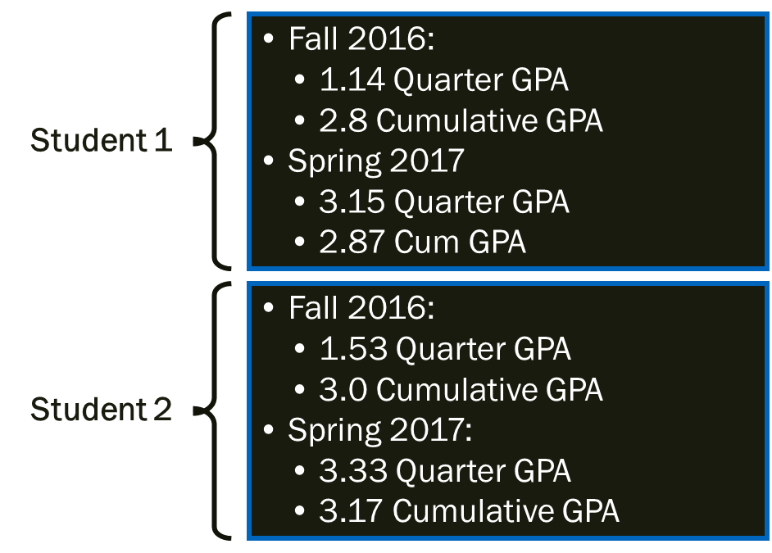
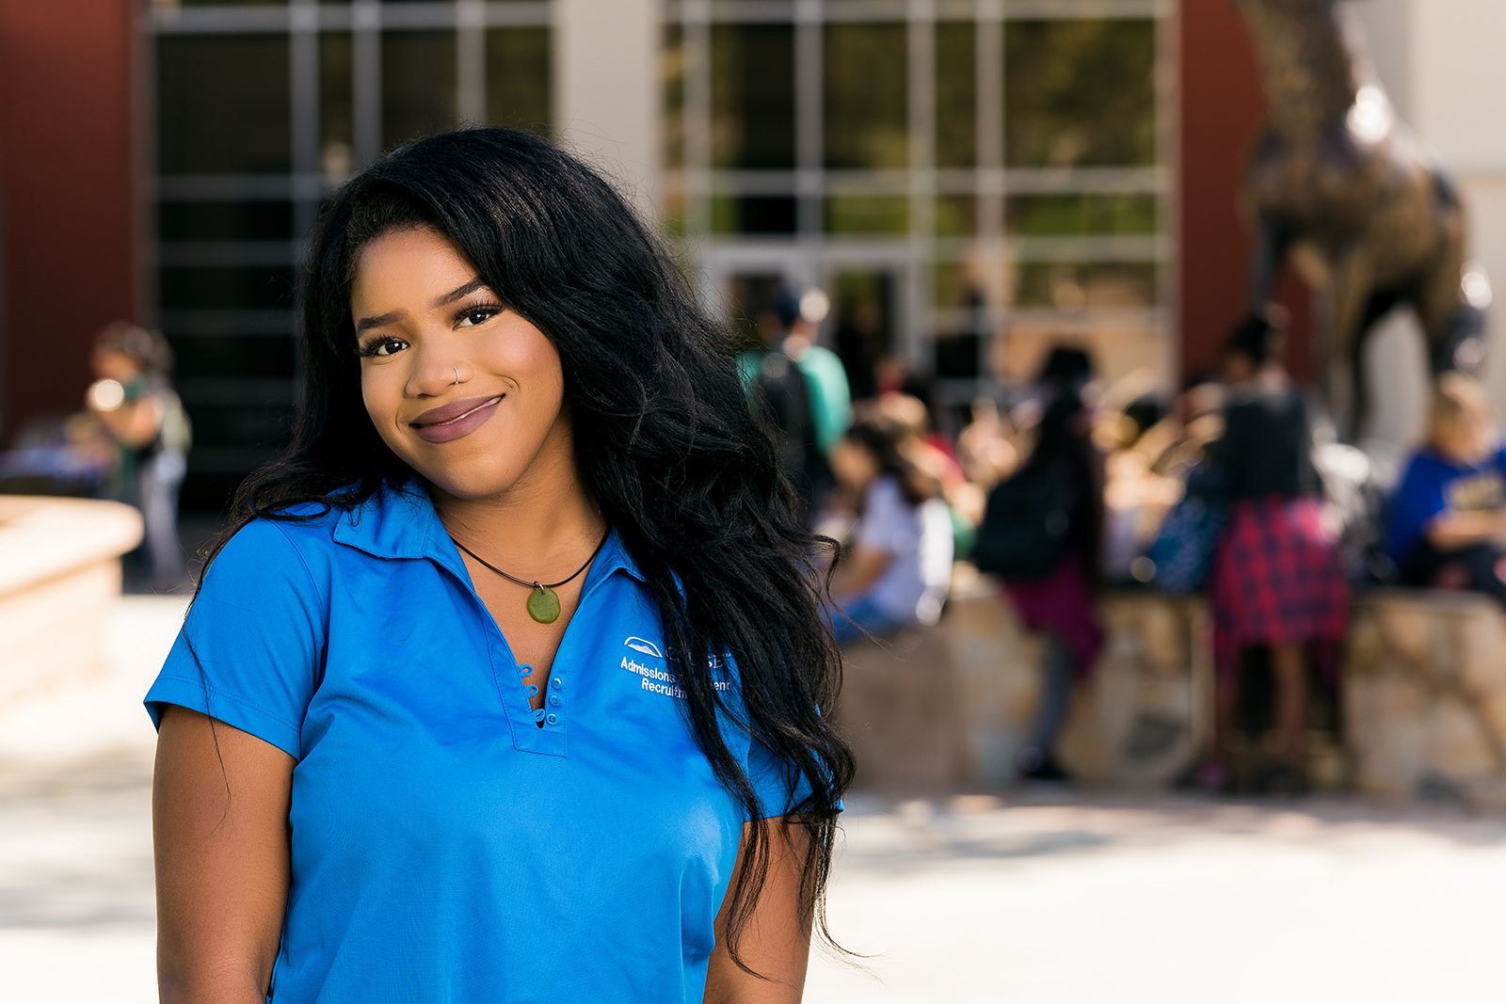
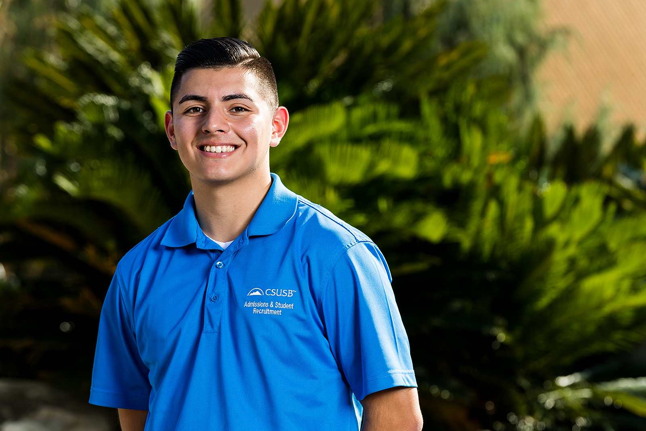
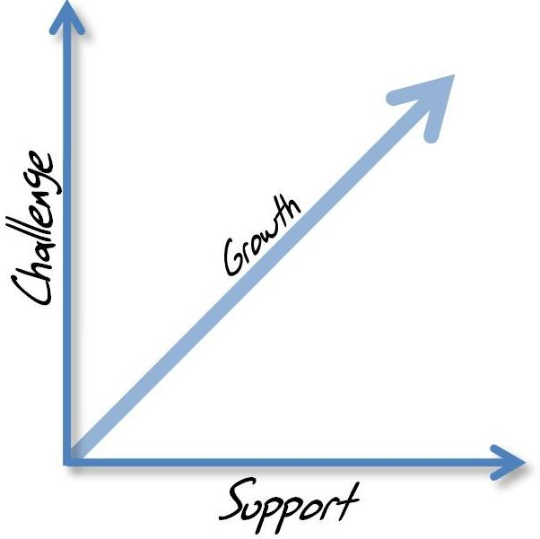
Creating a Dynamic Mentorship Program
Melissa Davila, M.S. and Jonathan Gonzalez-Montelongo
California State University, San Bernardino
Introduction
The Office of Admissions and Student Recruitment (ASR) at CSUSB has implemented a dynamic mentorship program, Coyote GROW¹, a dynamic mentorship program.
Coyote GROW has proven to help students make meaningful connections between what they are learning in the classroom and learning in their job, through feedback provided by their supervisor
Methodology
Our Implementation for this program was focused on 3 things:
  Challenge
  Support
  Readiness
Created a centralized structure
Developed more consistent standards of work
Set standards for academic performance and participation
Established a cause and effect to performance; with the effect focused on academic improvement and encouragement to visit more academic resources.
Evaluations were done of all paraprofessionals after every quarter and were given the opportunity to reflect on the work they do.
Quantitative Results
Fall 2016: 7 Students
Spring 2017: 2 Different students
Learning Objectives
Growth through their paraprofessional experience during their college career
Incorporation of co-curricular development
Standardized Expectations
Increased time-management skills
Creating a safe environment that encourages dialogue
Staff development
Qualitative Results
Improved academic and job performances
Improved initiatives
Paraprofessionals held themselves to a higher standard
Collaboration and cohesiveness between units was higher
Improved communication
Conclusions
In order to create a dynamic mentorship program we recommend modeling a theory where you challenge, support and ready your paraprofessionals.
An experience that has all three of these components allows students to naturally grow within their field and their academic career. These components must be implemented not only by supervising staff and paraprofessionals but the office staff as a whole. The support of the entire office is crucial to a successful program
Theory
Sanford’s Theory of Challenge and Support²
“I have learned how to speak professionally in large crowds and to people”
“I have learned how to utilize campus resources and make the right connections to be successful in college”
¹ Hansen, Sarah (2012). Iowa GROW: Guided Reflection on Work [PowerPoint]. Retrieved from https://vp.studentlife.uiowa.edu/assets/Iowa-Grow-2012.pdf
² Evans, N. J., Forney, D. S., Guido, F. M., Patton, L. D., & Renn, K. A. (2009). Student development in college: Theory, research, and practice. John Wiley & Sons.

