Slide 1
Personal Mobile Device Reimbursement– Concur
Personal Mobile Device Reimbursement is now possible, via Concur. Please view the following slides, to create an Authorization Request in Concur(one time; to secure the authorization of the full fiscal year, from your department) and the Expense Reports ( each month; to seek reimbursement).

Slide 2
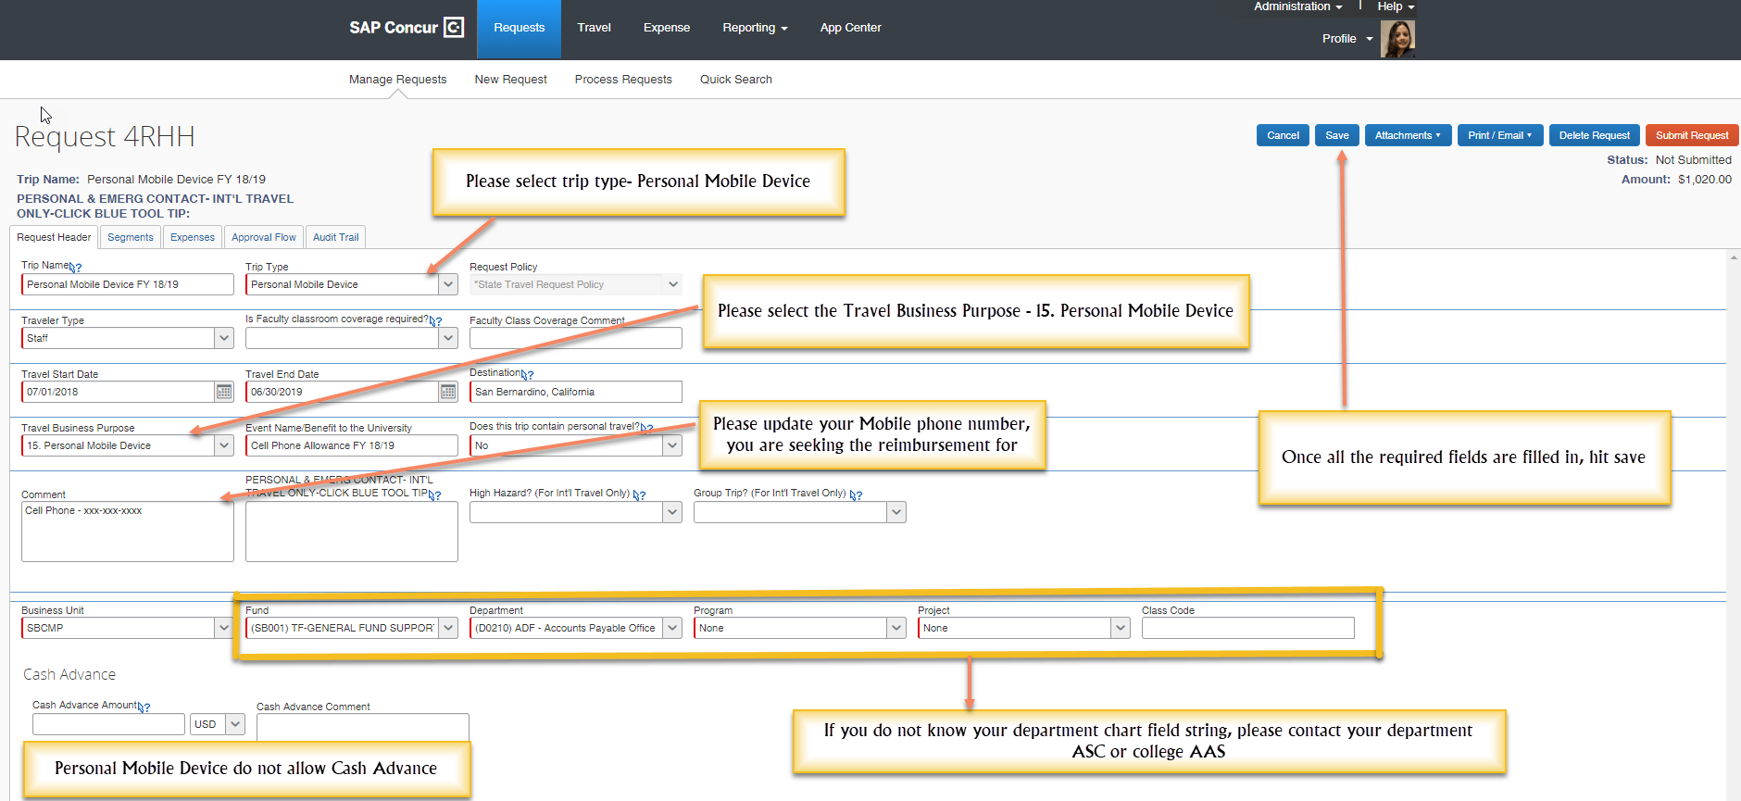
Request – Request Header – Start creating the Online Authorization Request to secure the authorization for the full FY, by clicking on New Request, and filling up all the details as per the below instructions. All the fields with a red line, are required fields that needs to be entered.

Slide 3
Request – Expenses – The Segments tab needs to be skipped, and based on the type of reimbursement levels, any one of the 2 Mobile Phone Levels are added, in the expenses tab.

Slide 4
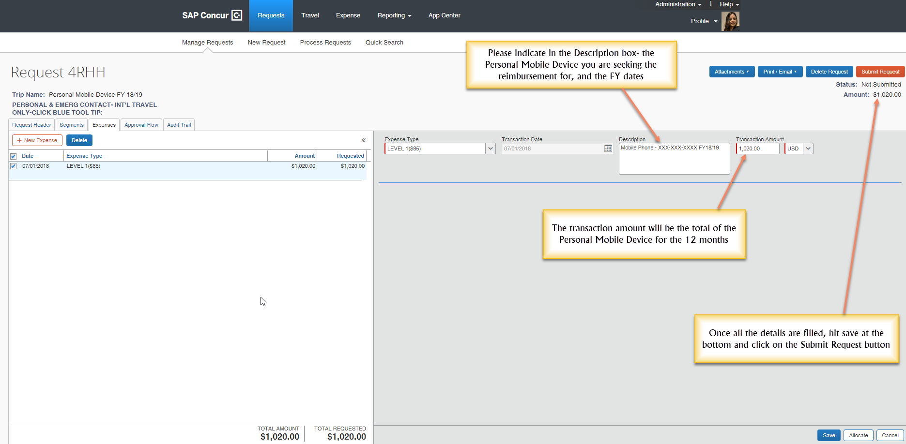
When all information has been entered, as per the below instructions, scroll to the bottom of the screen and hit Save, and submit the request.

Slide 5
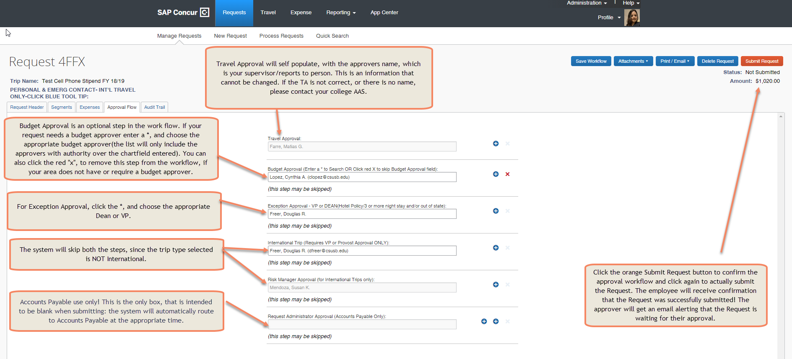
Request – Approval Flow – The Request approval workflow requires a name in each box. Concur sends approval emails only to the approvers needed based on the information that is included in your Request. A name in each approval field does not necessarily mean each approver will need to approve a particular request(that is why the comment, "this step may be skipped” appears).

Slide 6
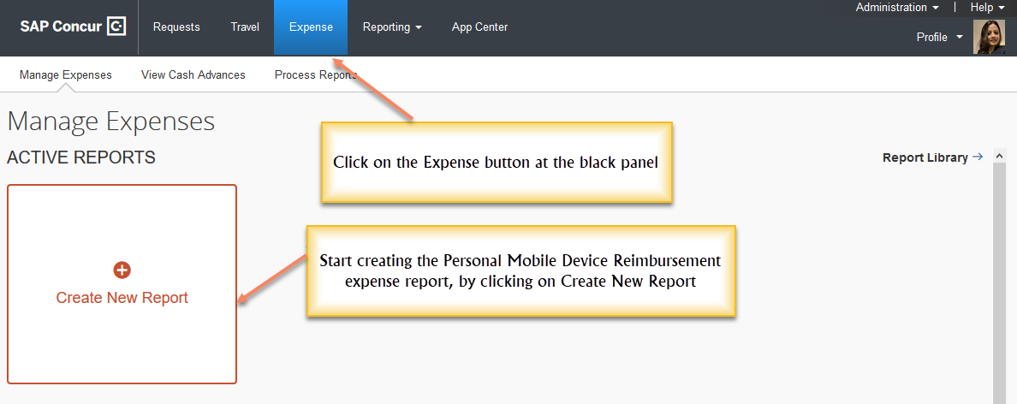
Expense Report- Once the Authorization Request is approved for the full FY, in order to seek reimbursement, the employee will have to submit the expense report each month, by attaching just the 1st page of the Personal Mobile Device Invoice.

Slide 7
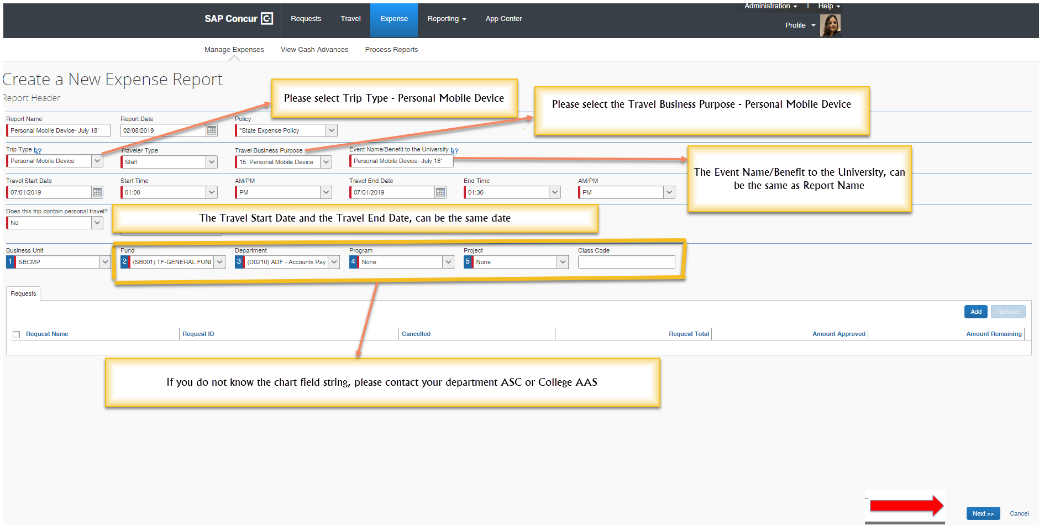
Expense Report Header - All the fields with a red line, are required fields that needs to be entered. When all information has been entered, scroll to the bottom of the screen, and click on to move to the next screen, and begin creating the Personal Mobile Device Reimbursement expense report.

Slide 8
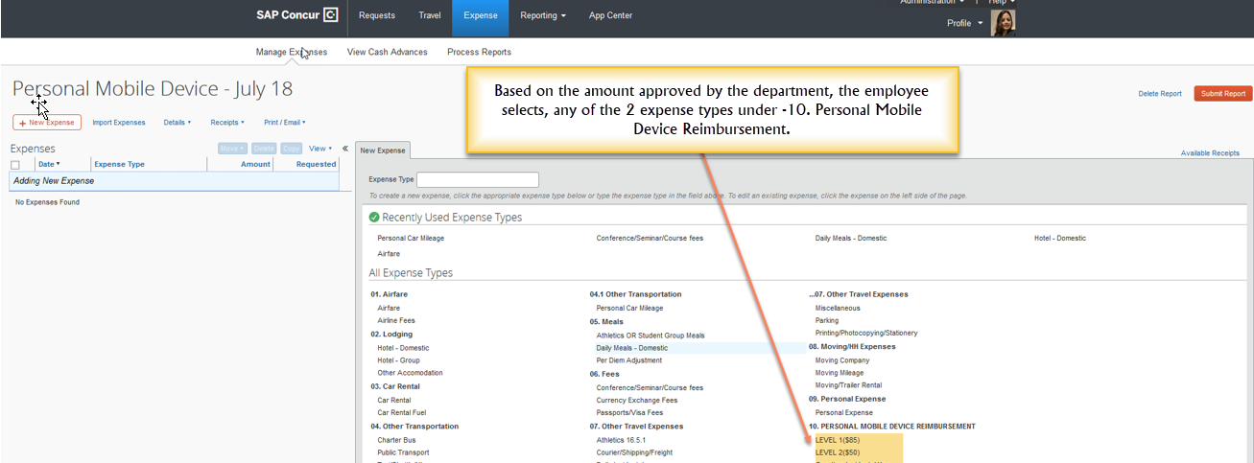
Expense Report – Based on the Personal Mobile Device Reimbursement Levels, approved by the department, the expense type is added, and the employee may now begin entering the details, as per the instructions on the next slide.

Slide 9
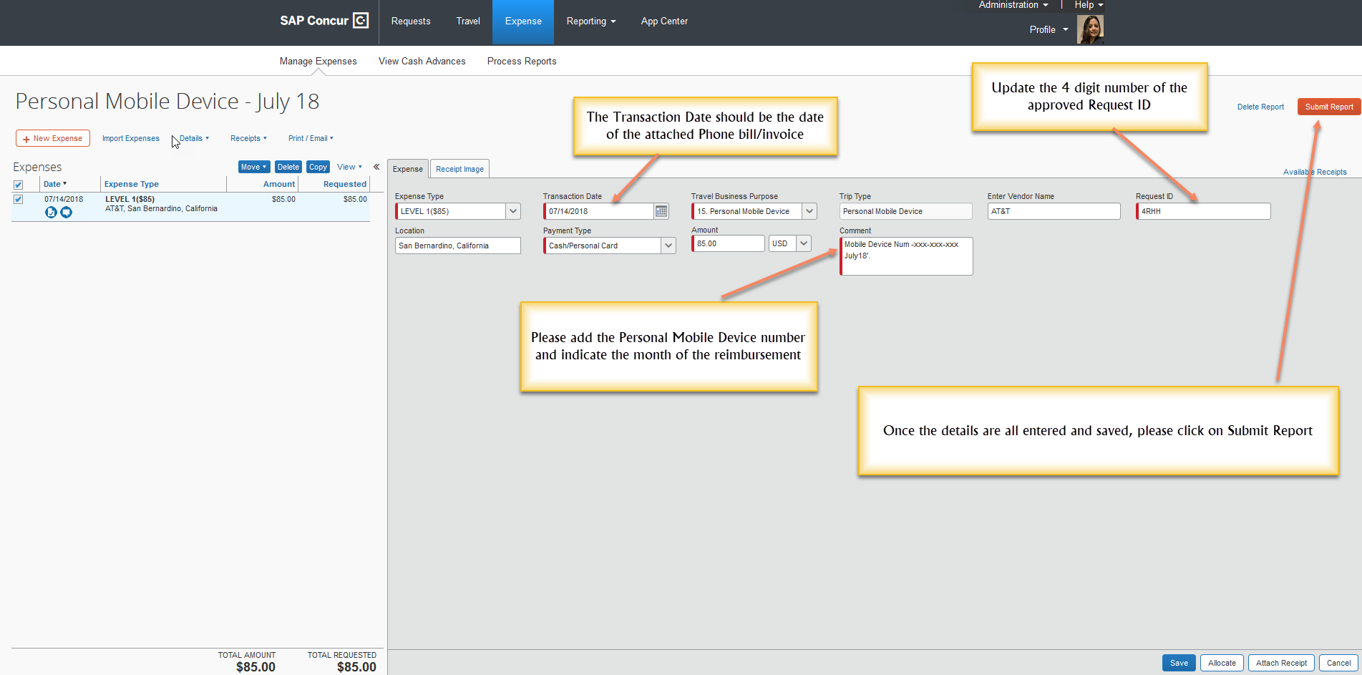
When all information has been entered, scroll to the bottom of the screen and hit Save, and submit the report.

Slide 10
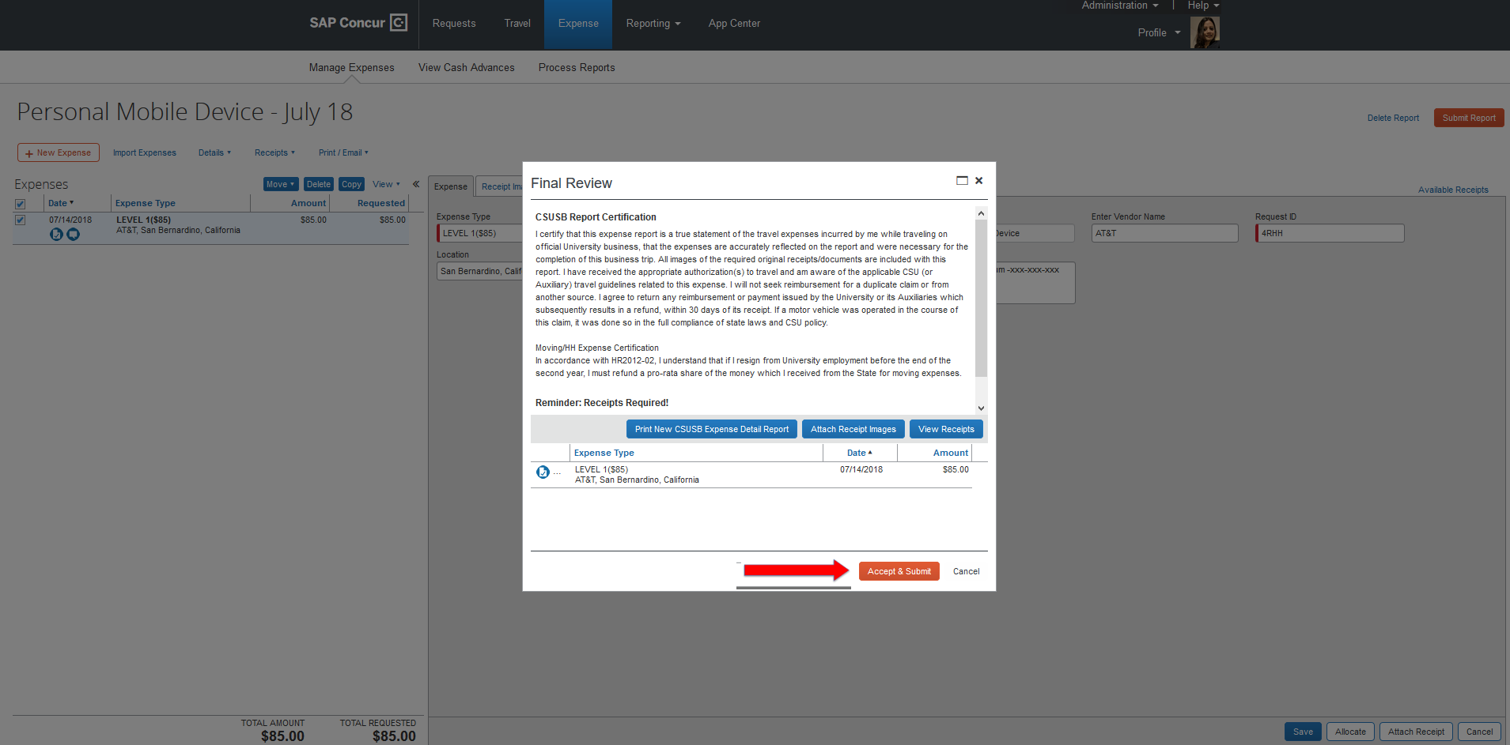
The certification page appears, and once that is reviewed, click on Accept and Submit, at the bottom.

Slide 11
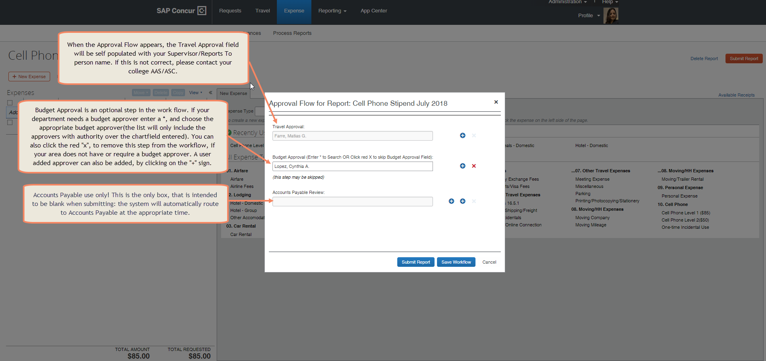
Expense Report – Approval Flow- Once the approval flow is updated/reviewed, click on the Submit Report again, to actually submit the Report. The employee will then receive a confirmation that the Report was successfully submitted!

Slide 12
