Slide 1
Internship Programming as a High Impact Practice
Presented By: Sarai Maldonado & Guadalupe Saldivar

Slide 2
National Association of Colleges and Employers (NACE)
“Starting and navigating the career planning process is unfamiliar territory for many students, but it can be undoubtedly overwhelming for first generation (FG) college students” (NACE, 2016).
Notes:
84% first gen csusb

Slide 3








NACE CORE COMPETENCIES
Critical Thinking/Problem Solving
Ex. Ability to analyze solutions
Oral/Written Communications
Ex. Email etiquette, public speaking
Teamwork/Collaboration
Ex. Manage workplace conflict
Digital Technology
Ex. Computer systems and programs
Leadership
Ex. Taking initiative, uplifting others
Professionalism/Work Ethic
Ex. Time management, body language, accountability
Career Management
Ex. Identify goals and potential growth and development
Global/Intercultural Fluency
Ex. Value, respect and learn from others different from self

Slide 4
Programs
HACU Student Track Scholarship
Career Center Internship Award
Stand Up for San Bernardino Internship Award
Internship Programs

Slide 5

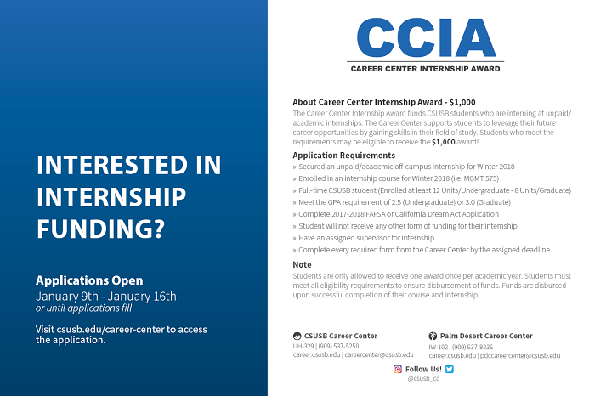
Internship Awards fund CSUSB students who are interning off-campus at an unpaid/academic internship. Selected students may be eligible to receive the $1,000 award.
Application Requirements*
Secured an off-campus unpaid/academic off-campus internship
Enrolled in an internship course
Meet GPA requirement of 2.5 (Undergraduate) or 3.0 (Graduate)
Have an assigned supervisor for their internship
Internship site is located in the City of San Bernardino (SUSB)
* Internship and Internship Course enrollment need to be within their respective quarter

Slide 6
SUSB: Testimonial Video
Notes:
https://youtu.be/UtYfykzoNEM

Slide 7
Interns
Fall 2017- Winter 2018

Slide 8
Interns
Fall 2017- Winter 2018

Slide 9
SUSB Internship Outcomes
Winter 2018

Slide 10

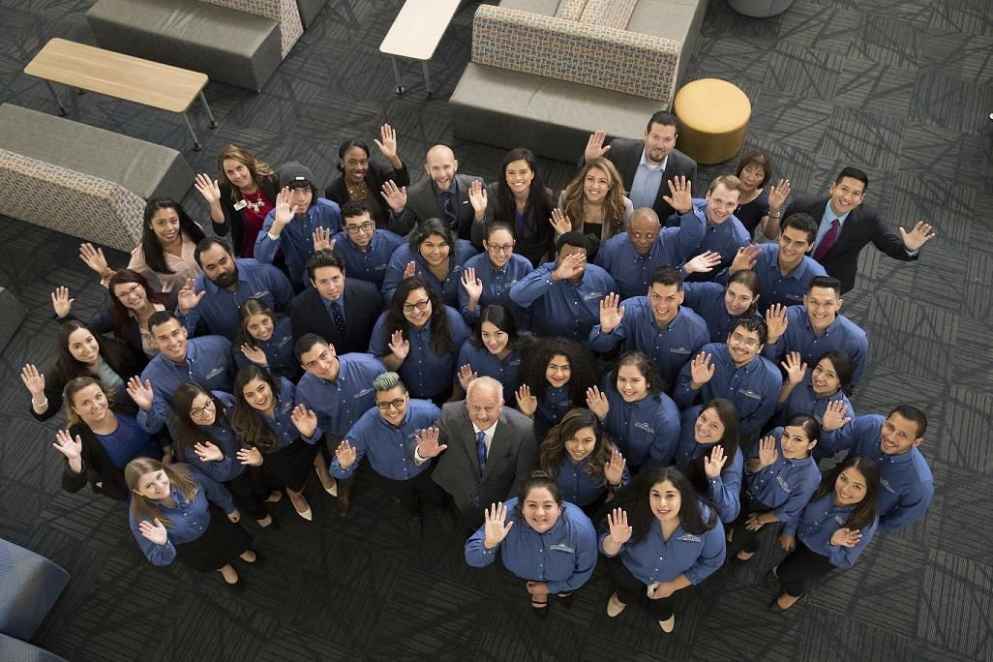
Hispanic Association of Colleges and Universities (HACU)
Student Track Scholarship
What is HACU?
HACU’s Annual Conference
Student Track Scholarship
Funding
Preparation Workshop
Notes:
Funding $40,000 academic affairs,
$10,000 from ASI
Introduce HACU
HSI Consortium NMSU Full circle
Various programs, and services
Student Track Scholarship
The center has been overseeing it since 2015, each year we take 40-45 students

Slide 11

Notes:
include HACU Preconference outcomes

Slide 12

Questions?

