Slide 1

Supporting Student Success
through the Basic Needs Initiative

Slide 2
Defining Food Insecurity
The USDA ERS Ranges of Food Security
Low food security: reports of reduced quality, variety, or desirability of diet. Little or no indication of reduced food intake.
Very low food security: Reports of multiple indications of disrupted eating patterns and reduced food intake.
Notes:
Low Food Security:
I got food from [the pantry] once and I just, I remember leaving and thinking to myself, “Damn, this is meant for somebody who actually needs it.” In my head, I was like, “I don’t actually need it.” So, I tried to never go again, because to my understanding I was like, “Well, I can afford food. I can’t afford great food, but I can afford food.” Umm…It was tough.
Very Low Food Insecurity:
It’s been difficult. Well, ‘cause in the beginning when I first got here I didn’t really have a lot of money and I didn’t have any grants. So basically what I used to eat 3 days out of the week was like Minute Maid and chips and that’d be it…I had maybe a dollar and then I had to make it like, stretch out of like, 2 days and then 3rd day…I wouldn’t eat anything cause I didn’t have any money.

Slide 3
Defining Homelessness and
Housing Insecurity
HUD defines homelessness as sheltered (in a HUD funded emergency shelter, transitional housing, and supportive housing) and unsheltered (on the streets, in abandoned buildings, cars, or other places not meant for human habitation)
U.S. Department of Health and Human Services defines housing insecurity as limited or uncertain availability of stable, safe, adequate, and affordable housing (examples: couch surfing, temporary arrangements, dorm crashing)
Notes:
Low Food Security:
I got food from [the pantry] once and I just, I remember leaving and thinking to myself, “Damn, this is meant for somebody who actually needs it.” In my head, I was like, “I don’t actually need it.” So, I tried to never go again, because to my understanding I was like, “Well, I can afford food. I can’t afford great food, but I can afford food.” Umm…It was tough.
Very Low Food Insecurity:
It’s been difficult. Well, ‘cause in the beginning when I first got here I didn’t really have a lot of money and I didn’t have any grants. So basically what I used to eat 3 days out of the week was like Minute Maid and chips and that’d be it…I had maybe a dollar and then I had to make it like, stretch out of like, 2 days and then 3rd day…I wouldn’t eat anything cause I didn’t have any money.

Slide 4
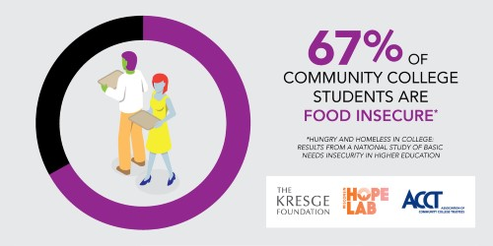
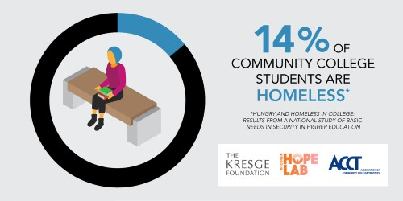
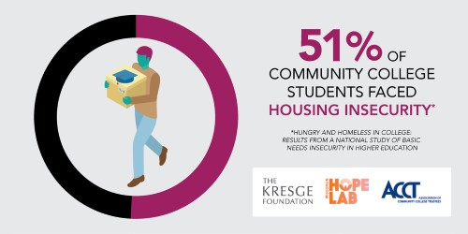
Survey of Basic Needs for Community College Students (March, 2017)
  67% are food insecure
  14% are homeless
  51% are housing insecure

Slide 5
CSU Study of Basic Needs
(January, 2018)
41.6% of CSU students reported food insecurity; 20% experienced low food security and 21.6% very low food security.
Food insecurity for U.S. households was 12.3%
10.9% of CSU students reported experiencing homelessness one or more times in the last 12 months
Notes:
Low Food Security:
I got food from [the pantry] once and I just, I remember leaving and thinking to myself, “Damn, this is meant for somebody who actually needs it.” In my head, I was like, “I don’t actually need it.” So, I tried to never go again, because to my understanding I was like, “Well, I can afford food. I can’t afford great food, but I can afford food.” Umm…It was tough.
Very Low Food Insecurity:
It’s been difficult. Well, ‘cause in the beginning when I first got here I didn’t really have a lot of money and I didn’t have any grants. So basically what I used to eat 3 days out of the week was like Minute Maid and chips and that’d be it…I had maybe a dollar and then I had to make it like, stretch out of like, 2 days and then 3rd day…I wouldn’t eat anything cause I didn’t have any money.

Slide 6
Food Insecurity by
Demographic Groups
Students who identified as Black/African-American and first-generation to attend college experienced the highest rates of food insecurity (65.9%) and homelessness (18%).
Other Food Insecurity rates:
First gen students 49%
Pell Grant recipients 51.4%
Transfer students 43.2%
Former foster youth 62.9%
EOP students 57.8%
ESL students 49.2%
Dreamers 46.7%
DACA students 44.6%

Slide 7
How does food and/or housing insecurity impact students?
Physical and mental health consequences associated with lower academic achievement
Higher rates of “inactive days,” where poor physical or mental health kept them from school, work, self-care, and recreational activities
“I would get bananas and I will cut it in half. I’d eat only half in the morning, and then I would wait five hours, then eat the other half, just so I have something in my stomach consistently…I would struggle to concentrate for sure, because sometimes that’s all I could think about was where was my next meal going to come from. At the same time, I would always push myself to just keep going, just keep going, just keep going.”
Susan CSUDH

Slide 8
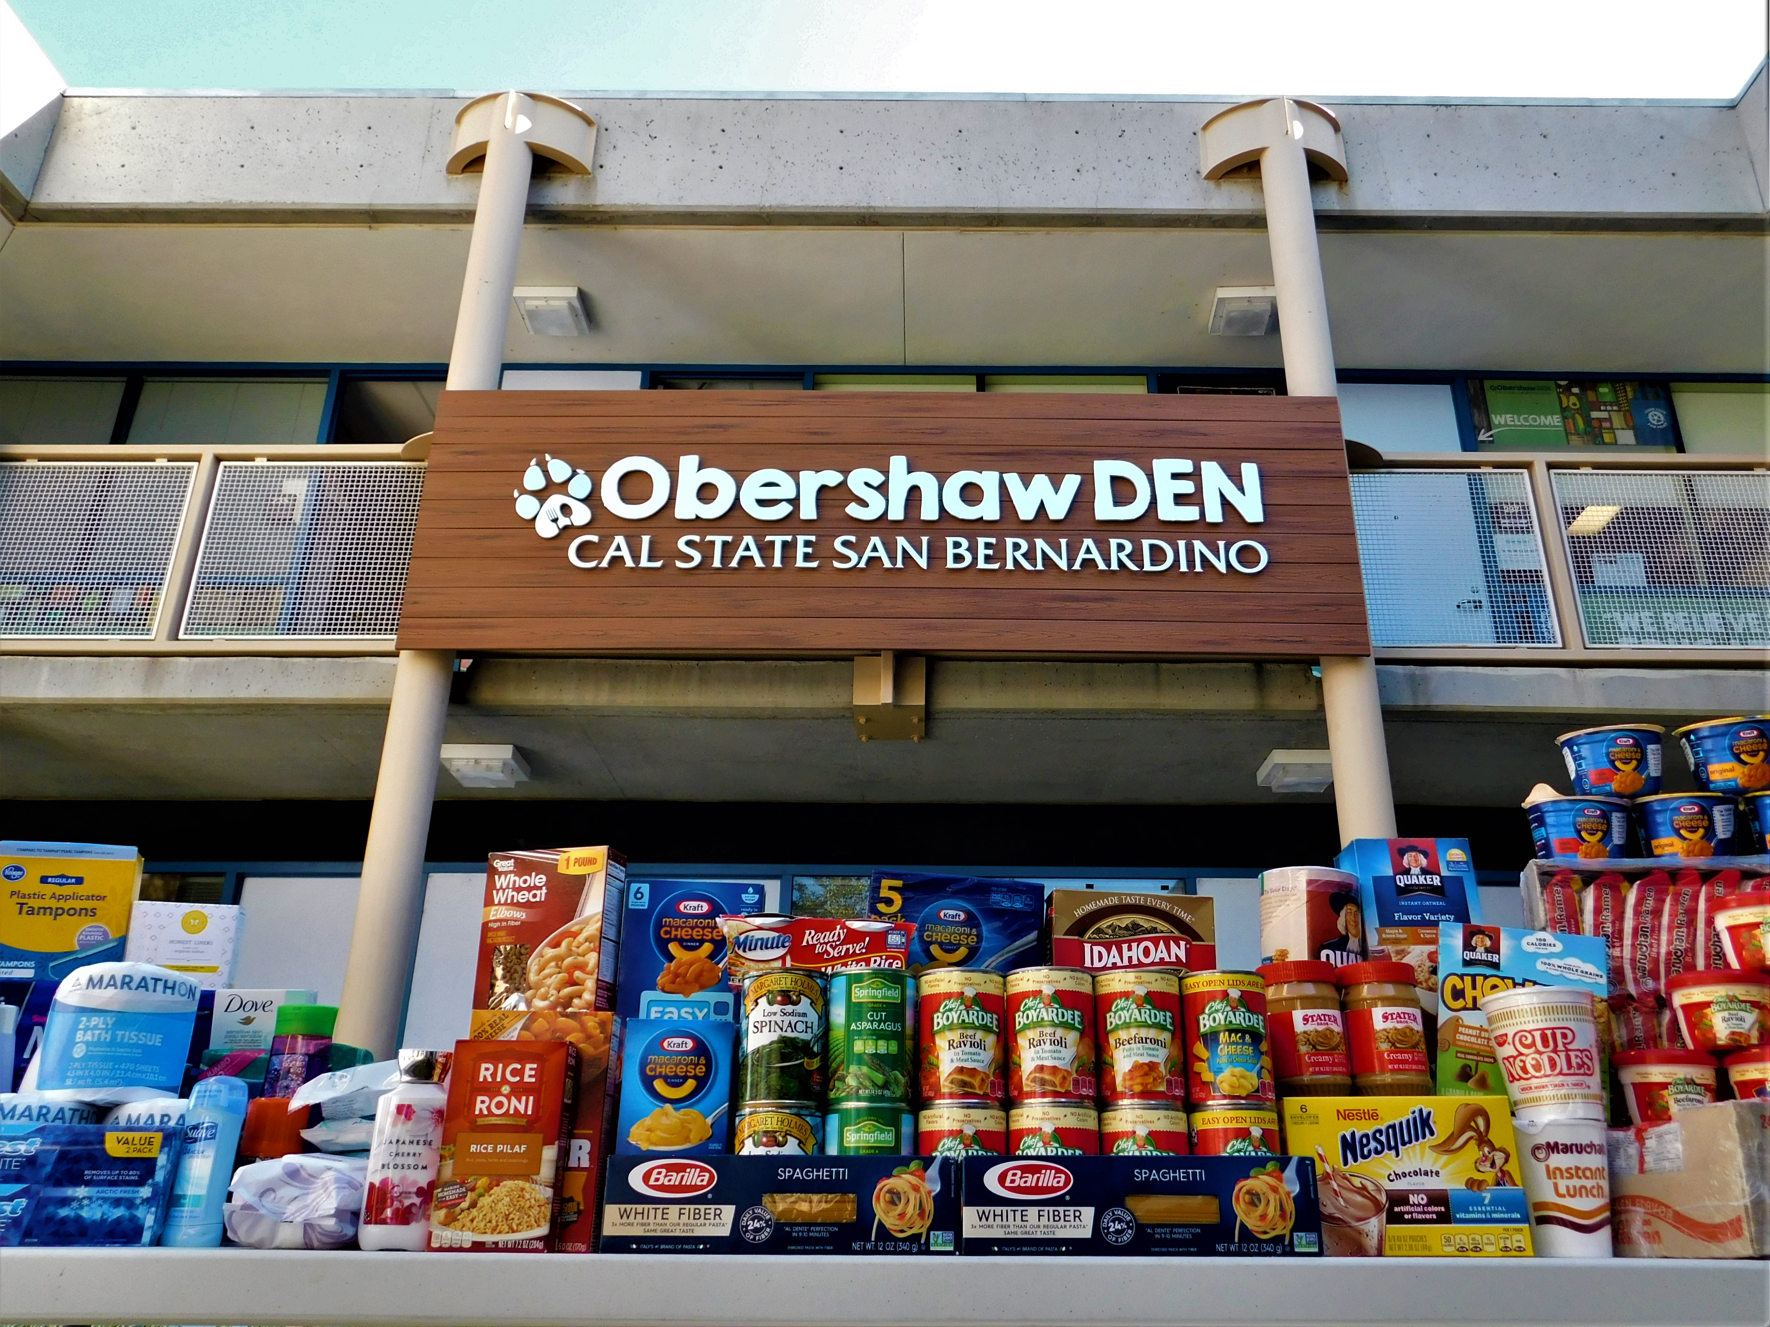
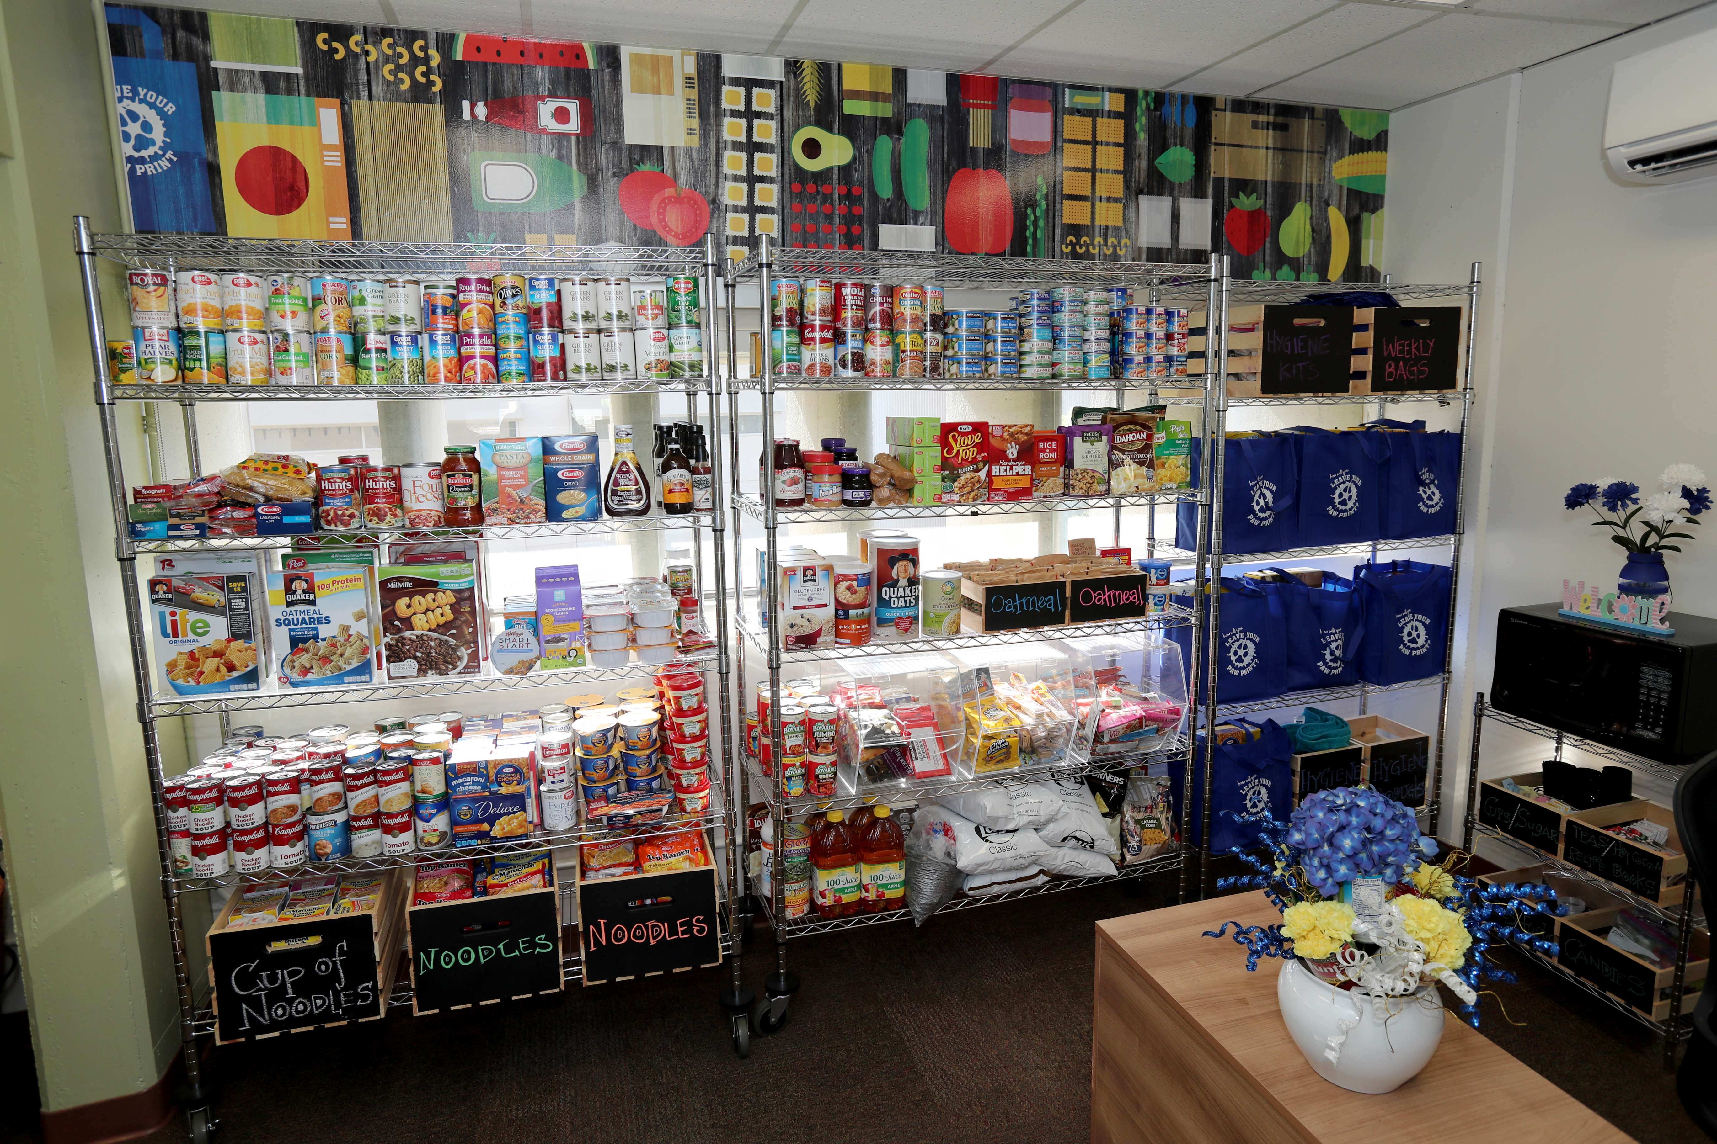
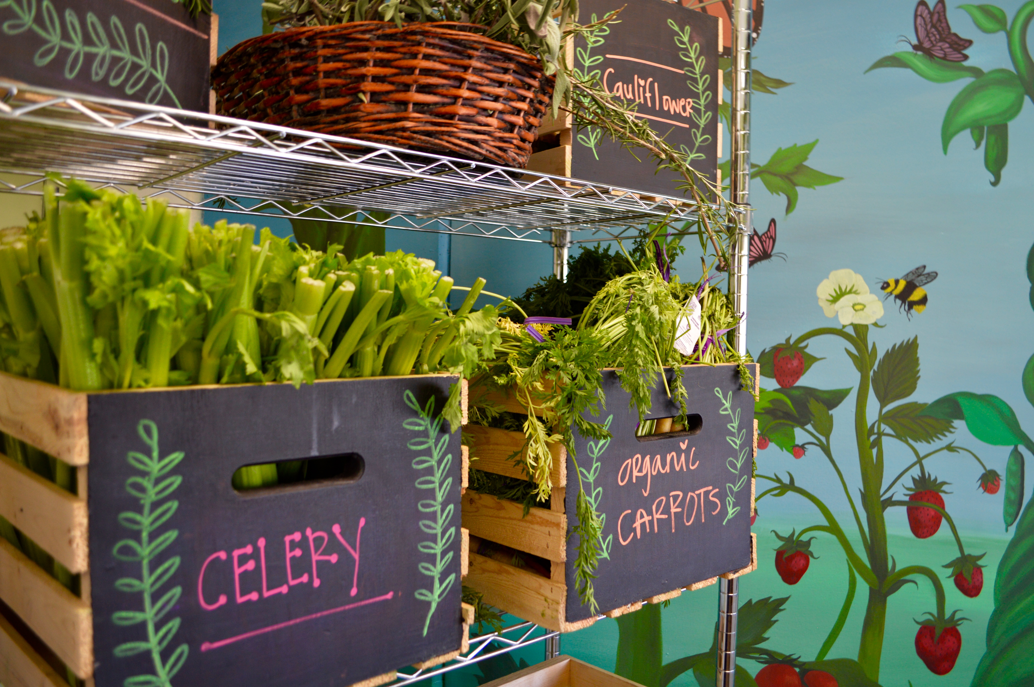
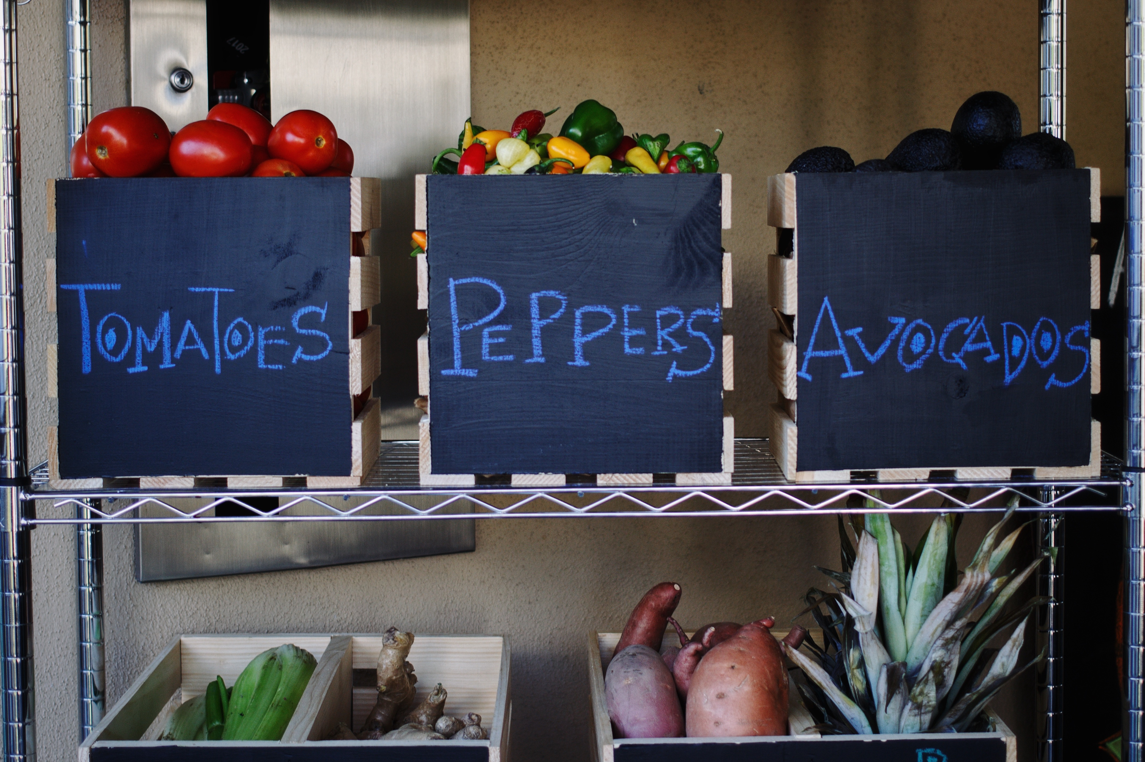

Slide 9




DEN average monthly distribution:
200+ individual lunch kits distributed at 12 campus locations and PDC
100+ grocery bags of food
50+ hygiene kits
Grocery store gift cards
Hot meal vouchers

Slide 10
Obershaw DEN Demographics by Basis of Admission
Category | First-Time Freshmen | Transfers | PB/Grad
First Gen | 80% | 70% | 69%
Pell | 72% | 64% | 6%
URM | 76% | 62% | 66%
Note: Unique student usage of The DEN from January 2015-April 2018
Excludes 8 transitory students and 5 CEL students
CSUSB Office of Institutional Research, 4/2018

Slide 11



Emergency Housing
Students can stay in campus housing for up to 14 days at no cost; discounted rate for remainder of quarter
Linens, hygiene packs, 10 pre-packaged food packs and two on-campus hot meal vouchers provided
Housing staff and the CARE Case Management Specialist meet with students to develop longer-term housing plan
In spring 2017, 2 students stayed for 7 days; Fall 2017*, 2 students for 81 days; Winter 2018, 7 students for 107 days
* Students paid discounted rate for > 14 days

Slide 12
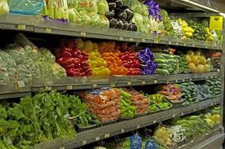
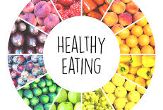

Expanding Food Resources
CalFresh – College students may qualify for an average of $150/month to purchase food
CSUSB “Healthy Eating” Program teaches students to prepare low cost, nutritious meals
Coyote Produce Stand brings fruit and vegetables to campus

Slide 13


Projects in Progress
“One stop” website of basic needs resources
Van purchase for transporting donated food and hygiene items
Salvation Army collaboration to address housing insecurity
On campus EBT so students may use CalFresh benefit

Slide 14
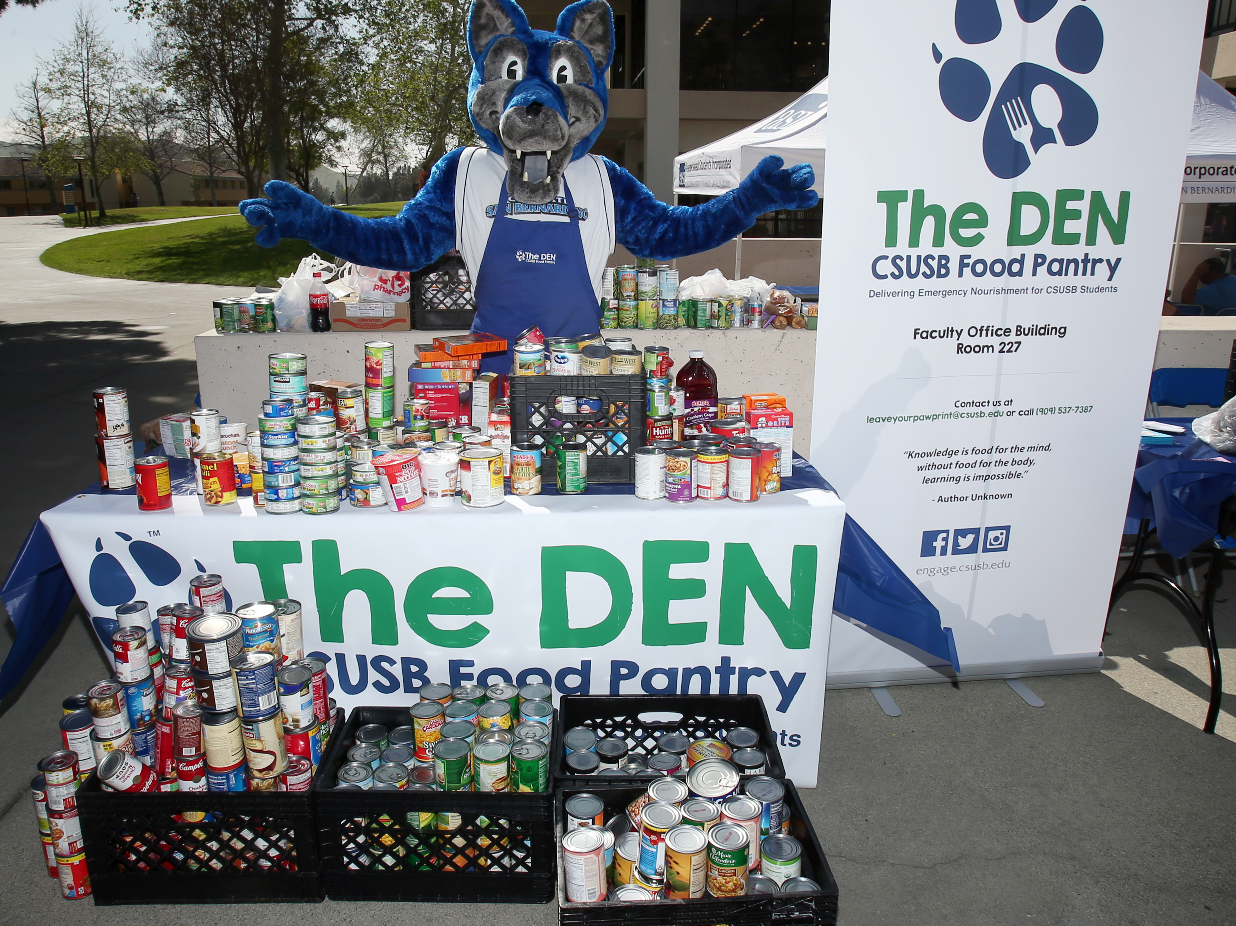
Questions?

