Slide 1


Slide 2
Any errors are my own and should not reflect in any form on the team that contributed to this research.

Slide 3
Important to Note
The explicit scope of this research is exploration and not policy recommendations. It should be interpreted as such.
This research is correlational.
Examining the detailed mechanism behind the findings was beyond the scope of this research.

Slide 4
Questions
Explore factors associated with the probability of graduating in four years.
Explore factors associated with the risk of dropping out/not being retained.
Explore factors associated with course success (GPA).

Slide 5
Sample
Full data on 2011 first time freshpeople cohort.
2131 students.
214 students (10.04%) graduated in four years.
98 Hispanic students (45.79% of those graduating).
Mean High School GPA – 3.18.
Mean SAT Score – 904.
Mean parental income – $36,000-$48,000.

Slide 6
Breakdown by Gender

Slide 7
Breakdown by Race

Slide 8
Most Effective “Predictors” of Four-Year Graduation
SAT scores.
High school GPA.
First quarter GPA.

Slide 9
SAT Scores Predict Up to 90%

Slide 10
High School GPA Predicts Up to 90%

Slide 11
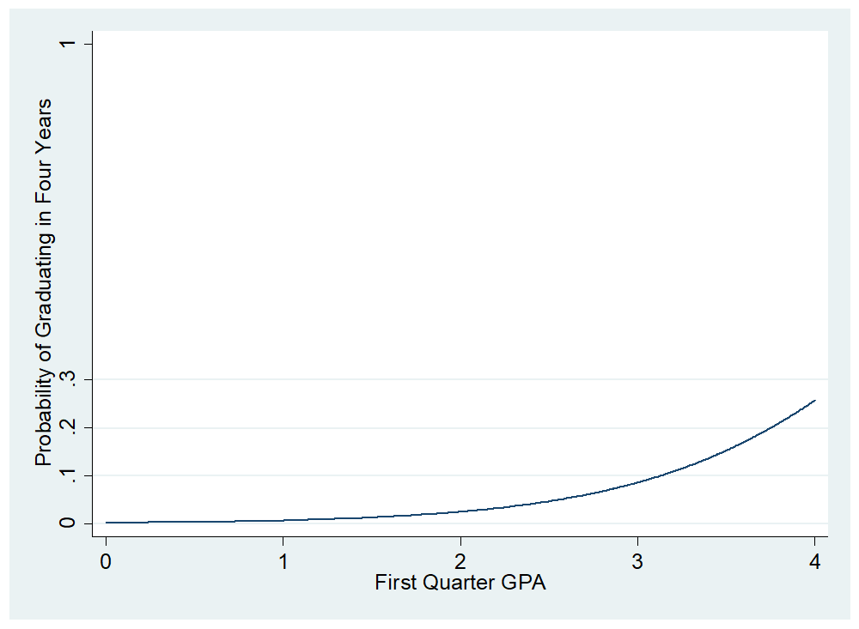
First Quarter GPA Predicts Up to 90%

Slide 12
Factors Associated with Higher/Lower Probability of Graduating in Four Years
Data – student level.
Method – logistic regression.
DV – graduated in four years.
IVs/controls – (1) gender (female), (2) lived in dorm, (3) EOP status, (4) federal unsecured loan recipient, (5) Hispanic student (6) needed English remediation, (7) needed Mathematics remediation, (8) parents’ education, (9) transfer units, (9) CAL, (10) CBP, (11) CSB, (12) CNS, (13) first quarter GPA, (14) enrolled in more than 15 credits and (15) number of first quarter online courses.

Slide 13
Results
Graduated in Four Years | Odds Ratio | Std. Err. | z | P>z | [95% Conf. | Interval]
First Quarter GPA | 2.761 | 0.412 | 6.800 | 0.000 | 2.060 | 3.700
Transfer Units | 1.052 | 0.008 | 6.540 | 0.000 | 1.036 | 1.068
15 or More First Quarter Units | 1.996 | 0.335 | 4.120 | 0.000 | 1.436 | 2.773
Hispanic | 0.532 | 0.092 | -3.630 | 0.000 | 0.379 | 0.748
CSB | 2.631 | 0.798 | 3.190 | 0.001 | 1.452 | 4.767
Needed Math Remediation | 0.553 | 0.110 | -2.990 | 0.003 | 0.375 | 0.816
Fed Unsub. Load Recipient | 0.628 | 0.120 | -2.430 | 0.015 | 0.431 | 0.914
Female | 1.478 | 0.262 | 2.200 | 0.027 | 1.044 | 2.092
EOP | 0.543 | 0.186 | -1.790 | 0.074 | 0.278 | 1.061
CBP | 1.885 | 0.671 | 1.780 | 0.075 | 0.938 | 3.788
CAL | 1.671 | 0.561 | 1.530 | 0.126 | 0.866 | 3.226
Needed English Remediation | 0.795 | 0.145 | -1.250 | 0.210 | 0.556 | 1.138
Num. of First Quarter Online Courses | 2.838 | 2.411 | 1.230 | 0.220 | 0.537 | 15.005
Lived in Dormitory | 1.184 | 0.259 | 0.770 | 0.440 | 0.771 | 1.818
Parents' Education | 1.047 | 0.120 | 0.400 | 0.687 | 0.837 | 1.311
CNS | 0.969 | 0.283 | -0.110 | 0.915 | 0.547 | 1.716
Intercept | 0.003 | 0.002 | -9.320 | 0.000 | 0.001 | 0.011
Log likelihood = -538.24705
Pseudo R² = .212
Correctly classified = 90.59%

Slide 14
Results (Hispanic Students Only)
Graduated in Four Years | Odds Ratio | Std. Err. | z | P>z | [95% Conf. | Interval]
Transfer Units | 1.049 | 0.010 | 4.950 | 0.000 | 1.029 | 1.069
15 or More First Quarter Units | 2.929 | 0.692 | 4.550 | 0.000 | 1.844 | 4.654
First Quarter GPA | 2.405 | 0.469 | 4.500 | 0.000 | 1.641 | 3.525
CSB | 2.531 | 1.085 | 2.170 | 0.030 | 1.093 | 5.865
Needed Math Remediation | 0.643 | 0.173 | -1.640 | 0.101 | 0.379 | 1.090
Fed Unsub. Load Recipient | 0.660 | 0.174 | -1.570 | 0.115 | 0.393 | 1.107
CAL | 2.074 | 0.985 | 1.540 | 0.125 | 0.817 | 5.262
EOP | 0.547 | 0.219 | -1.500 | 0.133 | 0.250 | 1.200
Needed English Remediation | 0.692 | 0.175 | -1.460 | 0.145 | 0.422 | 1.135
Female | 1.430 | 0.360 | 1.420 | 0.156 | 0.873 | 2.343
Parents' Education | 1.056 | 0.193 | 0.300 | 0.767 | 0.738 | 1.510
Lived in Dormitory | 0.959 | 0.319 | -0.130 | 0.900 | 0.500 | 1.842
CBP | 1.031 | 0.596 | 0.050 | 0.958 | 0.332 | 3.201
CNS | 1.016 | 0.440 | 0.040 | 0.971 | 0.434 | 2.375
Intercept | 0.003 | 0.002 | -7.480 | 0.000 | 0.001 | 0.012
Log likelihood = -301.74475
Pseudo R2 = 0.0959
Correctly classified 92.92%

Slide 15
Factors Associated with Higher/Lower Probability of Dropping
Data – quarter level.
Method – survival analysis/Cox panel data regression (quarter level).
DV – dropping/not being retained.
IVs/controls – (1) GPA at the start of the quarter, (2) number of online courses taken during the quarter,(3) number of units attempted during the quarter, and (4) number of tenure track faculty “faced” during the quarter.

Slide 16
Raw Drop Numbers
Quarter | Number of Drops
1 | 110
2 | 66
3 | 34
4 | 107
5 | 57
6 | 26
7 | 79
8 | 45
9 | 29
10 | 62
11 | 30
12 | 9
13 | 39
14 | 14
15 | 14
16 | 43
17 | 17
18 | 12

Slide 17
Results
Probability of Dropping | Haz. Ratio | Std. Err. | z | P>z | Conf. | Interval]
GPA at Start of the Quarter | 0.288 | 0.020 | -18.030 | 0.000 | 0.252 | 0.330
Num. of Units Attempted | 0.877 | 0.012 | -9.500 | 0.000 | 0.854 | 0.901
Num. of Tenure Track Faculty | 0.989 | 0.044 | -0.240 | 0.813 | 0.906 | 1.081
Num. of Online Courses | 1.173 | 0.115 | 1.630 | 0.103 | 0.968 | 1.422

Slide 19
Results (Hispanic Students Only)
Probability of Dropping | Haz. Ratio | Std. Err. | z | P>z | Conf. | Interval]
GPA at Start of the Quarter | 0.226 | 0.021 | -16.050 | 0.000 | 0.189 | 0.271
Num. of Units Attempted | 0.861 | 0.014 | -8.960 | 0.000 | 0.833 | 0.889
Num. of Tenure Track Faculty | 0.975 | 0.056 | -0.450 | 0.656 | 0.871 | 1.091
Num. of Online Courses | 1.189 | 0.148 | 1.390 | 0.164 | 0.932 | 1.516

Slide 21
Factors Associated with Lower Grades
Data – class level.
Method – fixed effects regression/panel data logistic regression.
DV – grade/grade C or better.
IVs/controls – (1) class enrollment, (2) online class, (3) class taught by tenure track faculty, (4) GE course, and (5) upper division course

Slide 22
Results
Grade | Coef. | Rob. Std. Err. | t | P>t | [95% Conf. | Interval]
Enrollment | -0.003 | 0.000 | -45.400 | 0.000 | -0.003 | -0.003
Tenure Track Faculty | -0.269 | 0.009 | -31.380 | 0.000 | -0.285 | -0.252
Online | 0.170 | 0.022 | 7.700 | 0.000 | 0.127 | 0.213
GE Course | 0.144 | 0.010 | 14.770 | 0.000 | 0.125 | 0.163
High Division Course | -0.103 | 0.011 | -9.280 | 0.000 | -0.125 | -0.081

Slide 23
Results
Passing Grade | Coef. | Std. Err. | z | P>z | [95% Conf. | Interval]
Enrollment | -0.004 | 0.000 | -17.260 | 0.000 | -0.004 | -0.004
Tenure Track Faculty | -0.647 | 0.036 | -18.030 | 0.000 | -0.718 | -0.577
Online | -0.329 | 0.076 | -4.310 | 0.000 | -0.479 | -0.180
GE Course | 0.499 | 0.040 | 12.400 | 0.000 | 0.420 | 0.577
High Division Course | -0.615 | 0.045 | -13.610 | 0.000 | -0.703 | -0.526

Slide 24
Conclusions
SAT, high school GPA and first quarter GPA – very good predictors of probability of graduating in four years.
Quarter GPA very good predictor of probability of dropping out.
The adjusted risk of dropping out is the highest between quarters 5 and 8.
Class enrollments, high division courses and course being taught by tenure track faculty associated with lower class grades.
Online and GE courses associated with higher grades; GE courses associated with higher probability of earning a passing grade.
Class enrollments, high division courses, course being taught by tenure track faculty and online courses are associated with higher probability of failing grades.

