Slide 1
Faculty-Student Interaction in the Context of a Faculty-in-Residence (FIR) Program: Experiences and Outcomes for Students
Dr. Jordan Perez Fullam, College of Education
Dr. Andrew Hughes, College of Education
Notes:
[Introduce presentation and presenters, then...] This research is in its early stages, so we will only briefly discuss some preliminary findings. More time will be spent discussing the context, background, and design of the research. And we also plan to leave some time at the end of this presentation to share a fun video that will show some of what Faculty-in-Residence work looks like on our campus.

Slide 2
The leading researchers and professional organizations in student affairs have called for institutions of higher learning to create integrated learning environments that bridge the divide between student affairs professionals and faculty.
Student Affairs
Academic Affairs
Integrated Learning Environment
(NASPA & ACPA, 2004; Manning et. al, 2013)

Slide 3
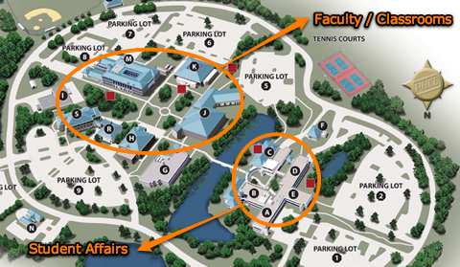
However, this is a difficult task for most colleges and universities where student affairs offices and faculty departments have historically been separated by differences in duties, career specializations, professional culture, and even physical distance (Browne et. al, 2009).
Notes:
[present slide, then...] This is the campus map of a community college in South Florida, and you can see the student affairs offices and faculty departments are literary separated by a MOAT. (haha) Now this is not exactly the situation we have here at CSUSB, but we thought this graphic could provide a humorous illustration of the challenges involved in this kind of collaboration. ….One promising route to improving the conditions for collaboration between student affairs staff and faculty is the development of faculty-in-residence programs or "FIR programs." These programs provide faculty with residential positions that allow them to collaborate with student affairs professionals and extend student learning beyond the classroom and into the residence halls.

Slide 4
What is a Faculty-in-Residence Program?
Faculty member lives in an apartment on campus and interacts with residential students
Faculty member has no supervisory role, instead focusing on programming and community building
FIR programming includes book clubs, running clubs, film series, speaker series, outdoor activities, music groups, arts & crafts workshops, and open houses
As Rhoads (2009) points out, these activities “are not just fun and games, as they often appear to be, but, more important, are aimed at helping students form the connections and social support systems that are helpful for academic success” (p. 21).
Notes:
Faculty involvement in an FIR program begins with a faculty member living in an apartment in a residence hall and engaging with residential students in a variety of formal and informal ways. The FIR typically has no supervisory role in the residence hall and is not responsible for supervising student staff, intervening in student crises, or addressing student conduct issues. Instead, the role of the FIR includes developing social, cultural, or recreational programming intended to build stronger connections with students and complement the work that is already being done by student affairs professionals. FIR programming, for example, has included book clubs, running clubs, film series, speaker series, outdoor activities, music groups. As Rhoads (2009), and FIR researcher, points out, these activities “are not just fun and games, as they often appear to be, but, more important, are aimed at helping students form the connections and social support systems that are helpful for academic success” (p. 21). And, of course, the broader goal here is to make faculty – the FIRs – part of those social support systems that students have access to in the residence halls.

Slide 5
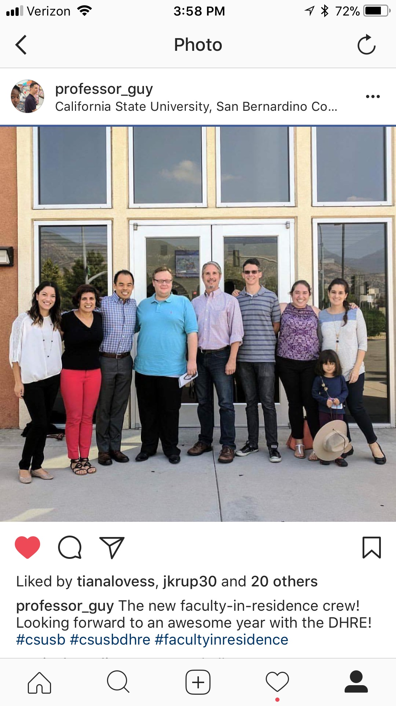
The Faculty-in-Residence Program at CSUSB
Faculty-in-Residence program started at CSUSB in 2016 with 4 FIRs
FIRS live on campus and are assigned to different residential villages (AV, UV, SV, CV)
Currently, 5 faculty serve as FIRs, including:
Dr. Joseph Wellman, Psychology
Dr. Isabel Huacuja Alonso, History
Dr. David Marshall, English
Dr. Manijeh Badiee, Psychology
Dr. Jordan Perez Fullam, Education
Notes:
The FIR program on our campus is new. It started in 2016 with 4 FIRs living on campus. It expanded this year, and currently 5 faculty are serving as FIRs. Along with some of our colleagues in the housing department, we are pictured here: there's Manijeh from the Psychology department, Joseph, also from Psychology, David from English who is also the director of the Honors Program, me and I'm in the College of Education, and Isabel from History along with her daughter Amalia. An interesting part of being an FIR is the way in which your family, who lives with you on campus, also becomes part of the campus community and in some cases part of the FIR program. For example, I consider my wife, Tiana, to be my partner in the FIR work that we do in the residential community. This is a screenshot from my Instagram, by the way....

Slide 6
RESEARCH QUESTIONS
What kinds of interactions are FIRs having with our students? How are students impacted by their interactions with the FIRs? What factors led to particular students engaging in sustained interactions with the FIRs? What obstacles and opportunities arise as student affairs professionals, faculty, and students collaborate to build community in the residence halls?
Notes:
[present slide, then...] These questions serve a practical purpose for us since we are seeking to help develop an FIR program that draws on research-based best practices. We also aim to use our research to contribute insights to the emerging literature on FIR programs as well as to broader discussions on faculty-student interaction.

Slide 7
RESEARCH DESIGN
Qualitative interviews with 15 students
NSSE data related to experiences with faculty
Fitzpatrick (2011) suggests that a goal of research on FIR programs should be to “shed light on the question of whether true community is formed on campus and if social capital can be acquired by or collaborative efforts” (p. 78).
Notes:
As the primary method of data collection, we are conducting interviews with 15 students who have interacted with FIRs. The interviews are exploring how frequently the students interact with FIRs, what kinds of interactions students are having with FIRs, and how these interactions impact students socially and academically. To augment the interview data, we also plan to draw on data from the National Survey of Student Engagement (NSSE) which was administered during the 2017-2018 school year. The study, in this manner, is both a case study and a mixed methods approach to investigating faculty-student interaction in the context of an FIR program. Fitzpatrick, an FIR researcher, suggests that a goal of research on FIR programs should be to “shed light on the question of whether true community is formed on campus and if social capital can be acquired by or collaborative efforts” (p. 78). We are taking this insight seriously and making as a focus of our study (1) relationships, (2) community-building, and (3) the development of social capital.

Slide 8
Research on Faculty-Student Interaction
Academic self-concept (Kuh & Vesper 1997; Woodside et al., 1999)
Persistence (Chickering & Gamson, 1987; Tinto, 1993)
Academic performance (Terenzini et al., 1996; Woodside et al., 1999)
Personal development (Astin, 1993; Kuh, 1995)
Student retention (Milem & Berger, 1997; Pike et al., 1997)
Positive attitudes toward learning (Pascarella & Terenzini, 1991; Cruce et al., 2006)
Positive multicultural attitudes (Armstrong, 1999)
Critical thinking skills (Frost, 1991; Terenzini et al., 194)
General satisfaction with the higher education experience (Wilson et al., 1975; Lamport, 1993)
Notes:
FIR programs are supported by a voluminous amount of research that points to the benefits students receive when they interact with faculty outside of the classroom. For example, research suggests that students who interact with faculty outside of the classroom experience gains in... [present slide] ….Research also shows that these benefits may be experienced by all students who interact with faculty outside of the classroom, but they may be especially impactful for students of color (Lundberg & Schreiner, 2004).

Slide 9
What Types of Faculty-Student Interactions are Impactful for Students?
Academic-oriented interactions (Anaya & Kole, 2001; Kuh & Hu, 2001; Kuh, 2003; Umbach & Wawrzynsi, 2005; Cotten & Wilson, 2006)
Social interactions (Aylor & Oppliger, 2003; Cox & Orehovec, 2007; Healea et al., 2015)
Sustained interactions (Ellett & Schmidt, 2011)
Notes:
While we know a lot about the benefits of faculty-student interaction, less is known about the types of interaction faculty have with students and how different types of interaction impact outcomes for students. For example, some researchers have argued that only academic-oriented interactions benefit students, while others have argued that even social interactions may lead to positive educational outcomes. Still others have argued that it is less important to distinguish between academic and social interactions, and instead sustained interactions between faculty and students are most impactful of the student experience. Ellett and Schmidt (2011), for example, suggest that FIR programs should aim to provide faculty with opportunities to have regular and ongoing interaction with the same students, giving them the opportunity to build relationships and serve as mentors.

Slide 10
Research on Faculty-in-Residence Programs
CHALLENGES FOR FACULTY
Lack of understanding of roles (Jessup-Anger et al., 2011; Manning et al., 2013; Golde & Pribbenow, 2000)
Faculty time constraints (Fitzpatrick, 2011; Healea et al., 2015; Humphrey et al., 2015)
Faculty discomfort with interacting with students outside of classrooms (Browne et al., 2009)
CHALLENGES FOR STUDENTS
RAs play a critical role in success of FIR programs (Ellett & Schmidt, 2011)
Student time constraints (Ellett & Schmidt, 2011)
Poor attendance at academic-oriented programs planned by FIRs (Browne et al., 2009)
Notes:
The research on FIR programs in particular is not as developed as the research on faculty-student interaction, but is useful for highlighting some of the challenges FIR programs can face, especially when they are young like our program. The literature suggests as potential challenges relating to the role of faculty serving as FIRs.... The literature also suggests as potential challenges related to the roles of students.... I don't have enough time to discuss how we're addressing all of these challenges in our FIR program, but I'll share two examples. We are training RAs and FIRs in strategies for relating and collaborating, recognizing the important role the RAs play in the success of the program. And to address the challenge of faculty time constraints, we have formerly made the case to our RPT committees that FIR work should count as service for the purposes of evaluation. Counting this work as faculty service allows FIRs to make the huge commitment of time and energy that is necessary to make FIR work successful.

Slide 11
Preliminary Findings
Students want us to find ways to make FIRs more visible on campus
Academic and social interactions are impactful for students
Students are benefitting both socially and academically from interactions with FIRs
Sustained interactions are essential (Ellett & Schmidt, 2011)
Notes:
Some preliminary findings from our study are.... And to illustrate how we understand these findings, I would like to read an excerpt from our paper that shows how we are relating the findings from our study to insights from the existing literature on FIR programs.... [transition to next slide]

Slide 12
From our perspective, it is misguided to debate whether only academic and intellectual interactions benefit students, or whether social interactions can also be beneficial. Cox and Orehovec (2007), for example, suggest that social interactions can have a “humanizing” and “personalizing” effect for FIRs and students, and “can serve as a stepping stone to more substantial interactions later” (p. 26). As FIRs and students build deeper relationships, the sustained interactions that result may open more and better opportunities for FIRs to serve as academic mentors and intellectual role models: “These sustained interactions between students and faculty create opportunities to share academic goals and learn from one another in the residence hall setting” (Ellett & Schmidt, 2011) (p. 32). In other words, intellectual and social interactions may be mutually reinforcing in the context of meaningful and productive relationships between FIRs and students.

