Slide 1

Political Rhetoric and Hate-motivated Incidents Against Migrants
Presentation of Professor Brian Levin, Center for the Study of Hate & Extremism
California State University, San Bernardino
Expert Roundtable
Organization for Security and Co-operation in Europe
Office for Democratic Institutions and Human Rights (ODIHR)
27 February, 2018 London, United Kingdom

Slide 2
Prof. Brian Levin Bio & Contact
Former NYPD; BA, Penn, ‘89; JD Stanford Law, ‘92
Former Assoc. Director, SPLC Klanwatch / Militia Task Force
Founder & Director, Center for the Study of Hate & Extremism California State University, San Bernardino
Appearances: Congress, Local/Federal Law Enforcement, numerous academic & media
Email: blevin8@aol.com
Phone: (909) 537-7711
Website: Twitter @proflevin

Slide 3
U.S. Foreign Population By Year Show Recent Annual Increases
PEW Research

Slide 4
U.S. Immigrant Population Diversifies After ‘65 Law Change
PEW Research

Slide 7
26% Spike in Election Qtr. ‘16 Over ‘15
Drove Hate Crime Increase in 2016
FBI Data retrieved by J. Nolan WVU/CSHE as First Reported by Ken Schwenke/Pro-Publica

Slide 8
U.S. Hate Crime: 4th Quarters ’92-16
2016 Worst 4th Qtr. in 8 Years
FBI Data/Dr. J. Nolan, WVU for Center for the Study of Hate & Extremism

Slide 9
Election Time 2016 Hate Crime In Major U.S. Cities
B. Levin/Center for the Study of Hate & Extremism
New York City, NY: 2 weeks of 2016 election 5X > over same period ‘15, & 129 hate crimes after election day through year end = 34% of ‘16
Los Angeles, CA: 4th Qtr. ‘16 >29% over ‘15
California: Nov. highest month of 2016.
Montgomery County, MD: >1/3 of 2016 “incidents” were in Nov. & Dec.
Seattle,WA: 14.6% of 2016 hate crime in Nov., & those 13 cases >2X Nov. ‘15
San Jose, CA: hate crime > from 2 in Nov. 2015 to 5 in ‘16.
Phoenix, AZ: 30% of 2016 hate crime in 4th Qtr. .
Boston, MA: Nov. ‘16 highest month in ‘15 or ‘16.
Phila., PA: 7 hate crimes Nov. 2016, w/only 1 for previous four Novembers combined. 9 of 21 (42%) of hate crimes in 2016 were in Nov. and Dec.

Slide 11
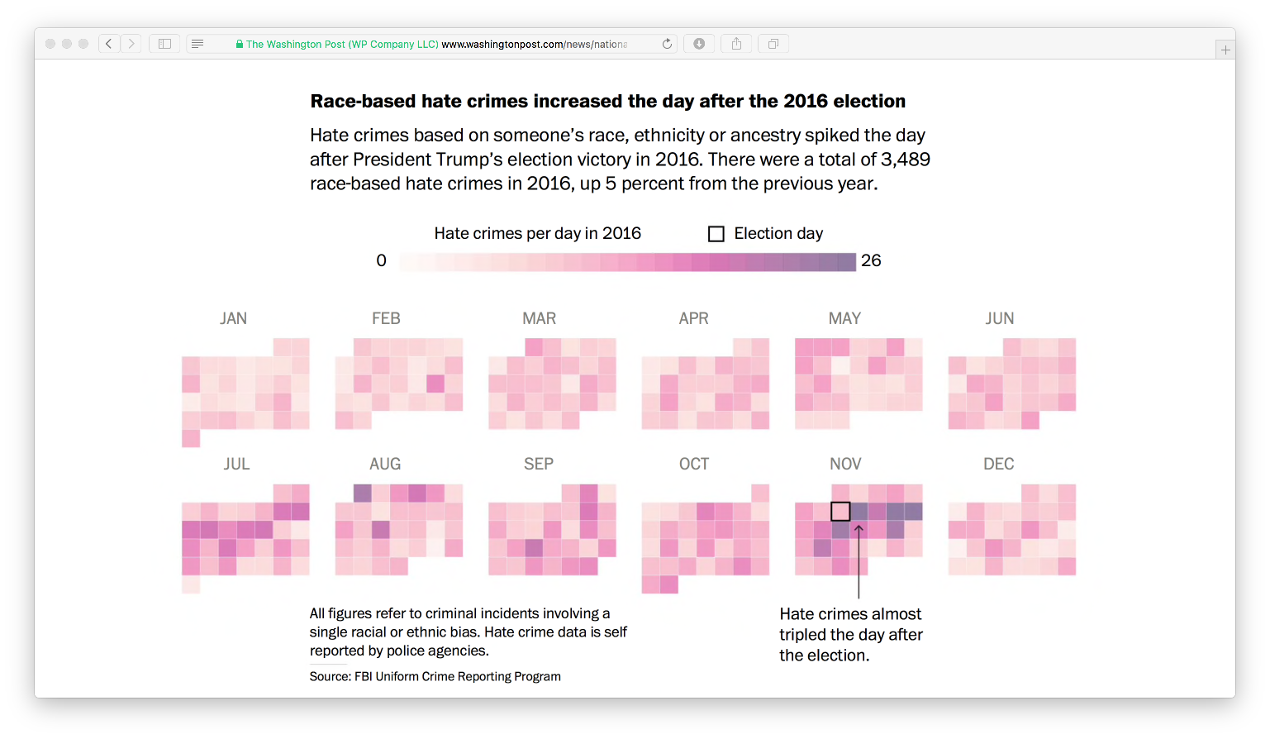
FBI U.S. Racial Hate Crime By Day, 2016
Increase Almost 3X Day After Election
FBI/Aaron Williams-Washington Post

Slide 12
Unofficial Hate Incidents US: Criminal & Non-Criminal
Southern Poverty Law Center (U.S. NGO)

Slide 13
Of 867 unofficial hate incidents in 10 days post-election 2016,
280 or 32%, were anti-immigrant
Chart/Data: Southern Poverty Law Center (U.S. NGO)

Slide 14
Think Progress Analysis of Post Election Hate Incidents

Slide 15
Number of Racially or Religiously Aggravated Offences Recorded by
Police by Month, 31 Forces, January 2013 to August 2017
Chart: Sylwia J. Piatkowska, Old Dominion University
23rd June: Day of Referendum
Lee Rigby Murder
Source: Police Recorded Crime, Home Office
.
Paris Attacks
London Bridge attack
Westminster Bridge attack
Finsbury Park Mosque attack
Conflict in Israel and Gaza
Charlie Hebdo Shooting
Manchester Arena attack

Slide 16
European & North Amer. Nations: Stealth Info Warfare Launched Upon Increasingly Divided Societies
Long Term Shifts: Demog./Immig., Econ., Info Tech & Socio-Political Change Amidst Period of > Anxiety, Distrust & Polarization
Socio-Political Divisions: Exacerbated by Rising Distrust of “Subverted” Gov’t & Institutions
Yields Opportunities For Internal Malefactors: Racial & Ethnic Nationalists Inter Alia
While External Malefactors Wage Asymetric Warfare: Russian Troll Armies & Internet Platforms
Nationalist’s Goals: Tie Citizenship & Patriotism to Race, Ethnicity & A Retreat from Int’l Engagement
Russian Goals: Internal Destabilization Diminishes Collective Efficiencies of Rival Allied Nations

Slide 18
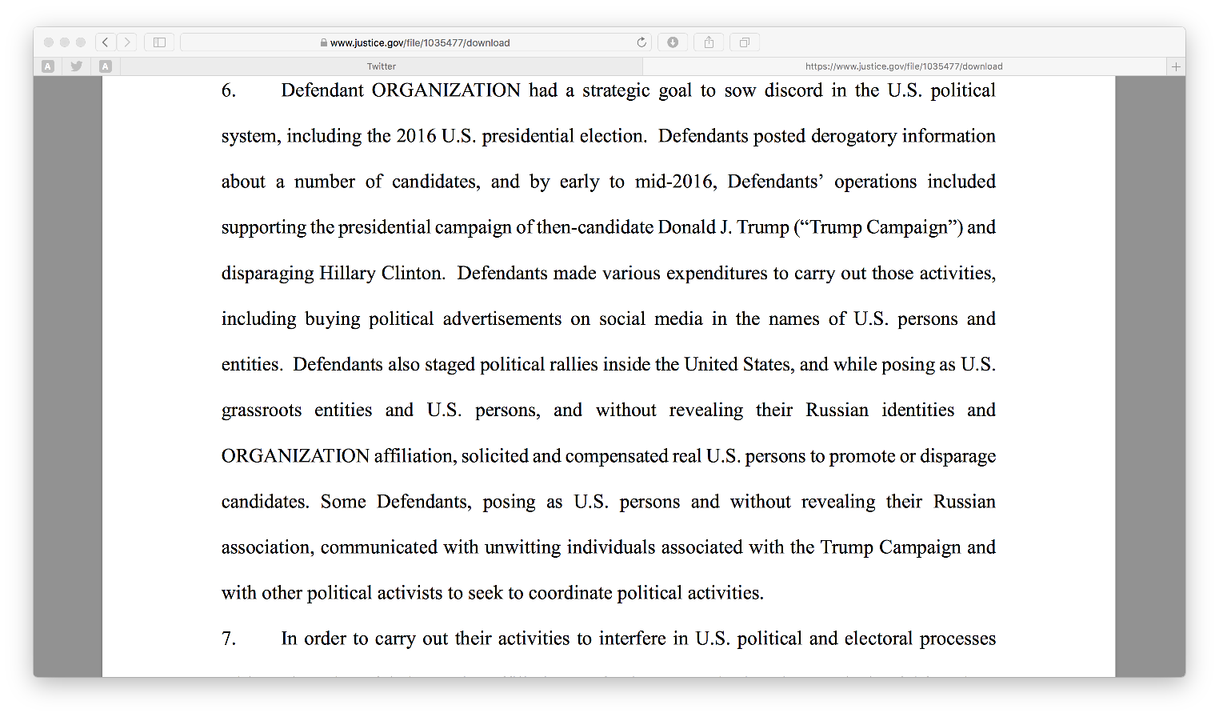
Feb 2018 U.S. Indictment: Russian Operatives had “strategic goal to sow discord in the U.S. political system, including the 2016 U.S. presidential election”

Slide 19
Violent Public Demonstrations & White Nationalist Rallies Rise
Through 3rd Quarter 2017, Violent Public Demonstrations In California Doubled Over 2016
Topics: Trump, Free Speech, Police Use of Force, Immigration & Muslims/Sharia
As first reported by ADL and later Cal St. Center there were more large “Mega Rallies” in U.S. in last 2 years than in all of previous decade
Charlottesville, VA “Unite The Right Rally” left 1 dead and 19 injured with over 500 largest in decades
White Nationalism in U.S. now coalesced socio-political force: Immigrants targetted

Slide 21
GMF: Alliance for Securing Democracy/ Hamilton 68 Project Report: January 2018
From January 14 and January 31, 159 unique articles analyzed that were among the top URLs shared by Kremlin-oriented accounts on Twitter.
31%: “Deep State” Narratives and attacks against U.S. DOJ & Mueller Investigation
11% targeted Hillary Clinton & 5% FBI Dep. Director McCabe
Anti-immigration: 10% of URLs articles highlighting crimes committed by undocumented immigrants in U.S. or migrants/refugees in Europe.
Europe was focus of 5% of the examined URLs; all of those URLs were coded as promoting anti-migrant or anti-Islamic narratives (and usually both).

Slide 22
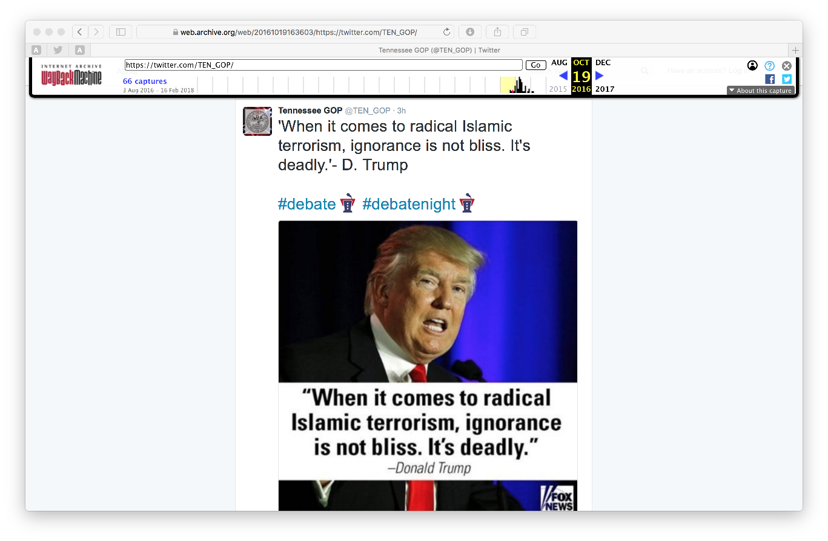
Fake Russian “Republican” Party Soc. Media Accts. Promoted Bigotry

Slide 23
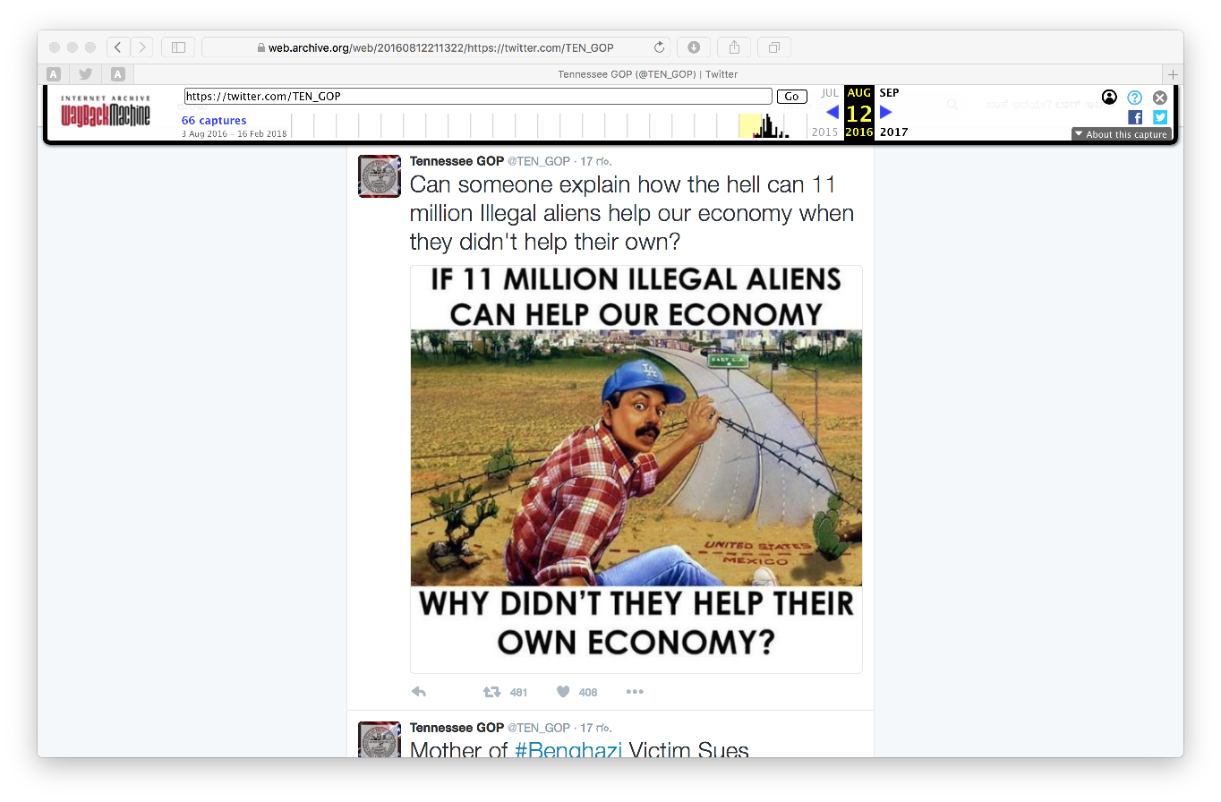
Fake Russian Accounts Also Attack Undocumented Mexican People

Slide 24
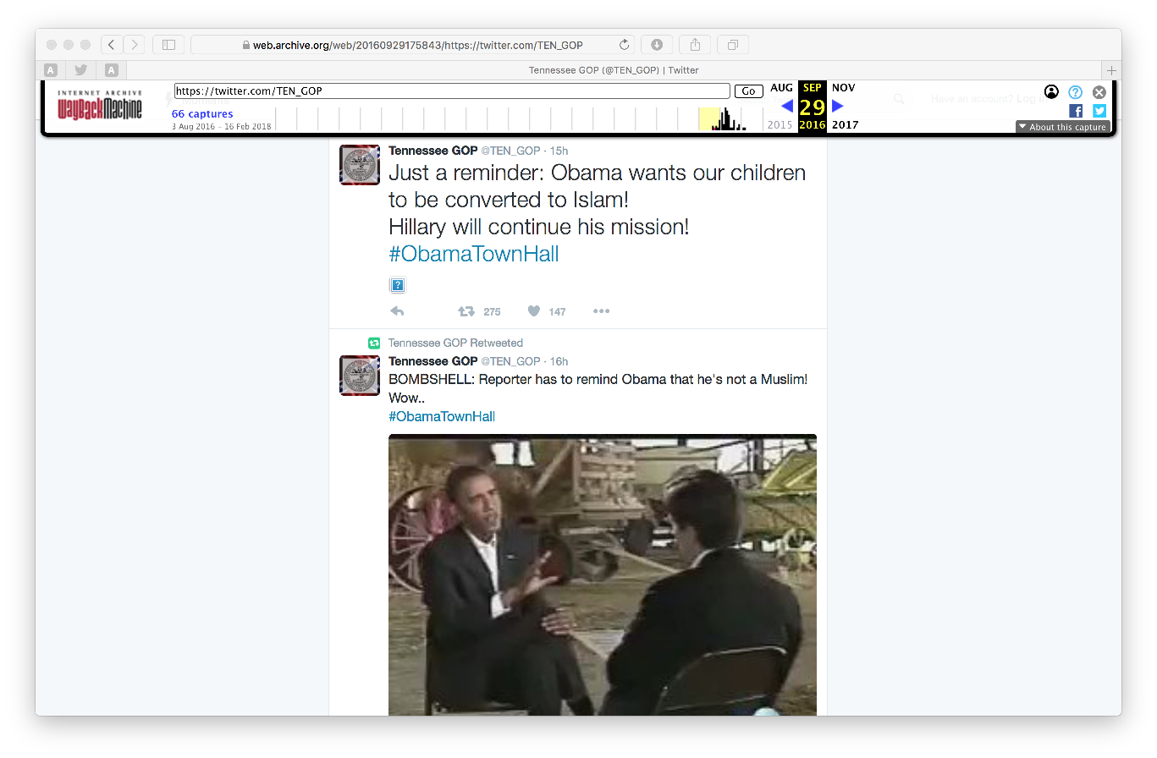
Political Conspiracy To Convert Our Children to Islam

Slide 25
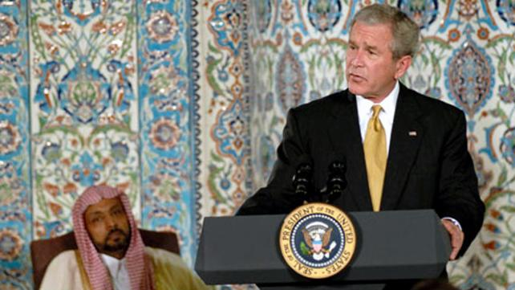
Pres. George W. Bush Sept. 17, 2001: Hate Crime Drop 47.5% to 66%
Those who feel like they can intimidate our fellow citizens to take out their anger don't represent the best of America, they represent the worst of humankind, and they should be ashamed of that kind of behavior.
This is a great country. It's a great country because we share the same values of respect and dignity and human worth. And it is my honor to be meeting with leaders who feel just the same way I do. They're outraged, they're sad. They love America just as much as I do.

Slide 26
Anti-Muslim Hate Crime Up After 9/11
But Down After Pres. Bush Speech Of 9/17

Slide 27
Anti-Muslim Hate Crime 9/11 & Pres. Bush Mosque Speech 9/17
J. Nolan WVU/Ctr. For the Study of Hate & Extremism

Slide 28
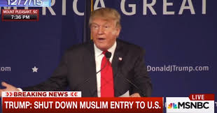
Mr. Trump., Dec. 7, 2015: Hate Crime (Unofficial) Up 87.5%
“Total and Complete Shutdown of Muslims”
From entering U.S.
Slammed “political correctness.”
Broad-brush warning “such a big portion” of Muslims drip with “hatred beyond comprehension.”
They’re Committed to “jihad” and want “to change your religion”
… “I don’t think so.”

Slide 29
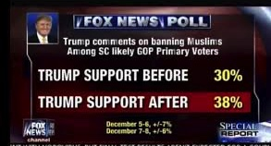
Candidate Trump’s Poll Numbers +27% in South Carolina
(2nd Primary)

Slide 30
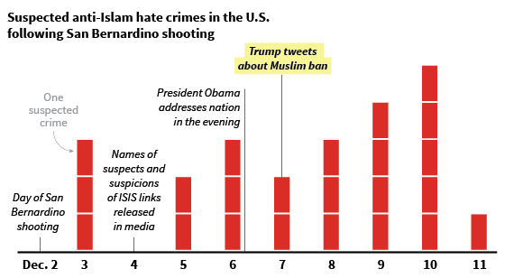
Anti-Muslim Hate Crimes Rise Following Muslim Ban Proposal
Unofficial Data: B. Levin/Center for the Study of Hate & Extremism Chart: Huffington Post

Slide 31
U.S. Hate Crime Nov./Dec 2015 Show Rise After Terror Attack on 12/2 and Again After 12/7 “Ban”
FBI Data: Chart J. Nolan/WVU/Ctr. For the Study of Hate & Extremism

Slide 32
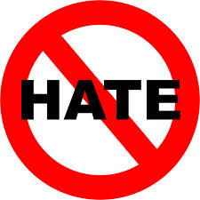
Hate Crime
Hate crime: Criminal offense motivated, in whole or substantial part, by the actual or perceived status characteristic of another
Hate Crime Statistics Act (28 U.S.C. § 534) “Crimes that manifest evidence of prejudice
based on race, gender or gender identity, religion, disability, sexual orientation, or ethnicity.”
Wisc. v. Mitchell, ’93: U.S. Sup Ct. Upheld HC laws
45 States & Fed.Gov. Have HC Laws

Slide 33
Europe Hate Crime In 2016
ODIHR, 2,154 racist and xenophobic incidents were reported in 2016 followed by 1,661 anti-Semitic incidents and 371 reports of “bias against Muslims”.
Office for Democratic Institutions and Human Rights (ODIHR)

Slide 34
FBI: U.S. Hate Crime By Bias Motive

Slide 36
UVA-Reuters/Ipsos: Race Relations
70% strongly agree “all races equal”/ all races should live where they choose
89% agree “all races should be treated equally; 11% disagree, neither/DK
55% agree “racial minorities under attack in U.S.”; 32% Support BLM
6% of respondents said they strongly or somewhat supported the alt-right.
8% expressed support for white nationalism.
4% expressed support for neo-Nazism.
14% of all respondents both 1) agreed that white people are under attack and 2) disagreed with the statement that nonwhites are under attack.
8% Support Antifa

Slide 38
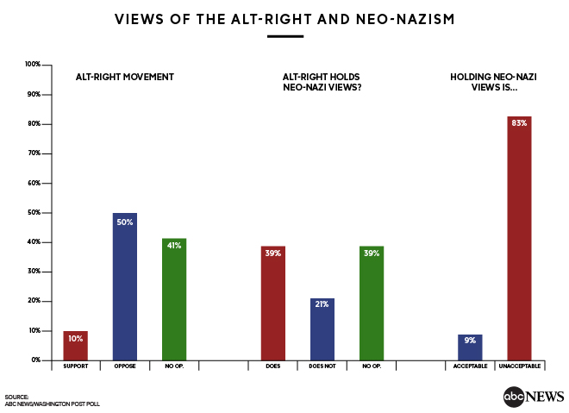
American Opinion: Alt. Rt/Nazism
ABC-Washington Post Poll/August 2017

Slide 39
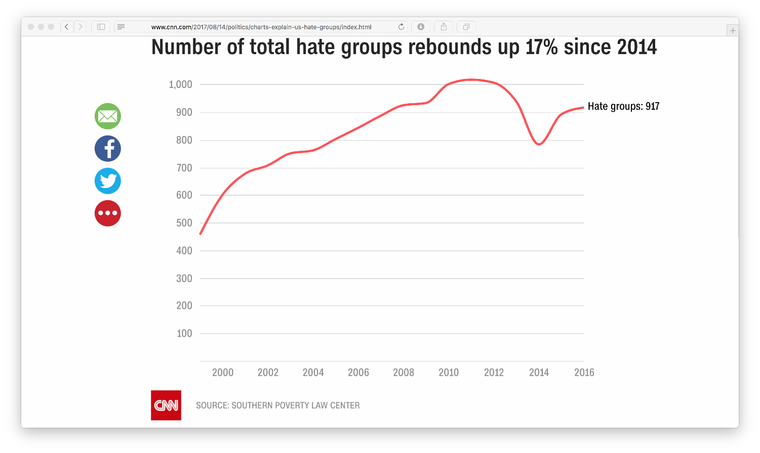
Hate Groups By Year: U.S.- 954 in 2017
Southern Poverty Law Ctr. (U.S. NGO)/CNN

Slide 40
Recommendations
Enact and Enforce Hate Crime Laws
Implement Data Collection, Training and Model Policies
Liaison to Immigrant Advocacy Groups
Protect Irrespective of Legal Status
Treat Foreign Interference As Nat’l Security Threat

Slide 41
Acknowledgements & Questions
Sylwia J. Piatkowska, Old Dominion University
Ken Schwenke, Pro Publica
James Nolan, WVU
Aaron Williams, Washington Post
Southern Poverty Law Center
Gallup
PEW Research Center
FBI-UCR
UK Home Office
Think Progess
ABC/Washington Post
Reuters/Ipsos-University of Virginia
Fox News Polling
Kevin Grisham & John David Reitzel: Center for the Study of Hate & Extremism-California State University, San Bernardino
Hamilton 68 Project /GMH Alliance For Securing Democracy

