Slide 1
How to Complete the CITI Training

Slide 2
Requirements and recommendations to complete the CITI training.
Computer (fully charged or plugged in)
Pencil and paper to take notes
Ability to save the final completion certificate
3-5 hours to complete the full training
You may complete the training in multiple sessions

Slide 3
Requirements and recommendations to complete the CITI training cont.
MUST complete all 15 modules.
MUST pass all module quizzes with 100% to pass the training (5-10 questions each). You are able to retake the quizzes if you do not pass.
Final test uses same questions as the previous quizzes, but rearranges the questions to ensure your paying attention.
After completing all modules, you will receive a certificate. Save the certificate and email it to Jen Bacon.

Slide 4
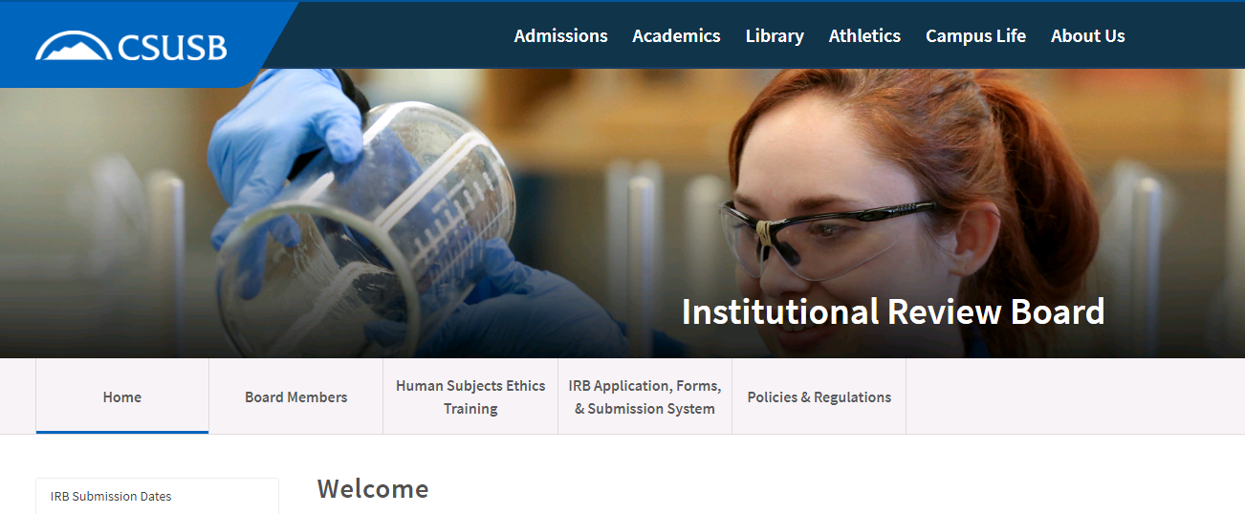
Step 1: Go to the IRB website for CSUSB
http://irb.csusb.edu/
Step 2: Select the “HUMAN SUBJECTS ETHICS TRAINING” tab (see below)

Slide 5
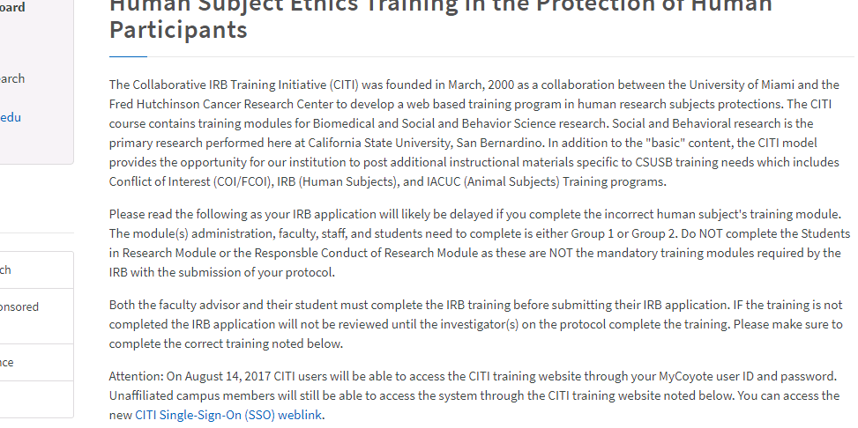
Step 3: Select the “CITI Single-Sign-On (SSO) weblink”.

Slide 6
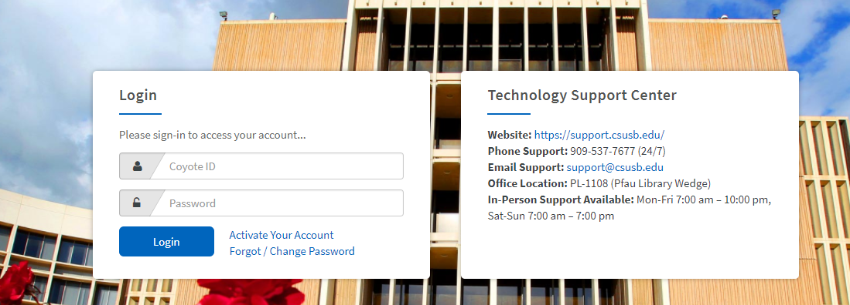
Step 4: A new screen will open and prompt you to enter your MyCoyote login information.

Slide 7
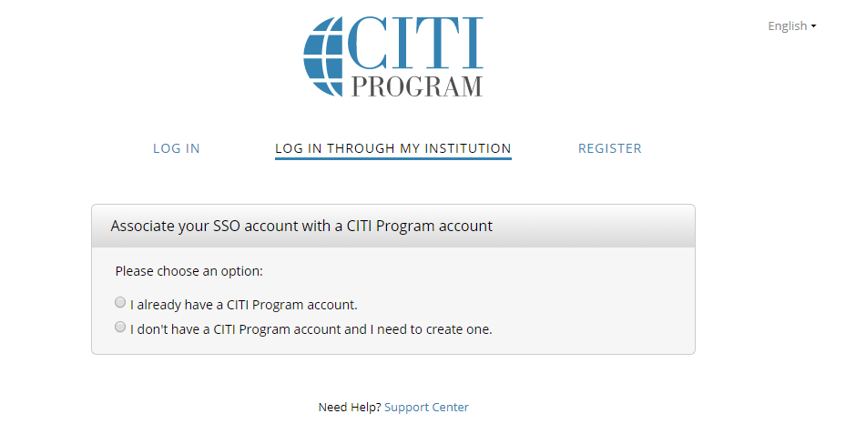
Step 5: A new screen will appear and should look like the picture below.
Step 6: Select the option that fits you. If you have never completed the CITI Training before select the second option.

Slide 8
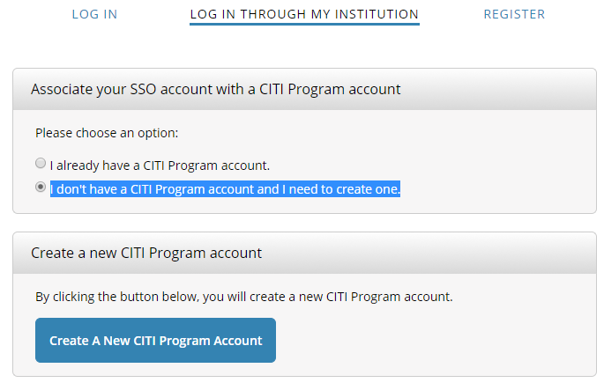
Step 7: After selecting the “I don't have a CITI Program account and I need to create one” the below screen will appear.
Step 8: Select the blue box that states “Create A New CITI Program Account”.

Slide 9
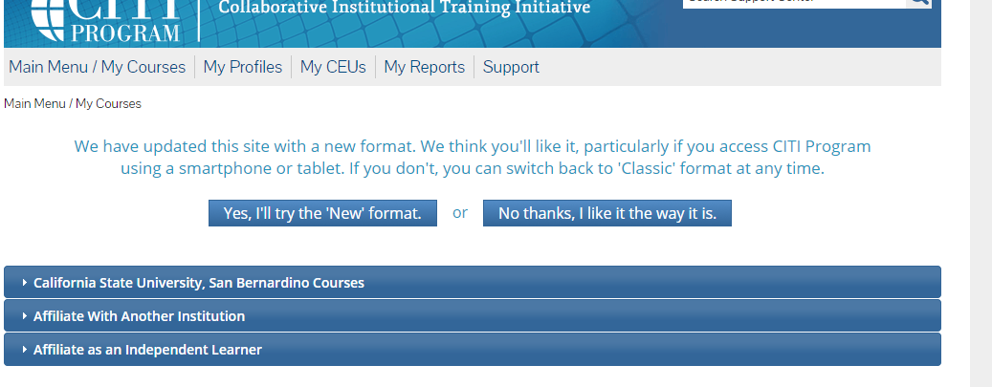
Step 9: A new window will appear and select “Yes, I’ll try the ‘New’ format.” option.

Slide 10
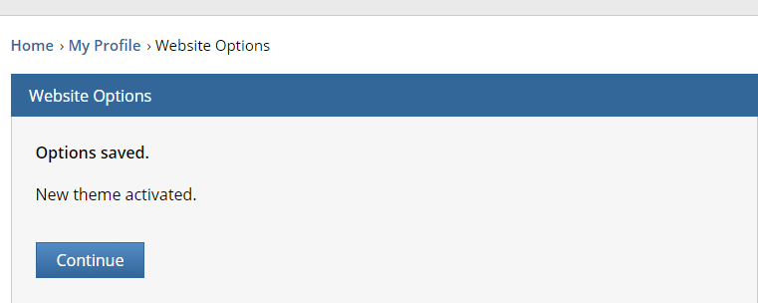
Step 10: Select “Continue” on the next screen.

Slide 11
Step 11: Select the first drop down menu option labeled “California State University, San Bernardino Courses”

Slide 12
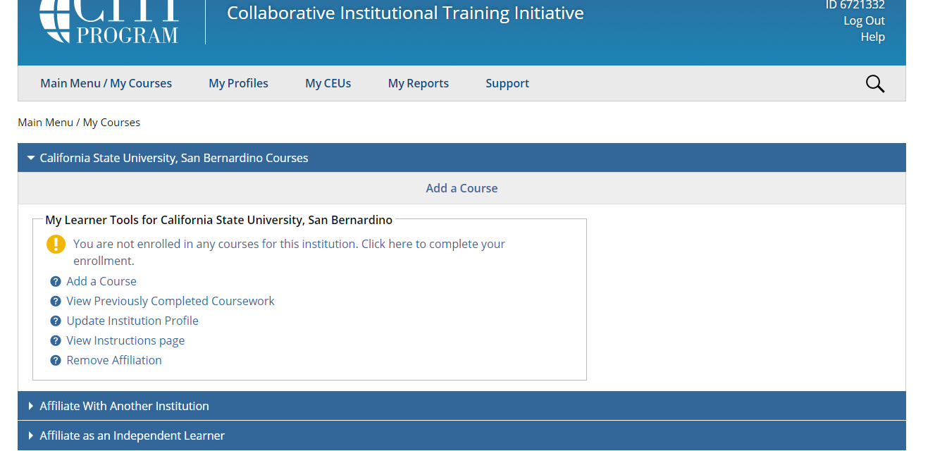
Step 12: Select the blue lettering “You are not enrolled in any courses for this institution. Click here to complete your enrollment”.

Slide 13
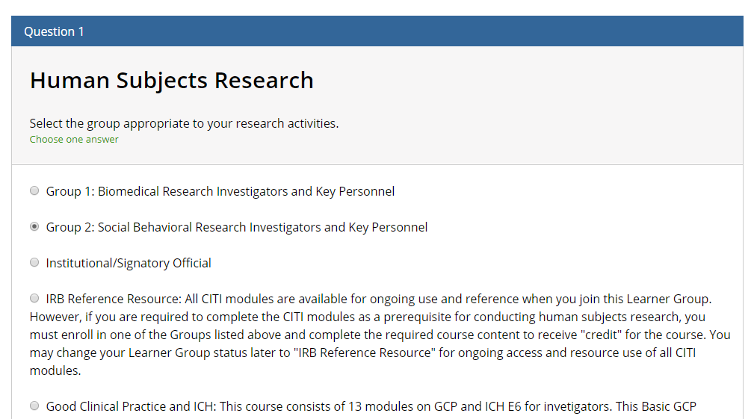
Step 13: For Question 1, select “Group 2: Social Behavioral Research Investigators and Key Personnel”.

Slide 14
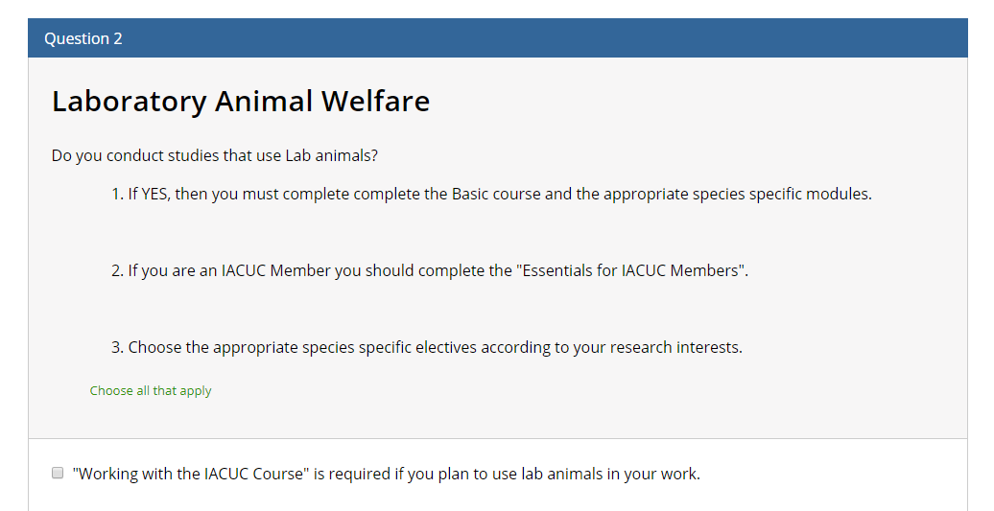
Step 14: Skip Question 2 and leave the question blank. DO NOT SELECT ANYTHING FOR THIS QUESTION.

Slide 15
Step 15: For Question 3, select “No”

Slide 16
Step 16: Leave question 4 blank. DO NOT SELECT ANYTHING FOR THIS QUESTION.

Slide 17
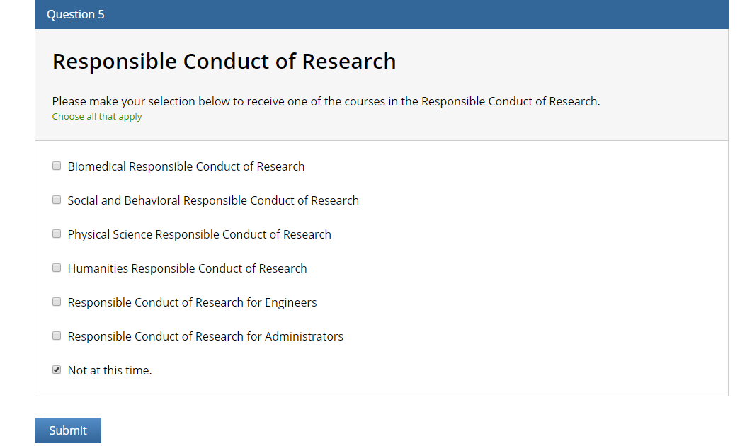
Step 17: For Question 5, select “Not at this time” and then select the blue “Submit” button

Slide 18
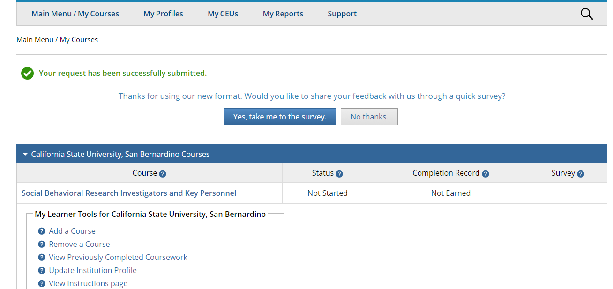
Step 18: Select “No thanks”

Slide 19
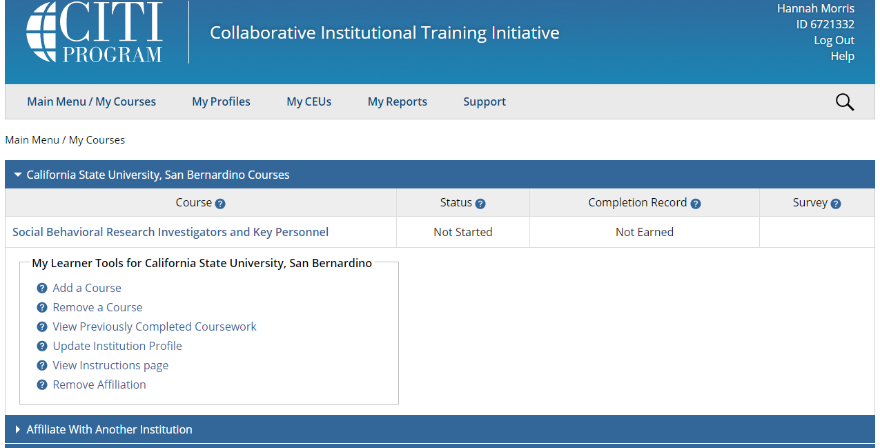
Step 19: You will now be able to complete the CITI training by selecting the blue “Social Behavioral Research Investigators and Key Personnel.

Slide 20
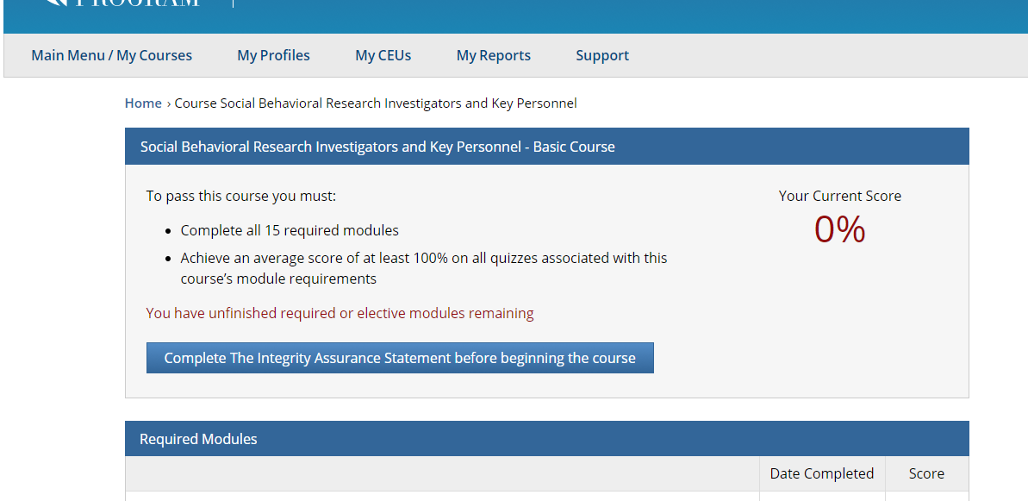
Step 20: You must complete the Integrity Assurance Statement before proceeding by selecting the “Complete the Integrity Assurance Statement before beginning the course” option.

Slide 21
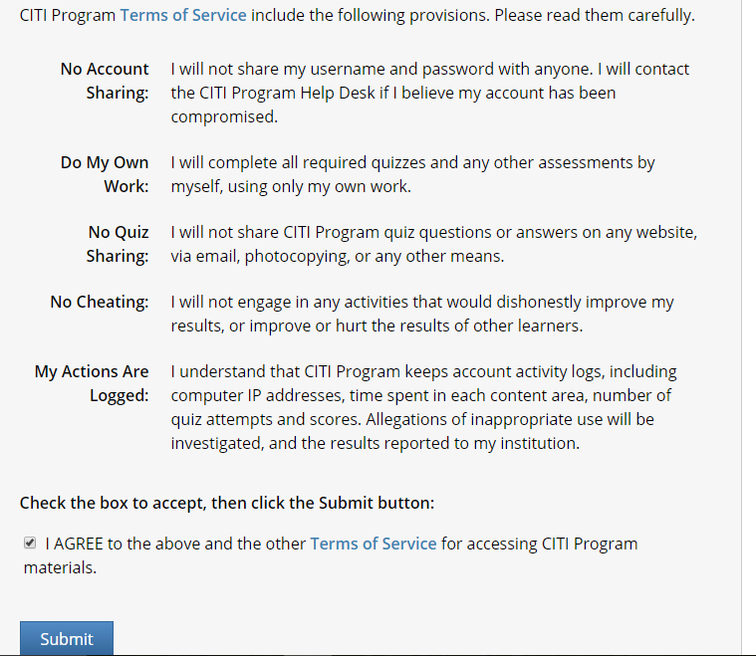
Step 21: Read the terms of service and select the box that says: “I AGREE to the above and the other Terms of Service for accessing CITI Program materials.”
Then select “submit”

Slide 22
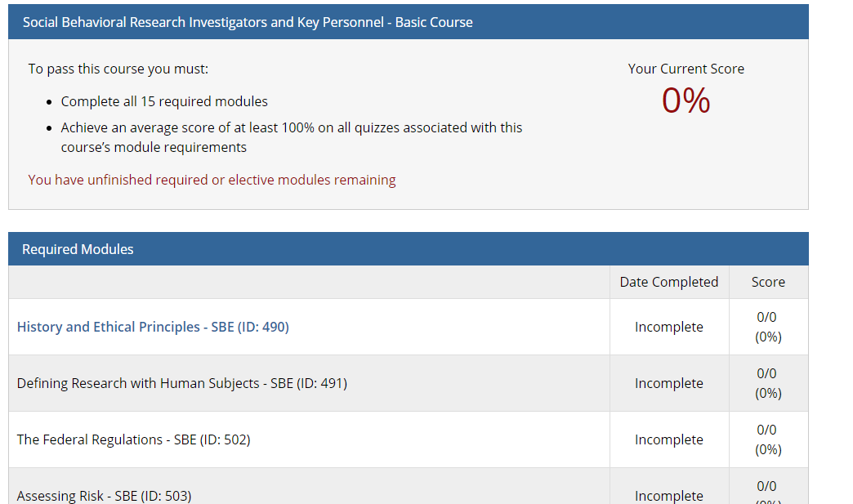
Step 22: After selecting the submit button, you will see the screen on the right.
To begin the training select the blue titles under the “Required Modules”.
Complete all the listed modules.
After completing all modules, you will receive a certificate/completion report. Save the certificate/report and upload it with your IRB application into the attachments section of the online Cayuse IRB application system.

