Slide 1

GRADUATION INITIATIVE 2025
Shari McMahan, Ph.D.
Provost & VP for Academic Affairs
Brian Haynes, Ph.D.
VP Student Affairs

Slide 2

COMPREHENSIVE FRAMEWORK
Progressive Pedagogy
Rapid Data Analytics
Student Campaign:
Leave your print
in 4
Leave your print
in 2
Informed Enrollment Management
Transparent Policies
And Procedures
Nurturing Student Engagement & Advising

Slide 3


PROGRESSIVE PEDAGOGY
Purpose:
Provide recommendations to the Senate on the maintenance of instructional quality
Provide systematic review of Instructional Quality Evaluation, and teaching excellence in an environment of rapid growth
Serve as advisory committee for the Teaching Resource Center; guide on the allocation of available funds and encourage supportive activities
Advise on faculty development opportunities for lecturers
Teaching Resource Center
Hybrid & Online Classes
(in conjunction with ATI)

Slide 4

PROGRESSIVE PEDAGOGY
Committee Members: (Instructional Quality Committee, 2016-17 Members)
                Lisa Bartle, Library, 2015-17
                Kathryn Howard, Education, 2015-17
                Ted Coleman, Natural Sciences, 2015-17
                Kimberly Collins, Business & Public Administration, 2016-18
                Kareen Gervasi, Arts & Letters, 2016-18
                Kevin Grisham, Social & Behavioral Science, 2016-18
                Eri Yasuhara, Former Dean, Arts & Letters
                Rong Chen, Associate Provost, Ex-Officio
                Davida Fischman, Chair, Teaching Resource Center Director, Ex-Officio
                Undergraduate Studies Rep, Ex-Officio
                Graduate Studies Rep, Ex-Officio

Slide 5
RAPID DATA ANALYTICS
Purpose:
Utilize technology and institutional research to stimulate discussion and address the complexity of our changing environment…
Discover meaningful patterns of data, identify problem areas, monitor progress, provide recommendations, and engage key campus stakeholders in analytics discussions and action…
Institutional Research
Information Technology
Services
…with the goal of graduating freshmen in four years and transfer students in two years.

Slide 6
RAPID DATA ANALYTICS
Committee Members:
        Tom Long, College of Social and Behavioral Sciences
        Craig Seal, College of Business and Public Admin
        Chuck Stanton, College of Natural Sciences
        Judith Sylva, College of Education
        Mihaela Popescu, College of Arts and Letters
        Sam Sudhakar, Co-Chair and VP, Information Technology Services
        Muriel Lopez Wagner, Co-Chair and AVP, Institutional Effectiveness

Slide 7
INFORMED ENROLLMENT MANAGEMENT
Purpose:
Expand student enrollment to meet workforce demands
Attract top students to CSUSB
Improve retention and graduation rates
Lower core completion rate / improve ADT transfer rates
Recruitment
Advising
Community College
Feeder Schools

Slide 8
INFORMED ENROLLMENT MANAGEMENT
.
Committee Members:
Brian Haynes, VP, Student Affairs
Shari McMahan, Provost and VP, Academic Affairs
Muriel Lopez-Wagner, AVP Institutional Effectiveness
Olivia Rosas, Co-Chair, AVP Enrollment Management
Dena Chester, University Budget Director
Francisca Beer, Interim Dean, Graduate Studies
Scott Duncan, Special Consultant, Admissions & Student Recruitment
Rachel Beech, Co-Chair, AVP Admissions & Student Recruitment
Davina Lindsey , Principal Cost & Policy Analyst
Sharon Brown-Welty, Dean, Palm Desert Campus
George Georgiou, Special Assistant

Slide 9

NURTURING STUDENT ENGAGEMENT & ADVISING
Purpose:
Provide recommendations for quality co-curricular programs that boost retention and graduation rates
Build upon social and co-curricular opportunities that foster student involvement and build affinity to CSUSB
Support academic development through SI
Advising
Coyote First Step
C0-Curricular Activities
Supplemental Instruction
Peer Mentoring

Slide 10
NURTURING STUDENT ENGAGEMENT
.
Committee Members:
Terry Rizzo, VP, Interim Dean & AVP Undergraduate Studies
Qiana Wallace, Assistant Dean, Undergraduate Studies
Alysson Satterlund, Chair, AVP & Dean of Students
Beth Jaworksi, AVP Student Services
Grace Johnson, Director, Student Health Services
John Yuan, Executive Director, Housing & Residential Life
Fred McCall, Director, Student Engagement

Slide 11
TRANSPARENT POLICIES AND PROCEDURES
Purpose:
Review and ensure Polices and Procedures are updated, clear and concise, and student friendly
Determine methods to keep students informed of important dates and revisions
Dates to Know
Academic Requirements
Dropping/Adding Classes
Unit Load

Slide 12

TRANSPARENT POLICIES AND PROCEDURES
Committee Members (Senate Committee chaired by Chris Linfeldt and Ryan Keating, CSBS)
      Allen Menton, College of Arts & Letters
      Kathryn Ervin, College of Arts & Letters
      Sherri Franklin-Guy, College of Education
      Nancy Acevedo-Gil, College of Education
      Brett Stanley, College of Natural Sciences
      David Maynard, College of Natural Sciences
      Kim Costino, Q2S Director, Ex-Officio
      Karen Kolehmainen, Chair, Faculty Senate, Ex-Officio

Slide 13
STEERING COMMITTEE
Members:
      Cabinet Vice Presidents
      Subcommittee Chairs
          Director, Teaching Resource Center
          AVP, Institutional Effectiveness / VP Information Technology Services
          AVP, Enrollment Management
          AVP, Dean of Students
          Senate Committee Co-Chairs
      Faculty Senate Chair
      Steering Committee Co-Chairs
          Provost & VP for Academic Affairs / VP of Student Affairs

Slide 14
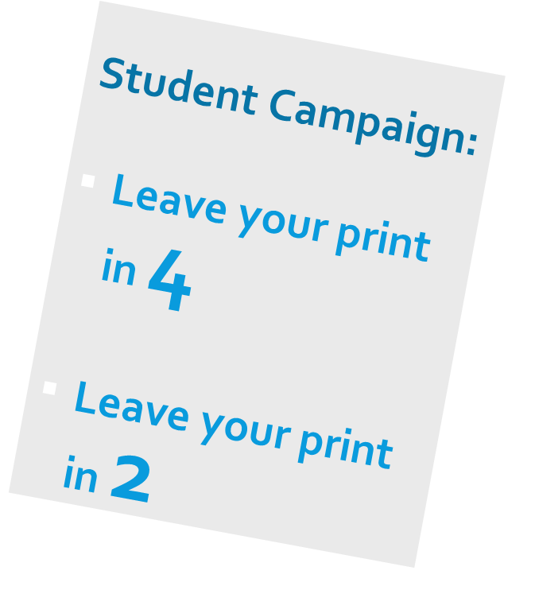

Communications Campaign
Communications Strategy Plan (mid-April)
Tagline and icon for students
Campaign video for students
Graduation Initiative 2025 website and email template for other internal/external stakeholders

Slide 15
GRADUATION INITIATIVE 2025
Thank you.

