Slide 1
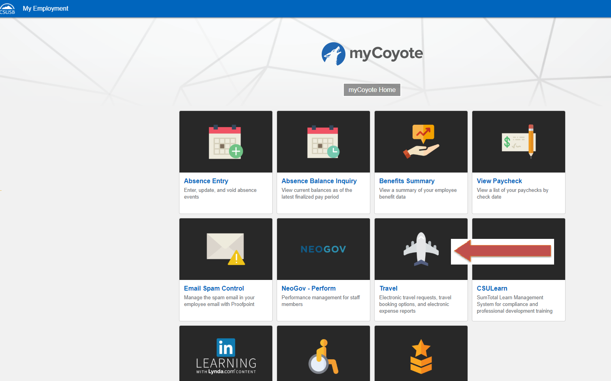
To sign in to Concur: Go to csusb.edu and click on mycoyote.
On the single sign on page, type in your mycoyote ID and password, hit enter and then either choose My Employment or, Administrative Systems and click on the Travel Icon as shown below:

Slide 2
Successful Log On to the Concur Landing page! To begin a Travel Request, click on Requests as shown below:
Notes:
This page is your home page
Go over all information on this page

Slide 3
Click on New Request

Slide 4
Input your travel information on the Request Header. Each required text box is noted by the red on the left of the box. Use the down arrows and the calendar when available on each box. After entering all the required information you may save. If you need the chart field string please contact your division or department administrative person.
When entering a request make sure if you are using non state funds (UEC or Auxiliary) to change to the Auxiliary Policy by clicking the down arrow. This field cannot be changed once request information has been entered.
When entering a chart field string, please begin typing and click on the appropriate fund, department, program is “none”, and project (will generally be “none” unless you are using Auxiliary funding).
If needed you must request your 80% cash advance here. Please deduct the cost of any prepaid items from your cash advance amount.

Slide 5
Click on the small blue Segments or Expenses tab, as shown below to enter your estimated expenses for your trip.
Use Segments for Hotel, Air, Rental Car & Train expense estimates. Use Expenses for all others.
Notes:
This page is your home page
Go over all information on this page

Slide 6
Entering Expenses
Click on New Expense or click on an expense type
to access the next page and enter your estimated travel expense.

Slide 7
When entering your estimated expenses be sure to save after each entry as noted below. When all estimated expenses have been entered you will see a summary on the left side and the total amount requested. You are now ready to submit your request! Hit Submit Request and the approval workflow will appear.
The amounts entered in segments for airfare, domestic hotel and rental car will appear here as estimated expenses in addition to the ones entered from the expenses tab.

Slide 8
Click the orange Submit Request button to confirm the approval workflow and click again to actually submit the request. You will receive confirmation your request was successfully submitted! The approver will get an email alerting them that the request is waiting for their approval.
The approval workflow requires a name in each box. Concur sends approval emails only to the approvers needed from the information that is included in your request. A name in each approval field does not necessarily mean each approver will need to approve a particular request.
Travel Approval will self populate with your travel approver and CANNOT be changed. If this is not correct contact Cindy Levin.
Budget approval is an optional step in the workflow. If your request needs a budget approver, enter an * and choose the appropriate budget approver. You can also click the red X to remove this step from the workflow if your area does not have or require a budget approver.
For exception approval, again click the * and choose the appropriate Dean or VP.
International Trips Only. Will skip these steps if your trip type is NOT International. A name still needs to appear in the field.
Notes:
The Concur approval workflow needs a name in each field to correctly send approver emails to the correct approver based on the information included in the request.

Slide 9
THANK YOU!
If further information or assistance is needed, please do not hesitate to contact Accounts Payable/Travel at 909-537-3158.
Notes:
Updated August, 2017 CL

