Slide 1
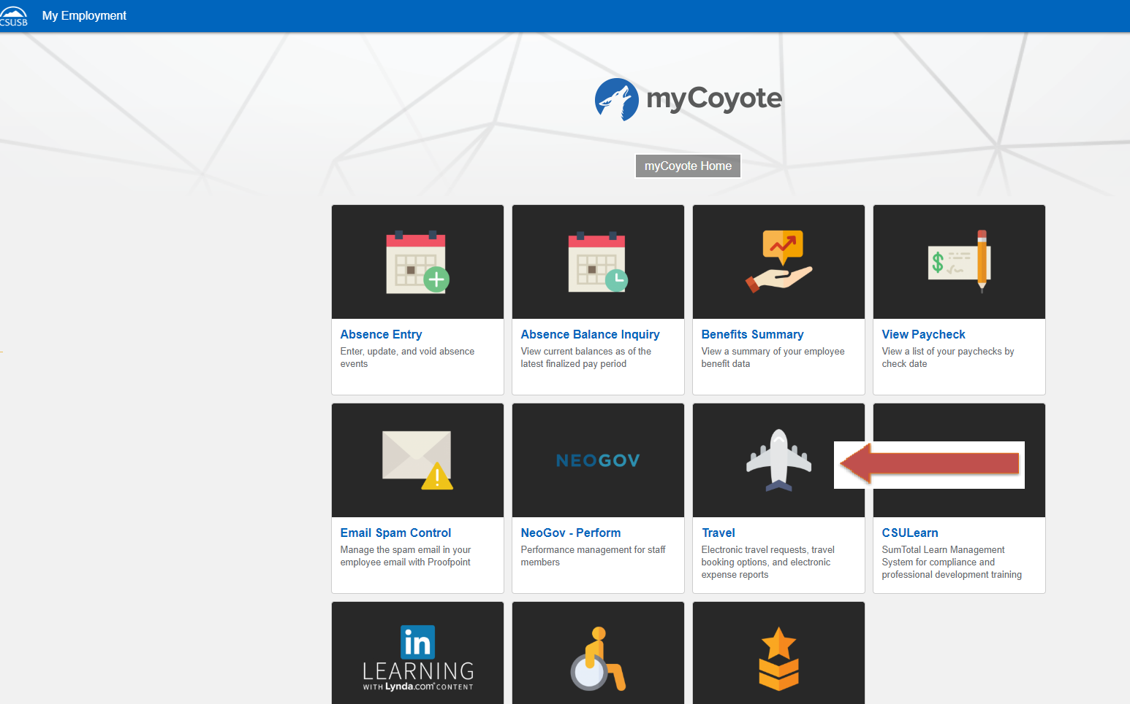
To sign in to Concur: Go to csusb.edu and click on mycoyote.
On the single sign on page, type in your mycoyote ID and password, and hit enter and then either choose, My Employment or, Administrative Systems and click on the Travel Icon as shown below:

Slide 2
Successful Log On! You are now on the Concur landing page.
Notes:
This page is your home page
Go over all information on this page

Slide 3
Updating Your Profile
Click on Profile, then Profile Settings to assign a travel assistant, a travel request and expense report delegate, input frequent flyer and/or hotel and car reward programs and update personal information.

Slide 4
Travel Request OR Expense Approver
The name of your travel approver should appear in this box. If that is not your travel approver please contact Mona Sinha at Manorama.Sinha@csusb.edu to have it changed.
Select Request Approvers

Slide 5
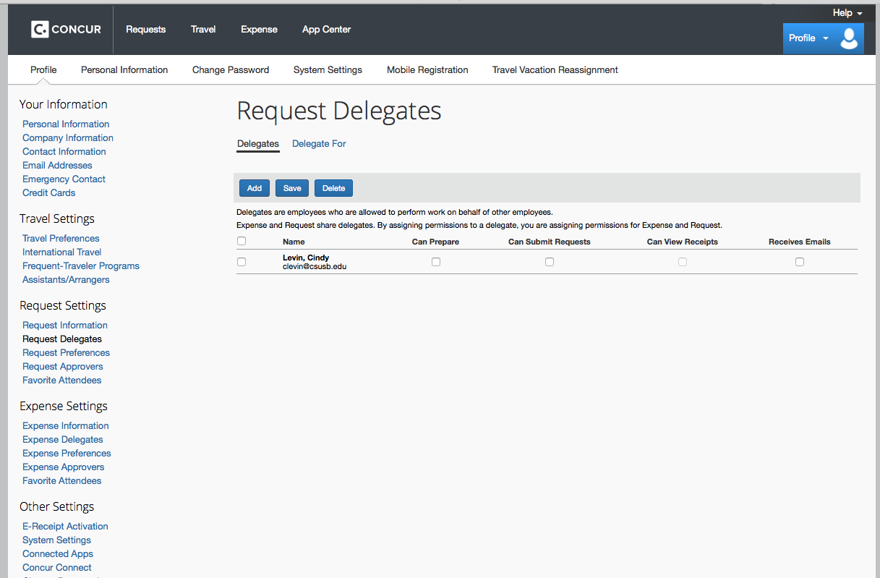
Assigning a Request & Expense Delegate
Search for your delegate by last name, click on the correct person and check the boxes that apply and SAVE! Expense and request SHARE delegates so enter your delegate once either in Request or Expense.

Slide 6
Assigning a Travel Assistant/Arranger
To assign a travel assistant in profile settings, on the left side column choose Assistants/Arrangers under Travel Settings. Click on “add an assistant”, enter their last name and save the entry.

Slide 7
Email Notifications In your profile, click on System Settings and approvers can choose to be notified each time something is put in or removed from their queue OR receive a daily summary. This is available to both approvers and users for email notification changes.
To turn the notification(s) off simply uncheck the box. Notifications can be turned back on by re-checking the box(es).

Slide 8
Thank you!
If further information or assistance is needed, please do not hesitate to contact Mona Sinha, Accounts Payable at 909-537-3158 or manorama.sinha@csusb.edu.

