Slide 1
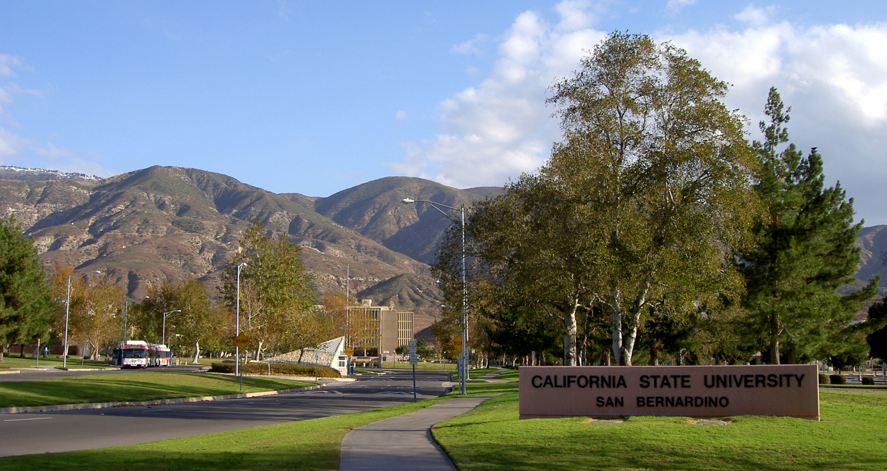
Cal state san bernardino
Campus master plan revision

Slide 2
agenda
Introduction
Project Team
Process Overview
Campus Outreach
Enrollment Demand and Capacity
Campus Experience
Conclusion

Slide 3
Project team

Slide 4
Team organizational Chart
CLIENT
California State University,
San Bernardino
RTKL
Nate Cherry, FAIA
Noam Maitless, AIA
ASSEMBLEDGE+
Richard Thompson, FAIA
PAULIEN & ASSOCIATES
Dan Paulien
Project Management,
Place-Branding, Design Guidelines, Stakeholder Outreach
Campus Master Planning
Academic Strategic Planning, Space Utilization Planning
BENNITT DESIGN GROUP
Todd Bennitt
FEHR & PEERS
Jason Pack
INTEGRAL GROUP
Lisa Fay Matthiessen
P2S ENGINEERING
Aravind Batra
BASIS
Rick Lloyd
Landscape Planning and Architecture
Mobility Analysis, Modeling and Planning
Sustainability Planning and Implementation Strategies
Infrastructure Analysis and Planning
Cost Controls

Slide 5
Who are THE RTKL/Assembledge+ TEAM?
Rtkl associates inc.
is an international architecture and Planning firm with one of the strongest portfolios of urban design and master planning in California.
- Over 250 public planning projects nationwide in the last 10 years
- 100+ Completed Master Plans in California…
- Currently completing 6 Major Specific Plans across the US:
- 20 major design awards over the last 15 years
- 9 APA Awards
- ULI Grand Award (LA LIVE)

Slide 6
Who are THE RTKL/Assembledge+ TEAM?
Richard THOMPSON, faia
has more than 40 years of campus planning experience
- 28 college and university master plans
- 6 for CSUS campuses
- Hands-on visionary who led each master plan
- retired last year from AC Martin after 18 years as principal for
urban design and planning
- Joined his son David’s architectural firm, assembledge+
Dan Paulien
is a nationally recognized academic planning consultant Who has worked on over 650 campuses around the country
OUR Consultant Team are the best in the nation in each of their disciplines
and have all worked together previously

Slide 7
Process
overview

Slide 8

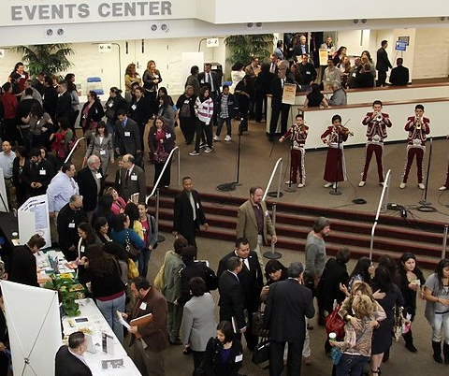

GOALS OF THE CSUSB MASTER PLAN
Upgrade Academic Facilities & Accommodate growth
Creating a collegial, aesthetic, 24/7 campus that supports learning
Incorporate near-term projects
Celebrate the Surrounding Environment
and promote sustainability
Enhance internal and external connectivity
Elevate the Cal State San Bernardino ‘brand’
Engage and positively impact the community
Next Steps

Slide 9
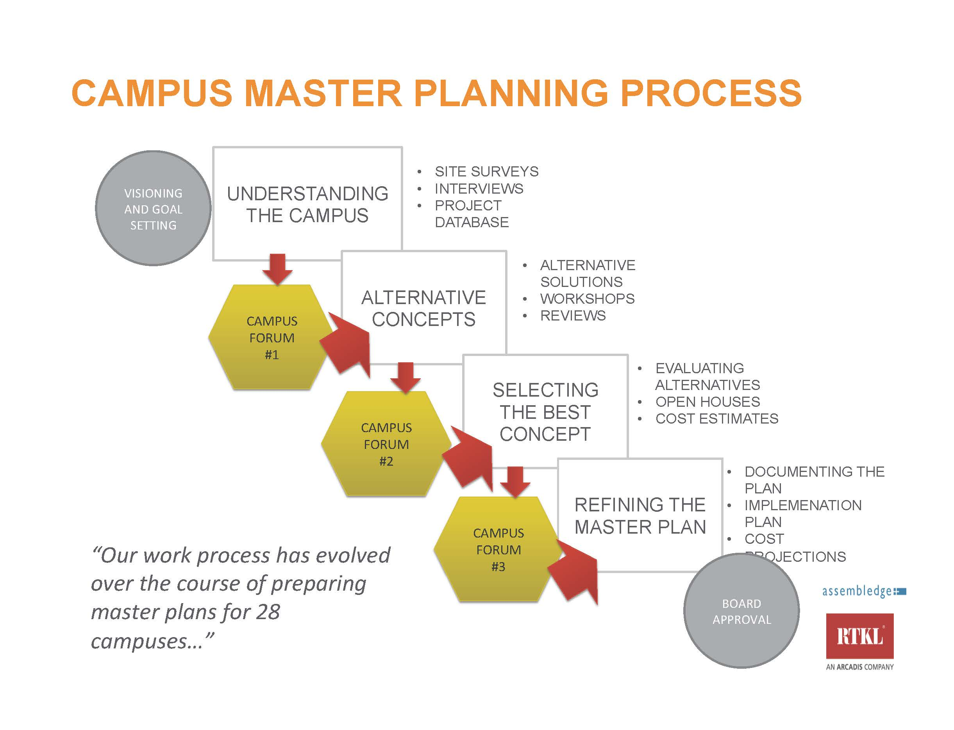
Master planning process
SPRING QTR. SUMMER QTR. FALL QTR. WINTER QTR. SPRING QTR.

Slide 10
Scope
PART 1: UNDERSTANDING THE CAMPUS/CONFIRMING THE VISION
Task 1 Project Initiation
Task 2 Data Collection and Analysis
Task 3 Potentials and Constraints
Task 4 Confirm and Articulate CSUSB Vision
Task 5 Campus Planning Forum #1
PART 2: CAMPUS MASTER PLAN DESIGN CONCEPTS
Task 6 Alternative Master Plan Scenarios
Task 7 Campus Planning Forum # 2
PART 3: REFINE PREFERRED CONCEPT
Task 8 Review and Refine Preferred Master Plan Concept
PART 4: DRAFT MASTER PLAN
Task 9 Draft Master Plan
Task 10 Campus Planning Forum # 3
PART 5: FINAL MASTER PLAN
Task 11 Final Master Plan
PART 6: SUPPORT FOR ENVIRONMENTAL IMPACT REPORT (EIR)

Slide 11
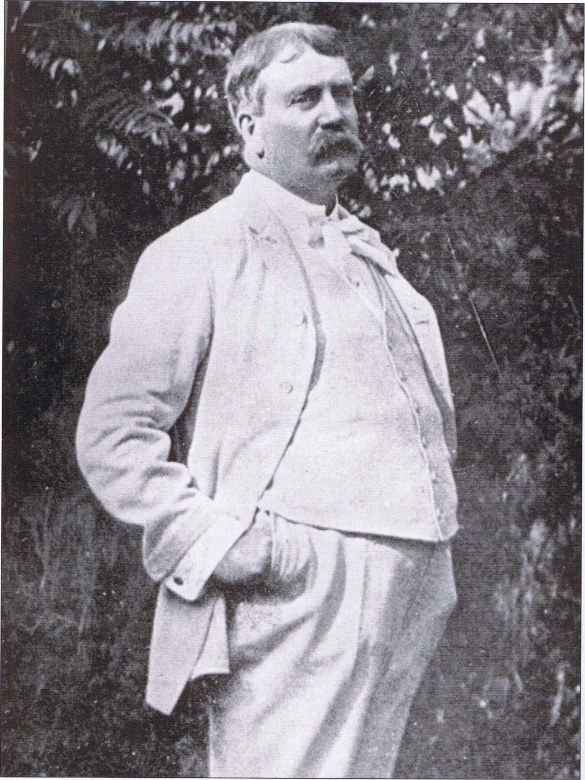
“Make no little plans.
They have no magic
to stir men's blood...”
Daniel Burnham
Notes:
Educational outcomes should be predictable, as should the outcomes of building design. It should be based in the accumulation and build-up of knowledge and research.
Research shows that in order to have a interactive collaborative environment that supports creativity, you mush have these attributes:
Views to nature
Light
High ceilings
Comfortable
Variety of spatial types
Food
Indoor or Outdoor
Gathering

Slide 12
Campus
outreach

Slide 13
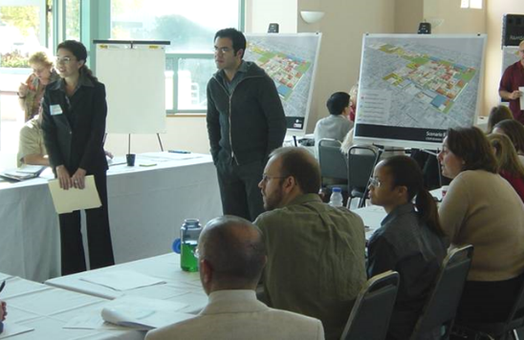
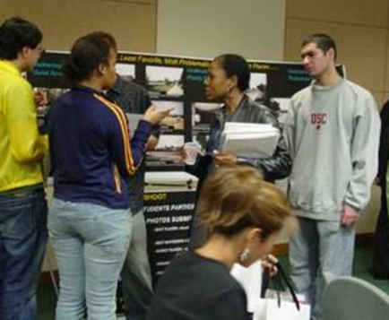
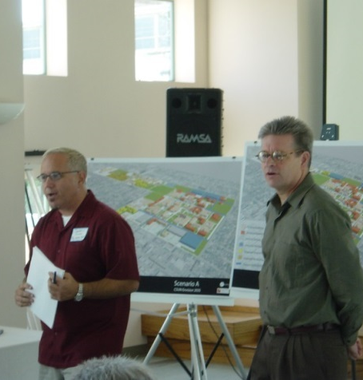
Dialogue and collaboration are critical to the success of any master plan.

Slide 14
CSUSB STAKEHOLDERS
Government
Local Government
City Department of Planning
City Public Works
County Government
Institutions
University Faculty and Staff
University Administration
Cal State Governance
Students and Student Groups
Alumni and Prospective Students
Advisory Committees and Advocacy Groups
Business
Chamber of Commerce
Local Restaurants
Local Professionals
Local Retail
Hospitality
Community
City Residents
Local and Regional Residents
City-wide Influencers
University Families
Homeowners’ Associations
Local Advocacy Groups

Slide 15

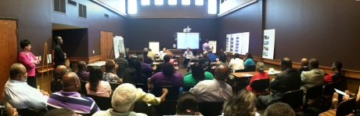

CAMPUS FORUMS -Transparent and open
CAMPUS FORUM ONE:
Introduce Planning process and Gather Input from Key Stakeholders
CAMPUS FORUM TWO:
Vet Alternative Plans, Secure Feedback
CAMPUS FORUM THREE:
Present Final Recommendations, Procure Buy-In

Slide 16
FORUM NO. 1 AGENDA
  Introduction: President Tomás D. Morales
  The Master Plan Consulting Team
  Purpose of the Master Plan
  Summary of Vision Statement
  Process Description and Schedule
  Campus Background and Existing Conditions
  Discussion of campus issues
  - What are the most important issues that should be addressed
  in the Master Plan?
  - What are the best things about the CSUSB campus?
  - What are the worst things about the CSUSB campus?

Slide 17
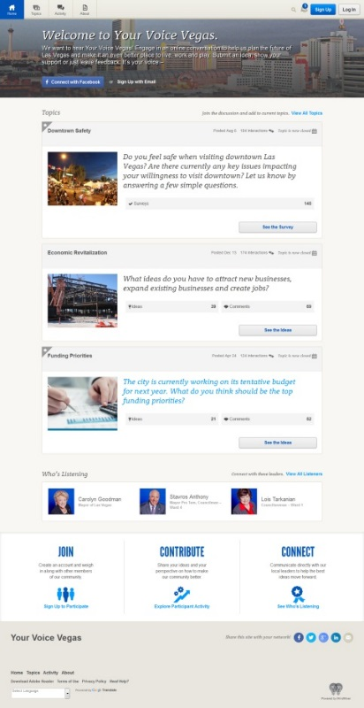
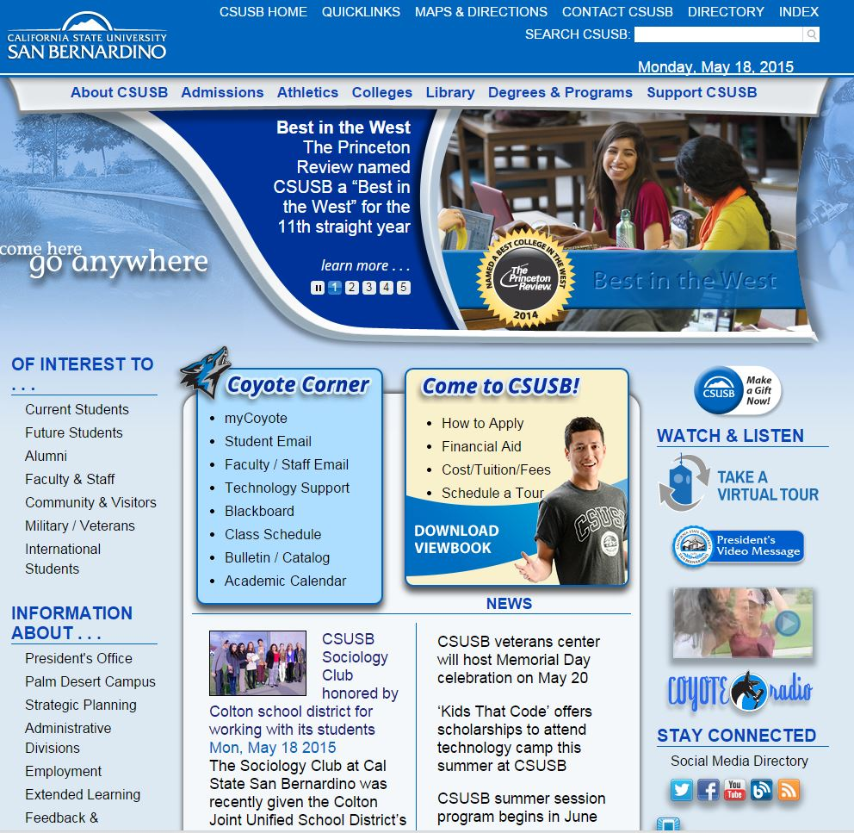
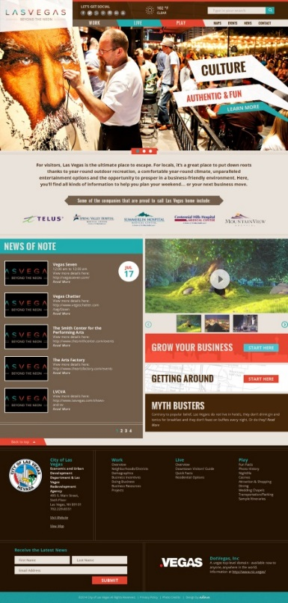
ONLINE TOOLS
Campus Web Site
and other online portals

Slide 18




ONLINE TOOLS
Social Media and 24/7 Interactivity, Project Communication,
and Data Collection

Slide 19
Campus
assets

Slide 20
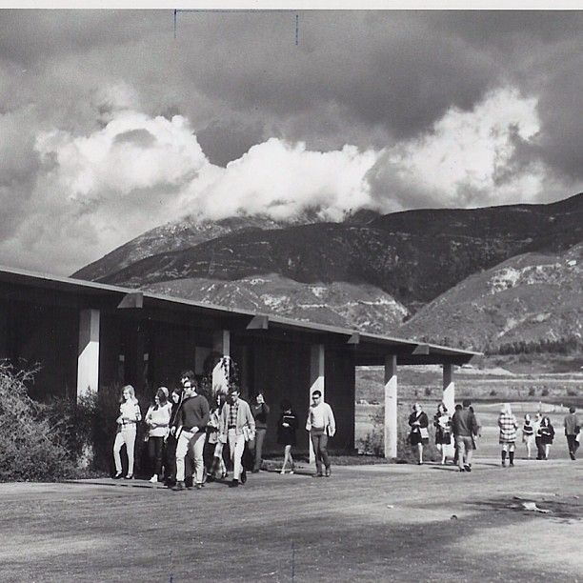
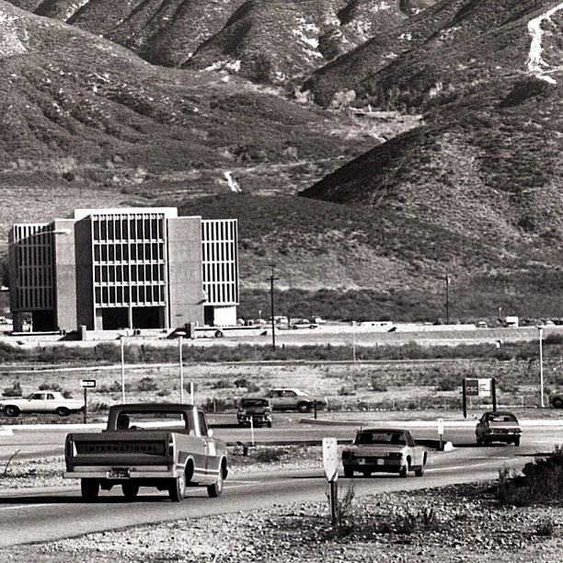
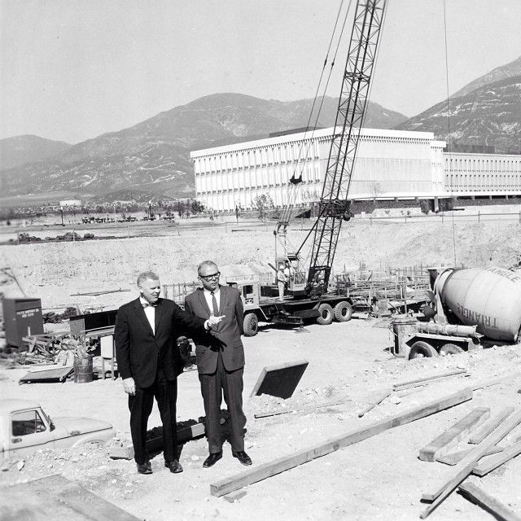
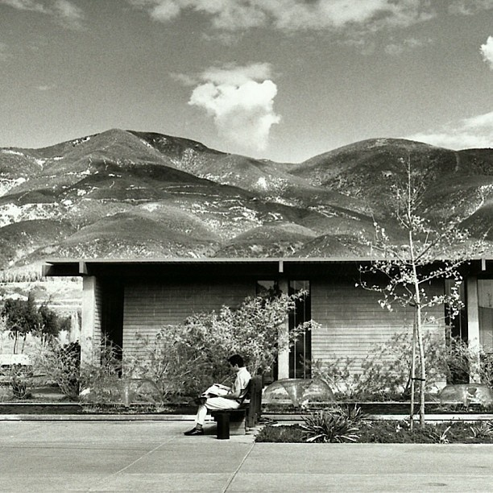
RESPECT THE CAMPUS HERITAGE
BUILD UPON THE CAMPUS LEGACY

Slide 21
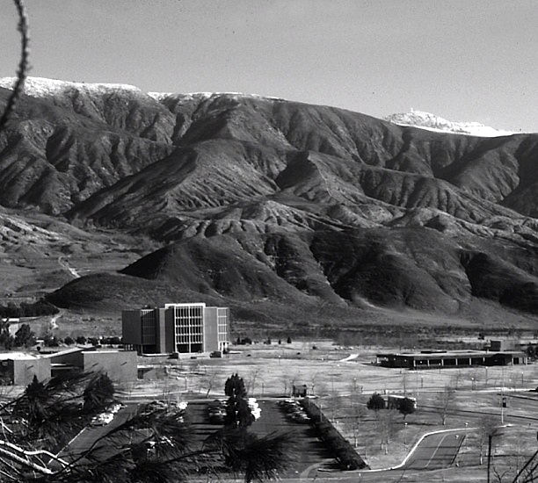
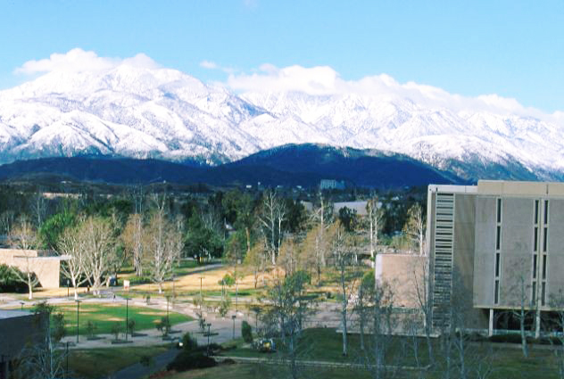
PROMOTE THE CAMPUS SETTING
SHOWCASE THE SAN BERNARDINO MOUNTAINS

Slide 22

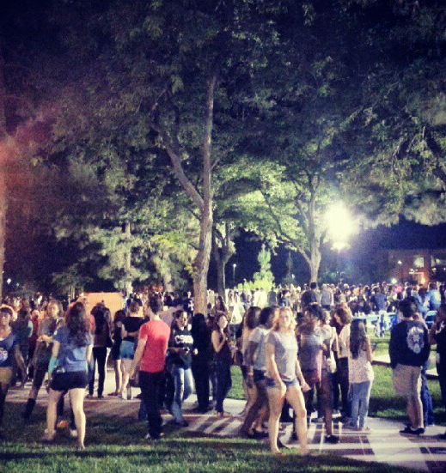

CELEBRATE CAMPUS CULTURE
RESPECT CAMPUS TRADITIONS

Slide 23
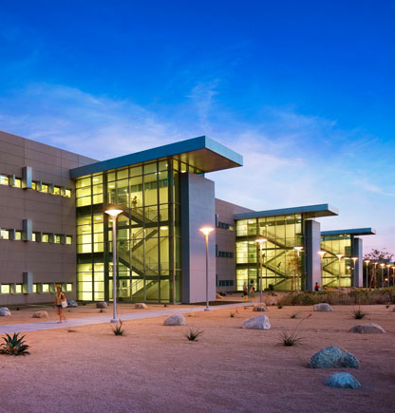
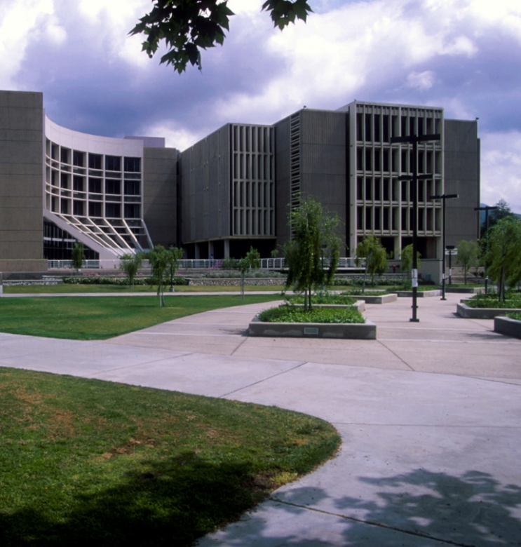
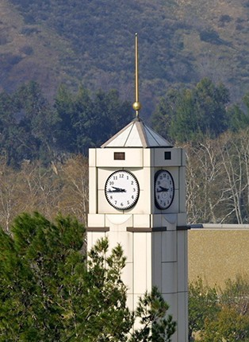
HARMONIZE CAMPUS ARCHITECTURE
ESTABLISH DESIGN GUIDELINES

Slide 24
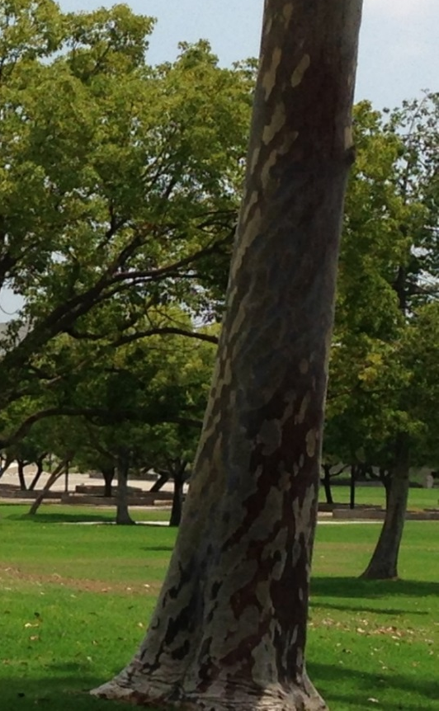
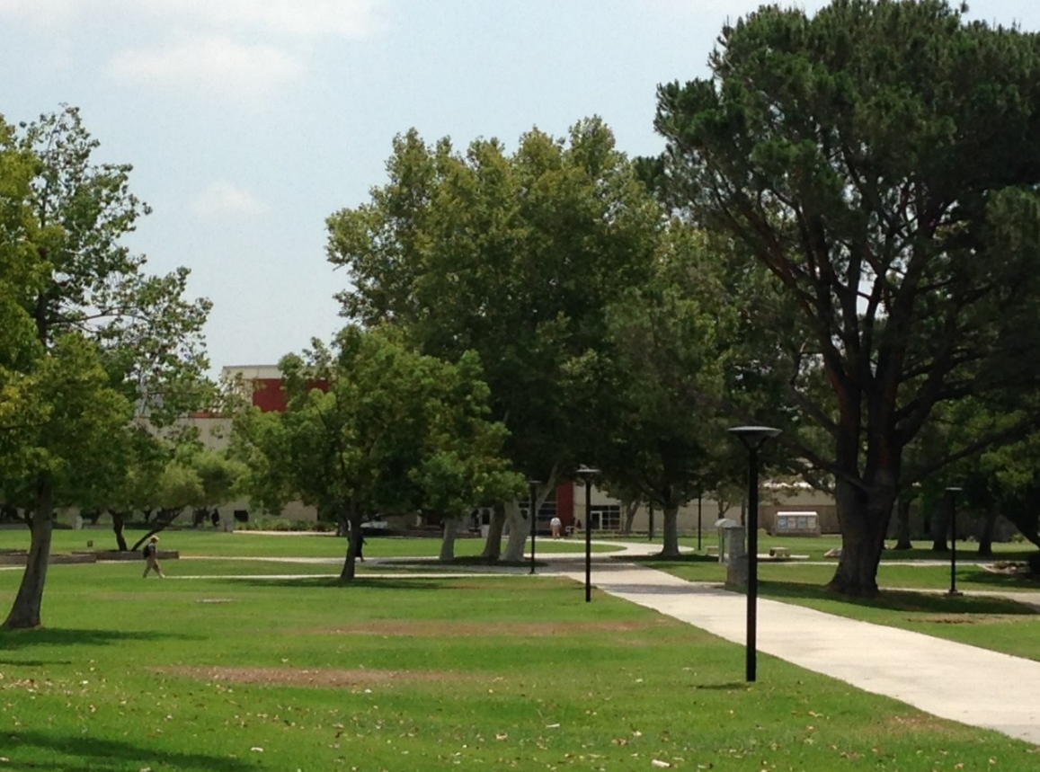
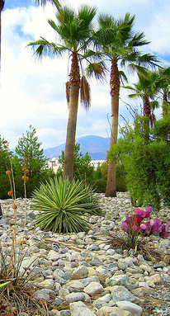
SUPPORT A SUSTAINABLE CAMPUS LANDSCAPE
PROVIDE SHADE, REPLACE TURF AND REDUCE WATER USE

Slide 25
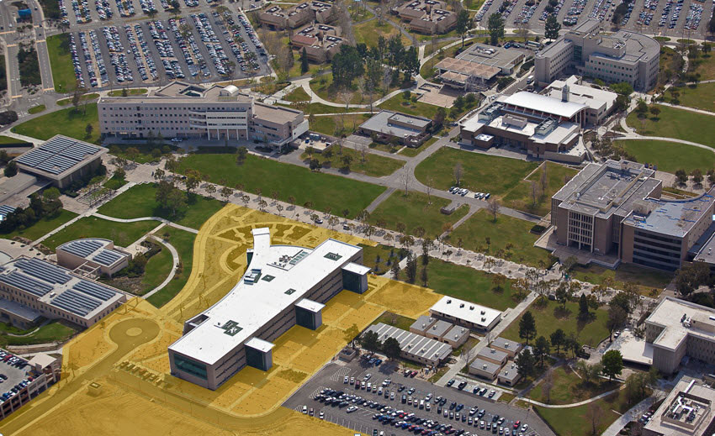
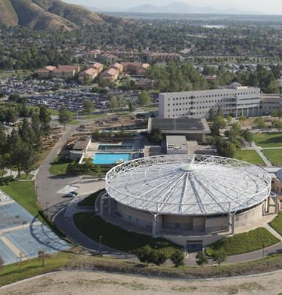
BUILD UPON CAMPUS ORGANIZATIONAL STRUCTURE
INFILL WITHIN EXISTING CAMPUS TO CREATE MORE HUMAN-SCALED OPEN SPACES

Slide 26
THE PSYCHOLOGY
OF CAMPUS DESIGN
why is it important?

Slide 27
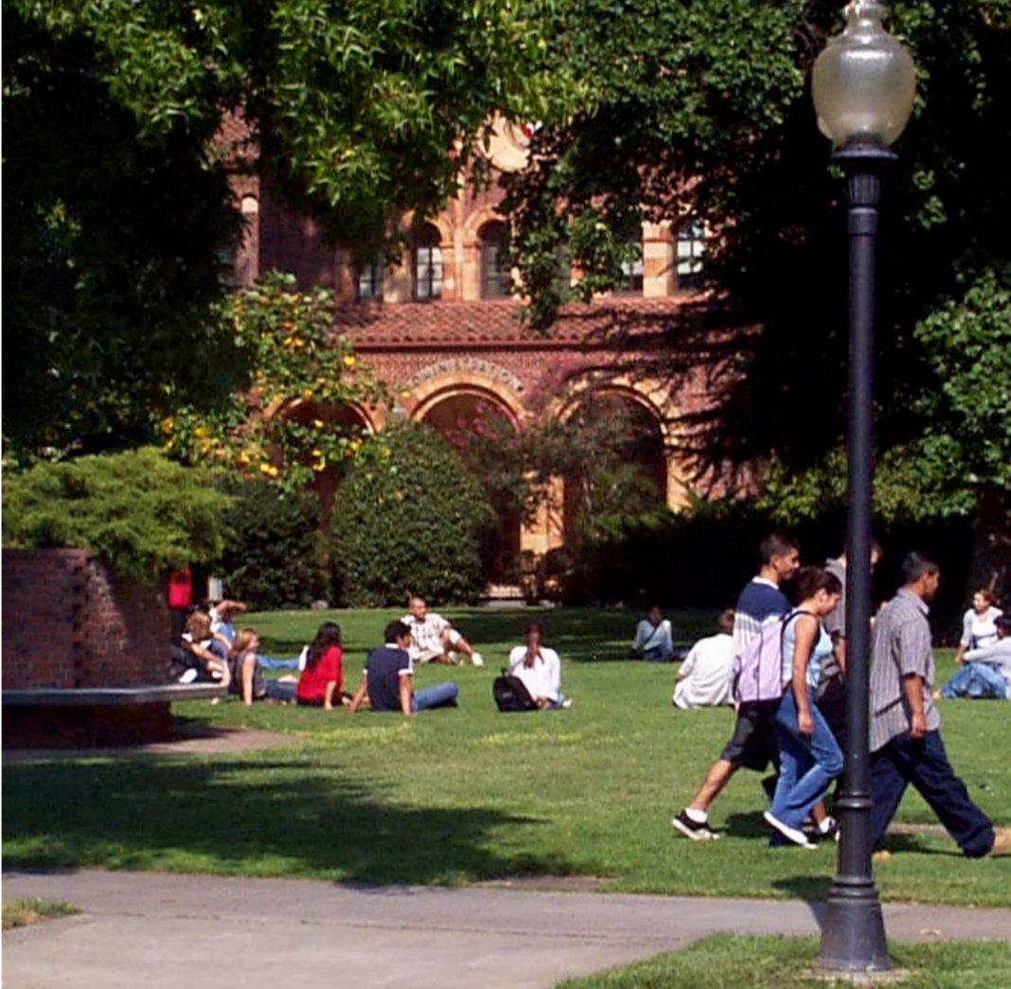
THE CAMPUS CAN BE A TOOL FOR LEARNING
“…research has shown that the campus physical environment can make a significant contribution to the quality of the educational experience for young students during an extremely important period of the emotional maturation of their brains…”
Dr. Susan Painter, Ph.D., FCPA
Developmental Psychologist
Campus Planner

Slide 28
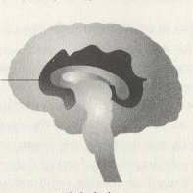
PERSON-ENVIRONMENT RELATIONSHIP
MOTIVATION
&
LEARNING
EMOTIONAL
RESPONSE
Student-campus
relationship
Limbic Brain
Mother-child
relationship
SENSORY
EXPERIENCE
OF THE
ENVIRONMENT
Notes:
The limbic brain is also where motivation and learning and sensory experiences of the environment are processed. Because this part of the brain evolved earlier, limbic functions take precedence—feeling trumps thinking every time.

Slide 29
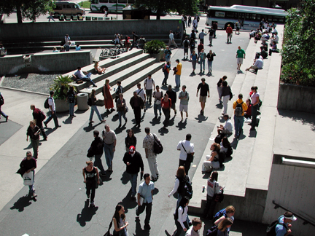
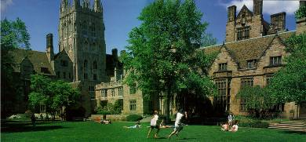
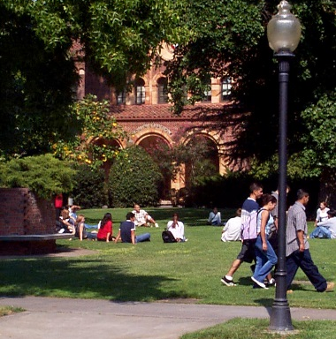
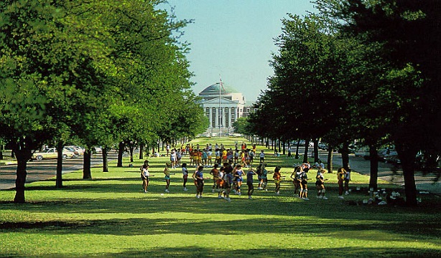
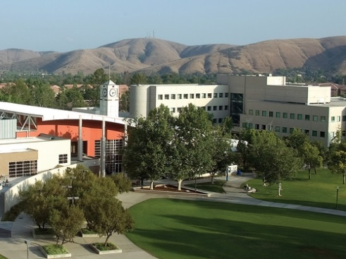
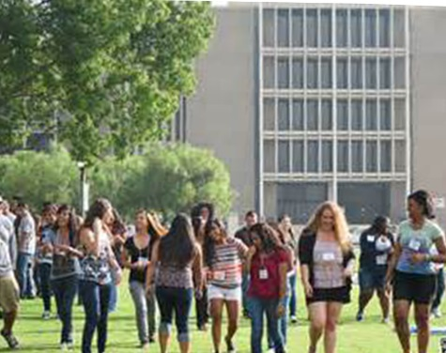
How?
The physical environment is the brain’s tool for organizing our experiences.
Cognitive, social and emotional experiences are “filed” in
the brain under the places where they happened.

Slide 30
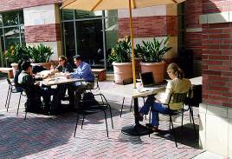
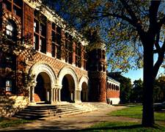
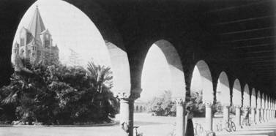
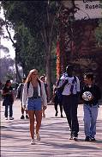
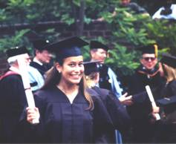
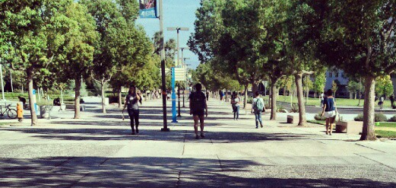
How?
Environment patterns signal the brain: “all is well”
A memorable campus can…
engage & motivate students
support higher retention & graduation rates
improve alumni involvement and help with student & faculty
recruitment

Slide 31
Enrollment demand and capacity

Slide 32




Today’s students
Always connected
Expect full and immediate access to media and information
Create and consume large amounts of information
Active, social, visual learners
Constant visual, multi-sensory technology use
Value the on-site campus experience
Consumer-oriented but expect everything to be on-line
Want to use technology to express creativity
Want technology for collaboration
Prefer authentic experiences
Global thinkers
Blend their social and academic lives

Slide 33
Bridging the gap
External Analysis
Internal Analysis
Population Projections
- Age
- Income
- Educational Attainment
- Ethnicity
Occupational/Labor Analysis
- Employment Projections
- Industry Outlook
- Unemployment
- Labor Force Skills
Participation Rates
High School Grad Projections
Residence Migration
Competition
Technology
Historic Enrollment Analysis
  - Age
  - Full-Time /Part Time
  - Gender
  - Ethnicity
  - FTE/Headcount Ratio
  - Placement Level
Current Degrees/Certificates
- Technical Degrees Granted
- Transfer
- Workforce Training
Enrollment Management
Recruitment/Marketing
Retention Rates/ Grad Rates
Faculty Ratios
Distance Learning
GAP
Strategic and Academic Planning

Slide 34
Csusb: Trends in COLLEGE majors

Slide 35
Csusb Demographic trends and degrees awarded

Slide 36
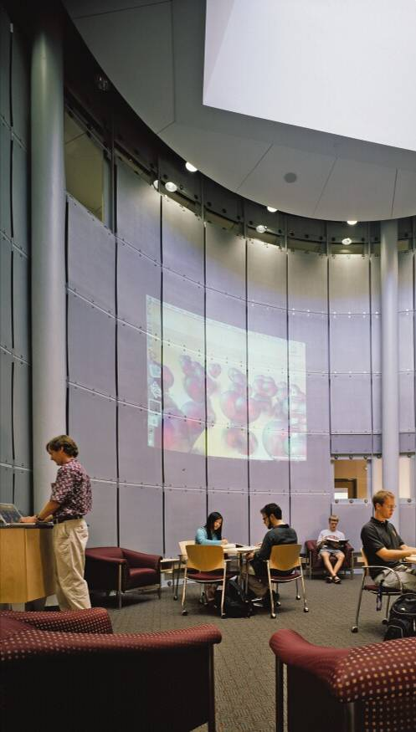
Learning trends
TRADITIONAL PEDAGOGY
CONTEMPORARY PEDAGOGY
Teacher-centered instruction
Single sense stimulation
Single path progression
Single media
Isolated work
Information Delivery
Passive Learning
Factual, Knowledge-based
Literal thinking
Reactive response
Isolated, artificial content
Student-centered instruction
Multi-sensory stimulation
Multi-path progression
Multimedia
Collaborative work
Student-centered activities
Active / Exploratory
Information exchange
Inquiry-based learning
Proactive / planned action
Authentic, real-world content

Slide 37
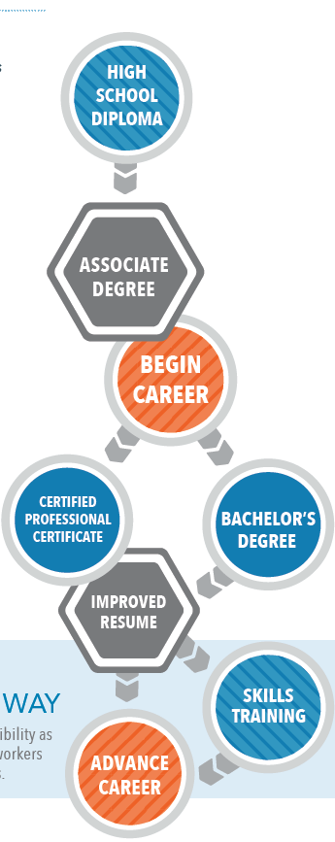
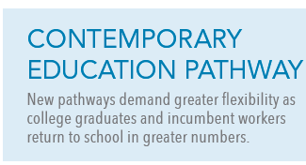
Flexibility and credentials
The new reality requires transition from the simple, ultra-linear 20th century model to one that involves an ongoing need for additional skills in a rapidly changing workforce.
Instructional Technology and its changing impact on higher education
Program Realignment
Alternative Delivery
Changing Credentials and other Postsecondary training models
  Badges (credential non-credit learning)
  Competency-based learning
  MOOCS
  Dual Enrollment
  Modularized Degree (multiple entry and exit points)

Slide 38

Successful
CAMPUS
PRECEDENTS

Slide 39
CSUSB Campus CHALLENGES
AND illustrative examples :
DEMAND/CAPACITY ANALYSIS
- CSU Northridge
24/7 CAMPUS
- CSU Chico
SUSTAINABILITY
- CSU Sacramento
PLACEMAKING
- CSU Chico
- USC
CAMPUS ORGANIZATIONAL FACTORS
- CSU Dominguez Hills

Slide 40
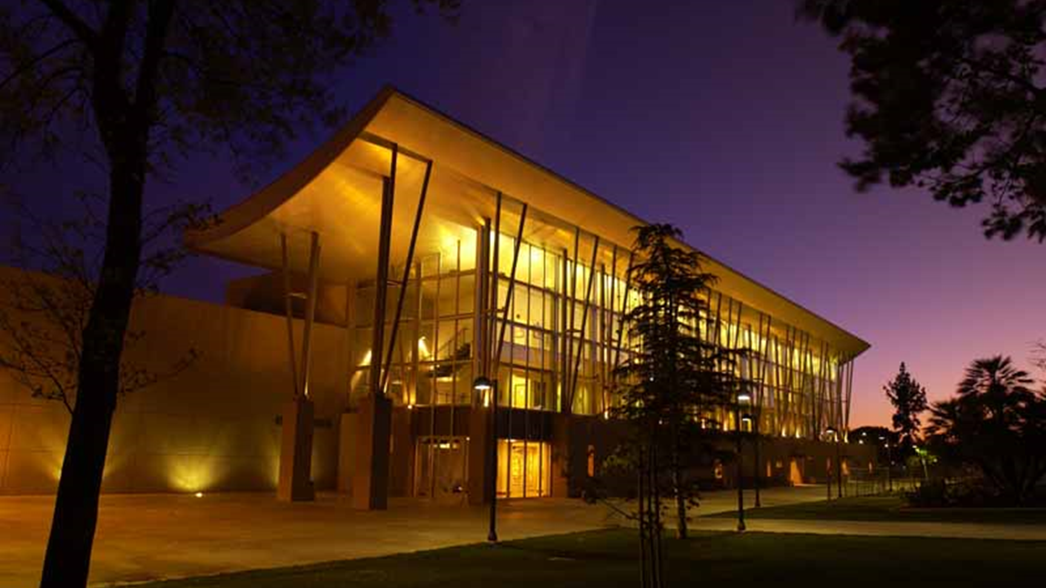
Master plan
Csu northridge

Slide 41
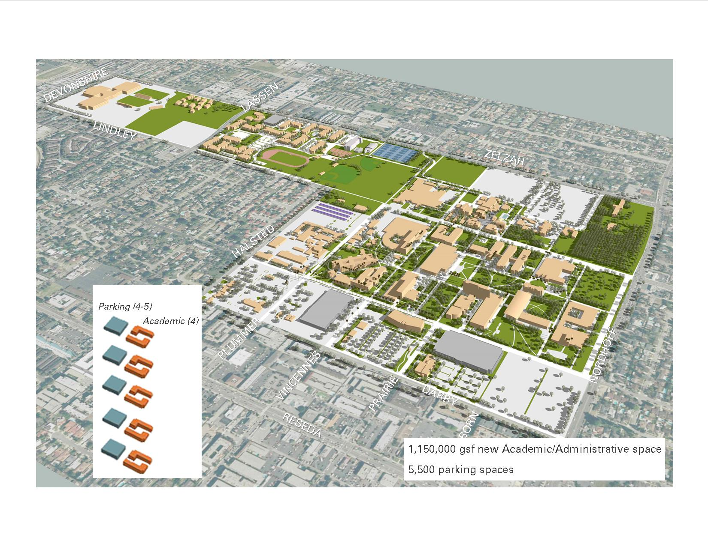
Accomodating
growth
Csu northridge master plan
GROWING THE CAMPUS FROM 25000 STUDENTS TO 35000 STUDENTS

Slide 42
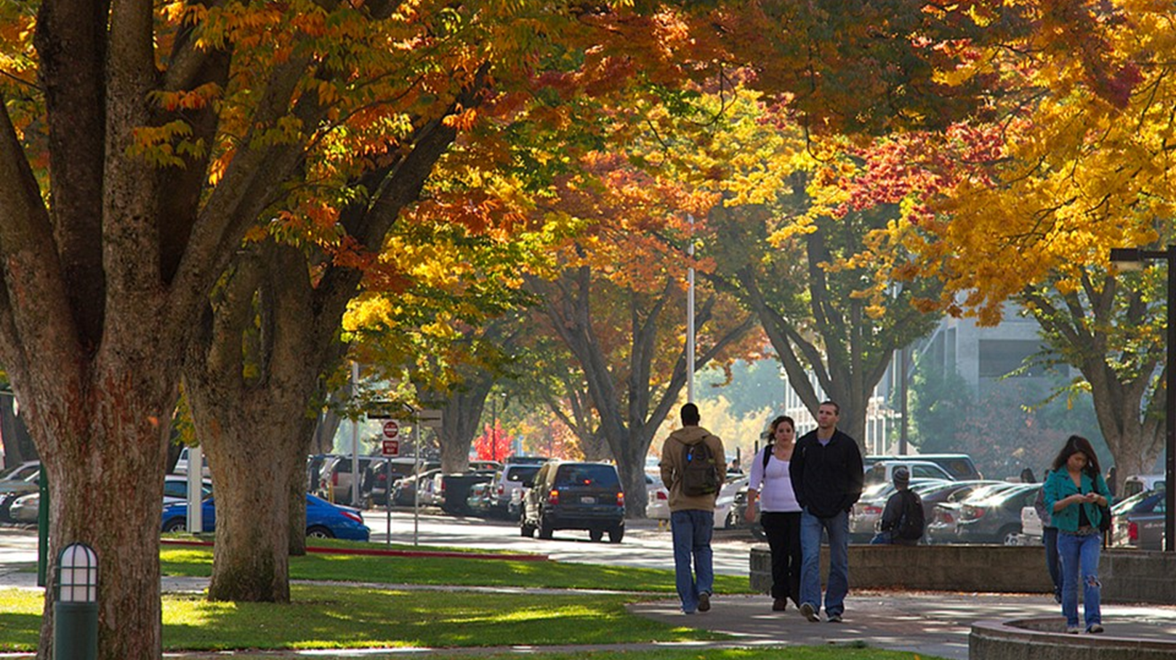
Master plan
Sacramento state university

Slide 43
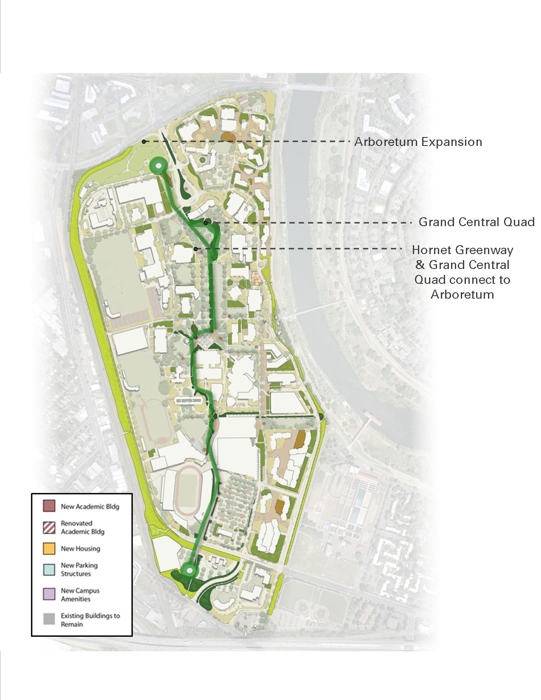
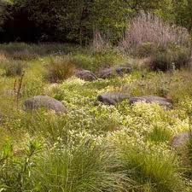
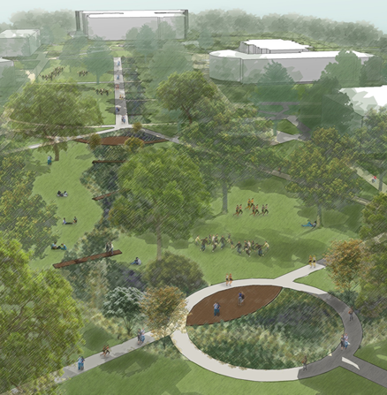
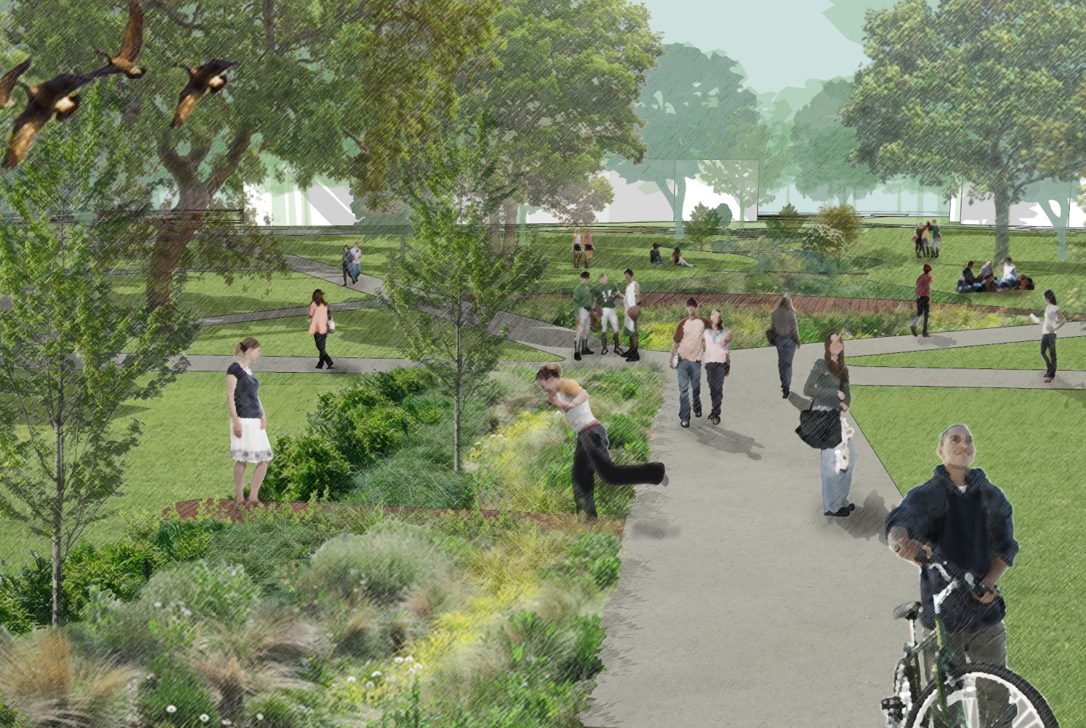
Hornet greenway
Sacramento state university
STORM WATER MANAGEMENT AND AN AESTHETIC LANDSCAPE ENCHACEMENT
Building run-off directed to rain-gardens for cleaning

Slide 44

Master plan
Csu fullerton

Slide 45

Master plan
Csu fullerton

Slide 46









ARTS PRECINCT
Student
Union
Library
Visual
Arts
Performing
Arts
Parking
Structure 1

Slide 47

Master plan
CSU CHICO

Slide 48



Master plan
Csu chico
NEW HOUSING
DINING
ACADEMIC
CORE
LIBRARY
NEW REC
CENTER

Slide 49


NEW STUDENT HOUSING AND DINING
Csu chico

Slide 50




NEW recreation center

Slide 51

Master plan
Csu
dominguez hills

Slide 52

Pedestrian circulation and open space
Csu dominguez hills
Images courtesy of AC Martin

Slide 53

Vehicle circulation and parking
Csu dominguez hills
Images courtesy of AC Martin

Slide 54

Illustrative master plan
Csu dominguez hills
Images courtesy of AC Martin

Slide 55

Master plan
usc

Slide 56

usc
Master plan
NEW STUDENT UNION
TROUSEDALE
MALL
NEW UNIVERSITY ILLAGE

Slide 57








Trousedale pedestrian mall

Slide 58

University village
usc
Student housing, retail, and academic

Slide 59

Usc university village
VILLAGE CENTER
Retail and academic
NEW STUDENT HOUSING

Slide 60


Slide 61

“Plans are nothing;
planning is everything”.
Dwight D. Eisenhower
Notes:
Educational outcomes should be predictable, as should the outcomes of building design. It should be based in the accumulation and build-up of knowledge and research.
Research shows that in order to have a interactive collaborative environment that supports creativity, you mush have these attributes:
Views to nature
Light
High ceilings
Comfortable
Variety of spatial types
Food
Indoor or Outdoor
Gathering

Slide 62
THANK YOU!

