Slide 1
CAMPUS MARKETPLACE
One-stop shop to preferred suppliers and contract pricing

Slide 2
Contents
What is the Campus Market place?
Supplier Overview
Logging In
Shopping Overview
Placing Orders

Slide 3
Contents
What is the Campus Market place?
Supplier Overview
Logging In
Shopping Overview
Placing Orders

Slide 4
What is the Campus Marketplace?
The Campus Marketplace is an online shopping site that features suppliers and special CSU contract pricing. The site is shared across 15 other CSU campuses including Bakersfield, Chico, East Bay, Los Angeles, Pomona, Sacramento, San Diego, San Francisco, San Luis Obispo and San Marcos. Together the campuses have created a common website, identified suppliers, and provided discounted pricing for the campus users.

Slide 5
Supplier Overview

Slide 6
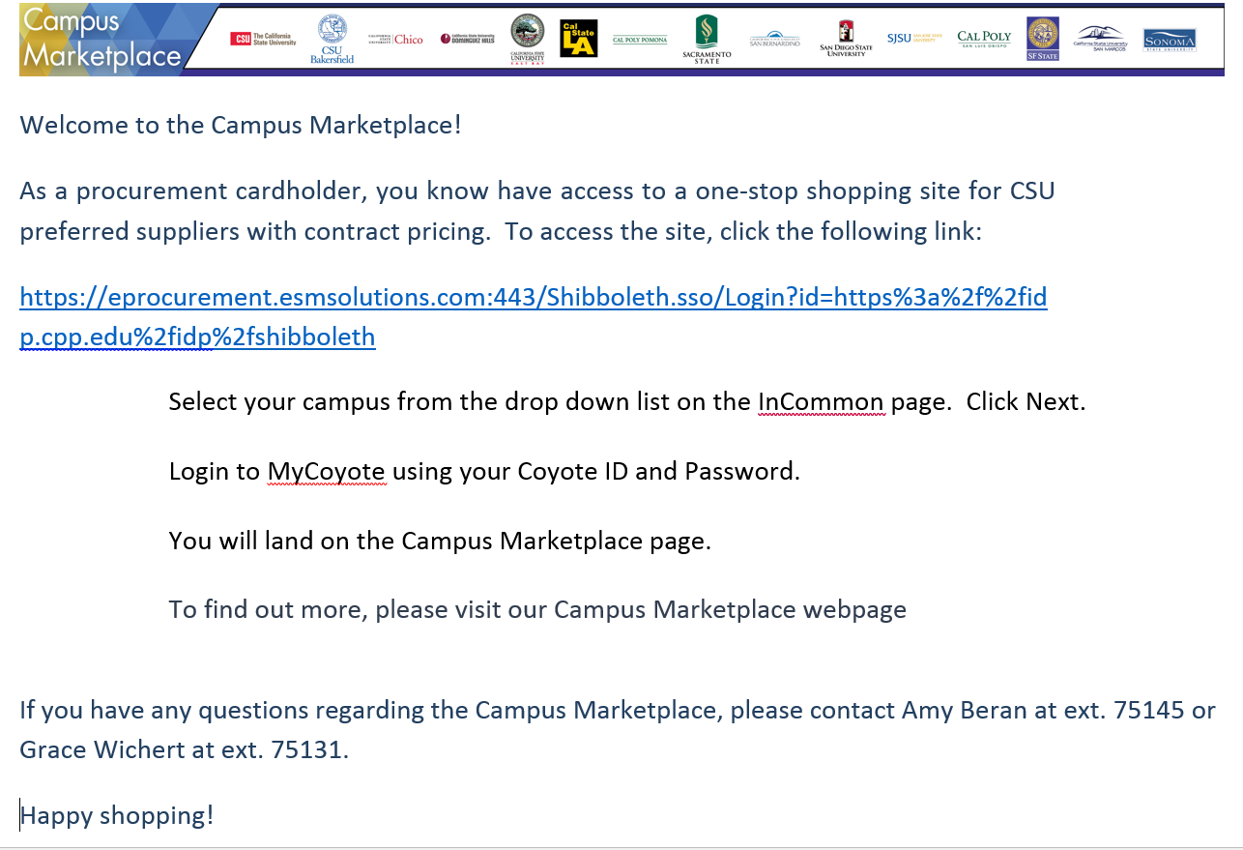
Logging into Campus Marketplace
As a procurement card holder, you are automatically enrolled as a user for the Campus Marketplace. You will receive an email notification from your system administrator similar to below, that will include the link and instructions on how to login:

Slide 7
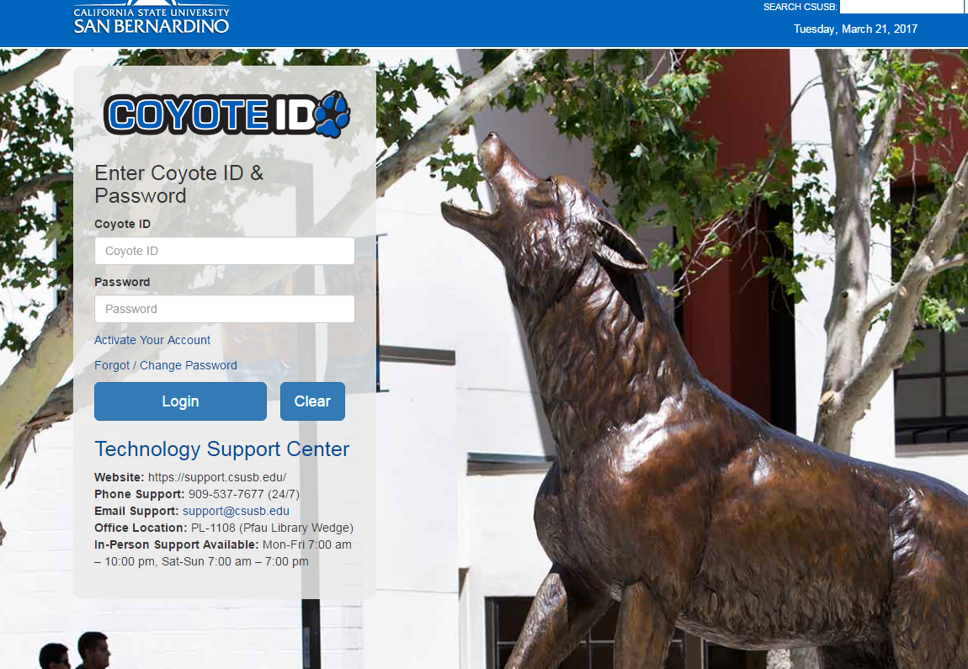
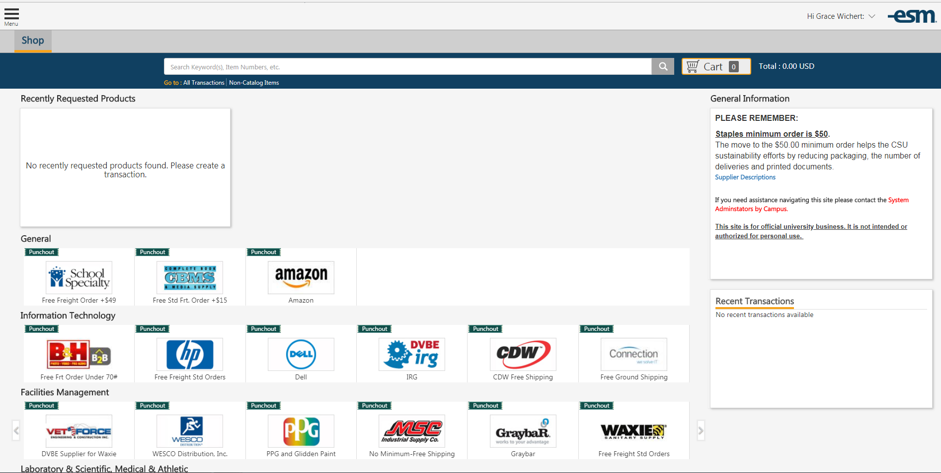
From InCommon page, select your campus
Login to the campus portal using you Coyote ID and login. Once you login, you will be directed to the Campus Marketplace website.
Once you login, you will be directed to the Campus Marketplace shopping page.

Slide 8
Shopping Overview
The Marketplace shopping page consists of 4 main components:
Recently Requested Products provides a list of the most recently viewed products.
Information box provides general information shared by campuses, including a link to the Administrator’s contact information.
Catalog box containing the logos from all participating vendors.
Recent Transactions box provides a list of the recently completed purchases.

Slide 9
There are two types of catalogs: Punch-out and Hosted Catalog
Hosted Catalogs
Punch-Out Catalogs
Transaction is processed completely within ESM site
Local, regional supplier
Excel spreadsheet from supplier
Stagnant data
Suppliers less technically capable
Supplier manages own site/updates items & prices continuously
Most national Suppliers
Dynamic link, electronic connection from supplier with full catalog
Shop within Supplier site, but still remain connected to the ESM site
Supplier receives order at ordering info center
Seamless

Slide 10
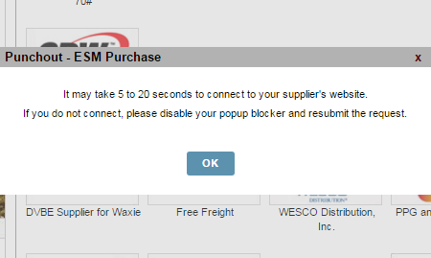
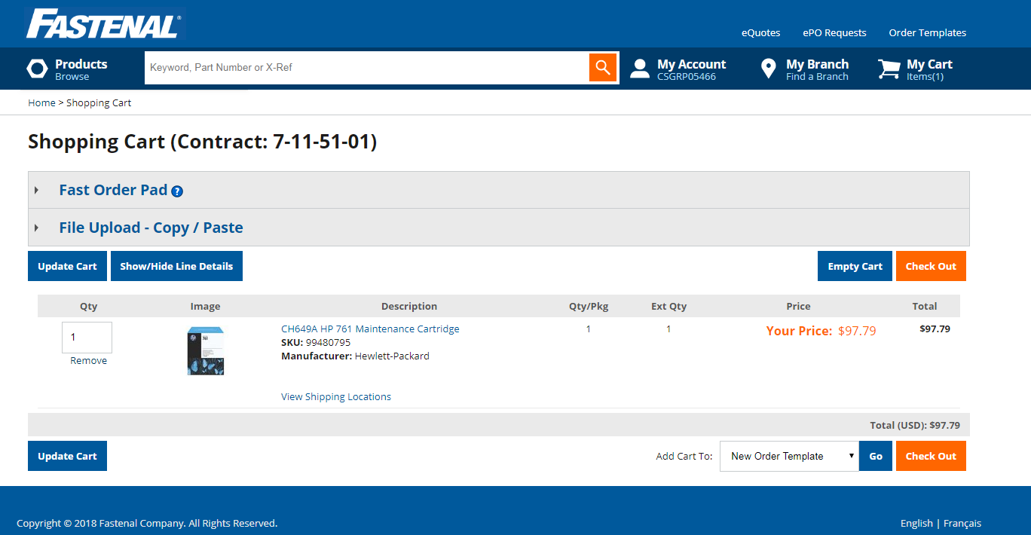
Placing an Order
From the shop page, select the catalog you would like to order from.
If the catalog is a punch-out, you will see this message. Press OK or wait for the catalog to load.
**Note: When using a punch-out catalog, please make sure that your pop-ups are enabled**
Once the catalog loads, select the item(s) you want to order and add them to your cart. When you have added all items, go to your cart and click the Checkout button.
*Note that each supplier and catalog terminology may vary. Some vendors my have an additional screen for checkout.

Slide 11
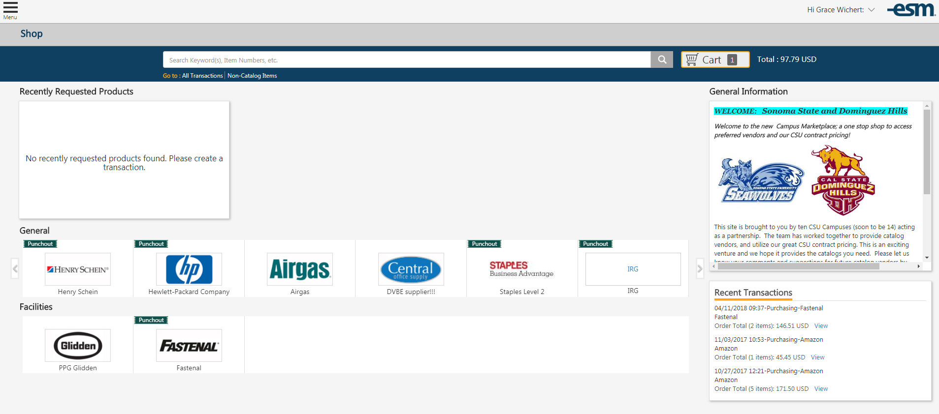
You will punch back in to Campus Marketplace.
The items are now in your cart.
Press the Cart button to view item(s).
Delete or update item(s), optional.
When done, click Checkout.

Slide 12
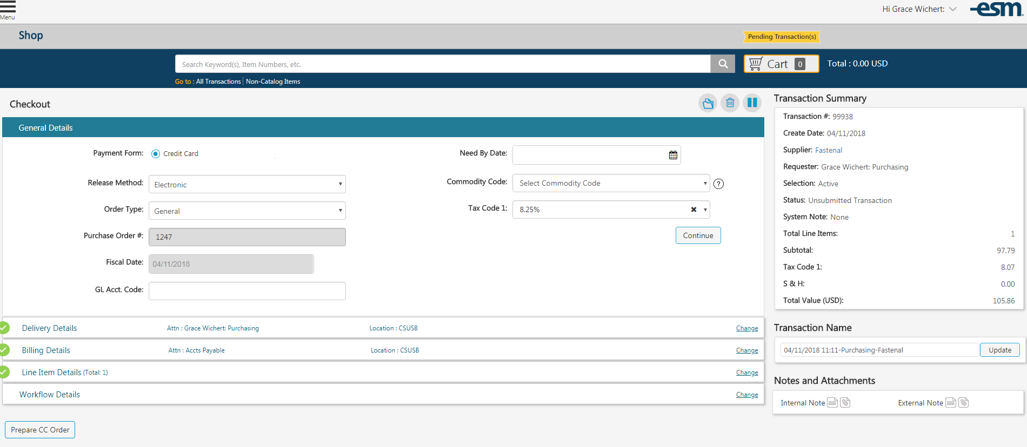
You will receive a check out box advising you that your cart will be converted to a transaction.
By selecting yes, it will bring you to your checkout page.
**You can click on each of the lines on this page to see delivery information, billing and line item details.
Click on Prepare CC Order

Slide 13
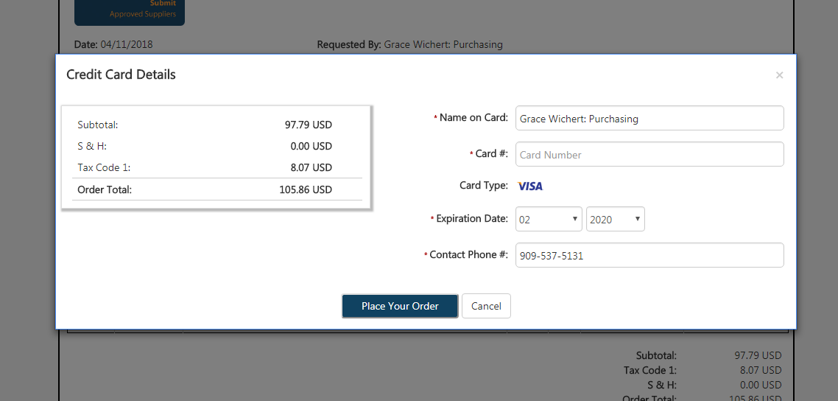
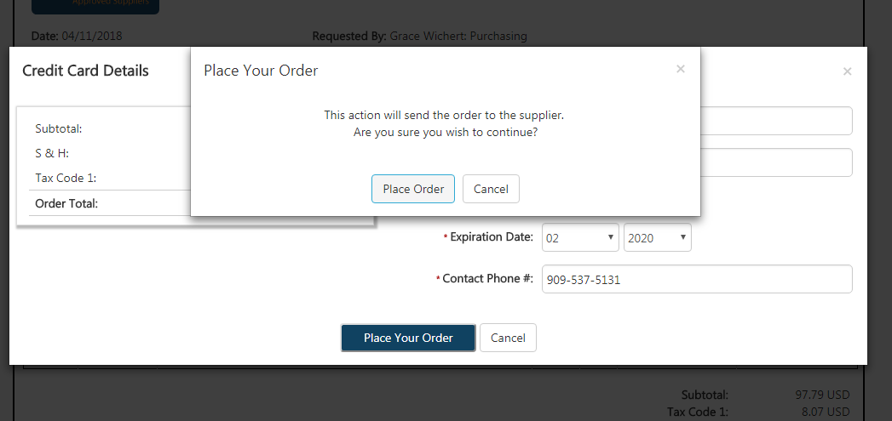
The Credit Card Details page will appear. You will need to enter your credit card/ Procurement card information on this page. Once you enter your card information, click Place Your Order.
A window confirming your order will appear. If you are ready to move forward, click Place Order.

Slide 14
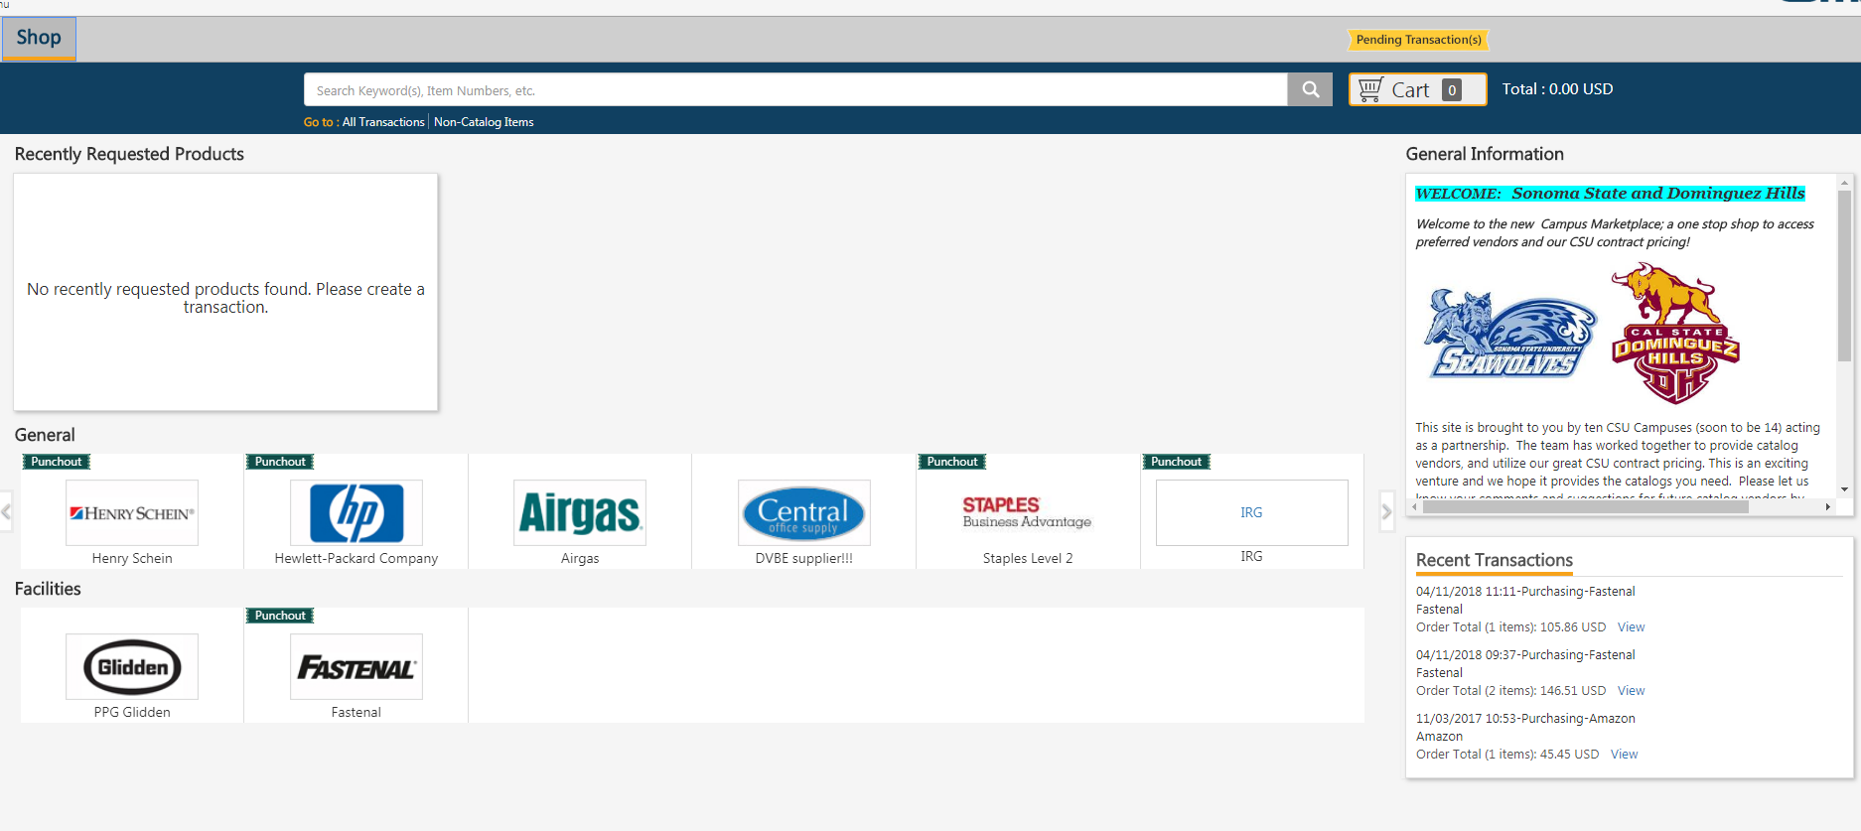
Once you enter your credit card information and submit your order, you will be brought back to this screen. Click on the Shop link on the top left corner to go back to the Campus Marketplace home screen.
You should now see your order listed under your recent transactions.

