Slide 1
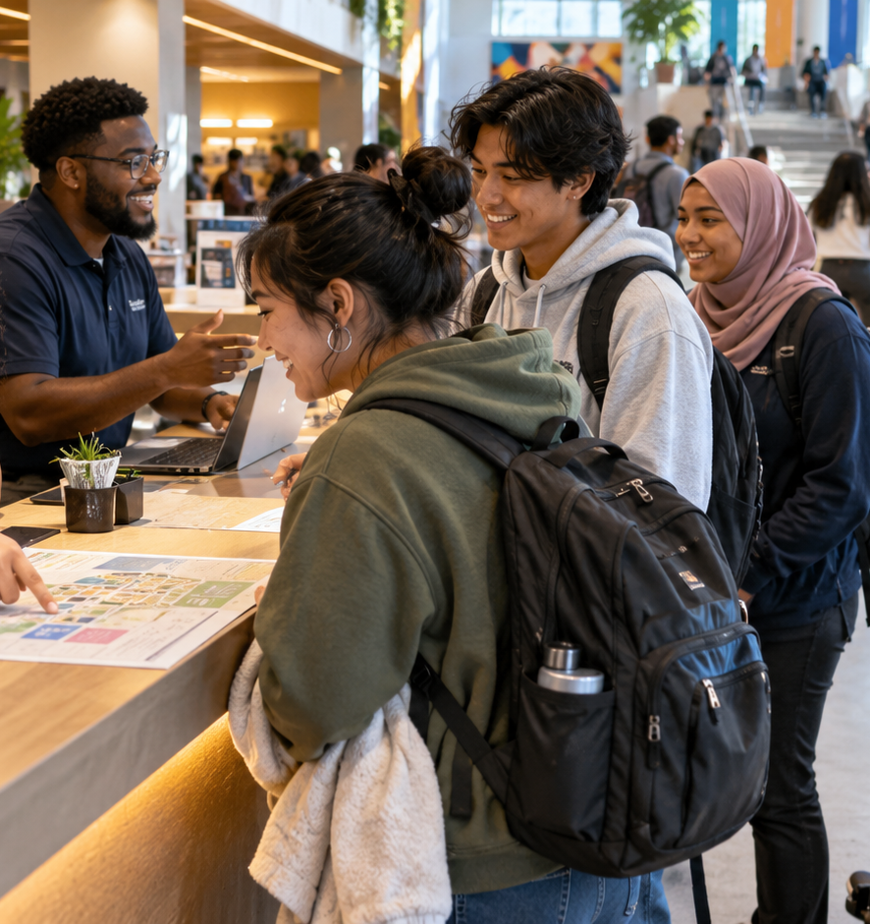
Sustainable Food Systems
Career Pathways
Explore six pathways, examine real California job postings, and choose your next career-building step.
60-minute Career Center visit
CSUSB Career Center
Notes:
Welcome students and distribute both handouts before beginning.

Slide 2
Today's roadmap
3 min
Students leave with one pathway to explore and a practical next-step plan.
1
Understand the field
See how food, people, business, public health and the environment connect.
Career planning works best as a series of small experiments.
2
Explore six pathways
Compare the work, roles and workplaces within each pathway.
Today, choose the next source of information, experience or connection.
3
Read real job postings
Separate duties, required qualifications and preferred qualifications.
4
Plan the next experiment
Choose one action for this week and one experience to build this term.
CSUSB Career Center
2
Notes:
Preview the sequence and explain that students do not need to choose a permanent career today.

Slide 3
Sustainable food systems as a career field
4 min
The work spans the full system, from production through access, policy and learning.
PRODUCE
MOVE + SELL
ACCESS + HEALTH
SHAPE + LEARN
Growing food, soil health, water, farm operations
Procurement, supply chains, markets, quality and logistics
Food access, nutrition education and community programs
Policy, research, evaluation, education and outreach
Your major provides one entry point. Internships, service, research, student employment and projects can connect you to another part of the system.
Pathways overlap, and careers can move between them over time.
CSUSB Career Center
3
Notes:
Ask students for one example of a food-system issue that touches more than one part of the system.
Sources:
- Supplied CSUSB Sustainable Food Systems Career Pathways handout

Slide 4
Six career pathways
3 min
Use the Career Pathways handout to mark roles and settings that interest you.
Food Business, Supply Chain +
Entrepreneurship
Sustainable Agriculture +
Food Production
Food Access, Nutrition +
Community Programs
Sustainable
Food Systems
Sustainability +
Environmental Management
Food Policy, Government +
Advocacy
Research, Education +
Outreach
You may select more than one pathway.
CSUSB Career Center
4
Notes:
Have students turn to page 1 of the Career Pathways handout and mark any pathway that interests them.
Sources:
- Supplied CSUSB Sustainable Food Systems Career Pathways handout

Slide 5
Pathway 1: Sustainable agriculture + food production
2 min
Work with crops, farms, production systems and agricultural programs.
EXAMPLE ROLES
WHERE YOU MIGHT WORK
COMMON WORK
STARTER EVIDENCE
Sustainable Agriculture Specialist
Farm or Operations Coordinator
Urban Agriculture Coordinator
Agricultural Program Aide
Farms and food producers
Agricultural nonprofits
Cooperative extension
Government agriculture programs
Plan crops and maintain records
Monitor irrigation, pests or inputs
Support field trials
Operate equipment safely
Garden, farm or field service
Lab or field coursework
Data logs and spreadsheets
Safety or equipment training
Question to consider
Would you rather spend more time in the field, in a greenhouse, or coordinating an agricultural program?
CSUSB Career Center
5
Notes:
Move quickly. Ask students to mark this pathway on the Career Pathways handout if any role or task sounds worth exploring.
Sources:
- Supplied CSUSB Sustainable Food Systems Career Pathways handout

Slide 6
Pathway 2: Sustainability + environmental management
2 min
Reduce environmental impact across food operations and communities.
EXAMPLE ROLES
WHERE YOU MIGHT WORK
COMMON WORK
STARTER EVIDENCE
Sustainability Coordinator
Sustainability Analyst
Climate Resilience Assistant
Sustainable Sourcing Specialist
Universities
Local government
Food companies
Environmental organizations
Collect environmental data
Coordinate waste or water projects
Prepare reports
Work with vendors and partners
Campus sustainability project
Waste or resource audit
Excel, GIS or data visualization
Project coordination sample
Question to consider
Which resource problem interests you most: waste, water, energy, sourcing or climate resilience?
CSUSB Career Center
6
Notes:
Move quickly. Ask students to mark this pathway on the Career Pathways handout if any role or task sounds worth exploring.
Sources:
- Supplied CSUSB Sustainable Food Systems Career Pathways handout

Slide 7
Pathway 3: Food access, nutrition + community programs
2 min
Connect people with food, nutrition information, benefits and community resources.
EXAMPLE ROLES
WHERE YOU MIGHT WORK
COMMON WORK
STARTER EVIDENCE
Food Access Coordinator
Community Health Worker
Nutrition Educator
Farm-to-School Coordinator
Food banks
Public health agencies
Schools
Community organizations
Conduct outreach
Support enrollment and referrals
Facilitate workshops
Track participation and outcomes
Food bank or pantry service
Community or public health course
Customer service or peer support
Bilingual communication
Question to consider
Do you want daily contact with community members, or more behind-the-scenes program work?
CSUSB Career Center
7
Notes:
Move quickly. Ask students to mark this pathway on the Career Pathways handout if any role or task sounds worth exploring.
Sources:
- Supplied CSUSB Sustainable Food Systems Career Pathways handout

Slide 8
Pathway 4: Food policy, government + advocacy
2 min
Influence public programs, regulations, funding and systems-level decisions.
EXAMPLE ROLES
WHERE YOU MIGHT WORK
COMMON WORK
STARTER EVIDENCE
Food Policy Coordinator
Agricultural Policy Analyst
Government Program Specialist
Community Organizer
City, county and state agencies
Advocacy groups
Policy organizations
Nonprofits
Research policies and programs
Write briefs and reports
Attend public meetings
Collect stakeholder input
Policy brief or writing sample
Public meeting observation
Government or advocacy internship
Research and Excel experience
Question to consider
Would you rather research policy, administer a public program, or organize people around an issue?
CSUSB Career Center
8
Notes:
Move quickly. Ask students to mark this pathway on the Career Pathways handout if any role or task sounds worth exploring.
Sources:
- Supplied CSUSB Sustainable Food Systems Career Pathways handout

Slide 9
Pathway 5: Food business, supply chain + entrepreneurship
2 min
Move food from producer to customer while balancing cost, quality and impact.
EXAMPLE ROLES
WHERE YOU MIGHT WORK
COMMON WORK
STARTER EVIDENCE
Procurement Specialist
Supply Chain Analyst
Food Hub Coordinator
Farmers Market Manager
Manufacturers and distributors
Retailers and food hubs
Hospitality and food service
Startups
Source products and vendors
Track inventory and logistics
Support quality and compliance
Analyze costs or markets
Operations or customer-service job
Inventory or logistics project
Excel and data analysis
Business plan or market research
Question to consider
Which part of the business interests you most: sourcing, operations, quality, logistics or market development?
CSUSB Career Center
9
Notes:
Move quickly. Ask students to mark this pathway on the Career Pathways handout if any role or task sounds worth exploring.
Sources:
- Supplied CSUSB Sustainable Food Systems Career Pathways handout

Slide 10
Pathway 6: Research, education + outreach
2 min
Generate evidence and help communities, organizations and decision-makers use it.
EXAMPLE ROLES
WHERE YOU MIGHT WORK
COMMON WORK
STARTER EVIDENCE
Research Assistant
Program Evaluator
Outreach Specialist
Sustainability Educator
Universities and institutes
Cooperative extension
Nonprofits
Public agencies
Collect and clean data
Conduct surveys or interviews
Evaluate programs
Create workshops and reports
Faculty or community research
Data analysis course or project
Poster, report or presentation
Teaching or peer education
Question to consider
Do you most enjoy asking questions, analyzing evidence, or explaining ideas to others?
CSUSB Career Center
10
Notes:
Move quickly. Ask students to mark this pathway on the Career Pathways handout if any role or task sounds worth exploring.
Sources:
- Supplied CSUSB Sustainable Food Systems Career Pathways handout

Slide 11
One challenge through six career pathways
7 min
Small groups choose one pathway and decide how that role would contribute.
A neighborhood has limited access to affordable fresh food. Residents want solutions that are practical, culturally relevant and sustainable.
AGRICULTURE
SUSTAINABILITY
ACCESS + HEALTH
Increase local production or improve distribution
Reduce waste and design resource-smart operations
Build outreach, benefits or nutrition programming
POLICY
BUSINESS
RESEARCH + OUTREACH
Change funding, rules or public programs
Build a viable sourcing, market or logistics model
Study the need and evaluate what works
Discuss: What would this role do first? What information would it need? Which partners would matter?
CSUSB Career Center
11
Notes:
Assign or let groups select a pathway. After discussion, ask two or three groups to share. Emphasize that the pathways complement one another.

Slide 12
Skills that travel across pathways
3 min
Job titles differ, but employers often ask for the same transferable skills.
Communication + community engagement
Outreach, facilitation, presentations, partner relationships
Research + evaluation
Data collection, surveys, Excel, analysis and clear reporting
Program + project coordination
Scheduling, documentation, follow-through and problem solving
Systems + operations
Supply chains, procurement, process improvement and resource use
Field knowledge
Food safety, agriculture, nutrition, policy or environmental practices
CSUSB Career Center
12
Notes:
Ask students to underline two skill areas they already have evidence for and circle one they want to build.
Sources:
- Supplied CSUSB Sustainable Food Systems Career Pathways handout

Slide 13
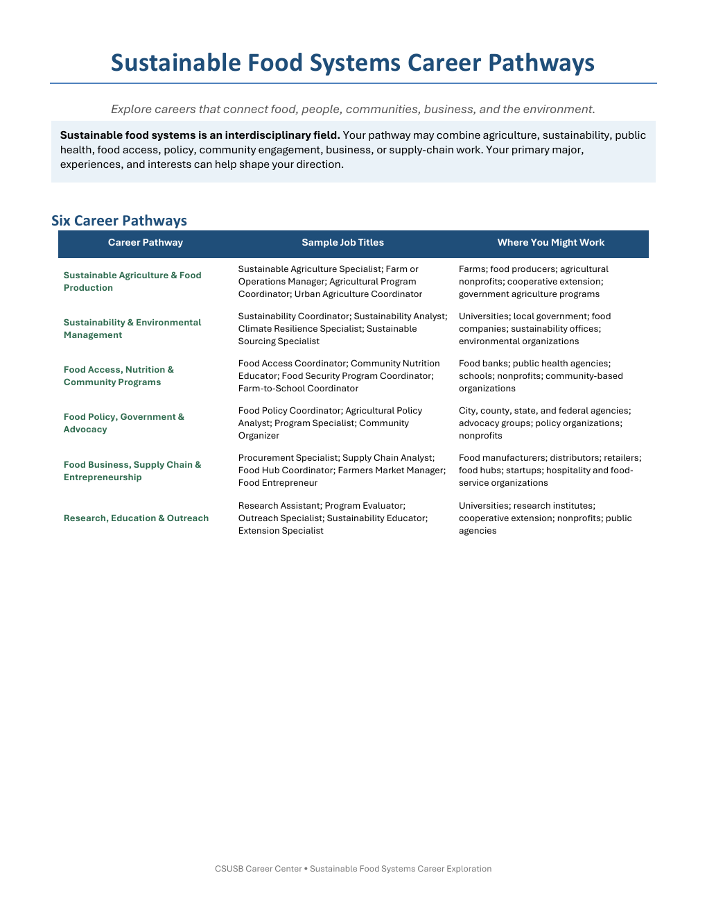
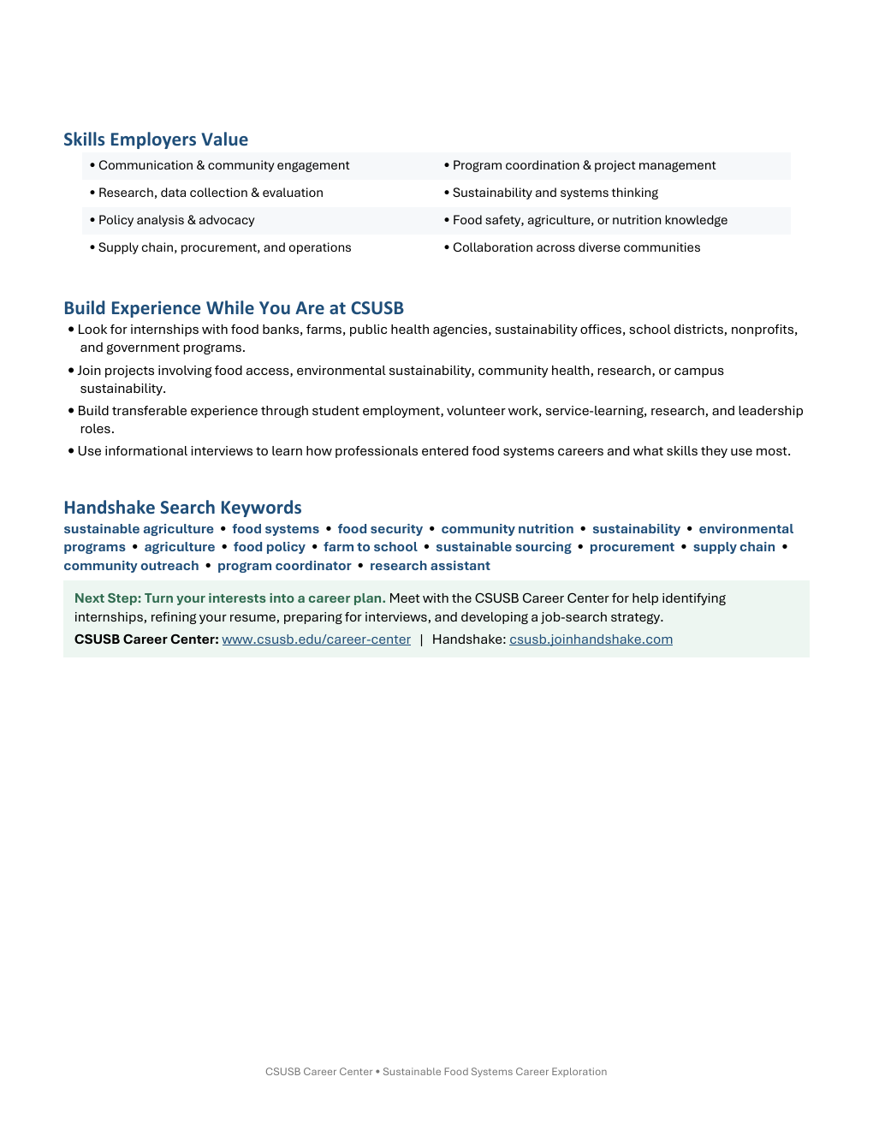
Handout activity: pathway scan
4 min
Use the two-page Career Pathways handout.
On your copy
Star two pathways you want to explore
Circle three job titles you want to research
Underline two employer skill areas you already use
Add one Handshake search keyword
You are gathering clues, not choosing a permanent career.
CSUSB Career Center
13
Notes:
Give students quiet time to scan both pages. Invite a quick pair-share about one role they marked.
Sources:
- Supplied CSUSB Sustainable Food Systems Career Pathways handout

Slide 14
Current California postings for career research
4 min
In-person roles available or recently posted as of September 29, 2026. Open links live during class.
Agricultural & Standards Program Aide
Seasonal entry role | No mandatory education or experience
Sacramento County | Sacramento
Plant Technician
Entry level | $22-$23/hour | greenhouse + lab data
Hippo Harvest | Pescadero
CalFresh Outreach Program Coordinator
On-site | $33.40/hour | one year related experience or training
Food Bank of Contra Costa and Solano | Fairfield or Concord
Agricultural Specialist
Full-time | deadline October 13, 2026 | early-career stretch role
Anaheim Union High School District | Anaheim
Coordinator, Garden of Health
Full-time | two years related experience | local stretch role
Loma Linda University Health | Loma Linda
Postings change quickly. Use them as current examples and verify status before applying.
CSUSB Career Center
14
Notes:
Open one or more postings live. The job titles on this slide are clickable.
Sources:
- https://www.governmentjobs.com/careers/sacramento/jobs/4299523/agricultural-and-standards-program-aide
- https://www.simplyhired.com/job/tomMPI2FVA6Gev5G76ygJXPoXycD4qd88g5CajU8ErMJiiW9kZwuGg
- https://www.foodbankccs.org/wp-content/uploads/2026/09/Job-Posting-CalFresh-Program-Coordinator-FF-and-Concord-0926.pdf
- https://www.edjoin.org/Home/JobPosting/1744363
- https://www.simplyhired.com/job/xwpxWa-SGrN3sTes4iEdmy4S2DUj9Ru15izBXBISIt5cCc5caOUHcw

Slide 15
How to read a job posting
3 min
The posting becomes a roadmap when you separate the information into four questions.
WORK
REQUIRED
PREFERRED
EVIDENCE
What would I do?
What must I show?
What would help?
What proves I can do it?
Look for repeated verbs and deliverables.
Check education, experience, skills, licenses and schedule.
Treat these as advantages rather than automatic disqualifiers.
Use work, coursework, service, research and projects.
Do not stop at the job title. Read the work, then identify the evidence you already have and the gaps you can build.
CSUSB Career Center
15
Notes:
Model the four questions before students examine a posting in groups.

Slide 16
Job lab 1: Agricultural & Standards Program Aide
5 min
Sacramento County | Seasonal, temporary full-time | $45,852 annually
WHAT THE ROLE DOES
MINIMUM + CONDITIONS
Support agricultural law and pest-control work
Read maps and plot trap locations
Keep records and prepare reports
Explain basic policy and procedures to the public
No mandatory education or experience requirements
California driver's license may be required
Outdoor work in varied weather
Physical tasks and non-routine hours
Next filing cutoff: December 15, 2026
Group prompt
Which course, volunteer, work or personal experiences could demonstrate record keeping, customer service, reliability or comfort working outdoors?
Open the live posting
CSUSB Career Center
16
Notes:
This is the clearest true entry-level example. Ask students to distinguish minimum qualifications from working conditions.
Sources:
- https://www.governmentjobs.com/careers/sacramento/jobs/4299523/agricultural-and-standards-program-aide

Slide 17
Job lab 2: Plant Technician
5 min
Hippo Harvest | Pescadero | Full-time | $22-$23 per hour
WHAT THE ROLE DOES
WHAT THE EMPLOYER ASKS FOR
Gather and analyze plant-performance data
Track growing conditions and inputs
Collect imagery, pH and nutrient samples
Maintain lab equipment and use sterile techniques
Detail orientation and willingness to learn
Spreadsheet experience for data entry
Basic lab skills such as stock solutions or pipetting
Team communication
Weekend availability
Group prompt
What could count as evidence of spreadsheet use, accurate data collection, laboratory technique or teamwork?
Open the live posting
CSUSB Career Center
17
Notes:
Ask students to translate classes and projects into evidence. Examples include lab notebooks, spreadsheets, group projects and weekend work history.
Sources:
- https://www.simplyhired.com/job/tomMPI2FVA6Gev5G76ygJXPoXycD4qd88g5CajU8ErMJiiW9kZwuGg

Slide 18
Job lab 3: CalFresh Outreach Program Coordinator
5 min
Food Bank of Contra Costa and Solano | Fairfield or Concord | On-site | $33.40 per hour
WHAT THE ROLE DOES
REQUIRED + PREFERRED
Conduct outreach at events, schools and partner sites
Help clients complete CalFresh applications
Build a community partner network
Maintain accurate client and outreach records
One year related experience or training, including equivalent education
Microsoft Office and Apple iOS
Professional writing and public speaking
Planning, judgment and respectful engagement
Preferred: bilingual ability and benefits-program familiarity
Group prompt
Which experiences could satisfy 'related experience or training'? Which preferred qualifications can a student begin building this term?
Open the posting PDF
CSUSB Career Center
18
Notes:
Point out that the employer accepts an equivalent combination of education and experience. Have students identify required versus preferred qualifications.
Sources:
- https://www.foodbankccs.org/wp-content/uploads/2026/09/Job-Posting-CalFresh-Program-Coordinator-FF-and-Concord-0926.pdf

Slide 19
Patterns across the postings
4 min
Repeated requirements show students what to practice and document.
REQUIREMENT
POSSIBLE EVIDENCE
NEXT MOVE
Accurate records + data
Spreadsheets, lab notes, inventory logs, client records
Save a clean work sample or describe the system you used
Communication
Customer service, presentations, outreach, partner contact
Write one resume bullet that names the audience and result
Reliability + organization
Schedules, deadlines, equipment, follow-through
Collect an example of managing several responsibilities
Related experience
Paid work, volunteering, coursework, research and projects
Translate the experience into tasks that match the posting
Work conditions
Driving, travel, outdoor work, lifting or weekend availability
Check practical requirements early before applying
CSUSB Career Center
19
Notes:
Ask students which repeated requirement they can already prove and which one they want to build.
Sources:
- https://www.governmentjobs.com/careers/sacramento/jobs/4299523/agricultural-and-standards-program-aide
- https://www.simplyhired.com/job/tomMPI2FVA6Gev5G76ygJXPoXycD4qd88g5CajU8ErMJiiW9kZwuGg
- https://www.foodbankccs.org/wp-content/uploads/2026/09/Job-Posting-CalFresh-Program-Coordinator-FF-and-Concord-0926.pdf

Slide 20
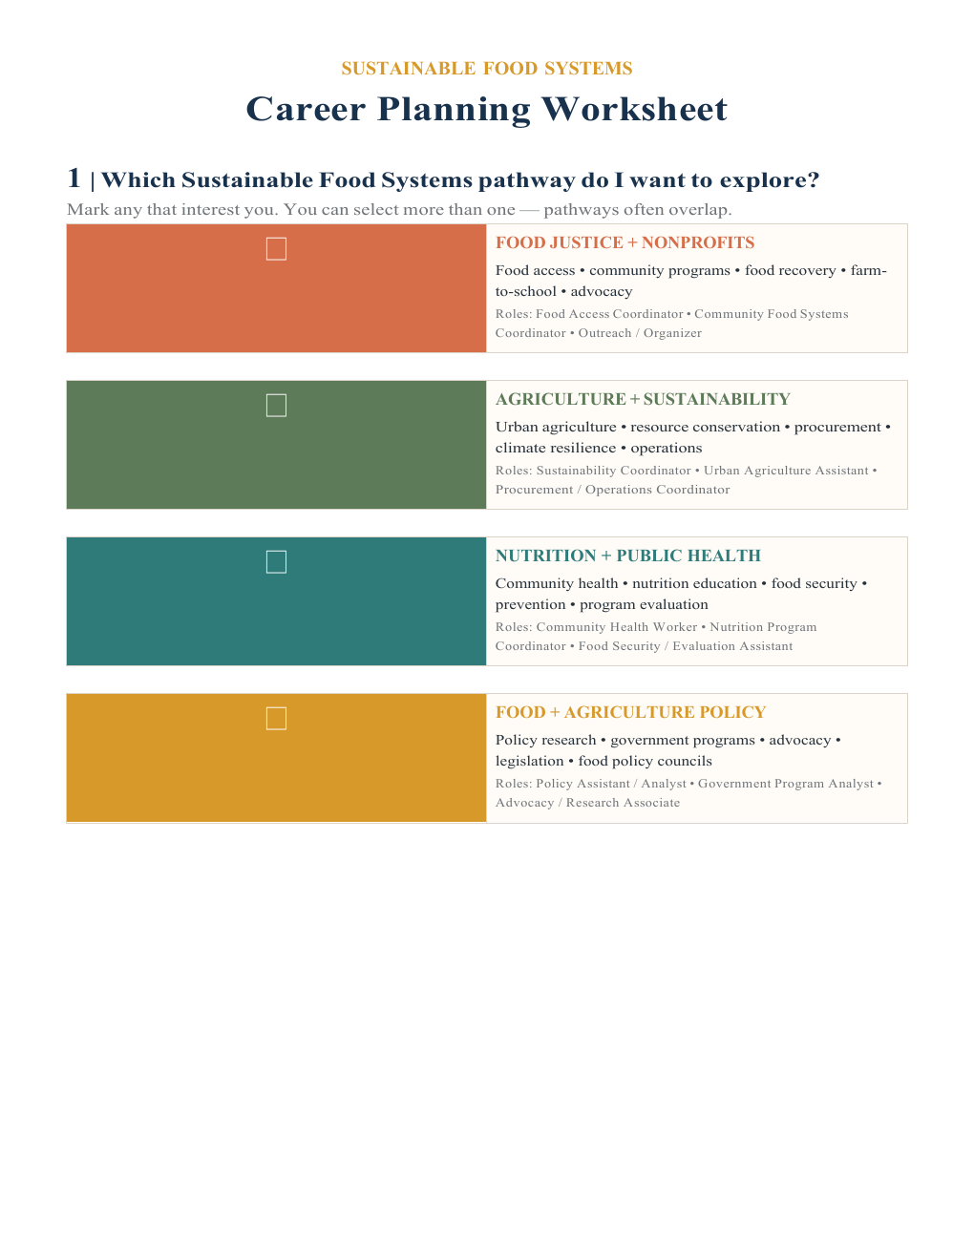
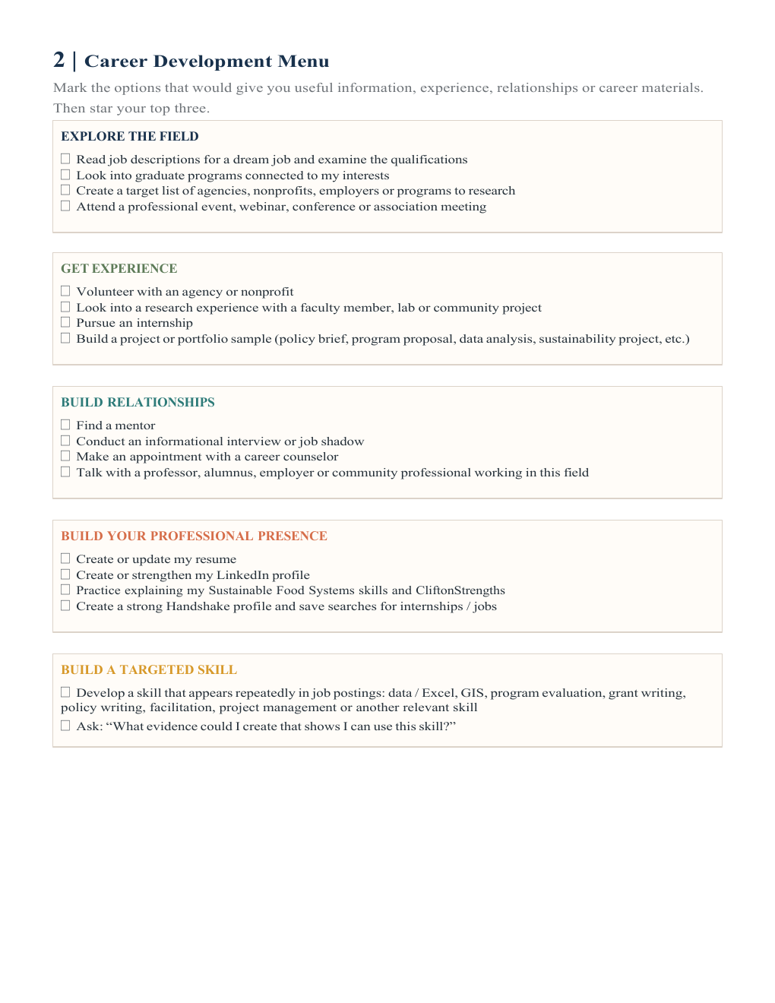
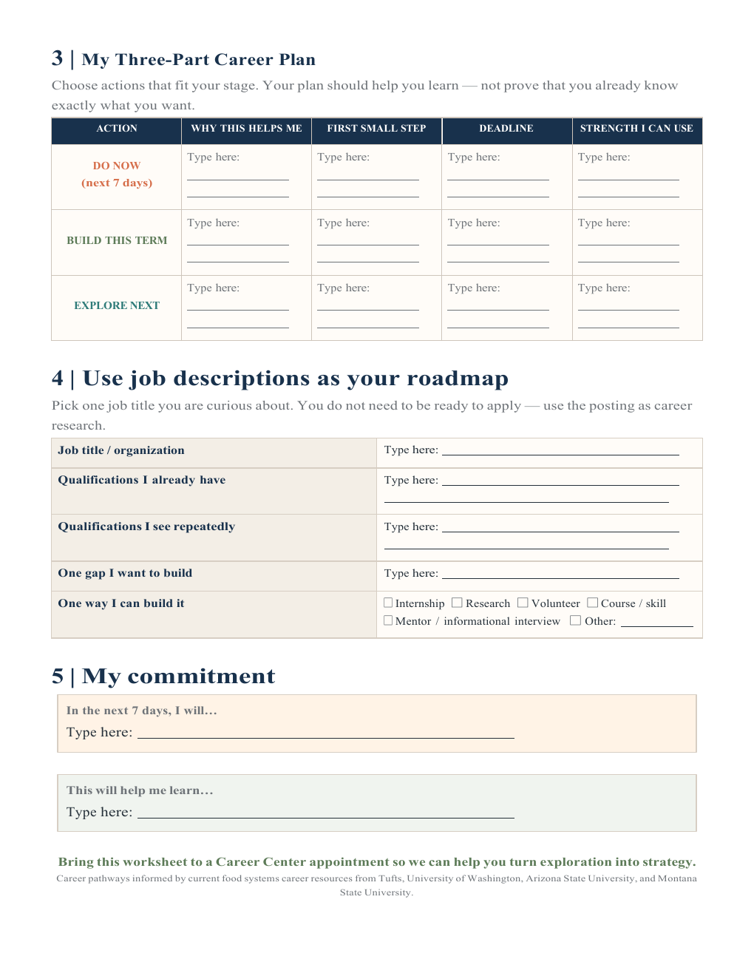
Career Planning Worksheet
8 min
Turn the career research into a short plan you can begin.
Complete these sections
Choose one or two pathways
Select three actions from the Career Development Menu
Use one job description as your roadmap
Write one action for the next seven days
Focus on interests, current qualifications, skill gaps and next steps.
CSUSB Career Center
20
Notes:
Students may skip any worksheet field related to CliftonStrengths. Direct them to focus on the pathway, qualifications, skill gap, action, first step and deadline.
Sources:
- Supplied Sustainable Food Systems Career Planning Worksheet

Slide 21

Leave with one next move
Complete this sentence on your worksheet:
In the next 7 days, I will ____________________ because it will help me learn ____________________.
The Career Center can help you
Research pathways and employers
Translate experience into resume evidence
Find internships and opportunities
Practice networking, interviews and job-search strategy
Bring your worksheet to a Career Center appointment so we can help turn exploration into strategy.
CSUSB Career Center
Notes:
Invite students to share their commitment with a partner. Remind them to bring the worksheet to a Career Center appointment.

