Slide 1
Personal Mobile Device Reimbursement Process – Concur
Personal Mobile Device Reimbursement is now possible via Concur. Please view the following slides on submitting the Expense Reports (each month) to seek reimbursement.

Slide 2
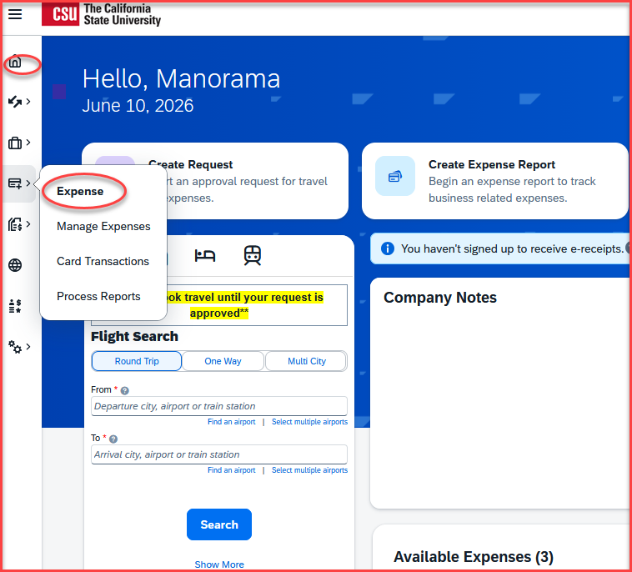
Expense Report- Once the Personal Mobile Device Reimbursement Approval Form is approved for reimbursement, the employee will have to submit the expense report each month, by attaching the 1st page of the Personal Mobile Device Invoice and Personal Mobile Device Reimbursement Approval Form.
Click on Home, then Expense

Slide 3
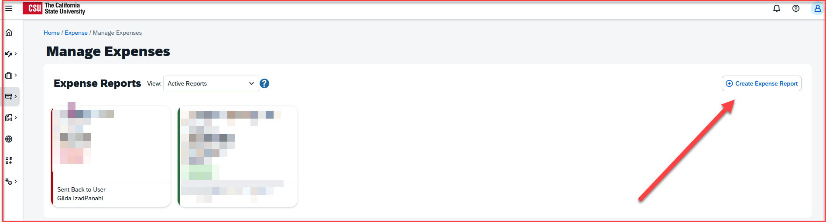
Click on Create new report

Slide 4
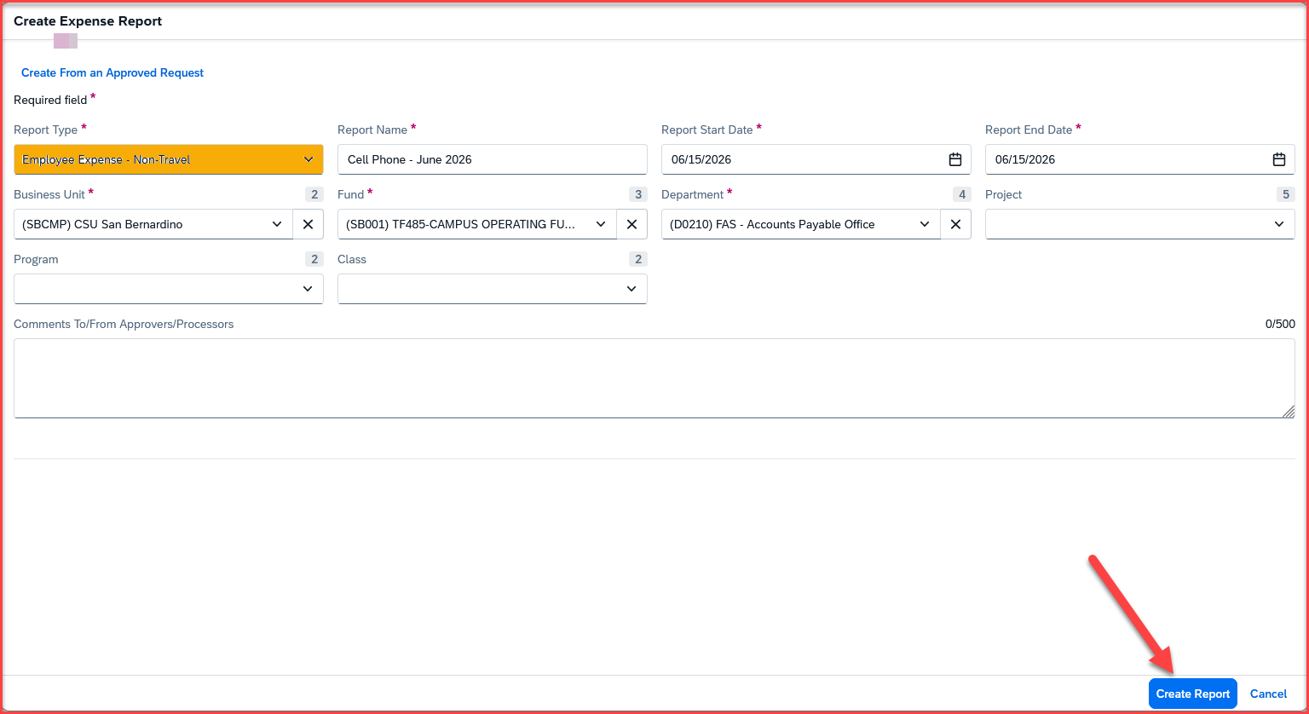
Expense Report Header- All the fields on the header need to be filled in.
The Report Type must be Employee Expense – Non-Travel
The Report Name should align to the reimbursement month(s)
Fill in the business unit, fund, department, program, class code, and project number of your respective department, and make the correct selection
Click on Create Report

Slide 5
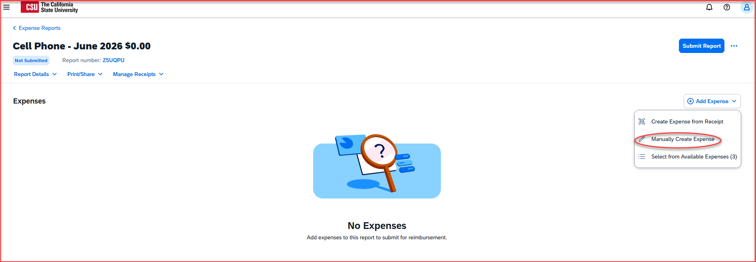
Click on Manually Create Expense

Slide 6
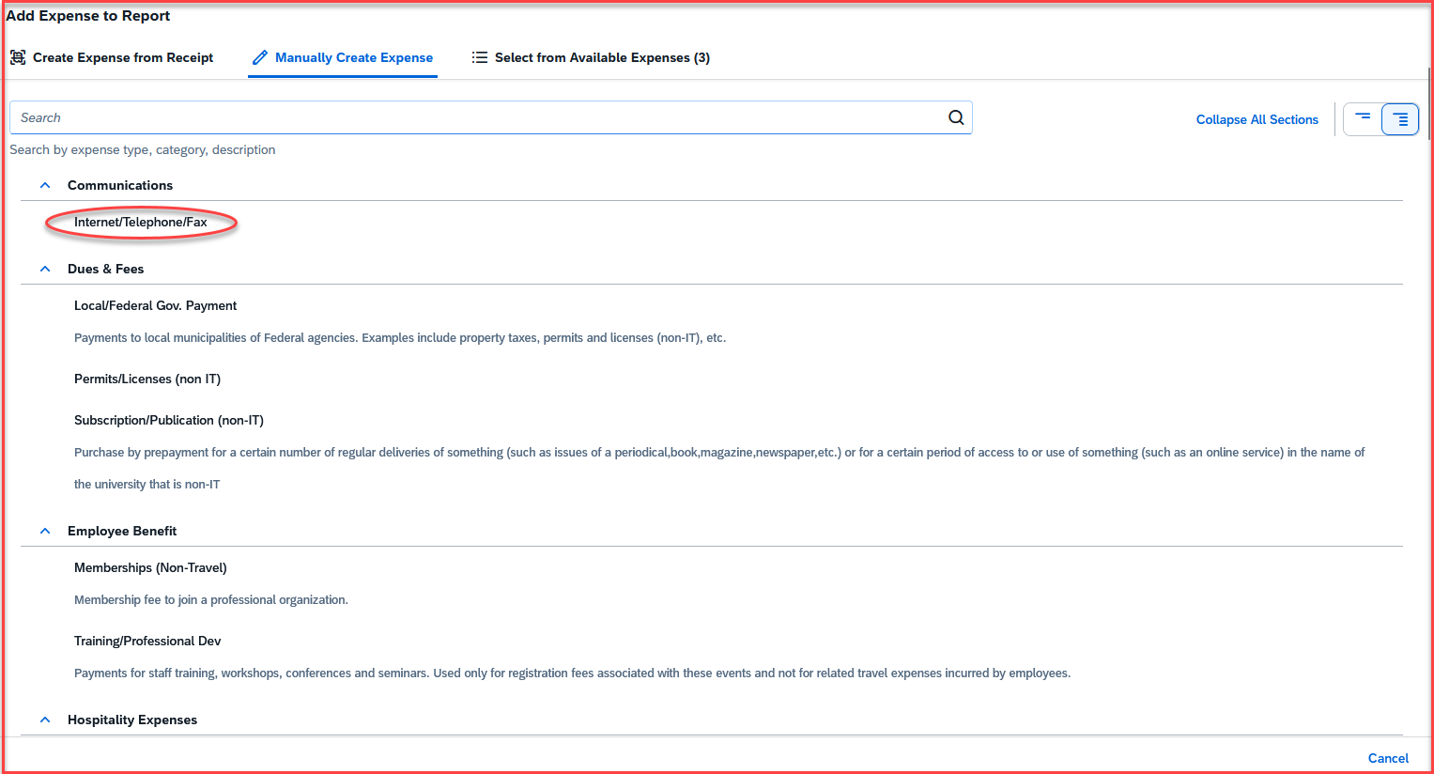
Select the Internet/Telephone/Fax expense type

Slide 7
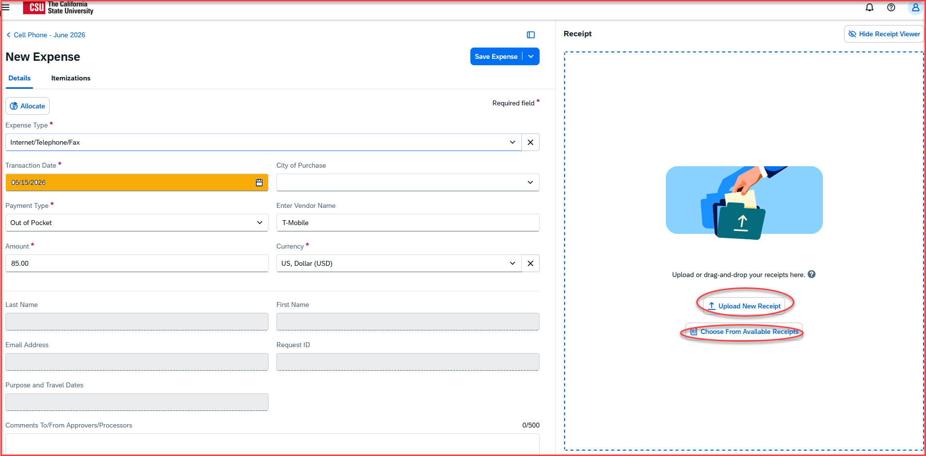
Add all the expense entry details as below
The Transaction Date will be the date of the invoice for the phone bill
Amount: enter the appropriate approved reimbursement amount
  Level 1: $85.00 per month
  Level 2: $50.00 per month
Reimbursement may not exceed the selected monthly level or the actual carrier charges, whichever is less.
Add the Vendor Name
Fill in the comment box with the cell phone number and the month you are seeking the reimbursement for
Click on Upload New Receipt in the right-hand box
The receipt can be uploaded either from the receipt library – Choose From Available Receipts or from the Upload New Receipt section
Once the receipt is attached, click on Save Expense

Slide 8
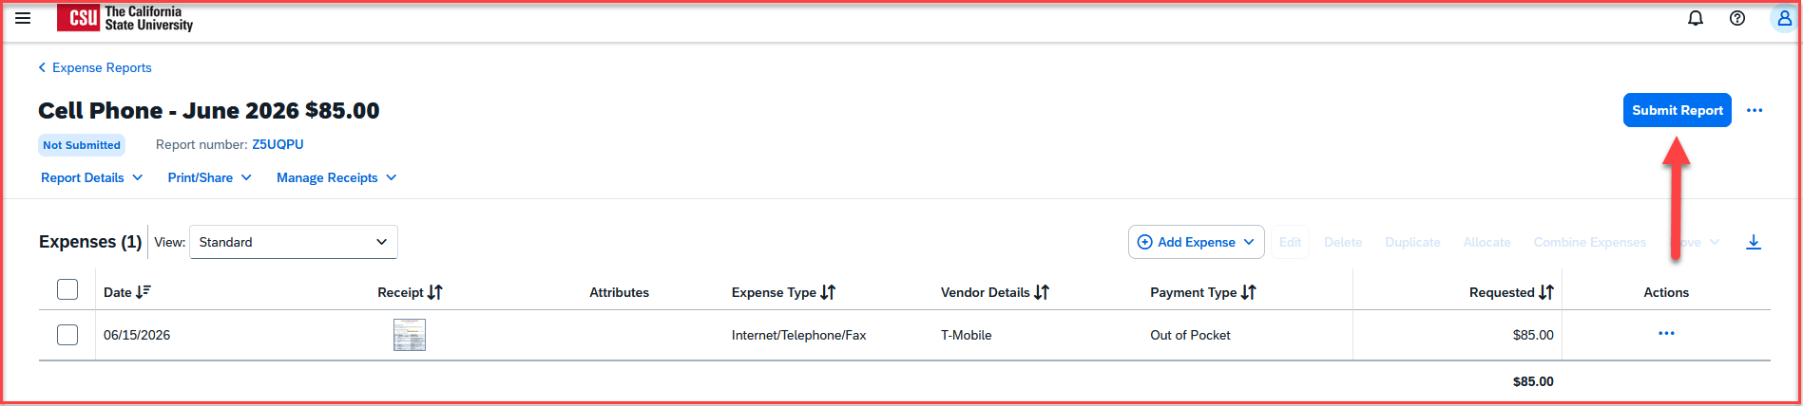
Once the receipt is attached, save the expense and click on Submit Report

Slide 9
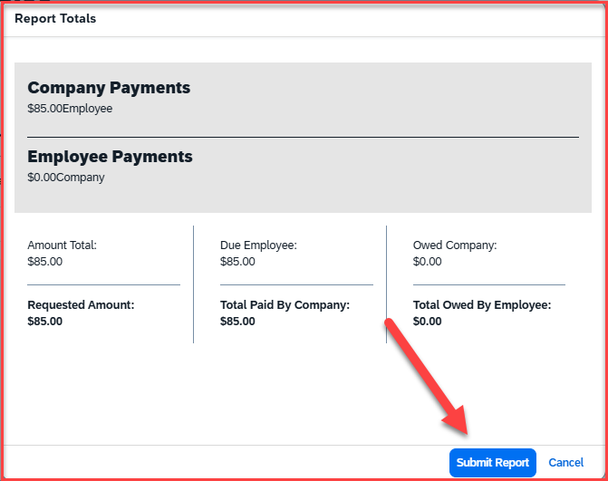
The Report Totals screen will appear. Once that is reviewed, click on Submit Report

Slide 10
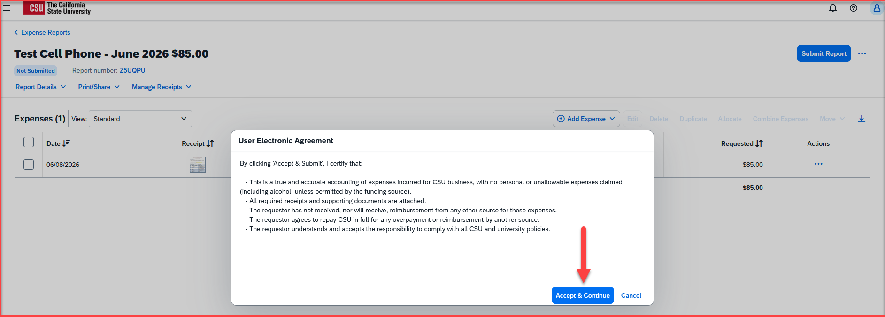
The certification page will appear. Read through, scroll, and click on Accept & Continue

Slide 11
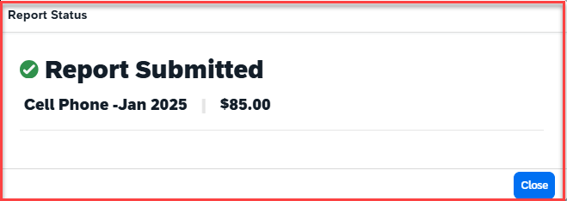
A message will pop up that the report has been submitted

Slide 12
Thank you!
If you need any further information or assistance, please do not hesitate to contact the Travel office at 909 537 5155

