Slide 1


‘TELL ME ABOUT YOURSELF’
Interviewing Successfully
Notes:
Minimalist Grey Brand Guideline Presentation

Slide 2




You Learn About…
PRE-INTERVIEW
POST-INTERVIEW
INTERVIEW

Slide 3

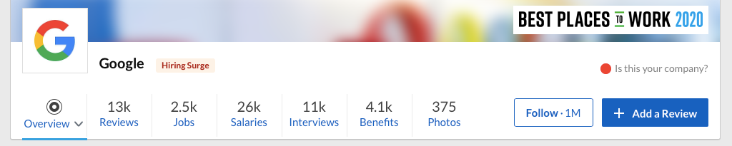
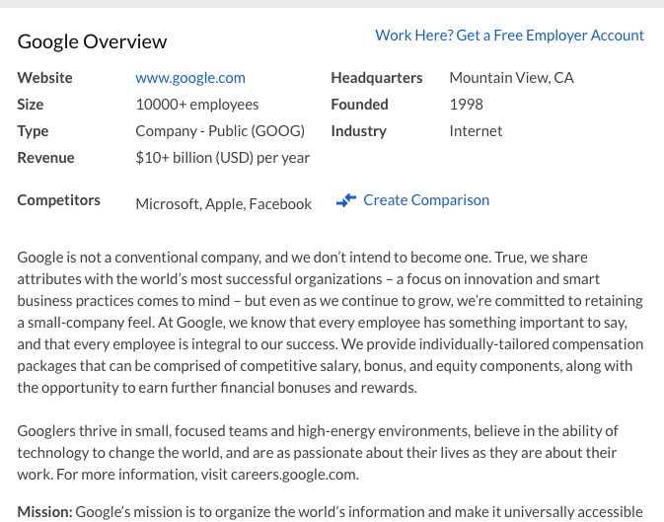
RESEARCH
HISTORICAL AND FINANCIAL BACKGROUND
  Origins-founding principles & mission and vision of the company
  How well is the company doing financially?
MACRO (THE BIG PICTURE)
  How well is the company doing in its respective industry?
MICRO (MORE SPECIFIC)
  What is it like working for the company?
  Number of employees
  Employee rating
    Glassdoor
    Indeed
PRE-INTERVIEW

Slide 4

PREPARATION
THE VIRTUAL INTERVIEW
FAMILIARIZE YOURSELF WITH VIDEO CHAT PLATFORMS
Google Meet, Zoom, Microsoft Teams, etc.
PREPARE YOUR TECHNOLOGY
Test your technology the day before. You may consider doing a test run with a friend so they can provide feedback about the quality of your video and sound.
PREPARE YOUR BACKGROUND
Virtual background or tidy your space, blank wall. No interruptions, people pets, phones, notifications
Angle screen eye level
PRE-INTERVIEW

Slide 5

IN PERSON INTERVIEW
TIME YOUR ENTRANCE
Arrive 10 min prior to interview
Know typical traveling time on the same day of the week/time as your interview
Know the parking situation
Know the typical time from parkin g to the location of interview

Slide 6


FIRST IMPRESSION
SKILLS:
Dress for Success!
REASONS
  More presentable and professional.
  When you are dressed your best, you tend to feel more confident.
  Research your industry
CUT
  Shirts and attire should be modest
  No slits in the front of skirts/dresses
PRINT
  Minimal print to solid (no print) is best
COLOR
  Nothing distracting
PRE-INTERVIEW

Slide 7

Communication
Spoken Word - FOUNDATION
Tone - CONFIDENCE GAUGE
Body Language – THE TRUST BUILDER
The Handshake
Eye Contact
Smile
C O N F I D E N C E

Slide 8
How to Answer the
"TELL ME ABOUT YOURSELF"
Question
WORK EXPERIENCE
EDUCATION
KEY STRENGTHS
FUTURE
  Begin with your year in school, major (and minor), and how you became interested in the field.
  Skills you have learned through school projects.
  Mention on campus membership/s and organizations (especially if in a leadership position).
  Discuss your current position, if you are currently working.
  Mention past jobs.
  Focus on transferable skills that would be valuable to employers in the field, professional accomplishments, or recognition you received.
  Based on your research of the organization, mention two key strengths of yours that match the requirements of the organization.
  End with why you are interested in working for the organization.
  State that you look forward to learning more about how you might be able to contribute your skills, talents, and experience in the future.
INTERVIEW

Slide 9
5 CATEGORIES OF Interview Questions
Questions related to your …
- motivation
- education and training
- experience and skills
- career goals
- why you want the job

Slide 10
AI & The Job
Description
Upload your resume and the job description.
Use your AI platform and add this prompt:
You are an HR expert with an expertise in recruitment. I will be interviewing for this position, see attached. Review my resume and provide me with the most likely questions that will be asked in this interview. Based on my resume, provide me with main points I should include in my answers.

Slide 11

BEHAVIORAL INTERVIEW QUESTIONS
Tell me about a time when…
What are your three stories?
SITUATION OR TASK
  Describe a specific event or situation.
  Give enough detail & context for the interviewer to understand.
  Draw from campus, work, or community experiences
ACTION
  Describe the action that you took to address the situation.
  If you are describing a group project, focus on your role.
RESULT
  What did you accomplish?
  If not success, what did you learn?
RELATE
  How does this relate to the position you're applying for?
INTERVIEW

Slide 12


ASKING THE RIGHT QUESTIONS
The interview is a two-way communication process
Asking meaningful questions will demonstrate that your interest extends beyond seeking employment.
What types of questions should you ask?
Please describe an average day on the job?
What do you like the most about working for this organization?
Here is how you can practice
INTERVIEW

Slide 13

Interview Summary
EXPAND
SHARE
KNOW
PREPARE
  Expand on key items listed on your resume/cover letter.
  Be sure to reference related, past experiences that fit the requirements of the position.
  Share your STARR stories that showcase past experiences.
  Know your strengths & weaknesses.
  Show how you have overcome at least
ONE weakness.
  Prepare a closing statement & questions.
INTERVIEW

Slide 14



AFTER THE INTERVIEW
Thank
you!
SEND A THANK YOU NOTE OR EMAIL TO THE INTERVIEWER/S TO THANK THEM FOR THEIR TIME
  Only 20% of candidates do this.
  Send a letter or email to each person who interviewed you.
  Use this letter to add info you thought of later that will advance you as a candidate of choice.
POST-INTERVIEW

Slide 15
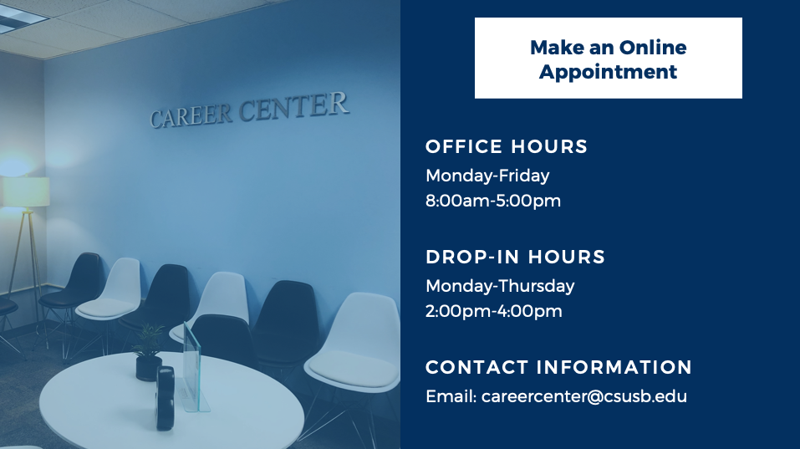
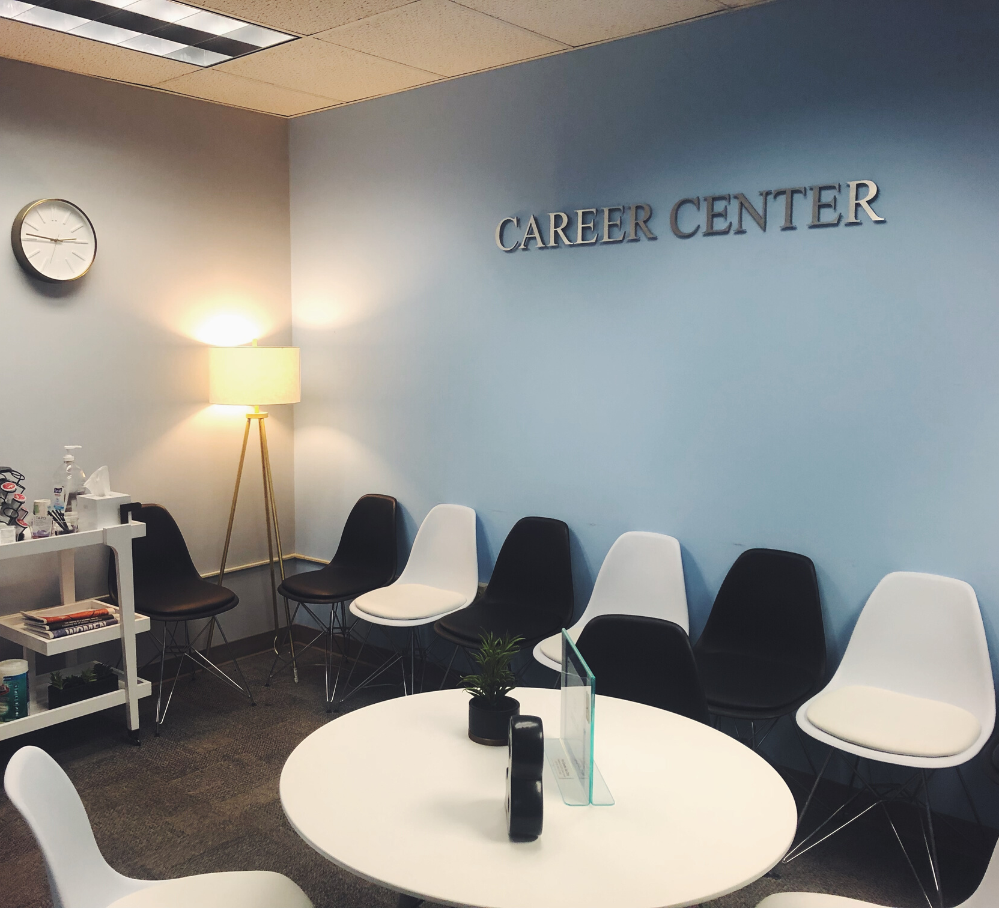
DROP-INS & APPOINTMENTS
OFFICE HOURS
Monday-Thursday
8:00am-5:00pm
SMSU SOUTH 112
https://www.csusb.edu/career-center
CONTACT INFORMATION
Email: careercenter@csusb.edu

Slide 16

Thank you for joining us!
Questions?

