Slide 1


CSUSB Office of Graduate Studies
April Lane, Graduate Resource Specialist alane@csusb.edu
Funding Your Graduate
Education

Slide 2

Overview of Today’s Topics:
Financial Aid Brochure
Basic Types of Aid & Categories
FAFSA & CADAA
CSUSB Scholarships
FAO Contact Information
The Graduate Equity Fellowship
The Pre-Doctoral Program and The Health Professions Scholars Initiative
The Chancellor Doctoral Incentive Program
Other funding opportunities
Tips for Completing Funding Applications
Funding Resources

Slide 3
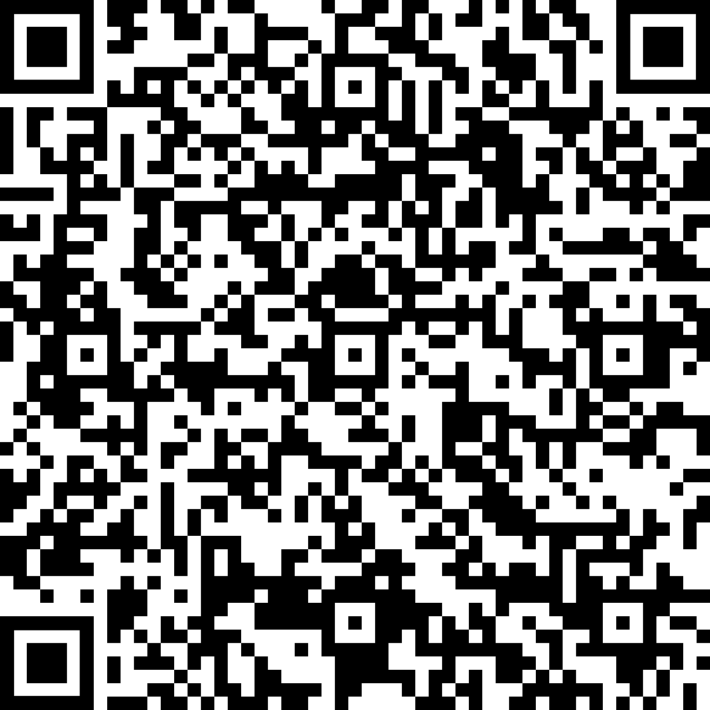
Financial Aid Brochure for Graduate Students
A one-stop-shop for funding opportunities for grad students, along with the requirements for each individual opportunity.
Please save the link to come back to this brochure when you might need to reference it!

Slide 4

Basic Types of Aid & Categories
Two Categories of Financial Aid:
Achievement-based
Need-based
Basic Types of Financial Aid Available
FAFSA/CADAA
State University Grant (SUG)
Grants
Loans
Scholarships
Office of Financial Aid & Scholarships

Slide 5

Grants and Loans
Grants
< A grant is free money! This is money that does NOT have to be repaid
< Grants will be automatically accepted when added the students financial aid award
< Example: State University Grant (SUG)
Loans
< This is money borrowed and will need to be repaid!
< Loans must be accepted by the student.
< Additional steps are required
by the student to have the loan be disbursed through the university.

Slide 6

Managed through The Office of Financial Aid & Scholarships
Free Application for Federal Student Aid (FAFSA) & California Dream Act Application (CADAA)
  Free and easy to apply
  If you don’t fill it out, you may miss out
    Apply early
    Apply yearly
  Federal Work Study
Scholarships
  On Campus
  Department fellowships
  Off Campus Scholarship Search Engines
    FastWEB
    iGrad Scholarship Search engine
    Scholarships.com
State University Grant (SUG)
  The maximum annual SUG award is up to the tuition/fee
  Does not cover additional campus charges
  Limited funding and based on availability of funding at time of review
  May not receive a SUG if you are receiving another type of aid that pays your tuition fee costs.

Slide 7
Free Application for Federal Student Aid (FAFSA)
Collects family’s personal and financial information used to calculate financial strength of the household (SAI)
For U.S. Citizens and eligible non-citizens, assesses eligibility for loans and federal and state grants
Opened on 11/16/2026 (planned)
Using 2025 Tax Year Income
Priority Deadline is March 2nd
Available in English and Spanish
Due March ₂nd!

Slide 8
California Dream Act Application (CADAA)
Collects family’s personal and financial information used to calculate financial strength of the household (SAI)
For eligible undocumented students
Opened on 10/01/2026
Using 2025 Tax Year Income
Priority Deadline is March 2nd.
Due March ₂nd!

Slide 9

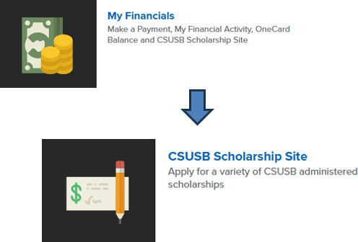

CSUSB Scholarships
The 2027-28 Scholarship Application is located within your MYCOYOTE Student Portal in the My Financials section, and the process is paperless! You must have a valid CSUSB Coyote ID
and email to log into the scholarship application portal. The application will be applicable for Fall 2027 and Spring 2028.
The 2027 -28 Scholarship Application is expected to open on November 16, 2026.

Slide 10



Contact Information
Cal State University San Bernardino (CSUSB)
Office: (909) 537-5227
Fax: (909) 537-7024
Email: financialaid@csusb.edu or pdcfinancialaid@csusb.edu
Website: https://www.csusb.edu/financial-aid
Scholarship Hotline:(909)537-7399
Email:
fascholarships@csusb.edu

Slide 11
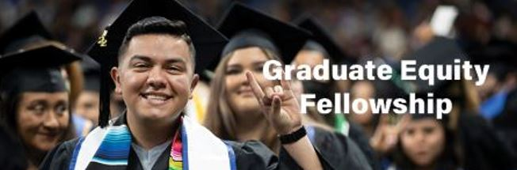
The Graduate Equity Fellowship
Awarded to eligible students currently in, or applying for, a master’s program.
Award amounts $500 - $2,000
Apply through the CSUSB Scholarship portal for the upcoming academic year. Expected to open on November 16, 2026 for AY 2027-28.
More information: Graduate Studies Graduate Equity Fellowship

Slide 12

The California Pre-Doctoral Program
(Pre-Doc) & The Health Professions Scholars Initiative (HPSI)
Benefits
Eligibility
Mentorship
Travel Funds
Professional Development Funds
A Summer Research Experience
Pre-Doc application opens: 12/2/2026
HPSI application opens: Late December 2026
Upper-division or master's degree students enrolled at a CSU
Must be enrolled during the award period.
Applicants must have a faculty mentor

Slide 13

Chancellor’s Doctoral Incentive Program (CDIP)
Benefits
Eligibility
Faculty Mentorship
Loans of up to $10,000 per year over a five year period, up to a maximum amount of $30,000
At the Completion of a Ph.D.: Full-time & Part-time teaching in the CSU are considered for loan forgiveness
Professional development workshops
Networking
Grant and research support
And much more!
Applicants who are applying for, or currently in, doctoral programs at accredited universities across the US
Upper-division or master's degree students, International students*,and lecturers
Must work with a faculty mentor at the CSU campus where you are applying for the CDIP
*Must be eligible to
work in the United States

Slide 14

The Merit-Based Presidential Scholarship
Details
Eligibility
For new non-resident students
Graduate Student Award Amount - $4,000/year
Two years maximum award duration
Meet CSUSB graduate admission requirements and pay non-resident tuition.
Are classified as a California non-resident for tuition purposes
Must be enrolled in no fewer than 6 semester units
Must have a grade point average (GPA) of 3.5 in the last 60 semester/90 quarter units attempted.
Reach out to international@csusb.edu for questions about this funding opportunity.
https://www.csusb.edu/international-education/international-admissions/international-admissions-forms

Slide 15
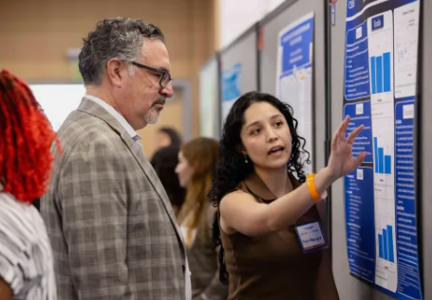
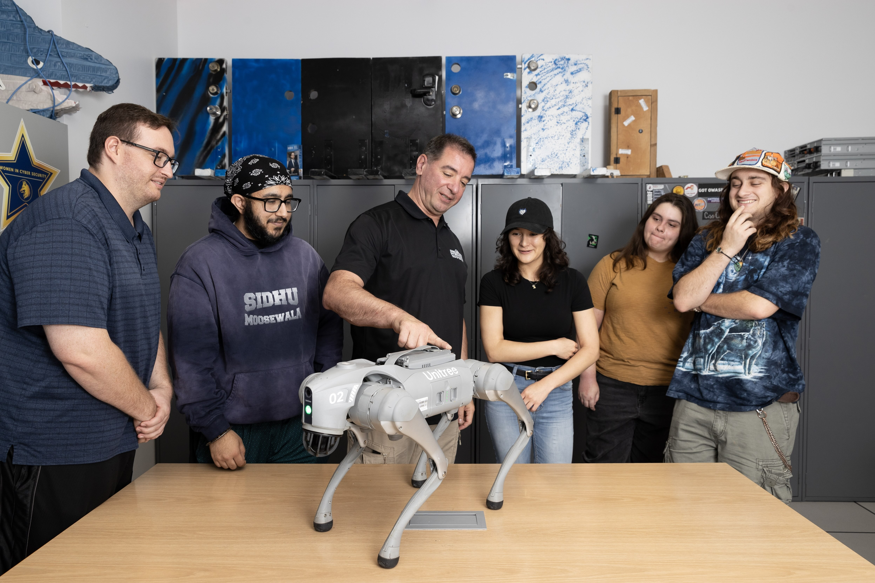
Office of Student Research & Innovation
Funding & Resources
Student Research and Travel
SSI Graduate Research Award
Artificial Intelligence, Quantum Computing, Fusion Energy, and Semiconductors (AQFS) Research and Training Lab
Research & Creative Activities Database
Workshops & Information Sessions
https://www.csusb.edu/student-research
Professional Development
Palm Desert ShowCASE
CSUSB Student Research Competition
Meeting of the Minds Research Symposium

Slide 16

Over 60 Program
Allows a limited number of California residents, sixty years of age or older to enroll in regular session courses without payment of certain specified fees.
Open to California residents, 60 years of age or older
All regular admission requirements must be met
Excludes books, parking, and lab/supply fees
Office of the Registrar Over 60 Program

Slide 17

Other Graduate Education Funding Options To Explore
Graduate Teaching Assistantships
Employee Fee Waiver Program
Student Assistant Positions
Internships
Tips for completing funding applications - Be prepared to:
Develop a well-written and thought-out project/topic
Reflect on how a commitment to diversity and underserved populations may be demonstrated in your written statement
Provide an overview of you plan to use the money and resources
Respond to all the prompts

Slide 18
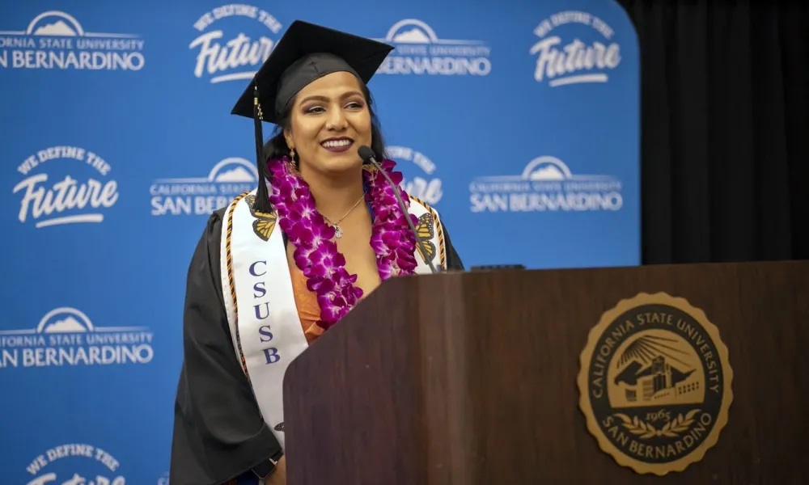
Experiential Learning Fellowship
Available to all Undocumented CSUSB students
“Learn by Doing” experience connected to learning outcomes
Hands-on Opportunities to apply academic
learning
Funding provided by host departments, including:
Stateside-funded departments
Department or Individual grants
Philanthropically funded departments
Tips on Getting started:
Network, confirm placement, funding contact
USSC about forms: Undocumented Student Success Center

Slide 19

Immigrants Rising: Scholarships & Fellowships
Scholarships & Fellowship Resources
Explore funding opportunities for mixed status students
Scholarships and Fellowships that do not require proof of U.S. citizenship
Searching tool for graduate-level funding and fellowships
Application Tips:
Prepare a strong personal statement
Highlight your goals and experiences
Review eligibility and deadlines
Resources: Applying for Scholarships & Fellowships

Slide 20
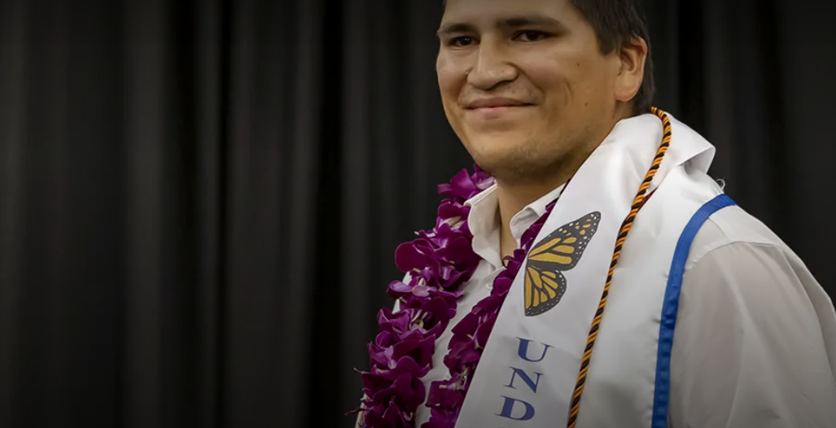
California Dream Loan
Loan option for eligible California Dream Act
students
May be available to qualifying graduate students
Requires eligibility verification and financial need
Loans must be repaid with interest
Before applying
Confirm graduate program eligibility with Financial Aid
Review loan terms and repayment requirements
Resources: CSUSB Dream Loan Information

Slide 21


Slide 22
Funding Resources
California Pre-Doctoral Program: https://www.csusb.edu/graduate-studies/financial-support/california-pre-doctoral-program-turn-your-dreams-reality
Chancellor’s Doctoral Incentive Program: https://www.csusb.edu/graduate-studies/financial-support/chancellors-doctoral-incentive-program-supporting-emerging
Fastweb: https://www.fastweb.com/
Graduate Equity Fellowship: https://www.csusb.edu/graduate-studies/financial-support/graduate-equity-fellowship
iGrad: https://www.igrad.com/tools
Office of Financial Aid & Scholarships: https://www.csusb.edu/financial-aid
Office of Student Research & Innovation: https://www.csusb.edu/student-research
Over 60 Program: https://www.csusb.edu/registrar/over-60-program
Scholarships.com: https://www.scholarships.com/
The Merit-Based Presidential Scholarship: https://www.csusb.edu/international-education/international-admissions/international-admissions-forms

Slide 23


Other Resources
Career Center offers programs, workshops, and services at the San Bernardino & Palm Desert campus. They partner with local and national industry leaders to offer specialized programming, distinctive resources, and tailored events for over 20,000 current students as well as countless alumni across the Inland Empire and beyond.
Cody’s Closet provides a FREE clothing resource for CSUSB students to access professional attire appropriate for career fairs, interviews, networking events, and the workplace. Professional attire available includes suits, blazers, skirts, button-down shirts, ties and more. Our aim is for students to feel confident and secure.
Handshake is a platform that connects talented Coyotes with internships, jobs and career opportunities. Use Handshake to find workshops, events and other career development programs hosted by the CSUSB Career Center.

Slide 24
Other Helpful Resources
< Federal Student Aid Page: https://studentaid.gov/
< Graduate Studies Financial Support Page:
https://www.csusb.edu/graduate-studies/financial-support
< HOWL Program: https://www.csusb.edu/howl-program
< Professional Resource Engagement Program:
https://www.csusb.edu/graduate-studies/prep-program
< SMSU Financial Literacy Center:
https://www.csusb.edu/smsu/resources/financial-literacy-center
< The Writing Center: https://www.csusb.edu/writing-center

Slide 25
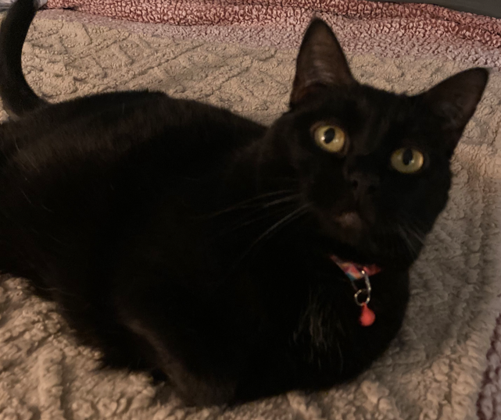
Thank you!

