Slide 1

HOW TO SUBMIT A
DOA 360
REQUEST

Slide 2
Before you Begin
All DOA 360 access requests must be submitted by the employee’s
CIA Delegate through Optimize.
The process requires two submissions:
An Optimize CIA Request
A DOA 360 Google Access Request form
The Optimize request number connects the two submissions..

Slide 3

Log In to Optimize
Select the link below for Optimize – SB – CIA Request Form

Slide 4
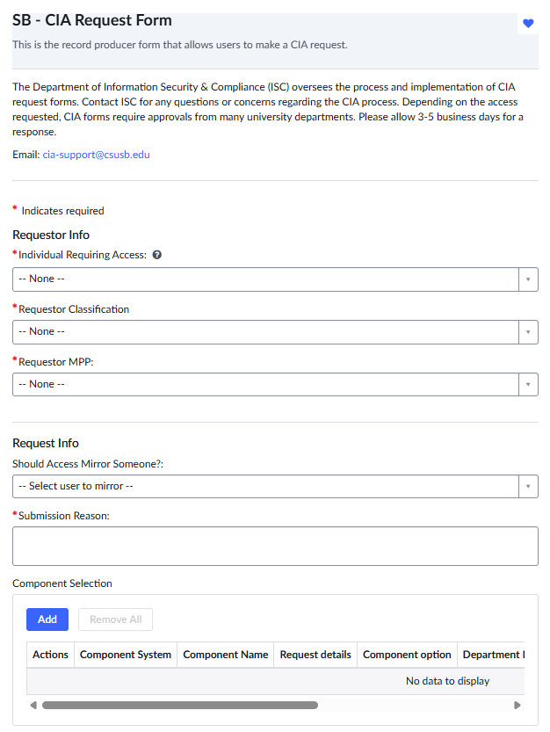
Employee Information
Indicates REQUIRED field
*
Enter the name of the individual requiring DOA 360 access. You can also use their Coyote ID#.
Once you find them in the drop down, the Requestor Classification and Requestor MPP will automatically populate.
If there is an employee already using the access you are requesting, you can ask to mirror their access by naming them here.
For submission reason you can type in any of the applicable reasons below:
Additional job duties
New employee
New DOA 360 access
Activate user for DOA 360

Slide 5
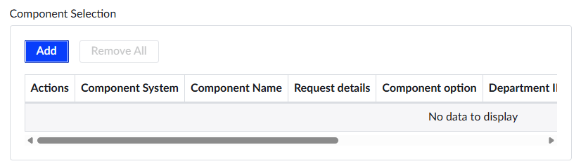
Go to the Component Selection section at the bottom of the request.
Select the blue “Add” button. A new window will open.

Slide 6
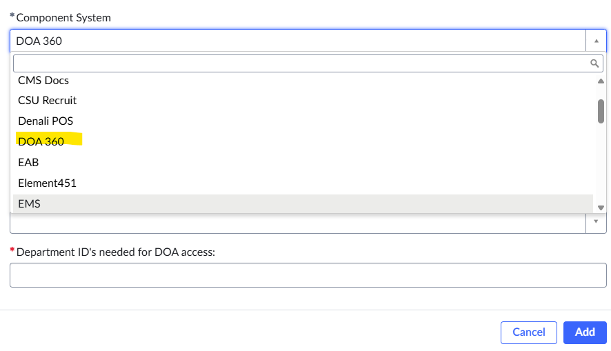
Open the Component System dropdown menu and
scroll through the available options.
Select DOA 360

Slide 7
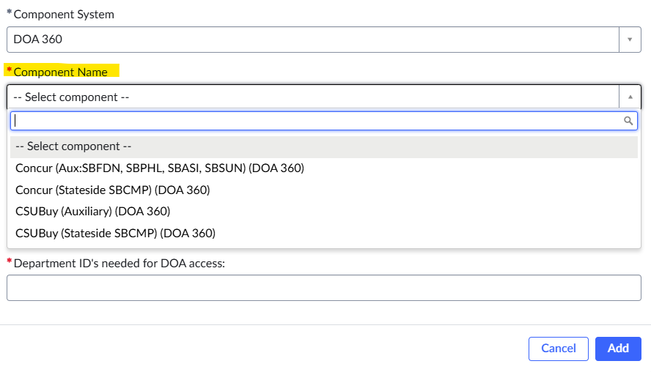
Open the Component Name dropdown menu.
Select the DOA 360 component needed for the employee’s access.

Slide 8
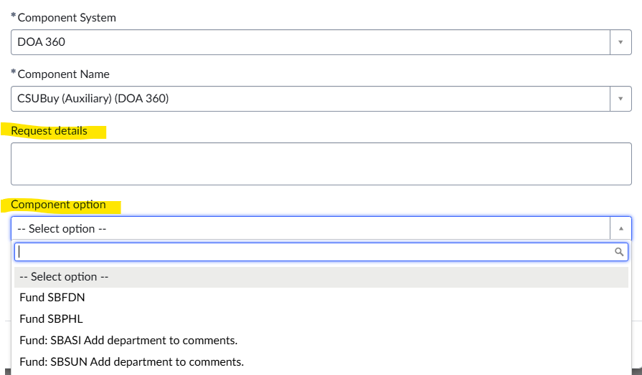
If applicable, select the appropriate fund type under Component Option.
If access to a specific project code is needed, enter the project code in the Request Details field.

Slide 9
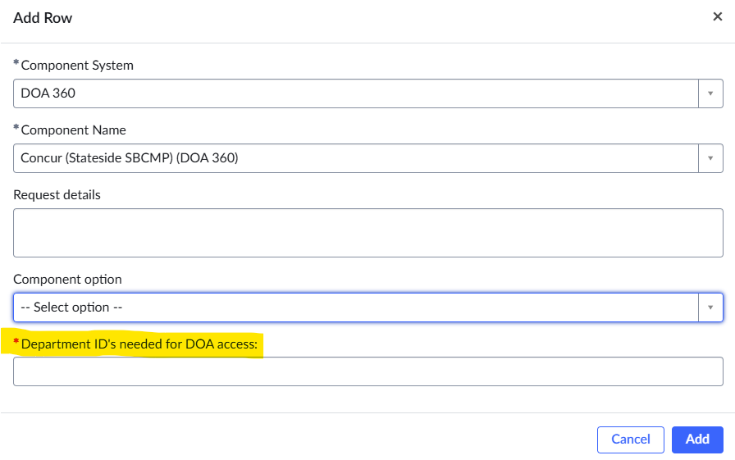
Enter “Department ID(s) needed for DOA access”..

Slide 10
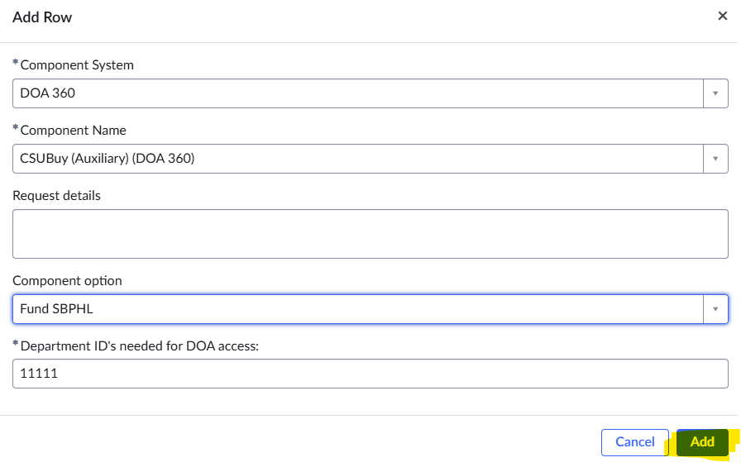
Review the information entered for accuracy.
Select “Add” to include the component in the request.

Slide 11
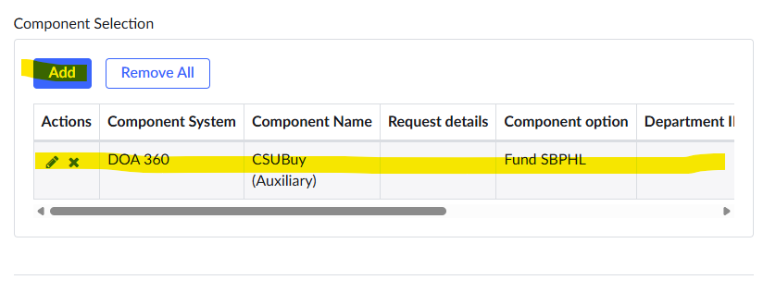
The selected component will appear in the Component Selection section.
Confirm that all information is correct.
Select the pencil icon to edit the selection.
Select the “X” icon to delete the selection.
Select “Add” to include another component.
Repeat these steps for each additional access component needed.

Slide 12
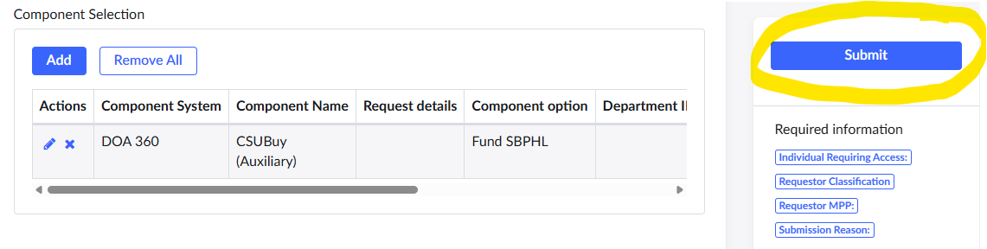
After entering all required access components, review the request for accuracy.
Select the blue “Submit” button.
Record the Optimize request number, if you forget to record it at the time of submission, you can also check your email as Optimize will send you a confirmation with the number of the request.
You will need this number to complete the DOA 360 Google Access Request form.

Slide 13
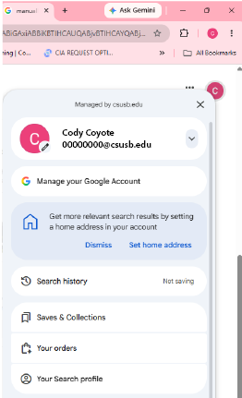
Before accessing the DOA 360 Google request form, please ensure that you are logged into your Google employee account
(hover over the initial on the top right corner of your screen)
using your email with your Coyote ID 00000000@csusb.edu.
DOA 360 Access Request Form
Complete all required fields and enter the Optimize request number so the two submissions can be matched.
Submit the Google form to complete the DOA 360 access request process..
Once both forms have been submitted, you will receive an email confirming completion of your request. If the DOA 360 administrator has any questions, they will reach out the requestor.

Slide 14
Questions?
For any questions about DOA 360 inquiries or assignments, please contact:
doa360admin@csusb.edu

