Slide 1
Personal Mobile Device Reimbursement– Concur
Personal Mobile Device Reimbursement is now possible via Concur. Please view the following slides to create an Authorization Request in Concur(one time, to secure the authorization of the full fiscal year, from your department) and the Expense Reports ( each month, to seek reimbursement).

Slide 2
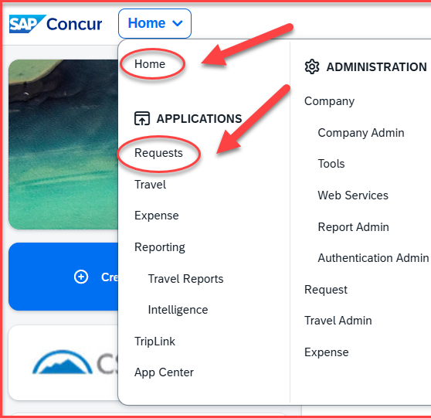
Start creating the Online Authorization Request to secure the authorization for the full FY, by clicking on Home and under Applications, click on Request

Slide 3
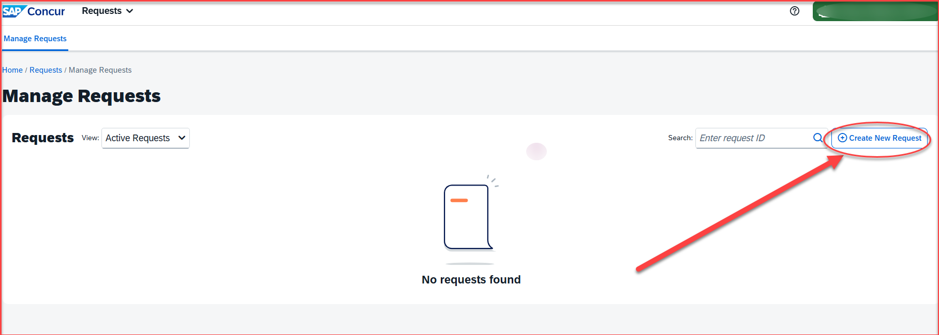
Click on Create New Request

Slide 4
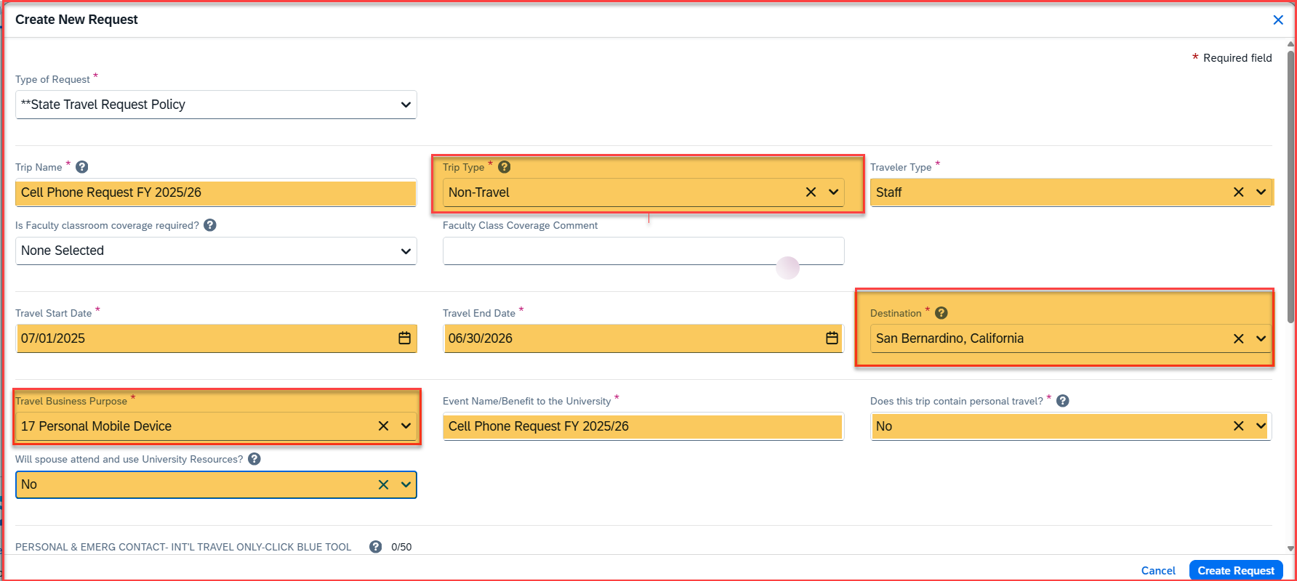
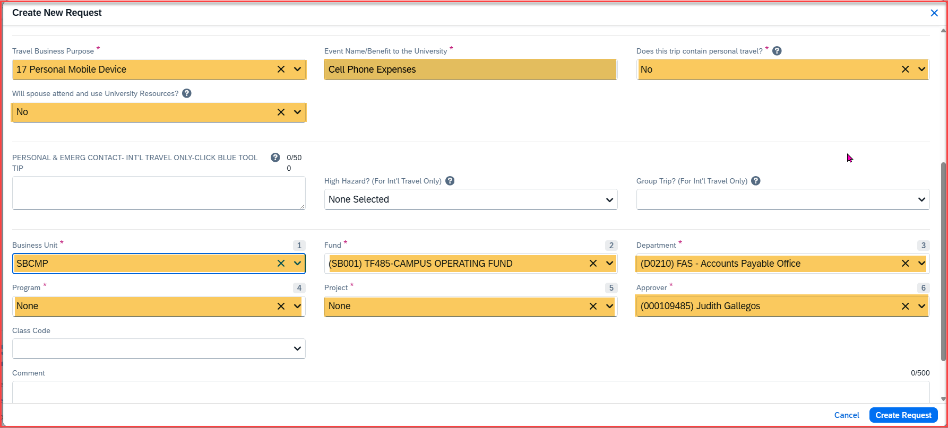
Please fill in all the fields in the request header.
Trip Type will be Non-travel
The destination will be San Bernardino
Travel Business Purpose will be 17. Personal Mobile Device
All the fields highlighted in yellow need to be filled in
The ones not highlighted are not required to be filled in for the cell phone approval request
For the business unit, fund, department ID, program, and project number, reach out to your department for the correct selection of the account numbers
Please add the correct approver on the header based on your department. This is the budget approver for your department/division
Once all the fields are completed, click on create request

Slide 5
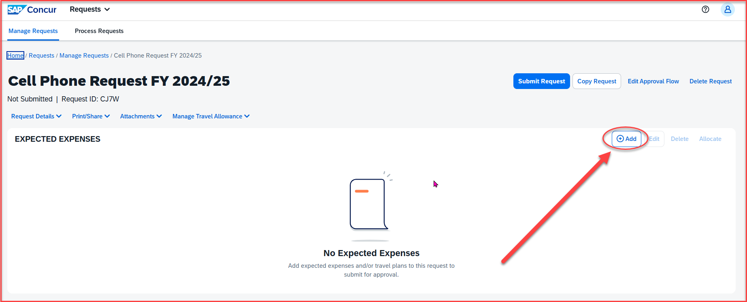
Click on Add

Slide 6
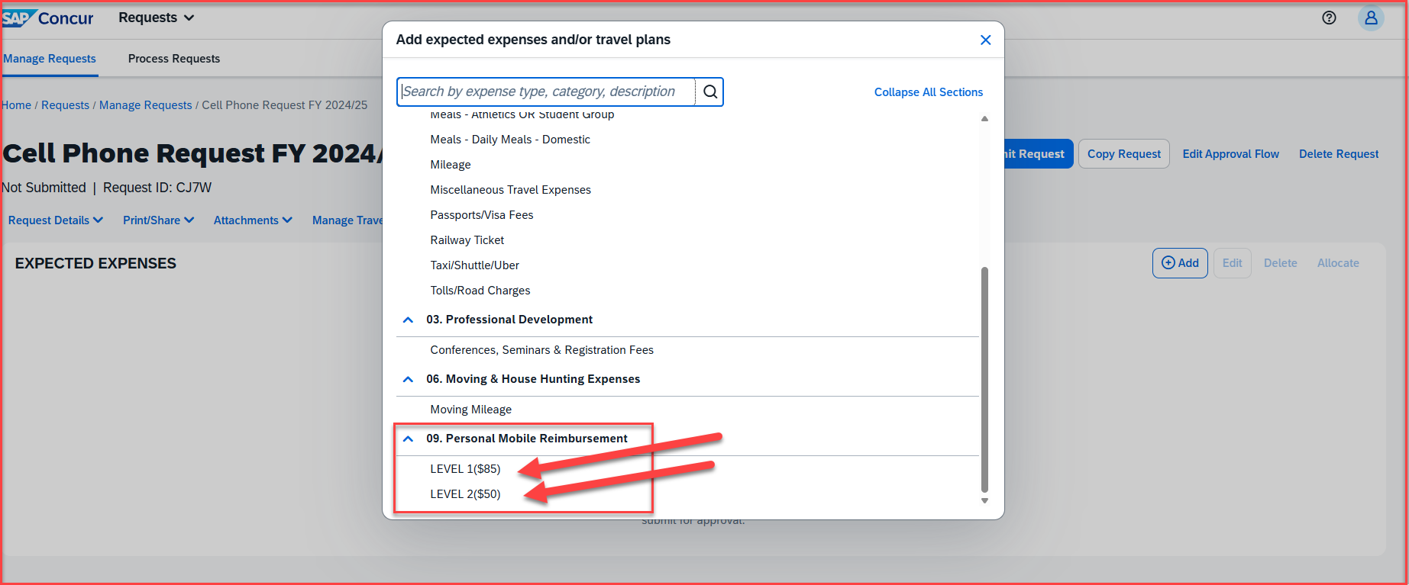
Scroll down to 05. Personal Mobile Reimbursement and select the level of cell phone level
Level 1 ($85)
Level 2 ($50)

Slide 7
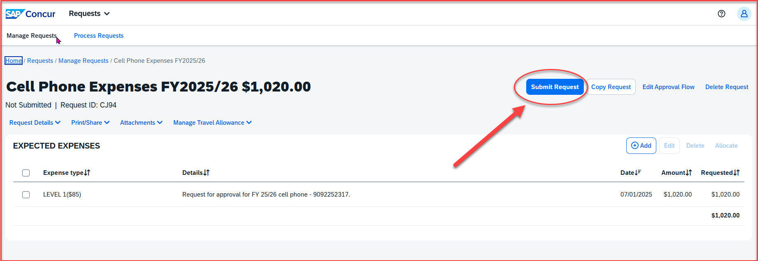
Once the selection is made, add the total amount in the transaction amount box. Update the description box and then hit save.
Then click on submit request

Slide 8
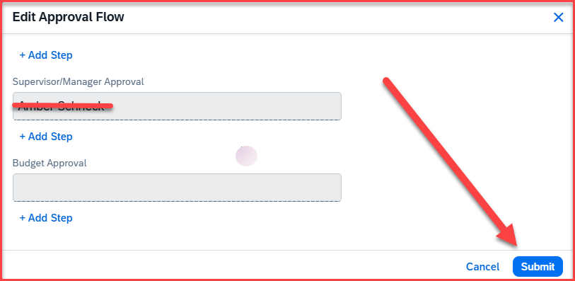
The approval flow will come up. Review the approvers and then hit submit.
The request is now successfully submitted. Once it is fully approved by all the approvers, users can submit the cell phone expense reports monthly for reimbursement.
Please review the following slides for the reimbursement process every month

Slide 9
Cell Phone Expense Report Reimbursement– Concur
Personal Mobile Device Reimbursement is now possible via Concur. Please view the following slides on submitting the Expense Reports (each month) to seek reimbursement.

Slide 10
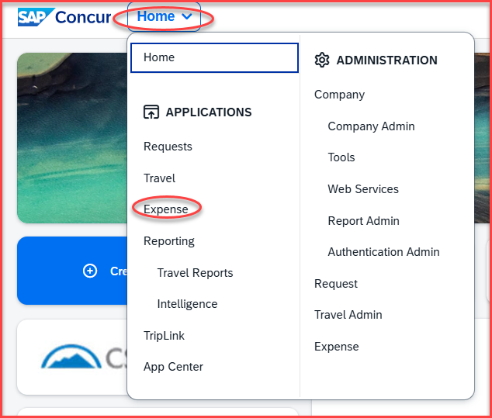
Expense Report- Once the Authorization Request is approved for the full FY, for reimbursement, the employee will have to submit the expense report each month, by attaching just the 1st page of the Personal Mobile Device Invoice.
Click on Home, then Expense

Slide 11
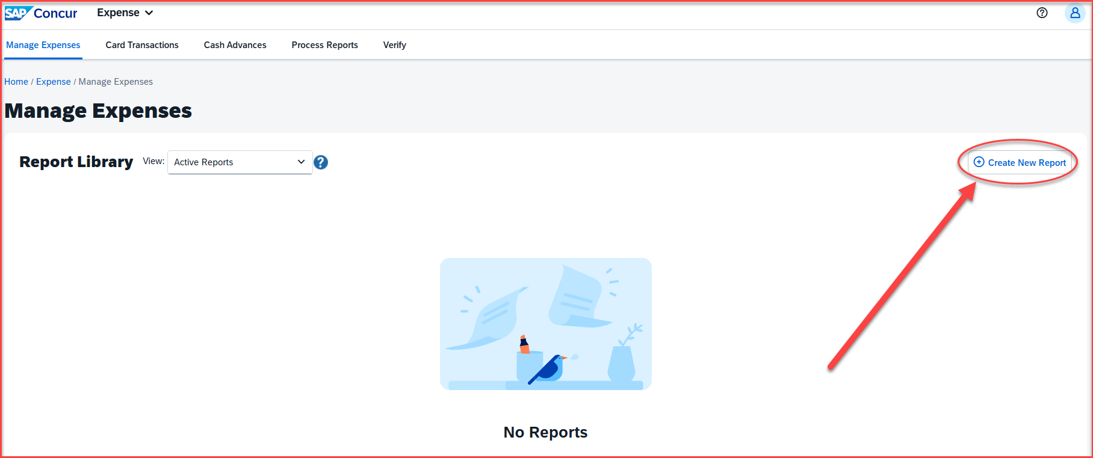
Click on Create new report

Slide 12
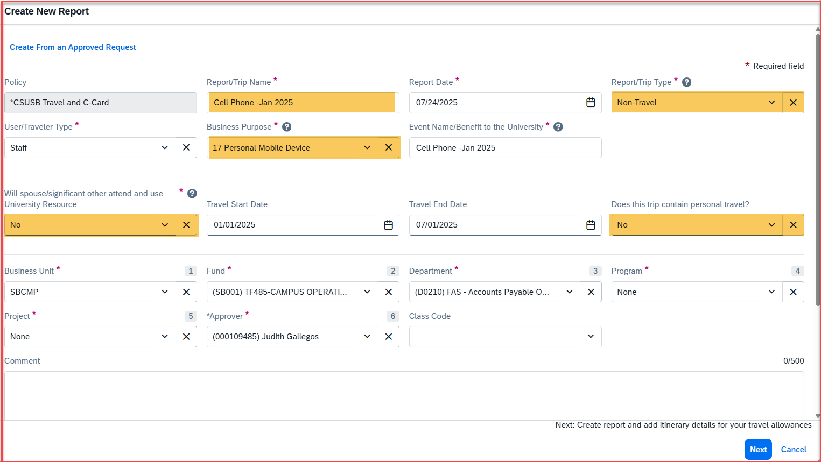
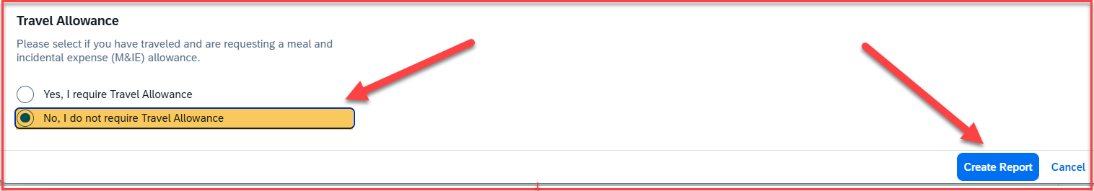
Expense Report Header- All the fields on the header need to be filled in.
The trip type must be non-travel
The business purpose must be 17. Personal Mobile Device
Please select No for the personal travel questions and the spouse attendance question
Fill in the business unit, fund, department, program, and project number of your respective department, and make the correct selection
Select No, I do not require the Travel Allowance
Click on Create Report

Slide 13
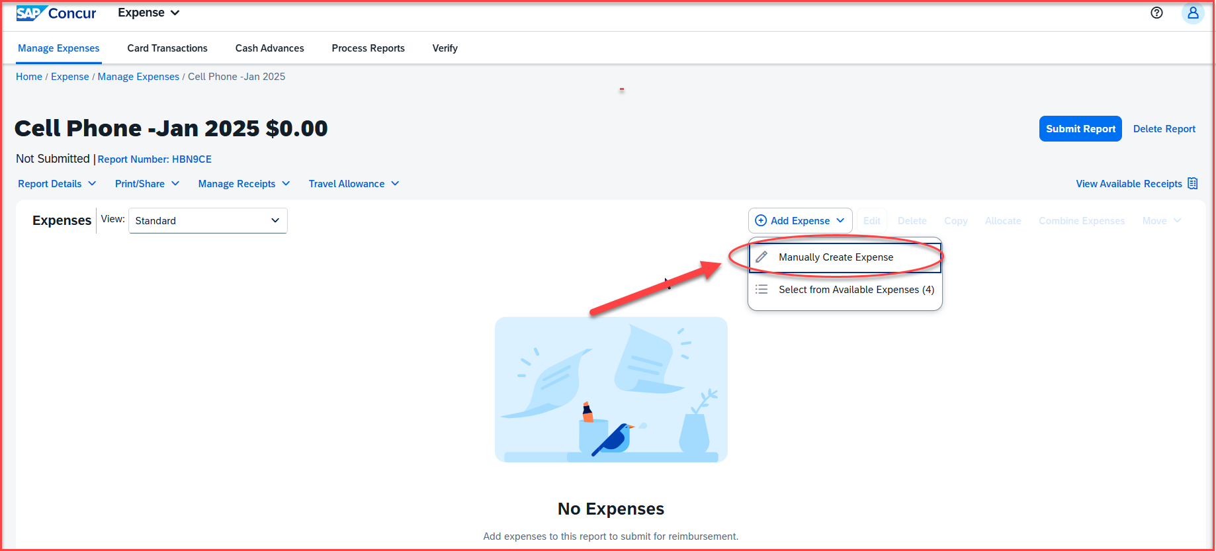
Click on Manually Create Expense

Slide 14
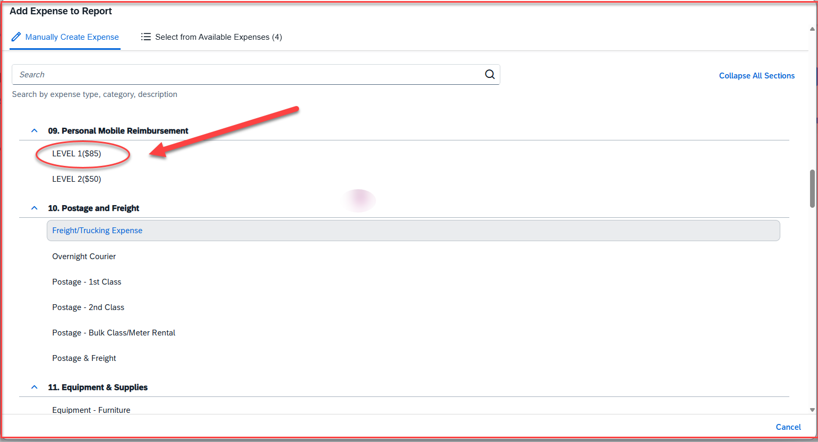
Scroll to 09. Personal Mobile Reimbursement and select the levels
Level 1($85)
Level 2($50)

Slide 15
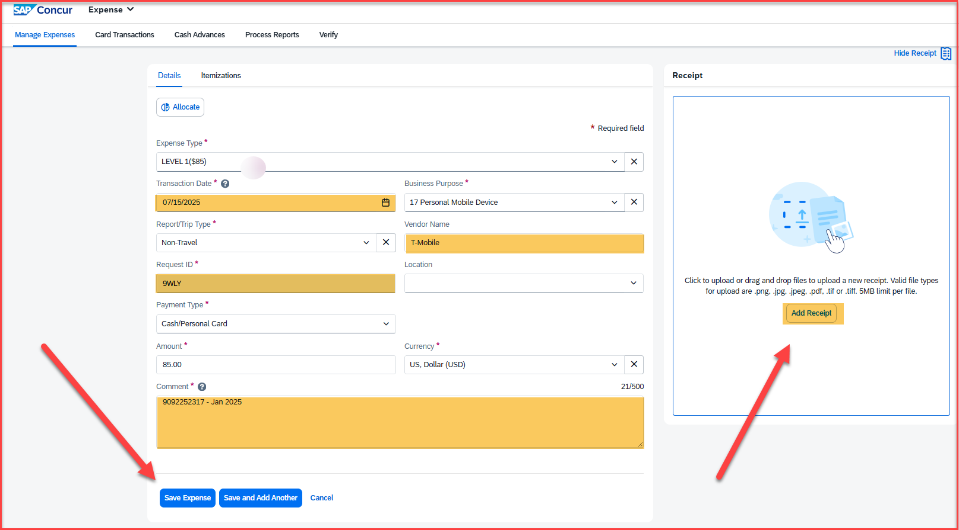
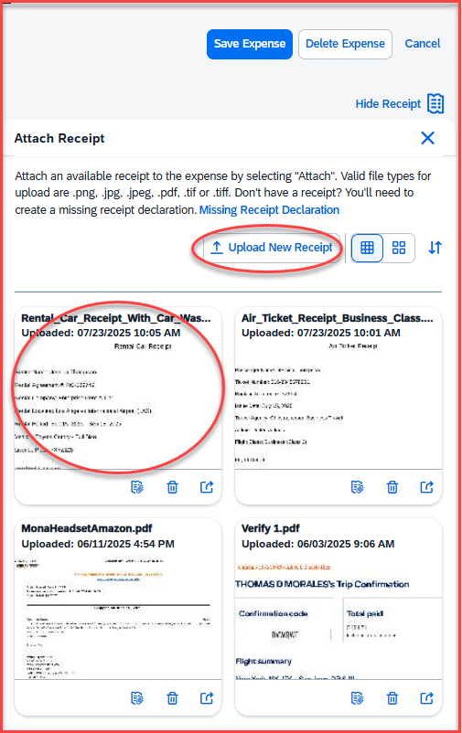
Add all the expense entry details as below
The Transaction Date will be the date of the invoice for the phone bill
Add the Vendor Name
Add the correct request ID from the approved request
Fill in the comment box with the cell phone number and the month you are seeking the reimbursement for
Click on Add Receipt on the right-hand box
The receipt can be uploaded either from the receipt library or from the Upload New Receipt section
Once the receipt is attached, click on Save Expense

Slide 16
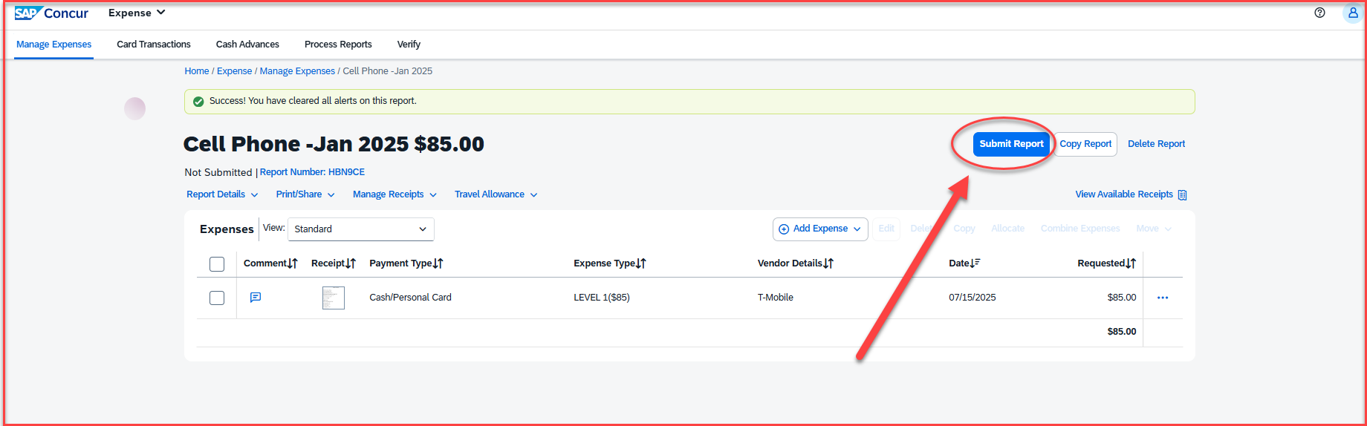
Once the receipt is attached, save the expense and click on Submit Report

Slide 17
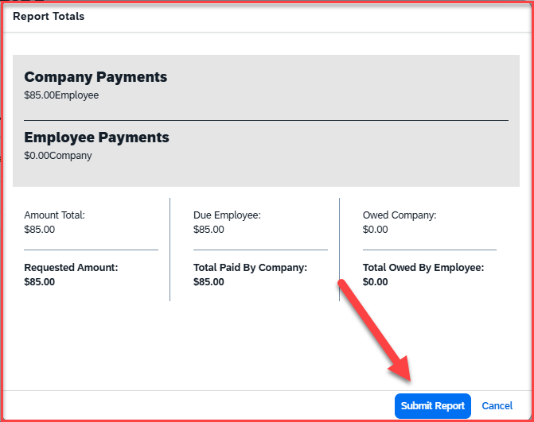
The Report Totals screen will appear. Once that is reviewed, click on Submit Report

Slide 18
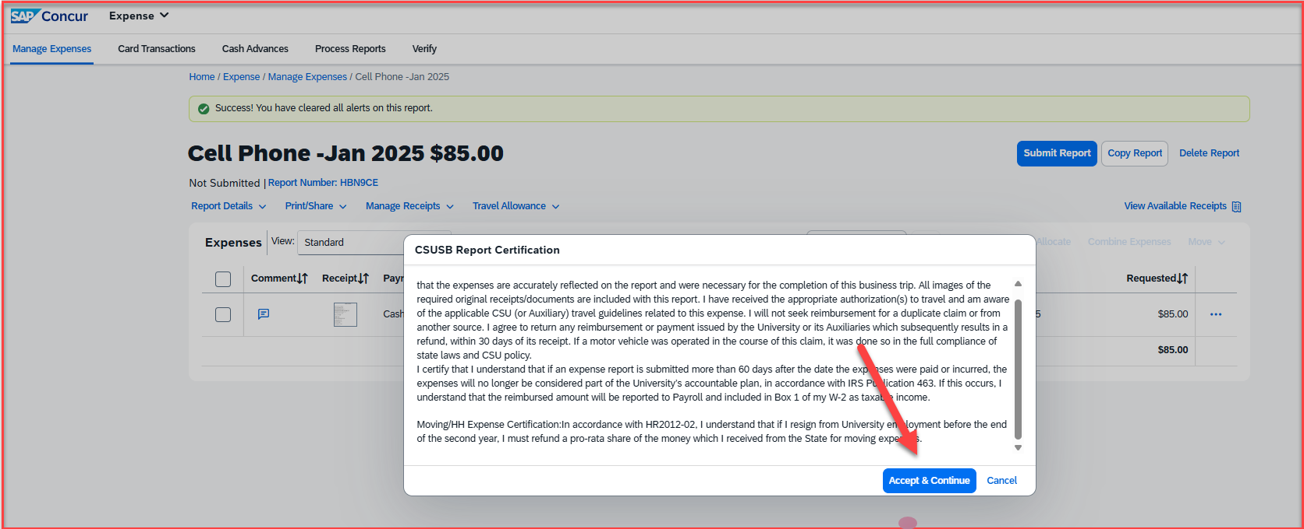
The certification page will appear. Read through, scroll, and click on Accept & Continue

Slide 19
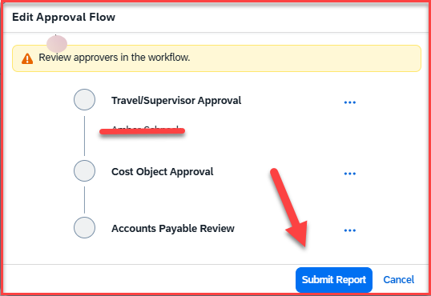
The approval flow page will come up. Once the approvers are reviewed, click on Submit Report

Slide 20
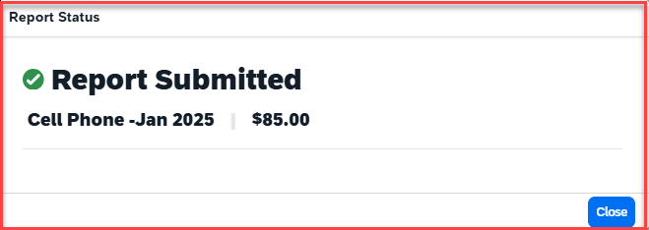
A message will pop up that the report has been submitted

Slide 21
Thank you!
If you need any further information or assistance, please do not hesitate to contact the Travel office at 909 537 5155

