Slide 1
Year End, Summer & Fall Employment Annual Training
Office of Financial Aid & Scholarships
California State University, San Bernardino
Notes:
Welcome to the 2025 Federal Work Study supervisor and timekeeper Training brought to you by the Office of Financial Aid and Scholarships work study department.

Slide 2
Agenda
Eligibility Requirements
Supervisor Responsibilities
FWS Policies & Rules
Placement & Deadlines
Job Posting
Job Codes: Bridge vs. Non-Bridge
Background Check
Summer/Fall Employment
Time Reporting
Termination/ Separation
Notes:
The topics covered in this presentation include: Student Eligibility Requirements, supervisor responsibilities, fws policies and rules, placement and deadlines, job posting, job codes for bridge and non bridge, background check, summer and fall employment, time reporting and termination/ separations.

Slide 3
Student Eligibility Requirements
FAFSA on file
Must be enrolled in at least half-time. (6 units undergraduate; 3 units graduate) per semester
Maintain Satisfactory Academic Progress (SAP) standards
Must have a federal need of at least $2,000
Awarded Federal Work-Study
24/25 for June 2025 employment
25/26 for July 2025 – May 2026 employment
Must be a U.S. citizen, eligible non-citizen, or permanent resident
Complete Online FWS Tutorial
Notes:
The following information is regarding Student eligibility requirements. Student must file the FAFSA application, Be enrolled in at least half-time status, Maintain good academic standing and satisfactory academic progress, demonstrate financial need of at least $2,000, If you plan for your student to work in June 2025 they must have remaining FWS from their 24/25 award, If you plan for your student to work in July 2025 though May 2026 they must be awarded Federal work study for the 25/26 academic year. Students must also be eligible to work in the United States, and complete the online FWS Tutorial yearly.

Slide 4
Supervisor Responsibilities
Provide adequate training
Monitor your student earnings to not exceed their FWS allocation
Develop a work schedule for each student
FWS students must be always supervised and must be aware of who to report to in the absence of the supervisor
Review and approve hours on CHRS on a timely manner
Verify enrollment each term
Complete FWS Supervisor/Timekeeper training
Notes:
The following information are responsibilities that supervisors must adhere to participate in the work study program. The supervisor has the responsibility for providing adequate training. Provide clearly defined supervision through well-defined expectations. This may be the first job the student has ever held. Give clear, concise directions and don’t assume they understand the required tasks/duties/responsibilities. Monitor student employee’s performance, for quality of work, an annual student employee performance evaluation will be asked to be completed at the end of each academic year
Monitor your student earnings to not exceed their FWS allocation
Develop a work schedule for each student including hours and days. Explain the methods for communicating missed work time. Review and approve student employee work hours accurately and verify that all hours reported are accurate (Students are not allowed to work during scheduled class hours.)
FWS students must be supervised at all times and must be aware of who to report to in the absence of the supervisor. The job duties assigned to a FWS student cannot replace those of a regular employee.
Review and approve hours on CHRS on a timely manner
Complete annual FWS Supervisor/Timekeeper training

Slide 5
FWS Policies & Rules
Provide orientation on job expectations, comfort breaks, training, phone usage, etc.
Monitor earnings and do not exceed FWS award
Do not exceed daily, weekly, monthly maximum hours
Student must stop working on the last day of the academic year, if they drop to less than half-time, withdrawal, or graduate
Student must stop working if funding is exhausted by student or FWS program
Any change in the student’s employment or supervisor must be reported to the FWS Lead
Verify enrollment each term
Students can only be employed in ONE FWS position on/off campus at a time.
If student wants to transfer to a different department, they must contact FWS BEFORE they accept another position under the FWS program
Notes:
The following information are some of the FWS policies and rules. Student must stop working on the last day of the academic year, if they drop to less than half-time, withdrawal, or graduate. Student must stop working if funding is exhausted by student or FWS program. Any change in the student’s employment or supervisor must be reported to the FWS Lead.
Students can only be employed in one FWS position on/off campus at a time. Should students wish to be employed in multiple positions on campus, the department(s) would need to hire the students through non-FWS student positions.
NOTE: If employed in both a FWS position and a non-FWS position students may still only work a maximum of 20 hours per week between both positions. If student wants to transfer to a different department, they must contact FWS BEFORE they accept another position under the FWS program.

Slide 6
FWS Placement & Deadlines
June 2025 Employment:
First day of summer employment is June 1st
FWS students must have remaining funding from 2024-2025 FWS award to work June 1 – June 30
If no 2024-2025 funding available for June, students cannot begin working until July 1st under their 2025-2026 FWS award
Students must be enrolled in at least half-time units for Fall 2025
July-August 2025 Employment:
Based on summer session enrollment
Students must have a 2025-2026 FWS award to participate
Students must be enrolled in at least half-time units for Fall 2025
Incoming Freshman or Transfer students may not begin working until August 18,2025
First day of Fall employment:
August 18, 2025
Placement deadline: October 6, 2025
Instructional Student Assistants (ISA)
Open until filled
The FWS student must complete the entire hiring process before they may begin working
If you allow your student to work before the entire hiring process has been completed, you will have to hire as a concurrent hire to pay the student from your department’s funds
Notes:
June 2025 employment: The first day of summer employment will be June 1st. FWS students must have remaining funding from 24-25 FWS award to work from June 1st through June 30th. If no 2024-2025 funding is available for June, students cannot begin working until July 1st under their 2025-2026 FWS award. Students must be enrolled in at least half-time units for Fall 2025
July-August 2025 Employment is Based on summer session enrollment. Students must have a 2025-2026 FWS award to participate, students must be enrolled in at least half-time units for
Fall 2025 and incoming freshman, or transfer students may not begin working until August 18,2025
The First day of Fall employment will be August 18, 2025,. As mentioned earlier the placement deadline for 25-26 will be October 6, 2025, for the exception of Instructional Student Assistants (ISA) those positions are open until filled.
FWS student must complete the entire hiring process before they may begin working.
If supervisors allow their students to work before they receive the FWS Routing Slip, it will become their responsibility to hire the student as a concurrent hire to pay the student from their department’s funds.

Slide 7
Job Posting
Create a FWS student position description in CSU Recruit for new hires
Hiring administrator will then receive an email notification of the fully approved position description
Employment Services will complete the job card within 24 hours and the recruitment will be posted
Determine hourly rate, justification are required for all starting rate above minimum hourly rates
Do not post FWS jobs on Handshake or the Campus/BB list serves
Please ensure that jobs are posted by August 1st to ensure students are hired by October 6th placement deadline
Continuing re-hire positions do not need to be posted on CSU Recruit you can re-hire students through Cherwell
Notes:
All FWS positions must be posted on CSU Recruit for new hires. Create a FWS student position description in CSU Recruit Hiring administrator will then receive an email notification of the fully approved position description. Employment Services will complete the job card within 24 hours and the recruitment will be posted. Determine hourly rate, justification are required for all starting rate above minimum hourly rates. Do not post FWS jobs on Handshake or the Campus/BB list serves
Please ensure that jobs are posted by August 1st to ensure students are hired by October 6th placement deadline. Continuing re-hire positions do not need to be posted on CSU Recruit you can re-hire students through Cherwell.

Slide 8
Bridge vs. Non-Bridge Appointments
Non-Bridge on-campus job code 1871
Non-Bridge off-campus job code 1872
ISA appointment job codes: 1151/1153
Bridge on-campus job code: 1875
Bridge off-campus job code: 1876
A bridge appointment occurs when there is a 5-week break in attendance based on student’s summer enrollment, student is subject to FICA and Medicare taxes
Notes:
The following information is for bridge and non bridge appointments. A bridge appointment occurs when a student has a 5 week break in enrollment. For example, if they are not taking summer classes, they will need to be bridge for the summer portion if they continue to work. The job code for non-bridge on campus students is 1871 and bridge students on campus is 1875. For Off campus the bridge job code is 1876 and ISA's will stay the same.

Slide 9
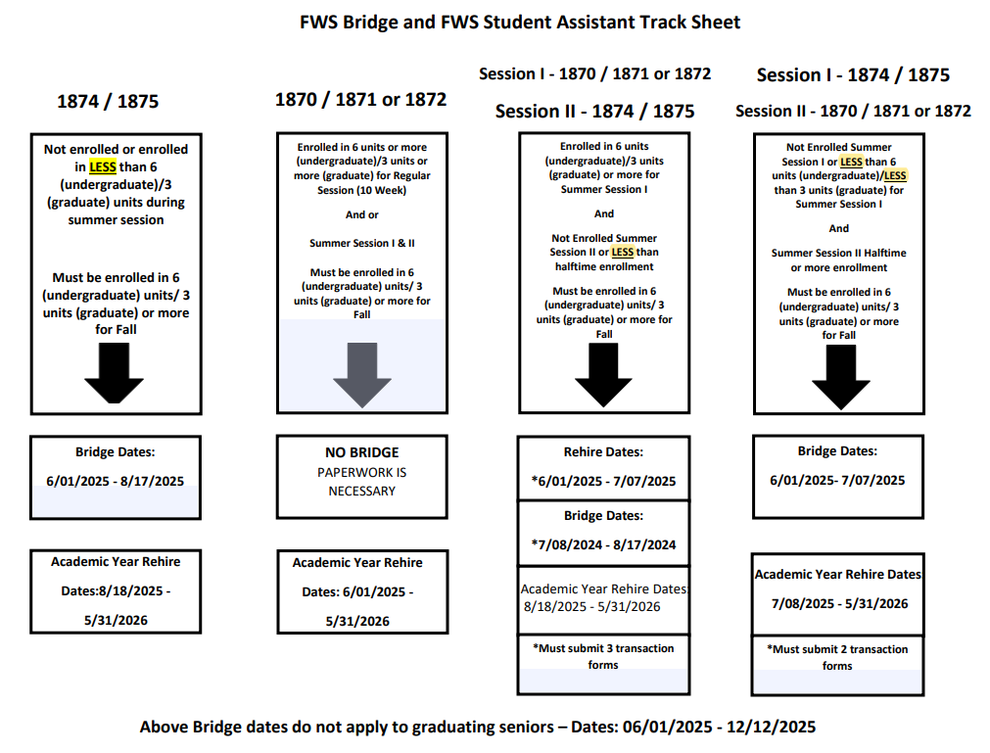
Notes:
This is our FWS Bridge and FWS student assistant track sheet for this summer and upcoming academic year it will show how many student transition requests you will need to complete through Cherwell depending on the students summer enrollment. In the past our office determined the dates dates and number of transaction forms you needed but this year we won’t be able to do so since the rehiring process will take place in Cherwell therefore this track sheet will be helpful when determining the amount of forms you will need to submit. We will still be reviewing your work and if you need additional transaction forms we will reach out to you.

Slide 10
Background Check
The hiring department is responsible for determining whether their student will be in a position in which a background check is required by law
Students employed in the following areas will require a background check:
Regular or direct contact with minors
Access to patients, drugs or medication
Access to stored criminal offender records
Access to, or control on a regular basis of amounts greater than $10k in cash, checks, credit cards, and/or credit card account information
Requires access to level 1 data
Rehire Exemption: not required for continuing students employed in the same position for the last 12 months
If you have any questions regarding background checks and/or Live Scans, please contact Human Resources at (909) 537-5138
Notes:
The hiring department is responsible for determining whether their student will be in a position in which a background check is required by law. Students employed in the following areas will require a background check: If the position requires being in regular direct contact with minors, Position requires access to stored criminal offender record information, Position requires access to patients drugs or medication, Position requires access to-or control on a regular basis of amounts greater than $10,000 in cash, checks, credit cards, and/or credit card account information. Students cannot begin employment until all clearances have been met. Rehire Exemption: not required for continuing students employed in the same position for 12 months. If you have any questions regarding background checks and/or livescans please contact human resources at (909) 537-3138.

Slide 11
Time Reporting
Approve time in CSU Common Human Resource System (CHRS)
Adhere to Student Positive Pay Calendar located on the FWS website
Adhere to 20 hour per week rule
Per CA Labor Code 512 employees are entitled to an unpaid 30-minute meal break when working more than 5 hours a day. However, if the student is working no more than 6 hours and there is both mutual consent of hiring manager and employee, the meal period may be waived.
Students are entitled a 10-minute paid break for every 4 consecutive hours worked
Report hours for the correct pay period
Students are paid once a month – Pay day is around the 15th of every month
No overtime, holiday or work during campus closure
Falsified timesheets are subject to termination and disciplinary action by Office of Student Conduct and Ethical Development
Notes:
The following are time reporting instructions. Please make sure you are reviewing and approving students' hours in CHRS. Adhere to the Student Positive Pay Calendar. The work-study student payroll calendar is located on the Federal Work Study website and Payrolls website under calendars. The payroll calendar provides information of when payroll is due; the maximum hours a student may work; and when they can expect their paycheck. Adhere to 20 hours per week rule, during breaks if you need your student to work over the 20 hours please send a memorandum to workstudy@csusb.edu, the memorandum should include the name and coyote ID# of the student, your name and departments name, and the reason why you are requesting for them to work over the 20 hours. Per California Labor Code 512 and the Dept of Industrial Relations website students are entitled to an unpaid 30 minute meal break when working more than 5 hours a day. However, if the student is working no more than 6 hours and there is both mutual consent of hiring manager and employee, the meal period may be waived. Students are also entitled to a 10-minute paid break for every 4 consecutive hours worked. No hours should be reported for any time other than the payroll period. Students get paid once a month on or around the 15th of every month. No overtime, holiday or work during campus closure. Students who falsify their hours are subject to termination and disciplinary action by Student Conduct & Ethical Development.

Slide 12
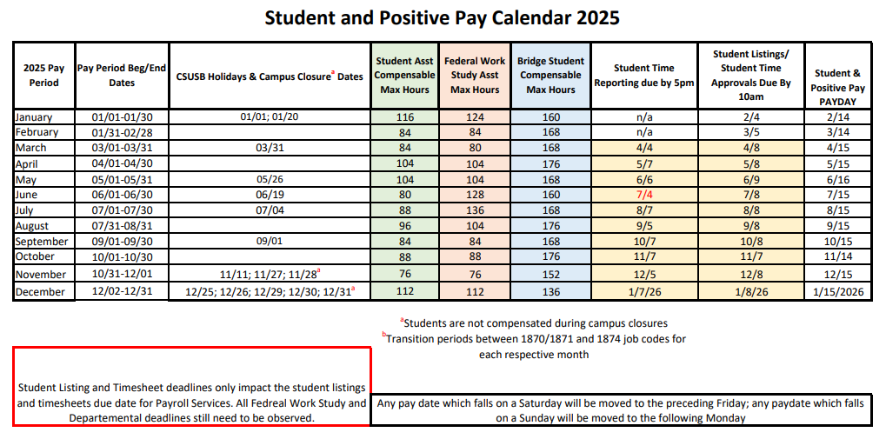
Notes:
This is the 2025 Student and Positive Pay Calendar. Note this calendar will give you each pay period beginning and end dates, please make sure your student is reporting hours for the correct pay period dates when approving their time. Note campus closure dates as students cannot get paid for holidays or campus closures. For FWS maximum monthly hours you will look at the pink section please do not let your students work more than 8hrs per day, no more than 20 hours per week and no more than the maximum hours each month. You will also find when student reporting is due and when student time approvals are due in this calendar please approve students time in a timely manner. Lastly you will also find the students expected pay day for each pay period.

Slide 13
Termination/Separation
Voluntary Separations include:
Separating or withdrawing from the university, graduating, resignation
Per AB 2410, which amended Section 220 of the Labor Code, an employee who voluntarily resigns must be paid wages earned no later than 72 hours from the date of separation.
Involuntary Dismissals Include:
GPA Ineligibility, Budget limitation, Attendance/observance of work hours, Serious misconduct, Involuntary Dismissals must have FWS approval before any action is taken.
Per AB 2410, which amended Section 220 of the Labor Code, an employee who is discharged must be paid wages earned immediately.
Note: The student is entitled to receive pay for all hours worked at the time of separation. Failure to comply is in violation of the Assembly Bill AB 2410 section 220 and may result in fines to the department. Please notify FWS Lead prior to terminating involuntary Dismissals
Mass Separations:
Year-end mass terminations will be completed for all work-study student assistant positions. These usually occur at the end of each academic year
Notes:
The following information is for terminations and separation.
Voluntary Separations include: Separating or withdrawing from the university, Resignation, Graduating (cannot work beyond the last day of finals week during eligible term),and resignation. Per AB 2410, which amended Section 220 of the Labor Code, an employee who voluntarily resigns must be paid wages earned no later than 72 hours from the date of separation. Although it is customary to provide at least two (2) weeks' notice, such notice is not legally required. A FWS student assistant who resigns from employment must be paid wages earned no later than 72 hours from the date of separation. If the student provides notice of resignation at least 72 hours in advance, then all wages earned must be paid on the last day of employment.
Involuntary Dismissals Include: GPA Ineligibility, Budget limitation, Attendance/observance of work hours, Serious misconduct, Involuntary Dismissals must have FWS Lead approval before any action is taken. Per AB 2410, which amended Section 220 of the Labor Code, an employee who is discharged must be paid wages earned immediately. Note: The student is entitled to receive pay for all hours worked at the time of separation. Failure to comply is in violation of the Assembly Bill AB 2410 section 220 and may result in fines to the department. Please contact Student Employment for general guidelines before proceeding with a dismissal request.
Year end Mass terminations will be completed by Employment Services at the end of every academic year. No termination paperwork required if the student employee is expected to be rehired.

Slide 14
Work-Study Contact Information
Leslie Delgadillo
Federal Work-Study Coordinator
Leslie.Delgadillo@csusb.edu
(909) 537-7149
Lizzet Lopez
Federal Work-Study Lead
Lizzet.lopez@csusb.edu
(909) 537-3433
Office hours: Monday-Friday 8AM-5PM​
Summer hours: Monday-Thursday 8AM-5PM​
Student line: (909)537-5226​
FAX line: (909)537-7024​
FWS Email: workstudy@csusb.edu
Notes:
The following information is the FWS contact information. You may contact Leslie Delgadillo our Federal work study coordinator at Leslie.Delgadillo@csusb.edu or via phone at (909) 537-7149. You may also contact our Federal work study lead at Lizzet.lopez@csusb.edu or via phone at (909) 537-3433. Please note! The Work Study office is located in University Hall room 150. The work study counter services office hours are Monday - Friday: 9 am - 5 pm. Summer hours are Monday - Thursday: 9 am - 5 pm. The student line extension is 75226. You may fax your documents to the Office of Financial Aid and Scholarship at (909) 537-7024. You may also email us at workstudy@csusb.edu. Thank you for completing the annual work-study supervisor training. This concludes the online work-study supervisor training please complete the assessment next.

