Slide 1
Create a domestic expense report with Hotel expense

Slide 2
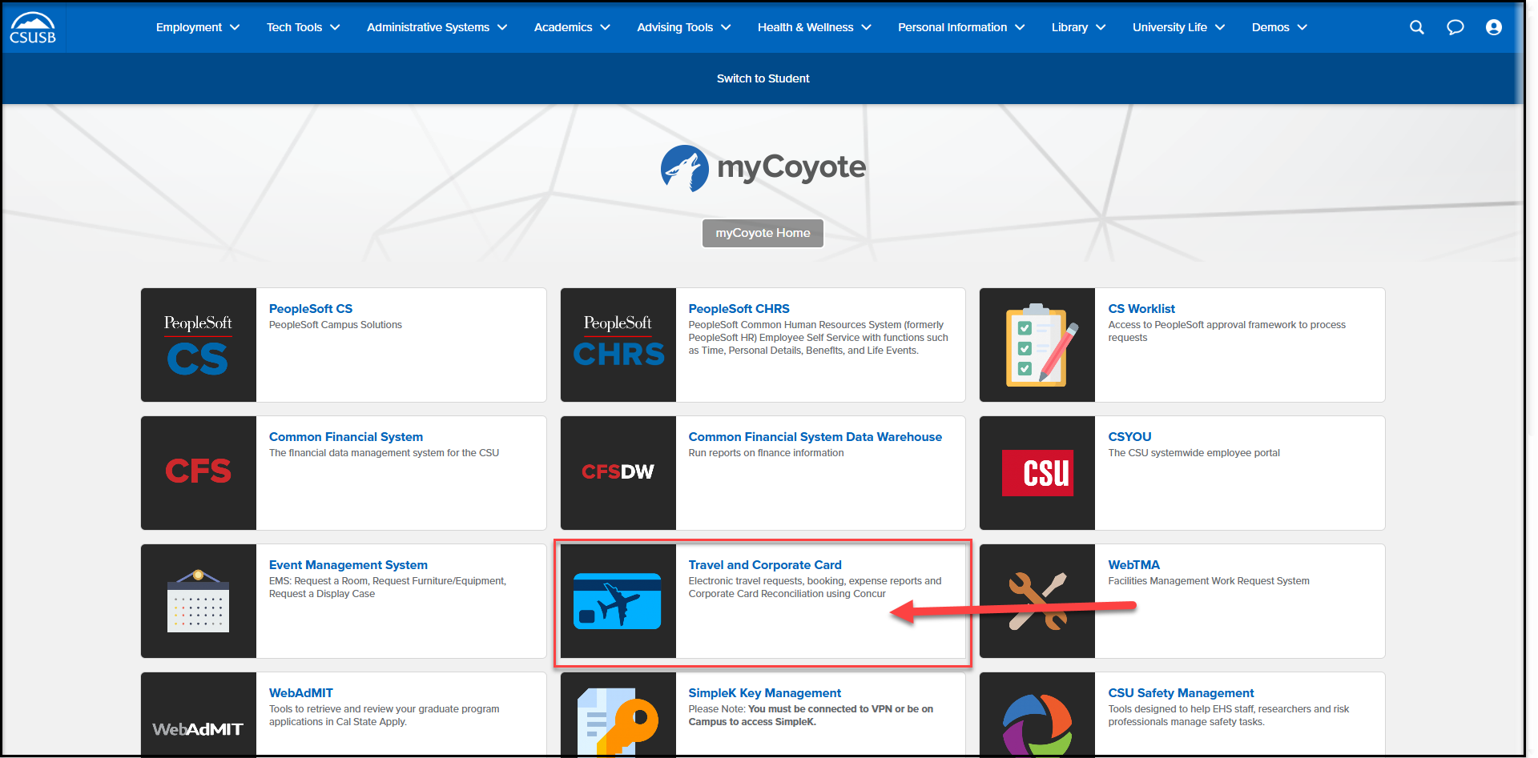
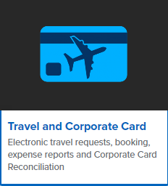
On the single sign on page, type in your mycoyote ID and password, hit enter and then either choose My Employment or, Administrative Systems and click on the Travel and Corporate card Icon as shown below:

Slide 3
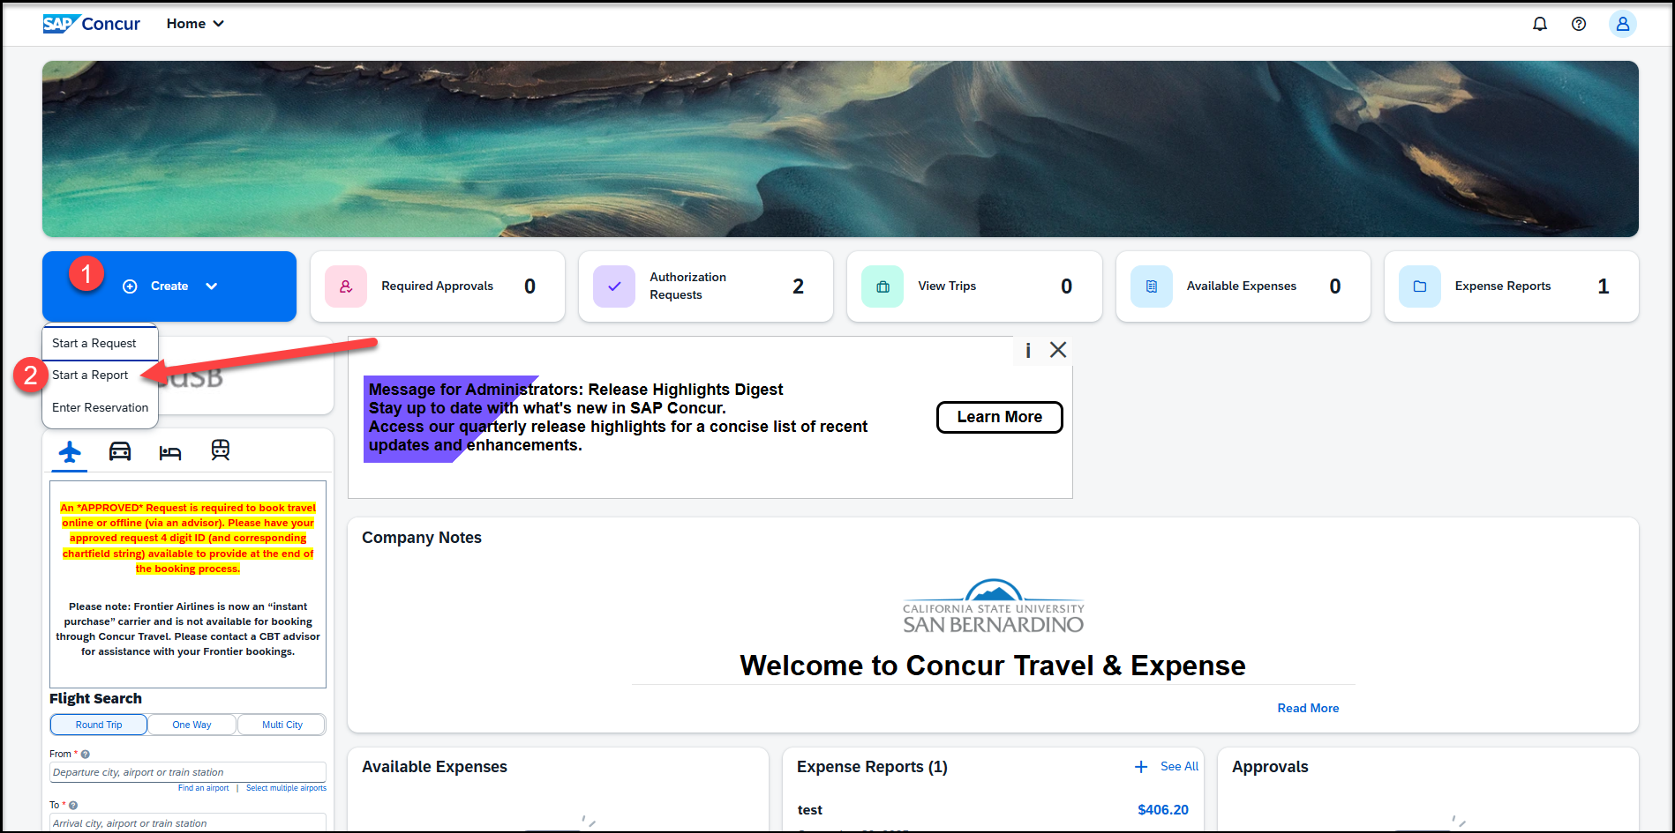
To begin the expense report, click on Create, then Start a Report

Slide 4
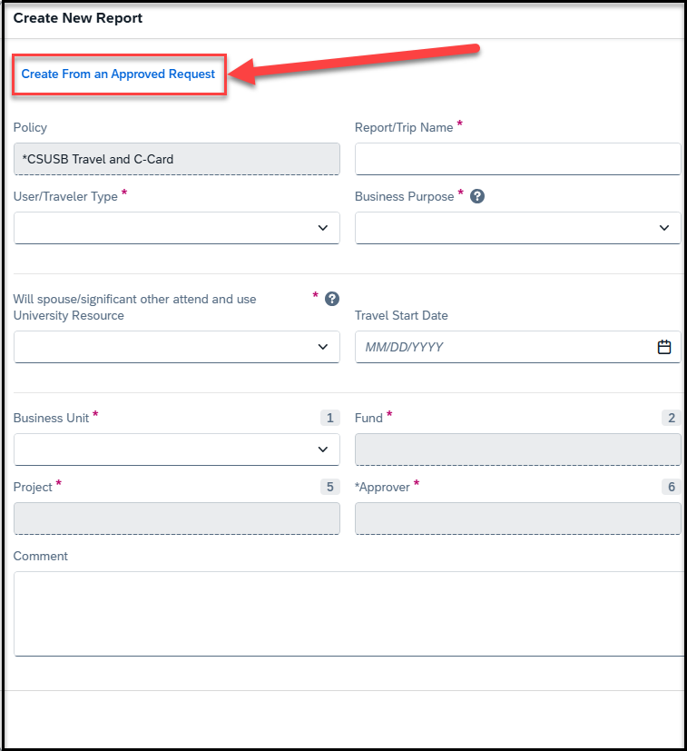
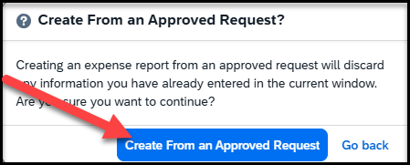
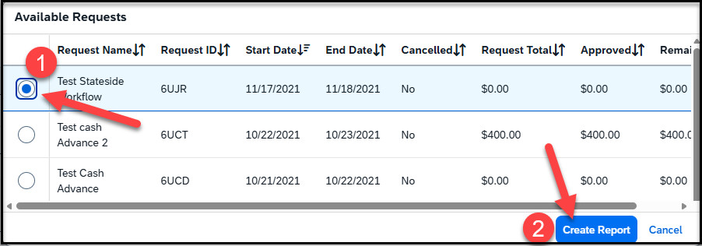
Click on Create from an Approved Request
Once you click on create from an Approved Request
-- Click on the first pop up Create From an Approved Request
--Select the Available Request and Create Report

Slide 5
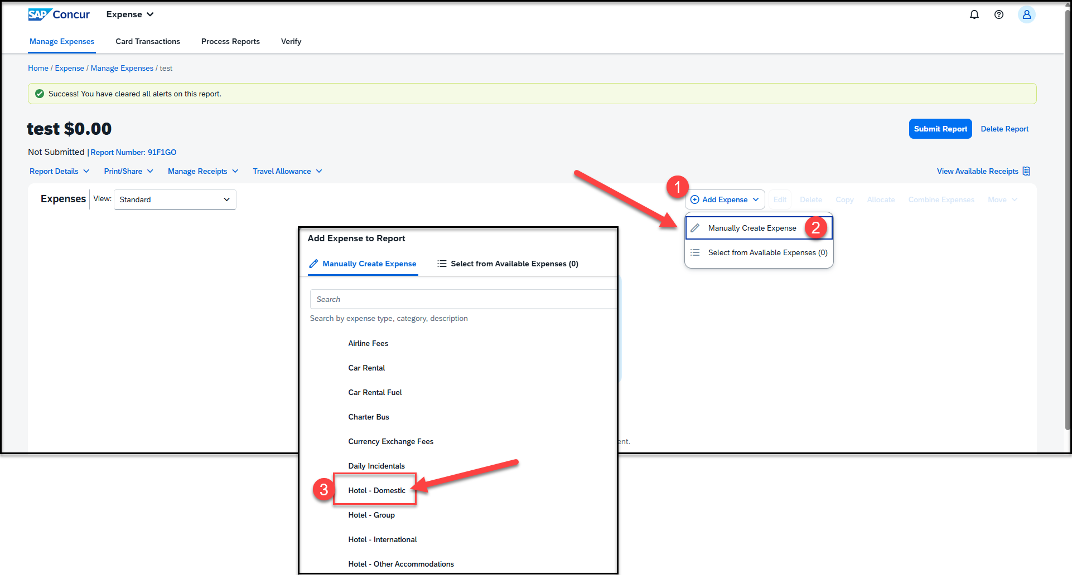
To add the Hotel expense, click on Add Expense > Manually Create Expense > Hotel-Domestic. For hotel expenses out of the country, select Hotel-International. For hotel expenses that involve a group of students, select Hotel – Group. For any other accommodation, like Airbnb, select Hotel - Other Accommodation.

Slide 6
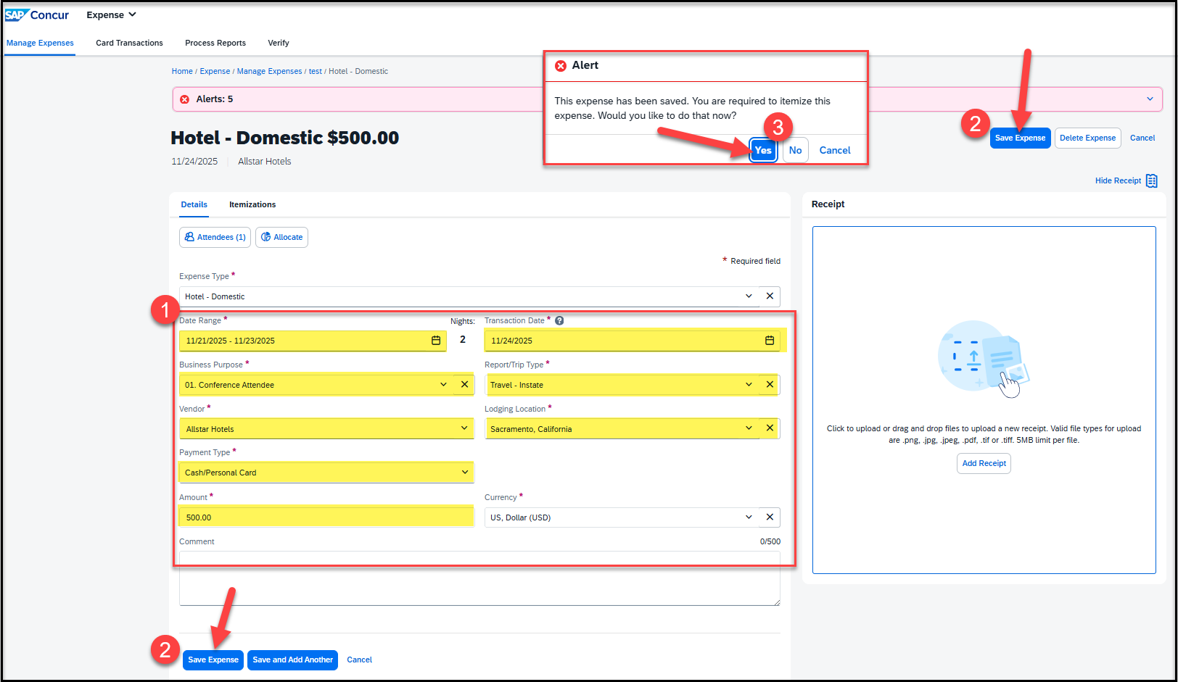
Add the Date Range (Check-in date and Check-out date), Transaction Date, Business Purpose, Report/trip Type, Vendor Name, Lodging Location, Payment Type, and Amount. Once all that is entered, Save Expense.
Once the expense is saved, an alert will come up to itemize the expense
Click on “Yes” to proceed

Slide 7
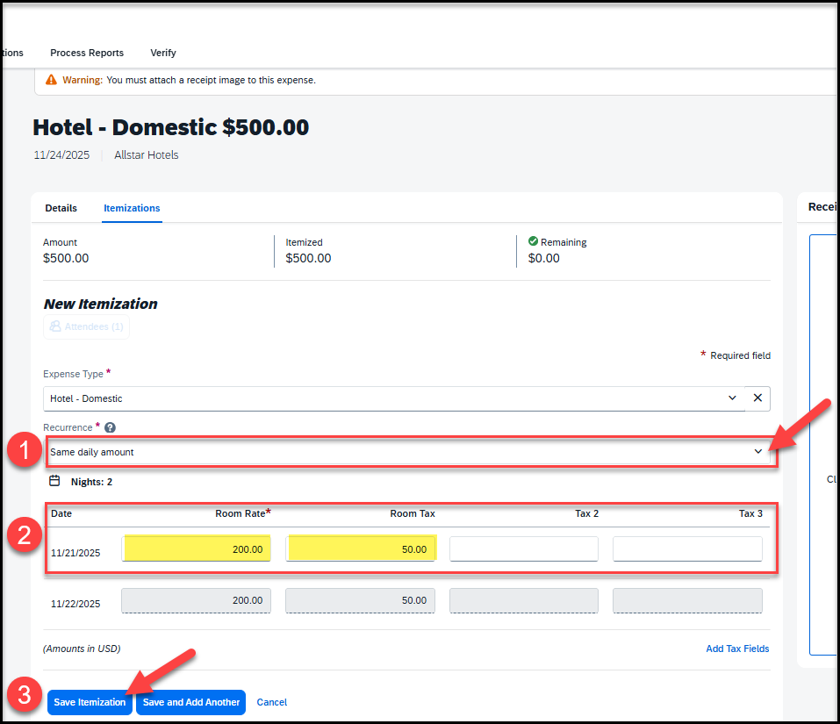
Adding Itemizations for hotel expense
If the nightly rates are consistent, select “Same daily amount” from the dropdown. If the rates vary by night, select “Different daily amount.”
Enter the Room Rate (per night) and Room Tax (per night)
Save Itemization

Slide 8
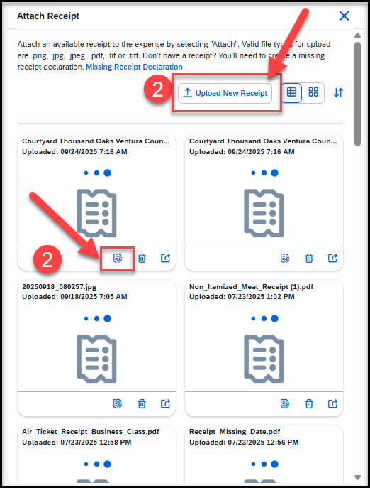
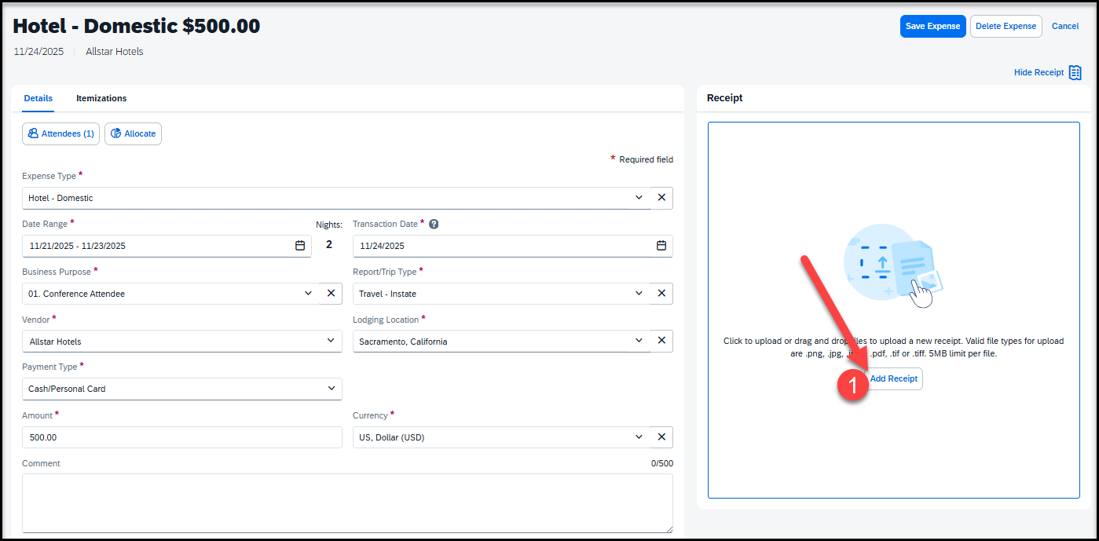

Attaching Receipts
Once the itemizations are saved, click on Attach Receipt Image
The receipt can be uploaded from the receipt library (Attach icon), or, from the folder where the receipt is saved (Upload New Receipt)
Attach receipt and any other supporting documentation and Save expense

Slide 9
THANK YOU!
If further information or assistance is needed, please do not hesitate to contact Accounts Payable/Travel travel@csusb.edu at 909-537-5155
Notes:
Updated August, 2017 CL

