Slide 1
Create an expense report with allocations

Slide 2
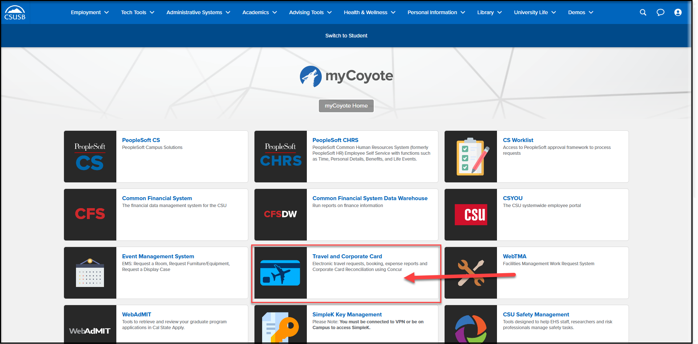
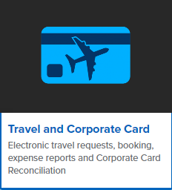
On the single sign on page, type in your mycoyote ID and password, hit enter and then either choose My Employment or, Administrative Systems and click on the Travel and Corporate card Icon as shown below:

Slide 3
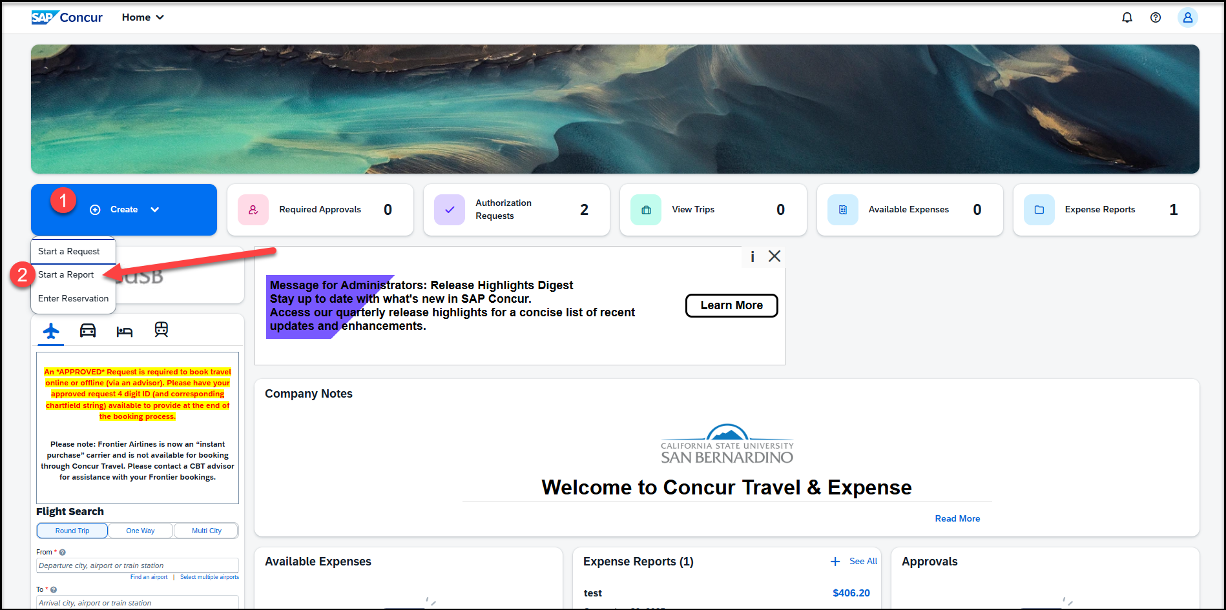
To begin the expense report, click on Create, then Start a Report

Slide 4
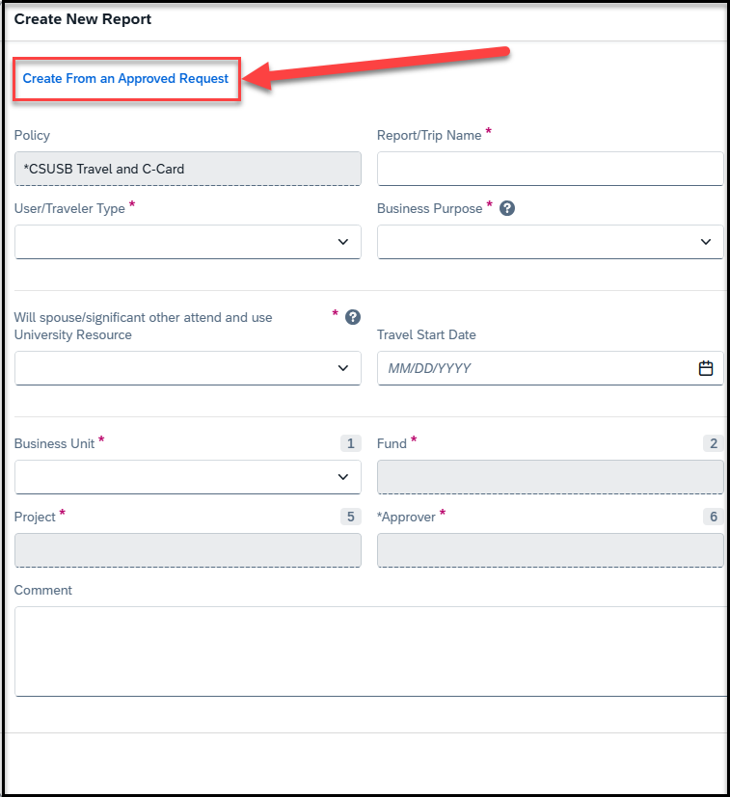
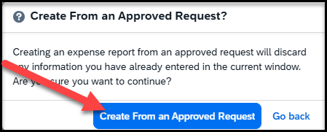
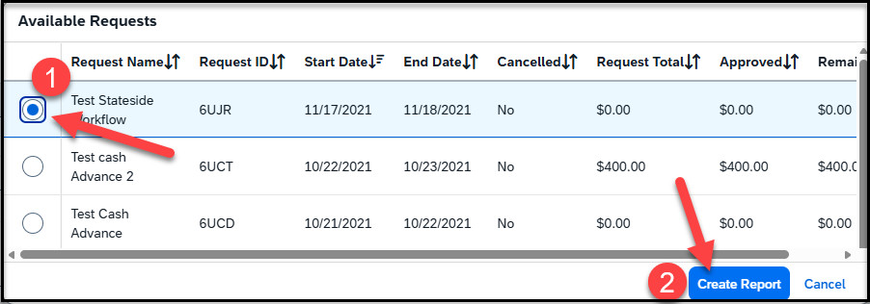
Click on Create from an Approved Request
Once you click on create from an Approved Request
-- Click on the first pop up Create From an Approved Request
--Select the Available Request and Create Report

Slide 5
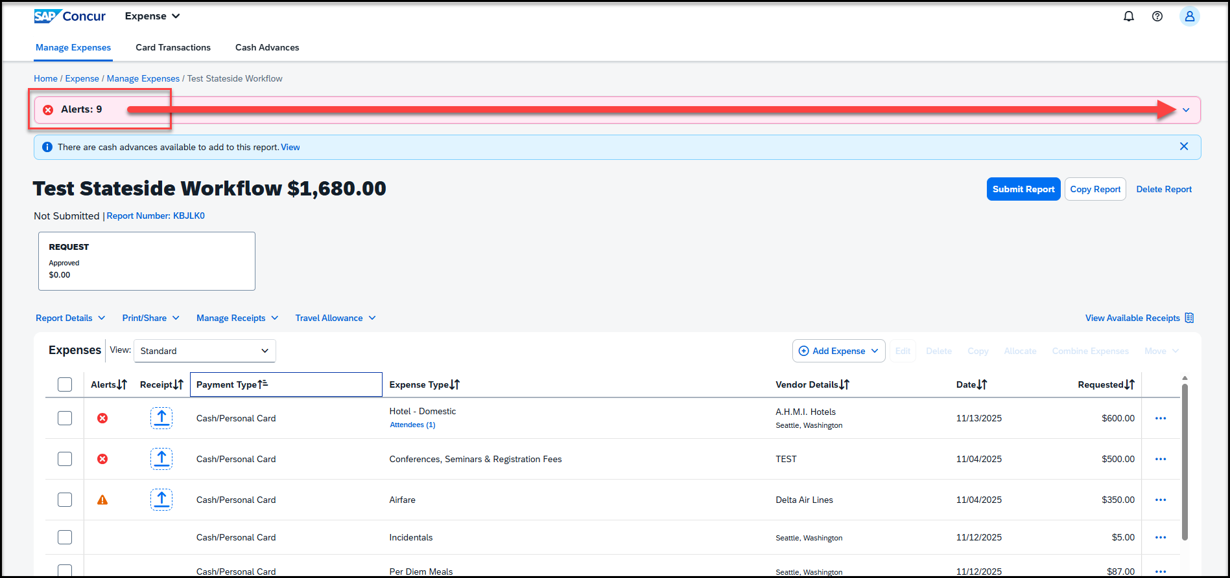
Once the report is created, there will be alerts. All the red alerts will have to be cleared. Click on the down arrow to view all the alerts

Slide 6
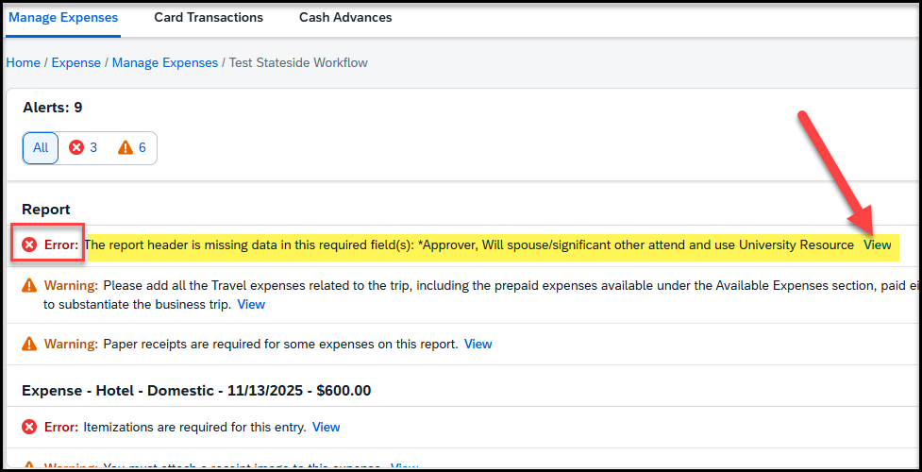
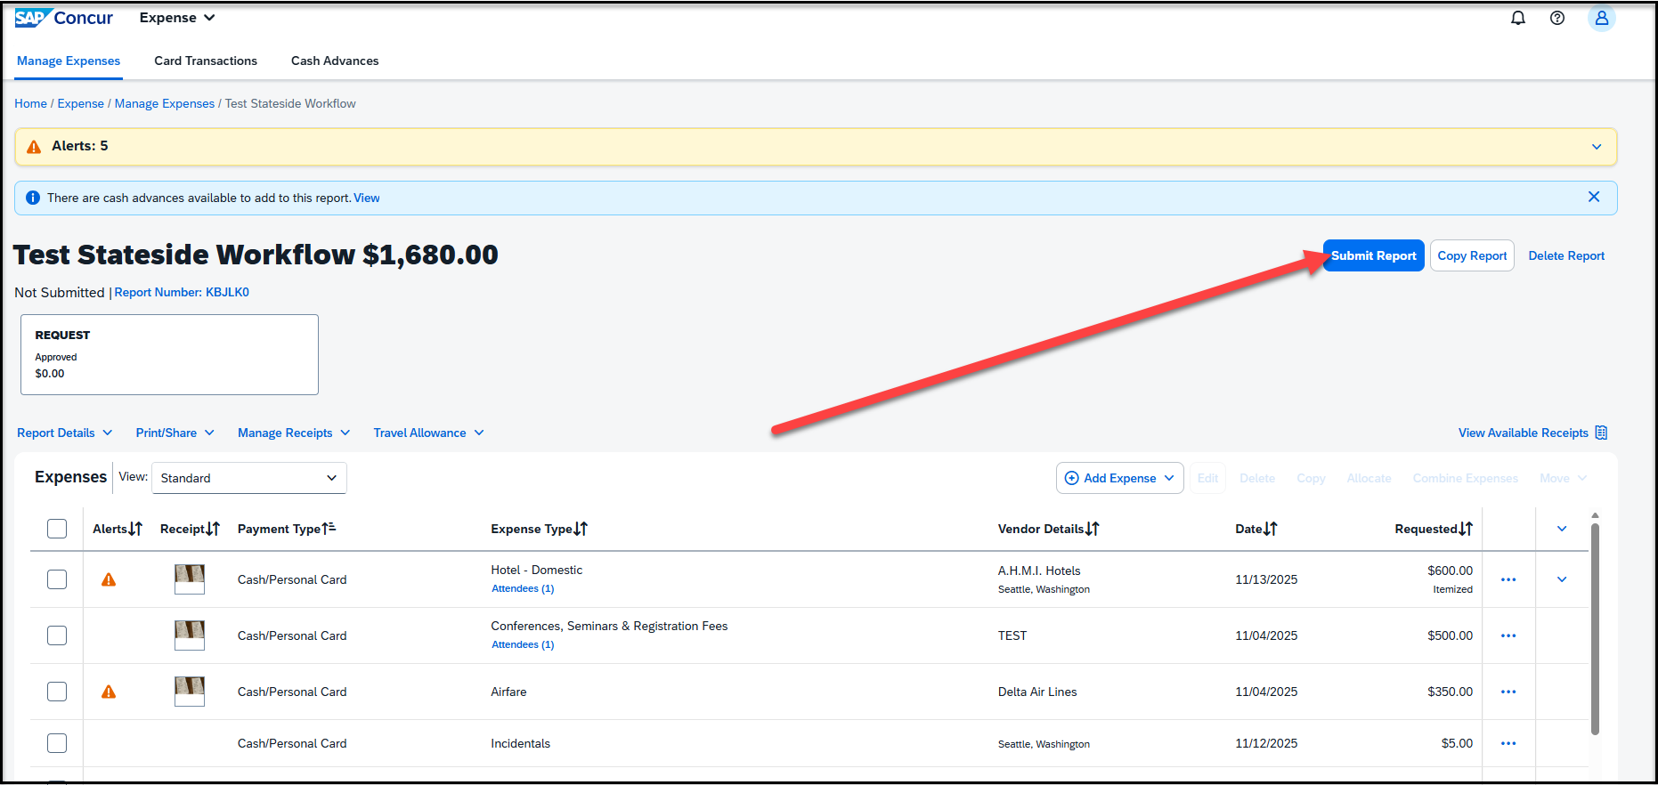
Clearing Alerts
In an expense report, there will always be an alert for missing data in the report header.
Please click on view and you will be directed to the header page, to update the missing information, including the budget approver, and hit save
All the other alerts will be either for attaching receipts, adding location for airfare, lodging etc. for expenses on the report
Since the expense report is created from your Travel Request prior to travel, you must update the actual meals for each specific days and exclude meals provided at the event. Use Travel Allowance.
Once all the alerts are cleared, the report is ready to be submitted – click on Submit Report

Slide 7
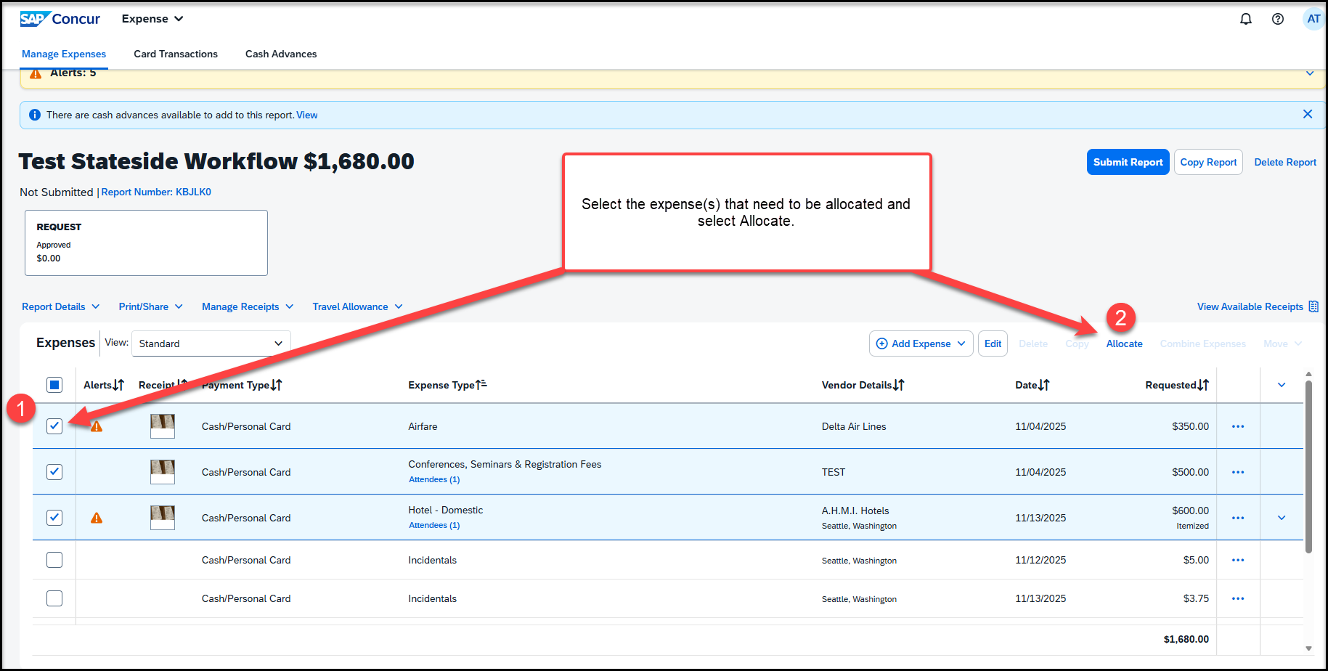
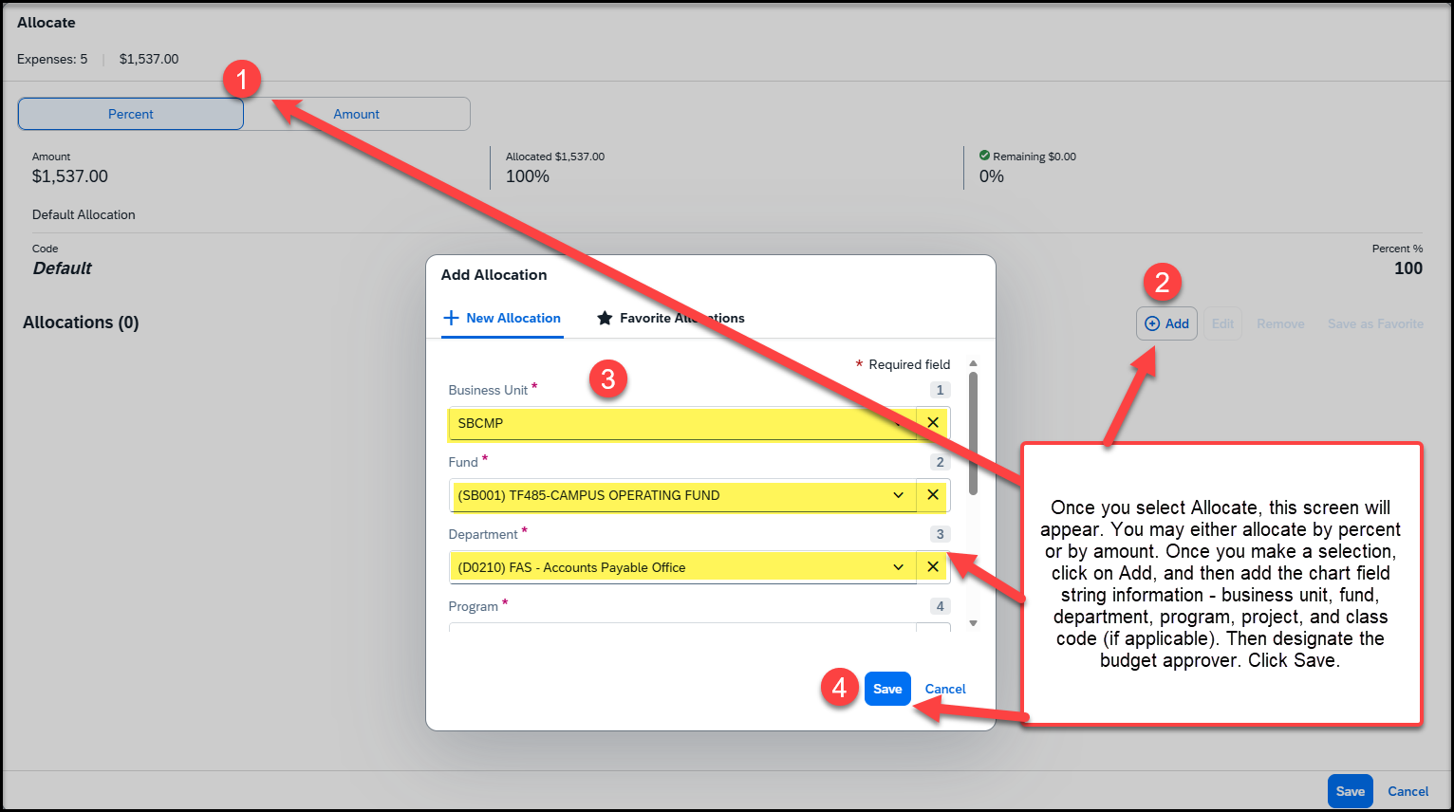
Adding Allocation
To start creating the allocations, select the expenses and click on allocate
The allocation can be done by percentage or by amount
Once the option is selected, click on Add, to start adding the chart field string
The budget approver will have to be added at the end of the chart field string

Slide 8
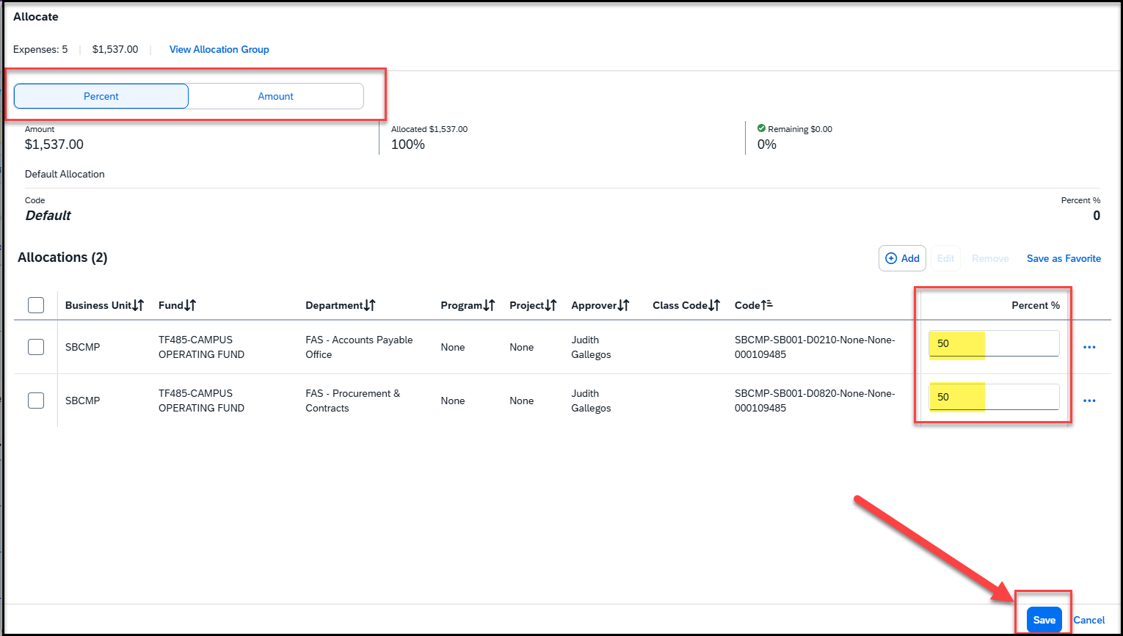
Adding the Chartfield String
Once the chart field is entered and saved, the allocations will appear, showing the account string
Adjust the percentage or amount. Click save at the bottom right corner
The expense report is now ready with the allocations

Slide 9
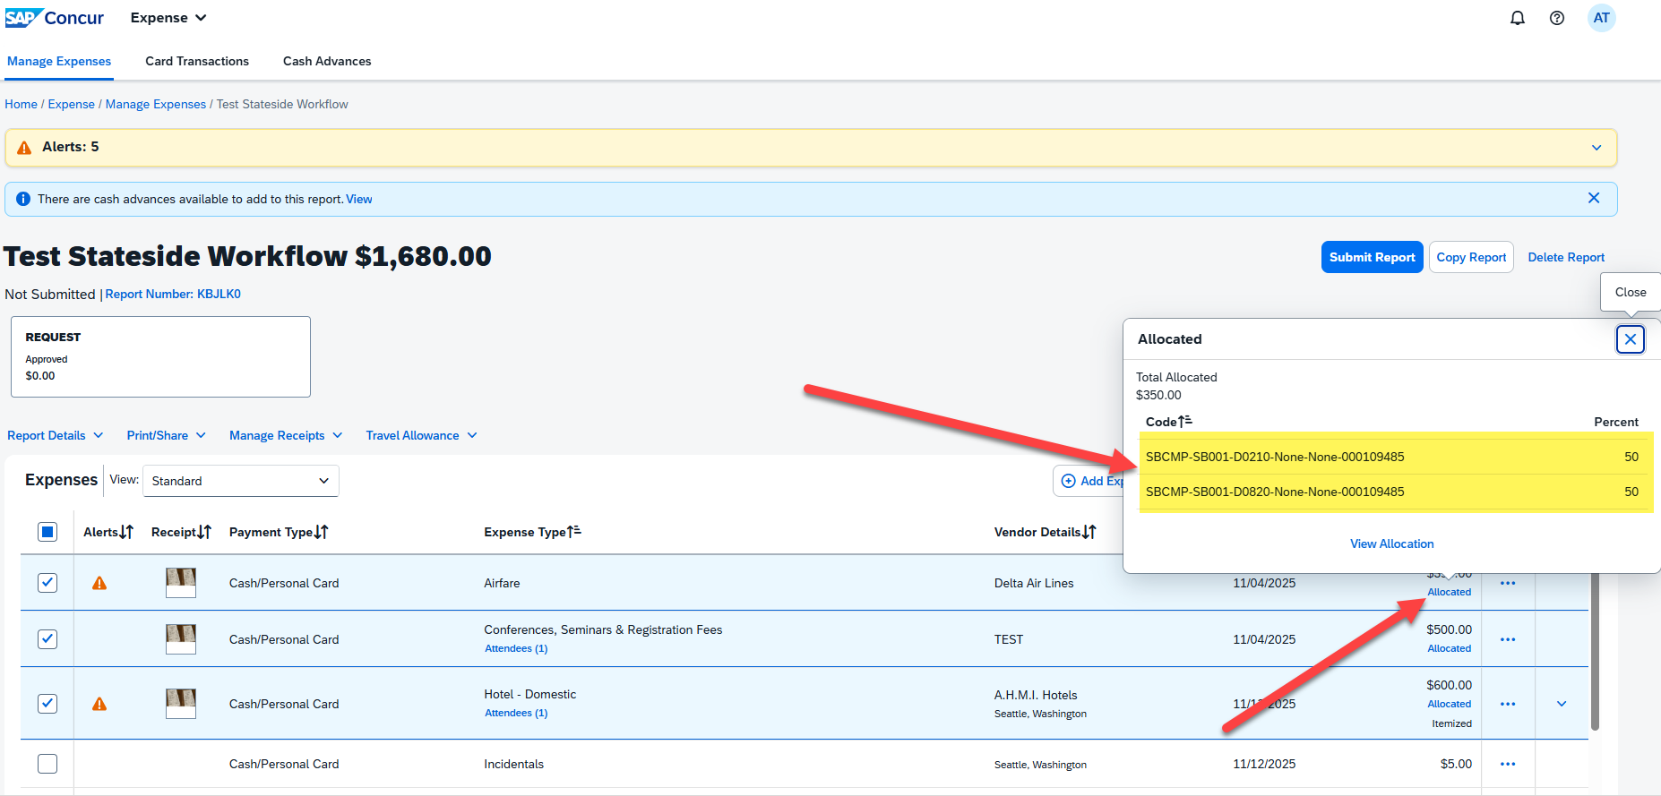
Once the allocations are saved, the expense line item will show as Allocated on the right corner. Click on the Allocated button, to show the chart field strings on a small pop up.

Slide 10
THANK YOU!
If further information or assistance is needed, please do not hesitate to contact Accounts Payable/Travel at travel@csusb.edu or 909-537-5155
Notes:
Updated August, 2017 CL

