Slide 1


How to Apply For Classes
Step by Step
Presented by: Osher Adult Re-Entry Center
Presentation created by: Leslie Leach
Notes:
How to apply for Classes Brought to you by The Osher Adult Reentry Center

Slide 2
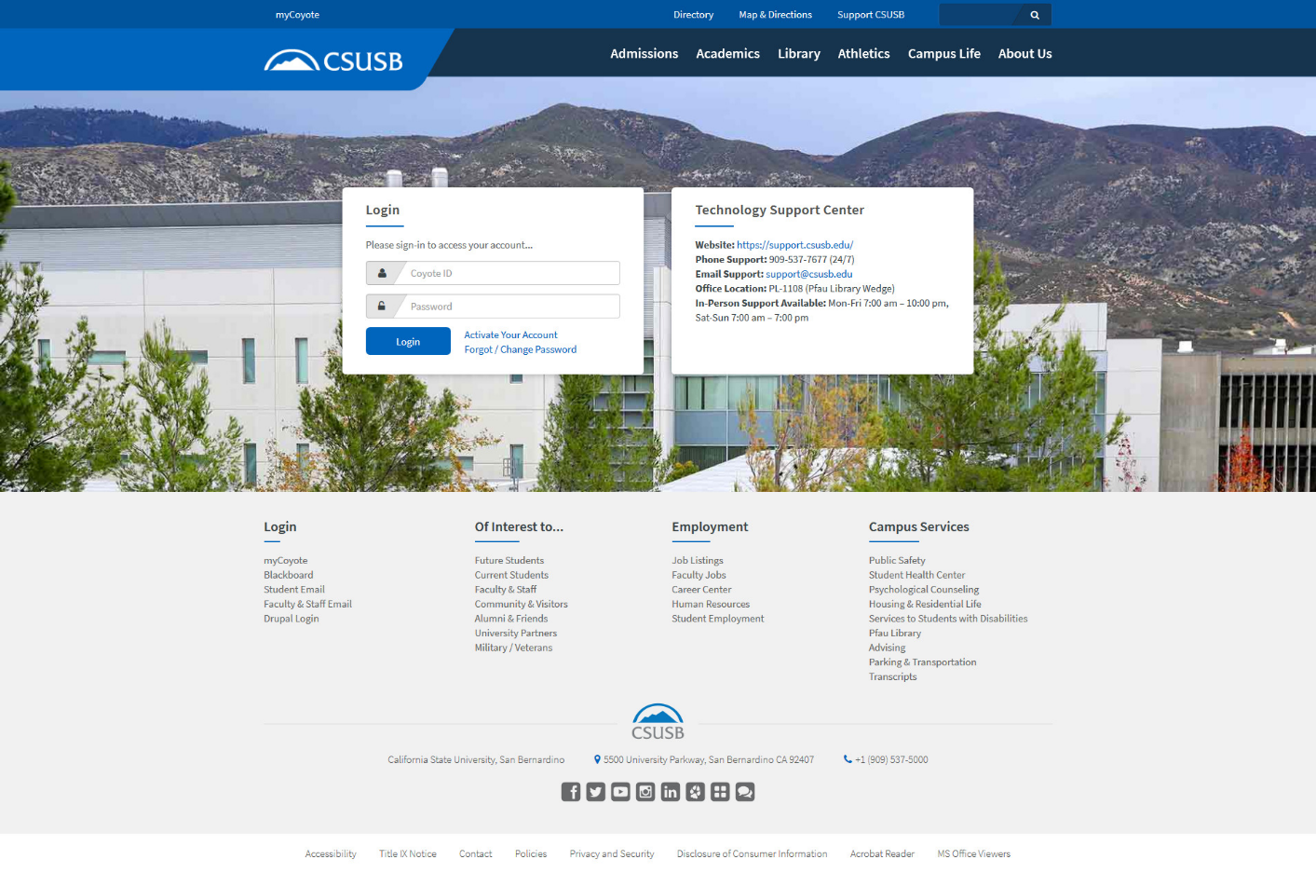
Step One
Student ID
Password
Notes:
Goggle: csusb.edu
Enter your student id number
Then enter you password

Slide 3
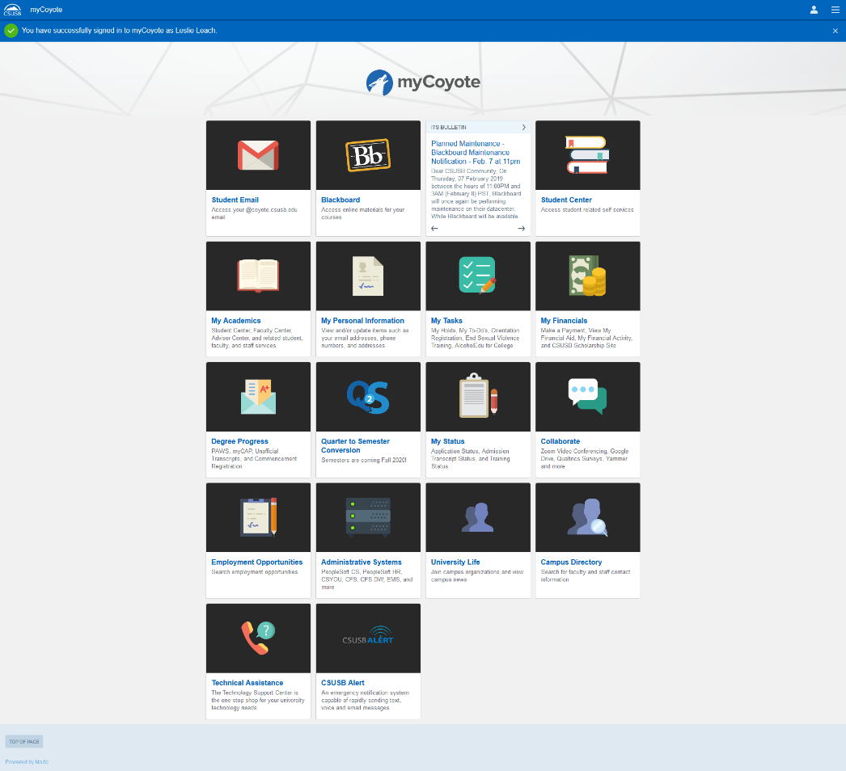
Step Two
CLICK HERE!!!
Notes:
Once your in, this screen will be displayed, find the icon that is labeled student center. Click it.

Slide 4
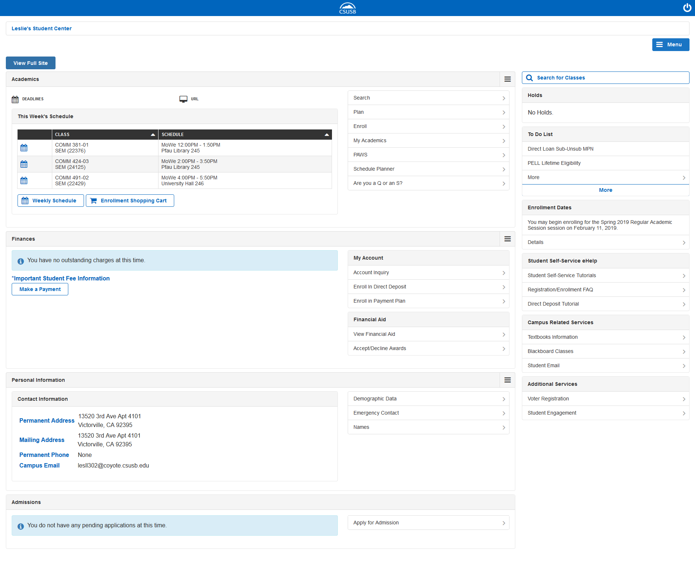
Step Three
CLICK HERE!!
Always Double Check
Check This!!
How to find your books after you enroll.
Notes:
In step three: you’ll see this screen displayed: this screen has a many different options that can get confusing. First : before we click to search. Always double check you enrollment dates, you can search ahead of time and select class which will be in your cart ready to go, this will help you obtain the classes that you so desire. Also: make sure that you always check to see if you have any holds or anything on your to do lists. Sometimes your academic advising department will place a hold on your account. This will delay your ability to enroll. So please make sure you don’t wait till last minute. The hold takes between 24 to 48 hours to be lifted. Once you have thoroughly checked your hold, to do list, and your enrollment dates Click SEARCH.

Slide 5
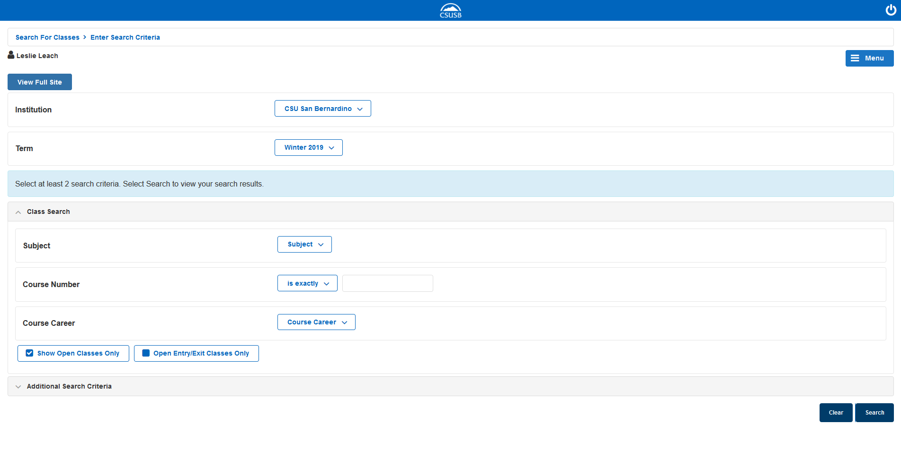
Step Four
Select
Make sure !!
*
*Select One
Example: English
+
Leave blank if you don’t know
Just leave blank
Notes:
Here in step four, this will be the screen displayed.
First make sure you select csu San Bernardino
Next: Make sure that you select the right term
Following that select the subject you are looking for( for example: English)
Course number and course career you can leave blank
Once you have made your selections click search.

Slide 6

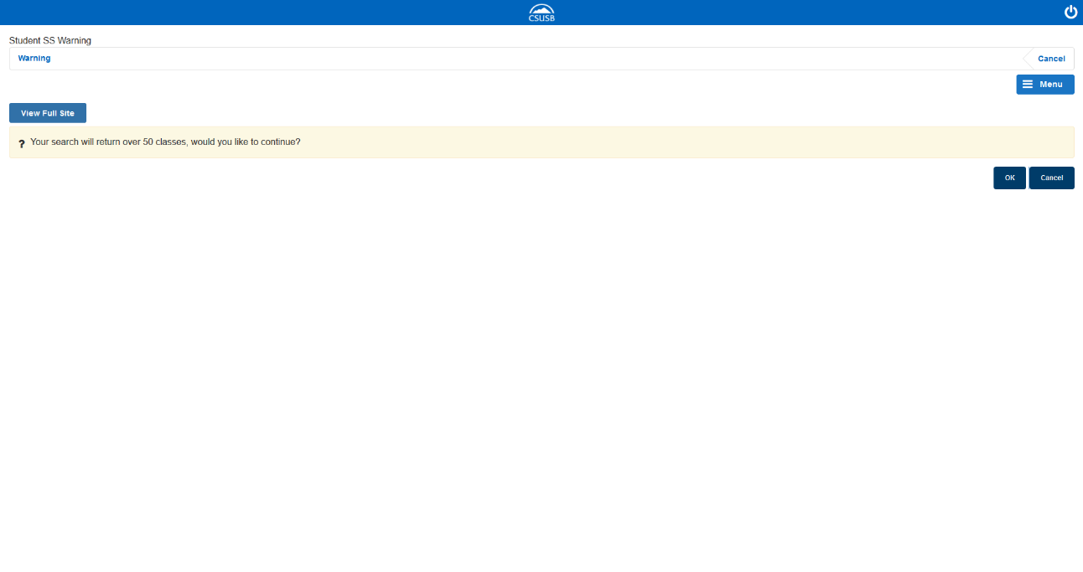
If you have NO Course Number
If this screen pops up, just click okay and the list of classes will follow
Click ok
Notes:
If you have no course number or have no idea what you want to take , do not panic. This screen will be pop up, go a head and just click okay. A list of classes within the subject you selected will display.

Slide 7

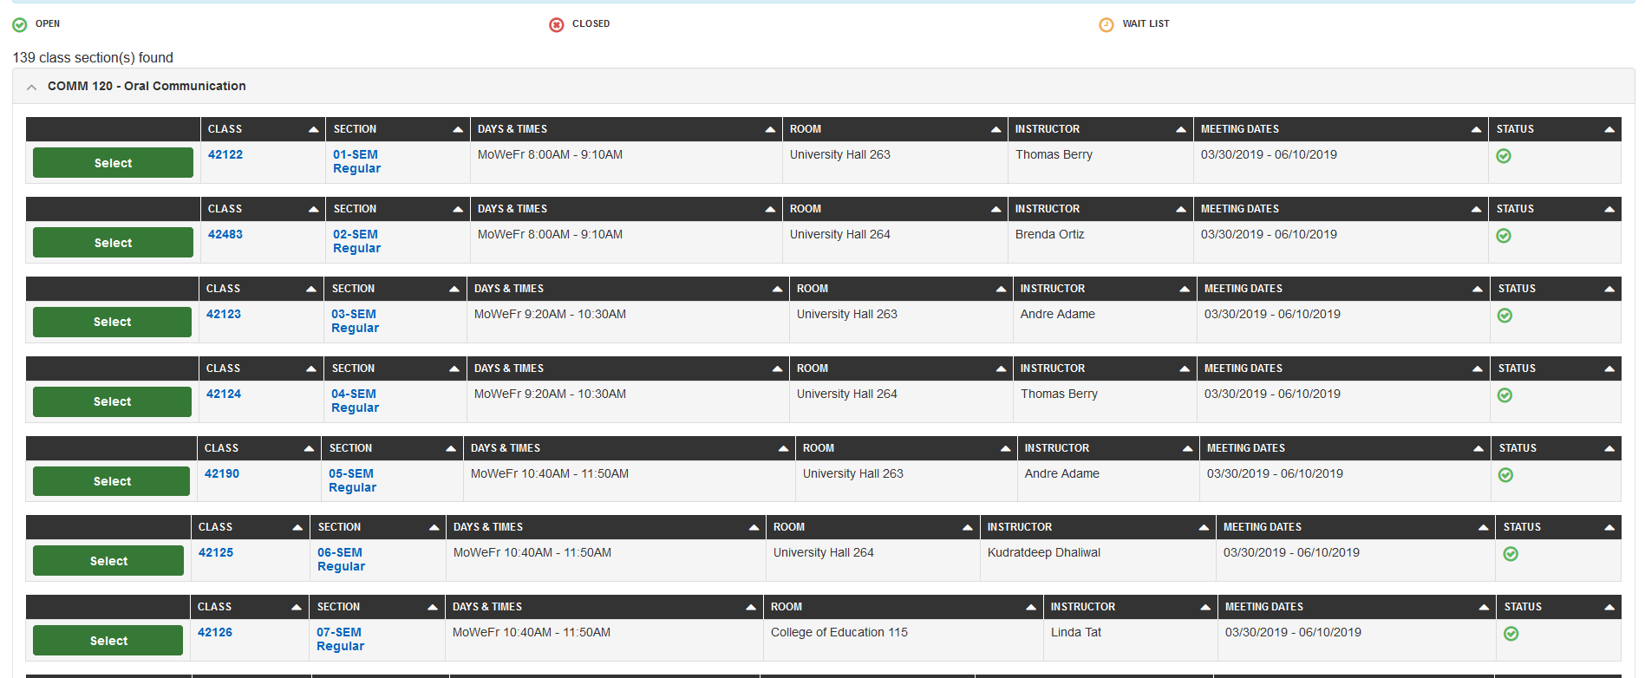
Class course list
Cant get in
Have a chance
open
This is where you can find out if the class is available
Open- classes are available
Closed- Classes are NOT available
Waitlist- class space limited
Notes:
Displayed above is an example of course listings, above are the icons that help you identify if the classes are available.
Open indicated that the class has available seating, the red X indicates that tha class is closed and has no seating available, the last yellow icon represents waitlist, this indicates that tha seating is full but there is a chance to be added.
In order to get in to a waitlist class YOU MUST ATTEND the first day of the class. Instructors will have codes that you must obtain in order to register.

Slide 8

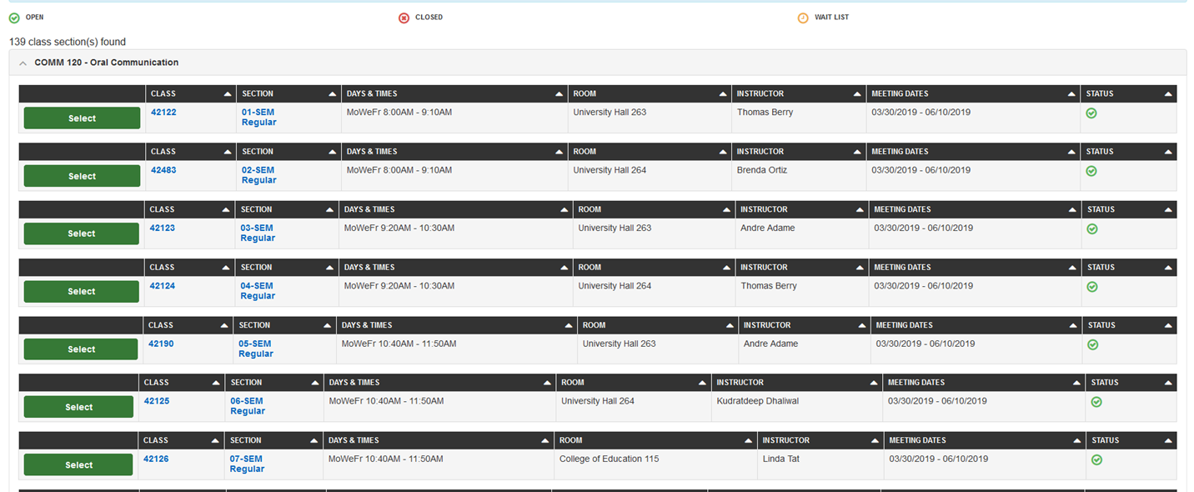
Select(Green Tab)
Select Course
Desired
Notes:
When looking for classes make sure you double check times and days. Once you find your desired class. Select the green Tab labeled select.

Slide 9
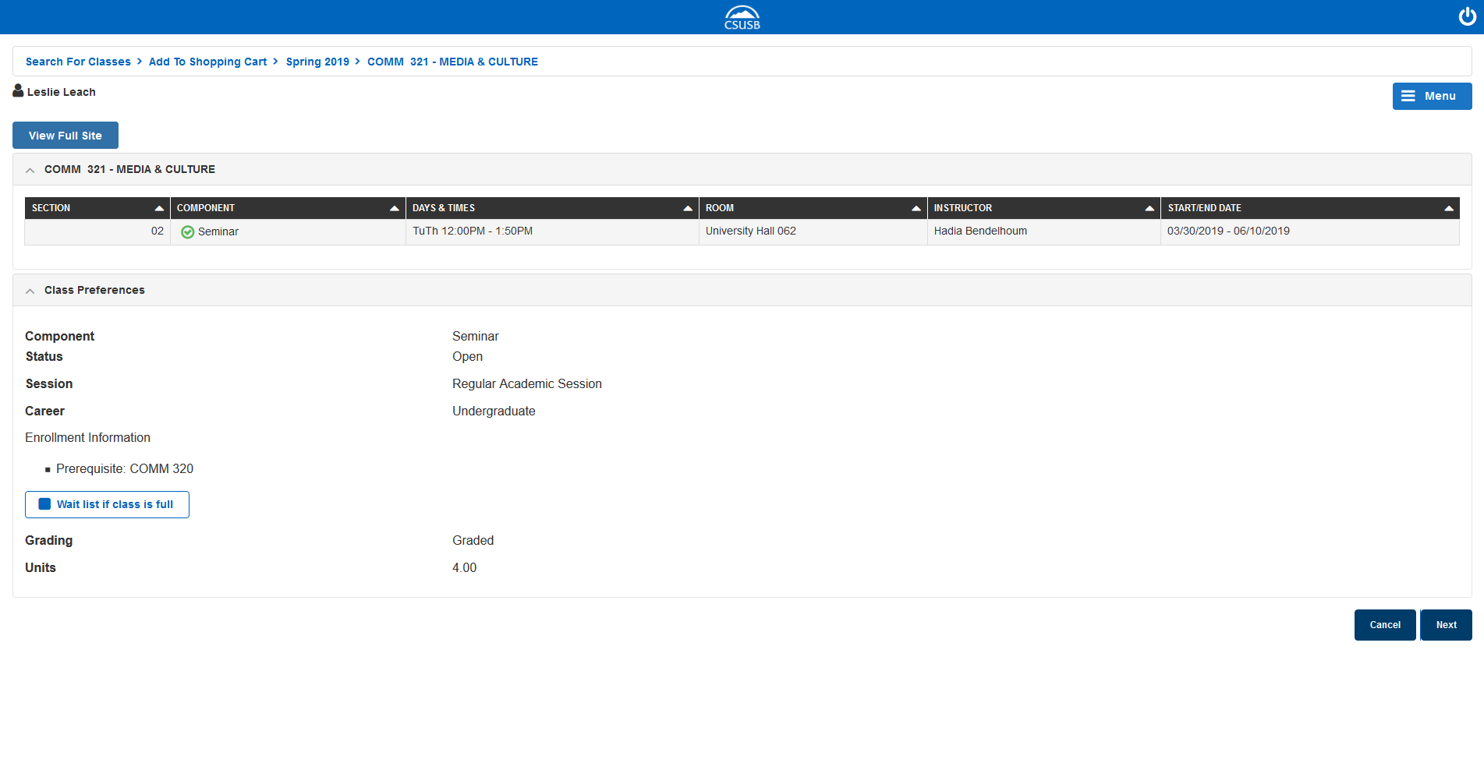

Professors
course
Days & Time
Location
Dates
Double Check
Pay close attention!!
Notes:
One your selection was made , the next screen that will displayis the break down of oyur selection.
The course, component, days and times, the location , the professors name, and the dates the class begins and ends.
Double check!!!! One key things to double check is if the class you have selected has a prerequisite, if it does and you have not taken it You can not enroll in that course.

Slide 10
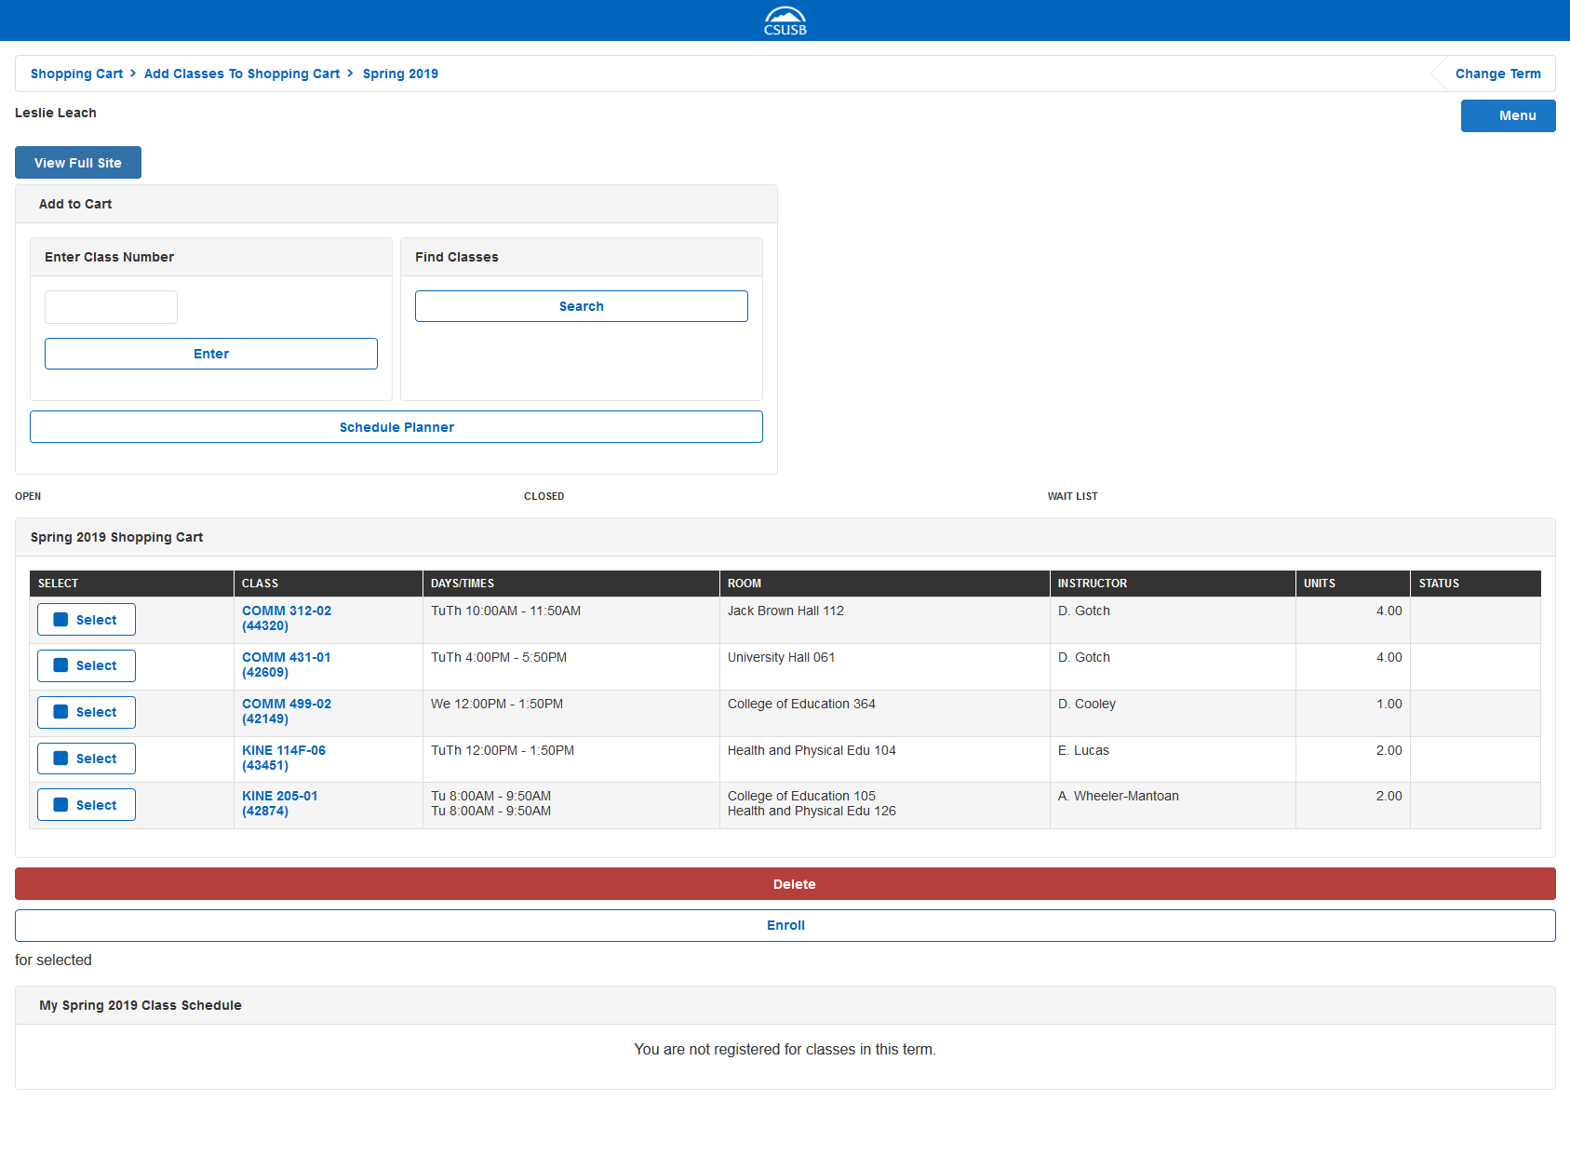

Shopping Cart
Classes you have selected to enroll in
Select Enroll
***Double check Enrollment time and dates!!!
Notes:
Once you have made all your selections they will be located in your shopping cart. Then click enroll.
If it is not your allotted time and date to enroll, it is okay to leave your classes in your shopping cart, just know that the availability can change, just because the courses are in your cart does not guarantee your spot. Please keep that in mind.

Slide 11

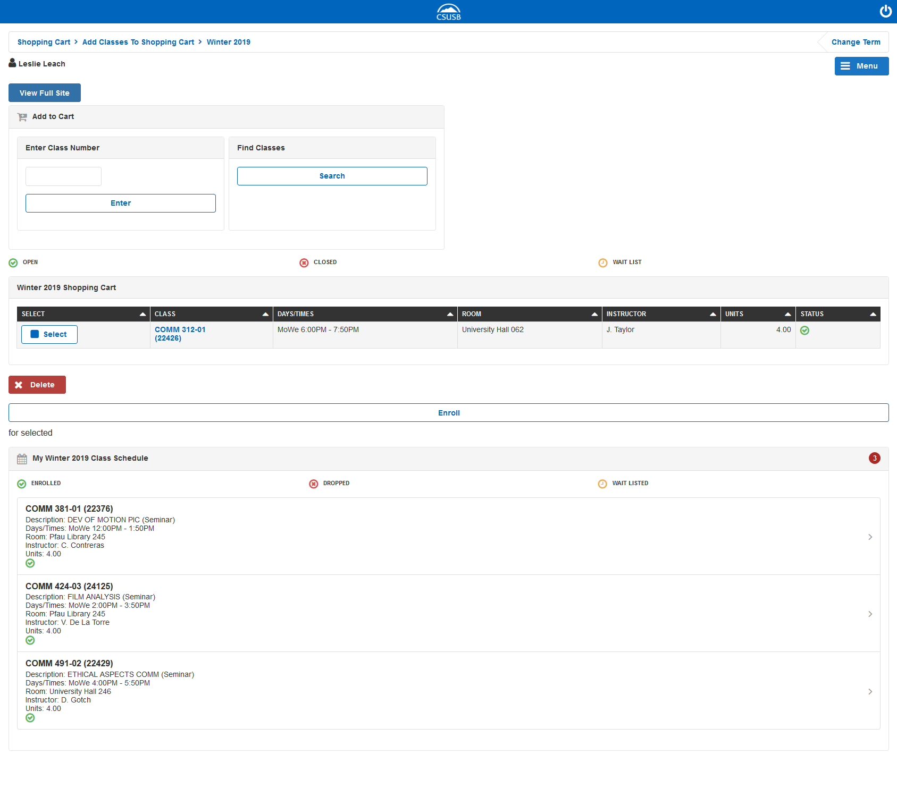
Once you have the ability to enroll in your classes and are successful, this is what the final result will look like.
If you don’t select a class they will still be in your cart.(its okay)
Did it!!!
Notes:
Congratulations you have done it. Your now enrolled in the classes you have chosen.

Slide 12
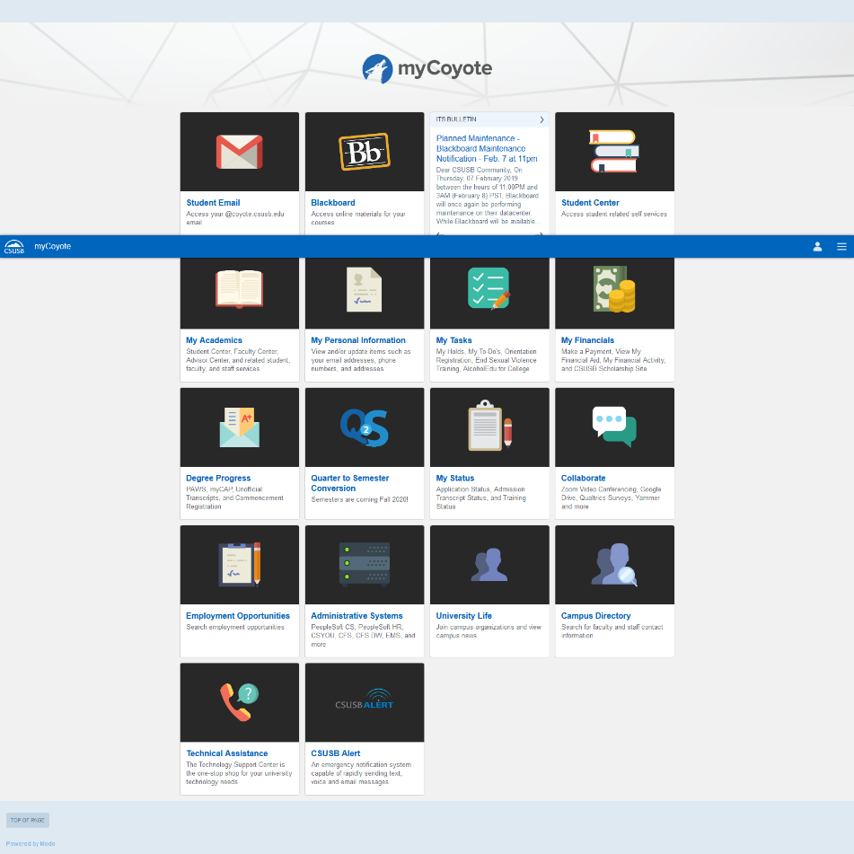

Add or Drop Classes
Select
Notes:
Ooh nooo! Have you chosen a class but now need to either add, drop or swap. Look for the “My academics” tab and select

Slide 13
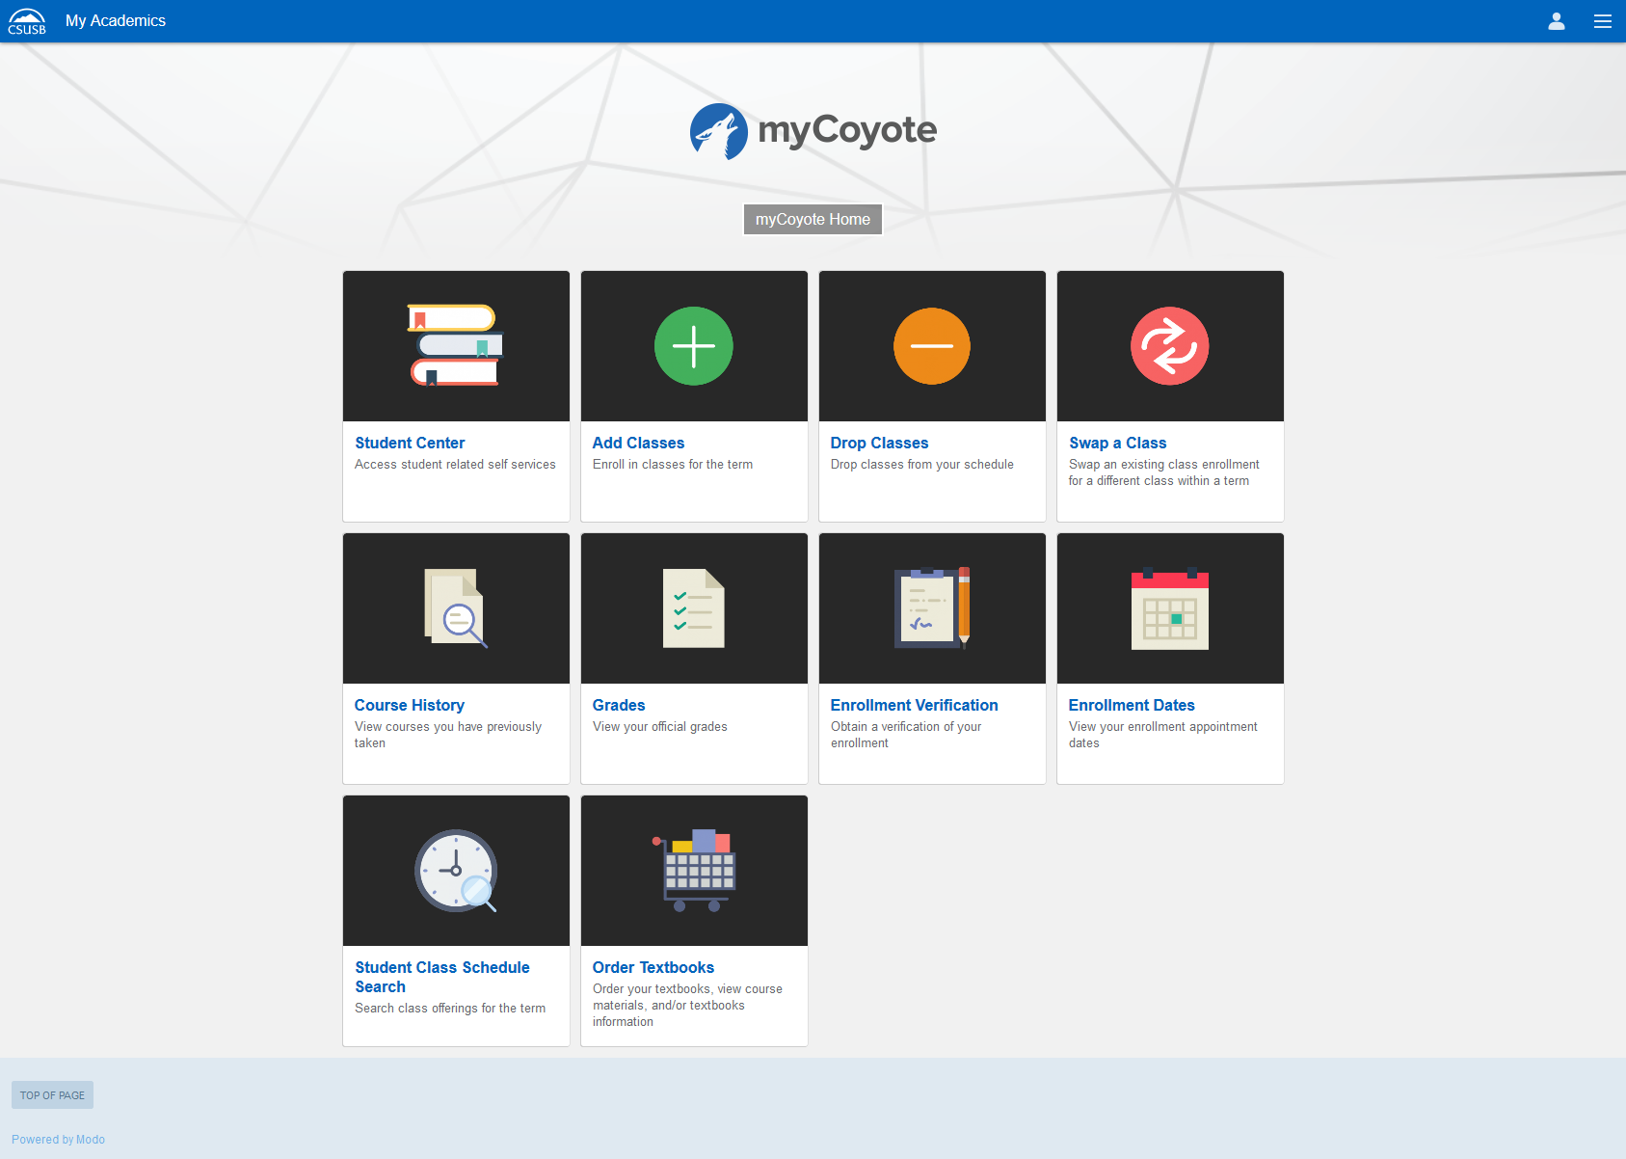
Your on the right Track!!!
Select which one you need.
Another way ☺
To check enrollment dates
Notes:
Select the icon that applies to you.
Side note. On this page is another way to check your enrollment date.

Slide 14
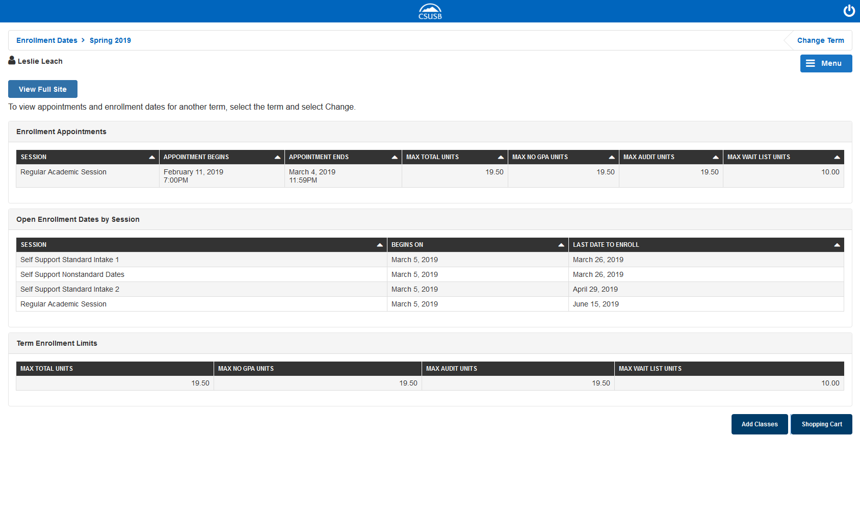
Another way ☺ to check enrollment dates
Date and Time your allowed to register. All differ!!1
Academic Session
Maximum units your allowed to take
Notes:
When looking at your enrollment date. This screen is very informative. This screen gives you date and time your allowed to register, the academic session and the maximum units your allowed to take.

Slide 15

Where can I Find My Text books?
How to find your books after you enroll.
Notes:
Now that your enrolled in your classes. Lets walk you through a few way to find your books. First way is to click on text information.

Slide 16
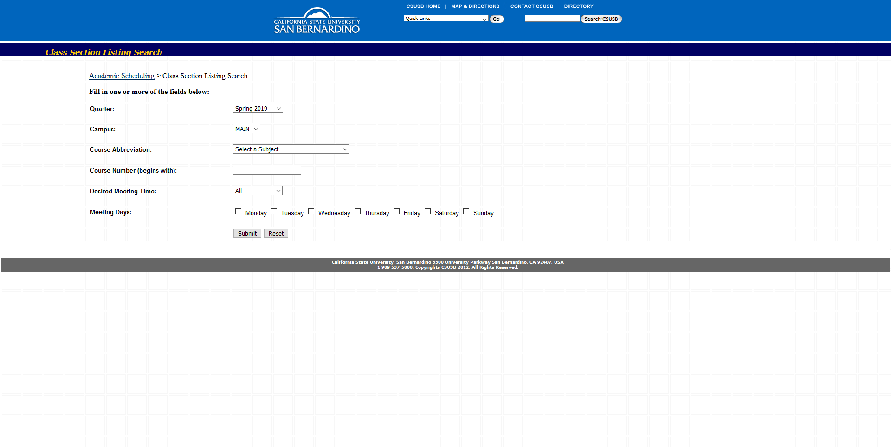

How do I find textbooks for my classes???
Pick term
Subject (example: Communication)
Course number(Example:400)
Click Submit
Notes:
Now your going to want to , pick the term, subject, course number and then click submit

Slide 17
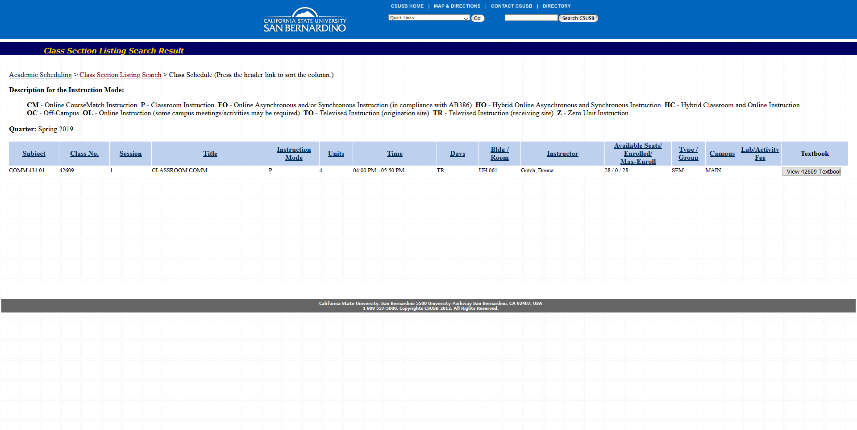


Stop!!!
Double check for your course number, days your attending. More then one listing may pop up..
*** Side note: Some times the Professor hasn’t listed the required reading, or in some cases just doesn’t have a required text.
Double check one the first day of class, or check the syllabus
Notes:
Now your class should be listed , always double check your course numbers and that you have selected the right dates and time.
Click viewtextbook.

Slide 18
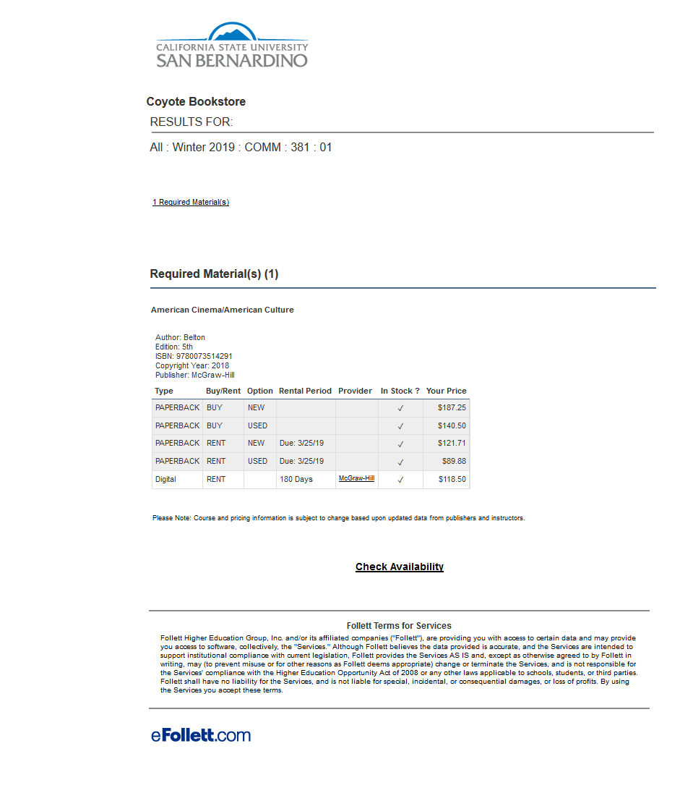




Course/Term
Key Information!!
Author, edition, ISBN, Copyright, Publisher
Chegg.com
Goggle book
iBook's(apple)
Other Resources
Can be pricey$$$$(CSUSB Bookstore)
Notes:
The next page displayed is the breakdown of the results:
This page will Display: the course/ term, key information like: author, edition, ISBN, copyright, and publisher.
Take note: that if the prices are to expensive for your liking there are also other alternative outlets, for example: Chegg, goggle books, and ibook just to suggest a few.

Slide 19

Where in the world do I find my
text book information??
CLICK HERE!!!
Notes:
Second option of finding your textbooks: Csusb has added and addition icon to help quicken the sets in finding the Key information. Click on the “my Academics icon”

Slide 20
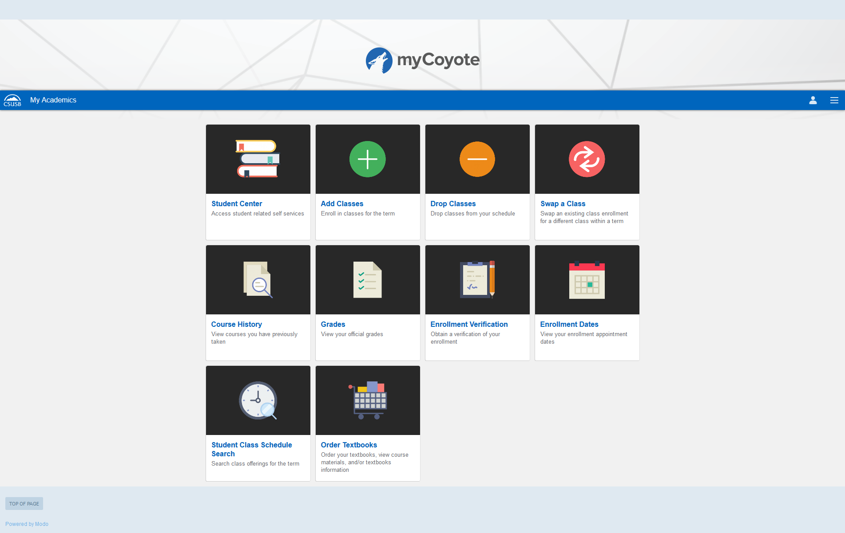
Click Here
Notes:
Select order textbooks.

Slide 21
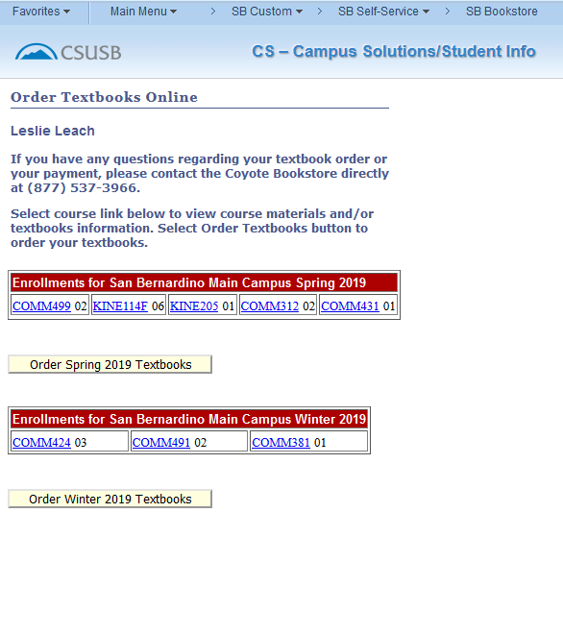
Classes/Term
Click Here
Notes:
Your classes that your enrolled in will be listed , click on each class and the

Slide 22
Key Information!!
Author, edition, ISBN, Copyright, Publisher
Chegg.com
Goggle book
iBook's(apple)
Other Resources
Can be pricey$$$$(CSUSB Bookstore)
Notes:
Here you will find all the vital information need to order you books, now again if the prices listed are to expensive for your taste then we suggested other options , a few examples or chegg, ibooks, and goggle books. Just make sure you have the ISBN number and the edition.

Slide 23
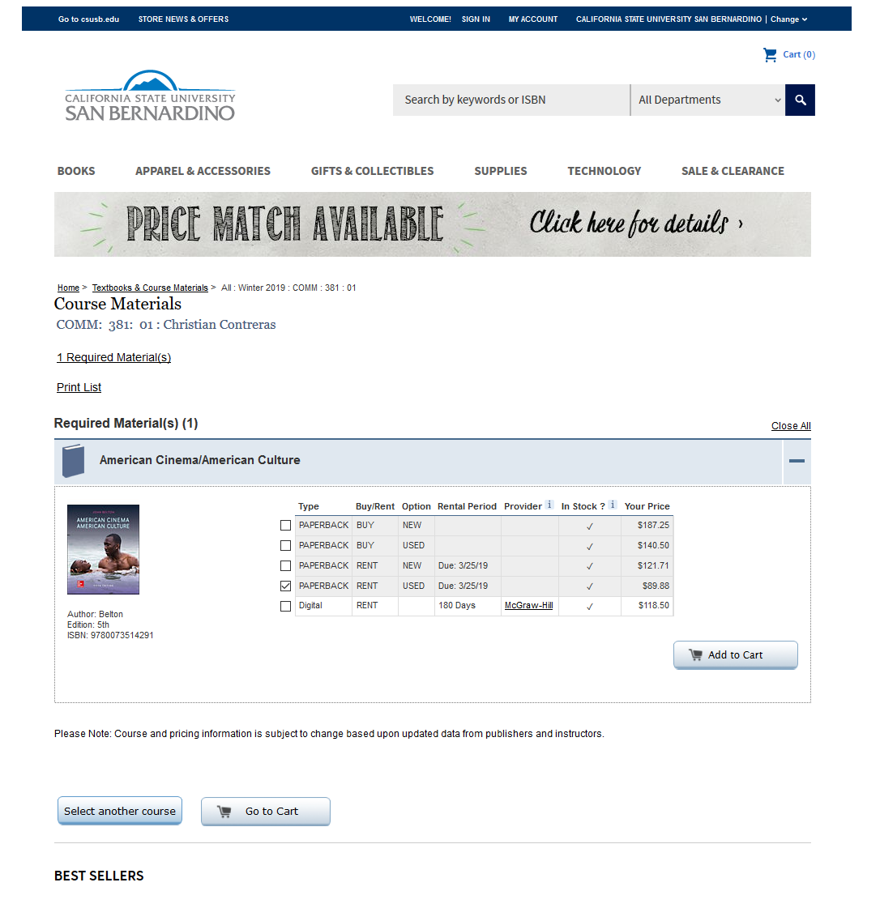

Coyote Bookstore
Bookstore
Make selection
Notes:
Here at our coyote bookstore you are given the choices of purchasing paperback, new or used, rented paperback new/used, or to rent a digital copy for a 180 days.
****The coyote bookstore does price match. However, you still have to pay the amount of the book and the difference of the price match will be loaded to a store gift card/ store credit.
Mark your selection . The click add to cart.

Slide 24
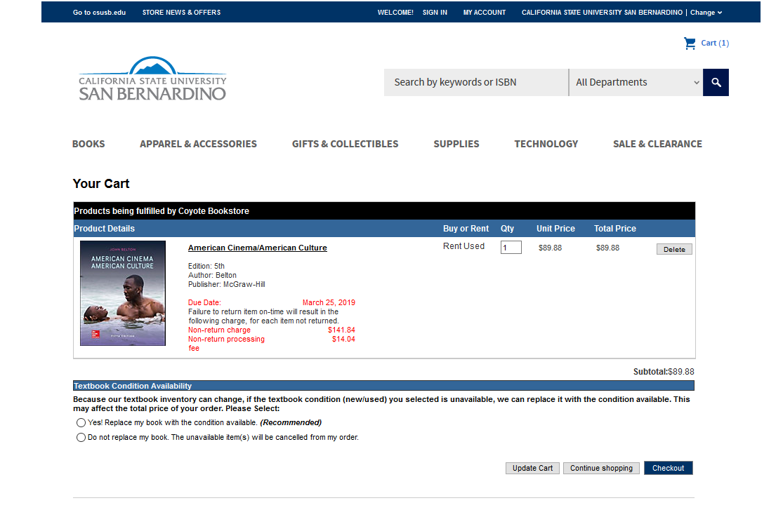

Pay close attention
Make selection
Notes:
Once you have made your selection, please take the time to pay attention to any due dates, if you have rented a copy or requested the digital copy there will be due dates along with a list of non-return charges/fees
Once you have made your selection, click the checkout button. And pay.

Slide 25


Osher Adult Re-Entry Center
Monday- Thursday 8am-7pm
Friday 8am-4pm
OARC supports adult learners by providing resources
to help make the most of your college experience!
Building Hours
Monday - Thursday: 7:30 am - 10:00 pm
Friday: 7:30 am - 8:00 pm
Saturday - Sunday: 10:00 am - 6:00 pm
Contact Info
Phone Number: 909-537-5940
Email: smsu@csusb.edu
Our Programs & Services
*Computer & Printer
*Free coffee & Tea
*CBEST Review
*Online Job Hunting
* Adult Learner Resource Fair
Scholarships
Osher ReEntry Scholarships
Crankstart ReEntry Scholarships
Smsu.oarc
CONTACT US
CENTER COORDINATOR: TAMARA HOLDER
909-537-5253
SMSUOsher
Adult ReEntry Center
Notes:
now that we have given you a 101 on registering for classes, how to add/ drop or swap classes , where to find the ISBN number to order you books, and the additional resources in keeping your cost down. Come and stop by th e Osher Adult re-entry center. Our head coordinator Tamer Holder and her team are located in the Smsu building room 111. Monday- Thursday 8am to 7pm, Friday from 8am to 4pm.
The Oarc supports adult learners by providing resources to help make the most of your college experience.
Our program includes: Computers/ printing, Free tea or coffee, Cbest Review, online job Hunting, a adult learners resources fair, and our Scholarship programs…

Slide 26

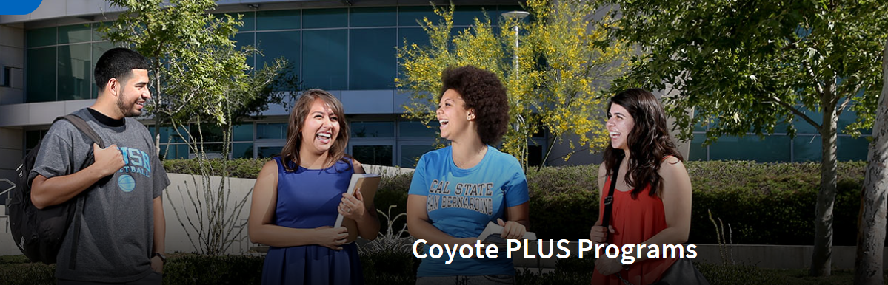
Student Mentoring Program
Supplemental Instruction

Slide 27
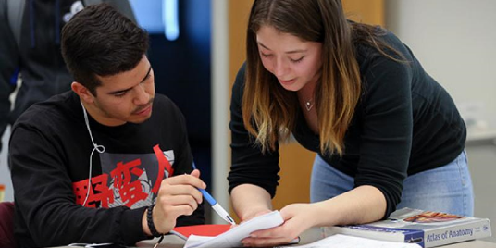
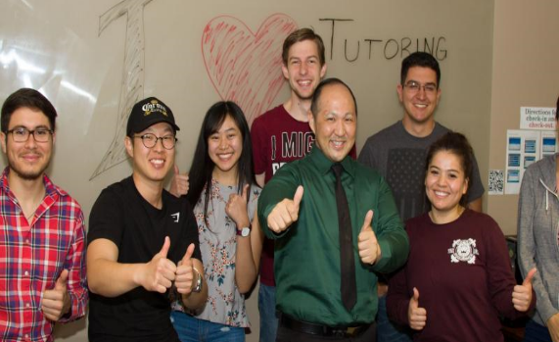
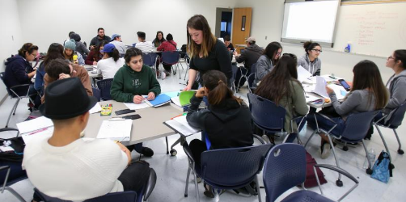
Student Mentoring Program
Who Are We?
WHAT DO WE DO?
We are a department within the Office of Undergraduate Studies committed to student success, creating collaborative peer-to-peer communities, educational equity, and providing spaces for impactful learning to occur. Participating in Coyote PLUS programs present opportunities to learn from peers who share similar experiences.
Our student leaders serve as your mentors, tutors, and supplemental instruction facilitators. Students work collaboratively by sharing study tips, subject specific knowledge, information about resources, and much more. Students who participate as peer leaders gain leadership and professional development opportunities that enrich the overall college experience.
Phone: (909)537-4499
Email: PLUS@csusb.edu
https://www.csusb.edu/coyote-plus/student-mentoring-program
Notes:
The Student Mentoring Program is located in the Library building on the second floor in Pfau LIBRARY ROOM 208. This program targets first year CSUSB students (freshmen and transfer students). Mentors are paired with students in the same major or college. Mentors are able to answer many questions because they have taken many of the same core classes. Mentors help student to stay on track to achieve their academic goals, and remind students to work on a balanced life that includes academic as well as personal goals. The program offers three seperate computer labs, free printing, movie rentals, microwave, refrigerator (to keep lunch or meals), and a lounge with tables to study or eat.

Slide 28

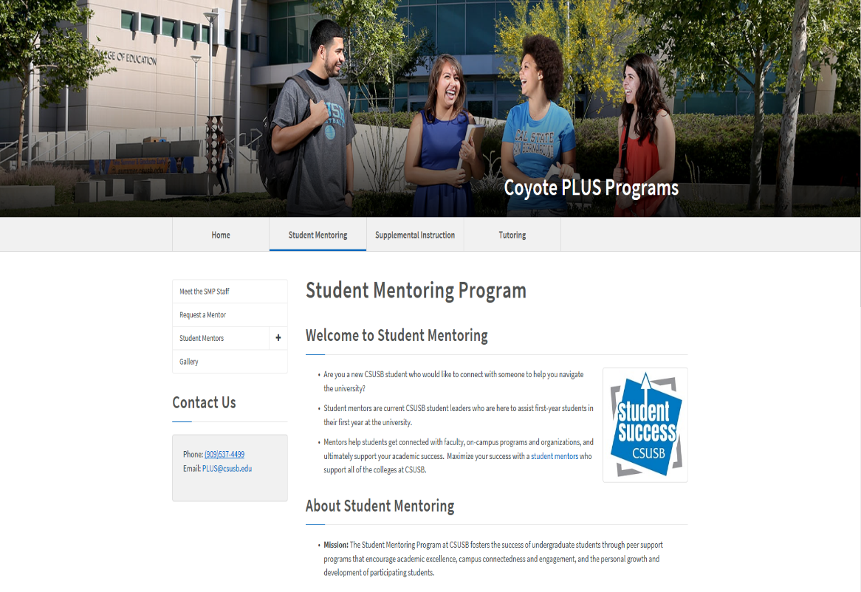
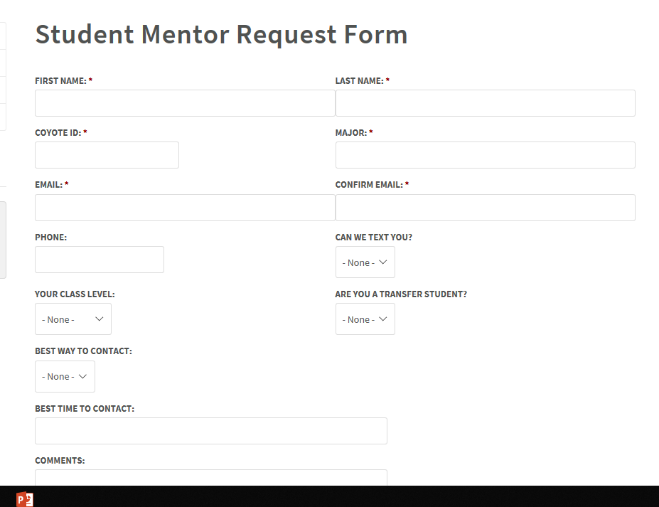
Request Form For A Member

Slide 29


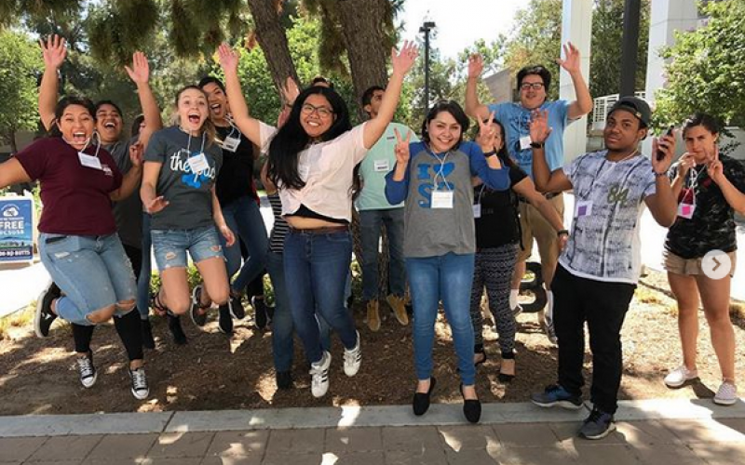
SI is a research-based, locally-proven method for helping students succeed in challenging courses by providing additional subject-matter discussion, support, and guidance for the strengthening of critical college skills. SI sessions meet twice a week or 50 minutes each. Each session is limited to 20 students to create and maintain a small group learning environment (students commit to the biweekly sessions).
Supplemental Instruction sessions are designed to help you...
Strengthen your understanding of the material presented in course lectures and texts
Develop both general and content specific learning strategies and study skills
Review for exams and develop effective test taking strategies
Notes:
The Supplemental Instruction program requires participants to commit to their success and to the twice a week sessions.

Slide 30
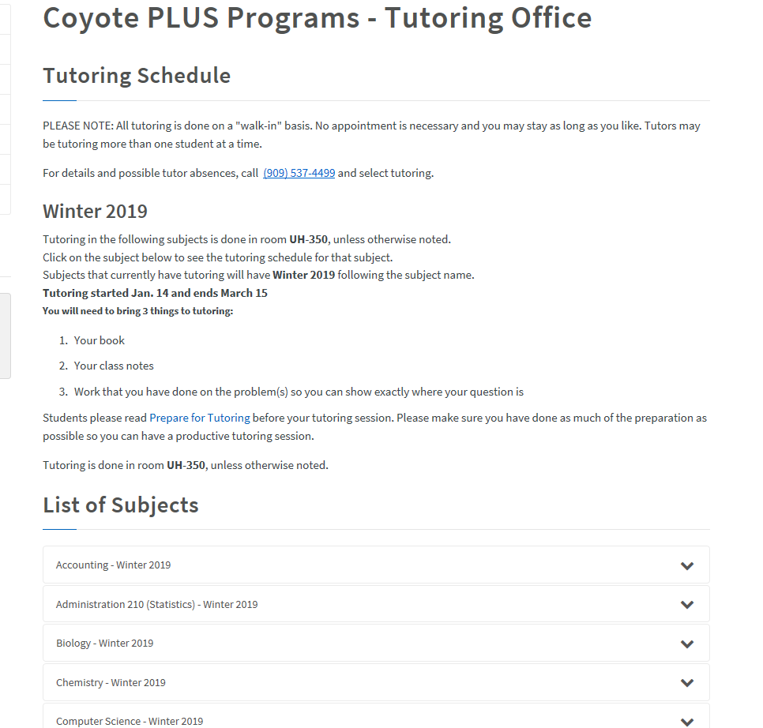

Click

Slide 31
