Slide 1
Intro to Individual Development Plans for Undergraduates
Adapted from Dr. C. Gita Bosch
We are continually faced with a series of great opportunities brilliantly disguised as insoluble problems. John W. Gardner

Slide 2
What is your game plan?
We succeed only as we identify in life, or in war, or in anything else, a single overriding objective, and make all other considerations bend to that one single objective. Dwight D. Eisenhower
Now You
Future You
B
theacademionsultant.com

Slide 3
Path to success
What people thinks it looks like
There Then
What it actually looks like
There Then
Here Now
Here Now
B
theacademicconsultant.com

Slide 4
Individual Development Plan
A living document
Self assessment
Strategies
Mission statement
Skills assessment
Goals
B
theacademicconsultant.com

Slide 5
IDP = GPS
GPS requires that you enter a starting point and an ending point to provide directions.
This is what your IDP does, you are here and you want to go there. Your IDP lets you create a roadmap to navigate your way and even when along the way you encounter life’s detours (marriage, birth, death, etc.), you will keep your destination in sight at all times.
With regard to excellence, it is not enough to know, but we must try to have and use it. Aristotle
B
theacademicconsultant.com

Slide 6
Mission Statement = North Star
Your ultimate purpose in life
It is a combination of your academic and professional aspirations and your personal and social ideologies
Greatness is not in where we stand, but in what direction we are moving. We must sail sometimes with the wind and sometimes against it - but sail we must, and not drift, nor lie at anchor. Oliver Wendell Holmes
B
theacademicconsultant.com

Slide 7
Career Mission
Explore career options
Ideal career
Alternative Careers
Define goals to get to career
Create plans/strategies to meet goals
I think that somehow, we learn who we really are and then live with that decision.
Eleanor Roosevelt
B
theacademicconsultant.com

Slide 8
Self-assessment
Weaknesses
Accomplishments
Interest
Strengths
Skills
Values
Talents
B
theacademicconsultant.com
Make & maintain positive & productive relationships

Slide 9
Self-assessment
What interests you?
What do you prefer to do?
What are you good at?
How good are you at it?
Who are you?
What is important in your job?
What is important in your personal life?
B
theacademicconsultant.com

Slide 10
Self-assessment
Self-assessment requires careful thought and it takes energy; it cannot be done in one sitting
You have to be introspective, and more importantly, you have to be honest
Knowing and understanding your interests, values and skills will help you prioritize your professional and personal goals
B
theacademicconsultant.com

Slide 11
What career path are you thinking about? How does this fit with your self- assessment?
Academia
K-12
Undergraduate/graduate
Research Institute
Government/Policy
NIH
NASA
White House
Business
Tech
Law
Journals (e.g., editors)
Industry
Pharmaceutical companies (big pharma)
Clinical Practice
Pediatrician
Oncologist
I think that somehow, we learn who we really are and then live with that decision.
Eleanor Roosevelt
B
theacademicconsultant.com

Slide 12
Education
Career
Identify what career
Identify where?
Identify how you will get there.
B
theacademicconsultant.com

Slide 13
Get help from Others
Trusted mentor to help you identify the skills and steps needed to reach your goals
Seek advice from
Academic and research advisors
Peers
Professors
Others who have followed a similar career/professional path
B
theacademicconsultant.com

Slide 14
Barriers to success
Academic and cultural isolation
Low self-esteem
Peers/friends/family who are not emotionally supportive of academic success
Discrimination, whether perceived or real
Stereotype threat = self-defeating prophecy
Low expectations can lead to low performance
Inability to acknowledge that the problem exists
Shame about where they come from
“Toward no crime have men shown themselves so cold-bloodedly cruel as in punishing differences of belief.” James Russell Lowell
B
theacademicconsultant.com

Slide 15
How does mentoring help
Personal and professional development
Communications
Financial obstacles
Motivate and give courage & confidence to go on
Removing institutional barriers
Access to informal networks and information
Avoids or decreases alienation
Improves Retention
Shows diversity in disciplines
“I never teach my pupils. I only attempt to provide the conditions in which they can learn.” Albert Einstein
B
theacademicconsultant.com

Slide 16
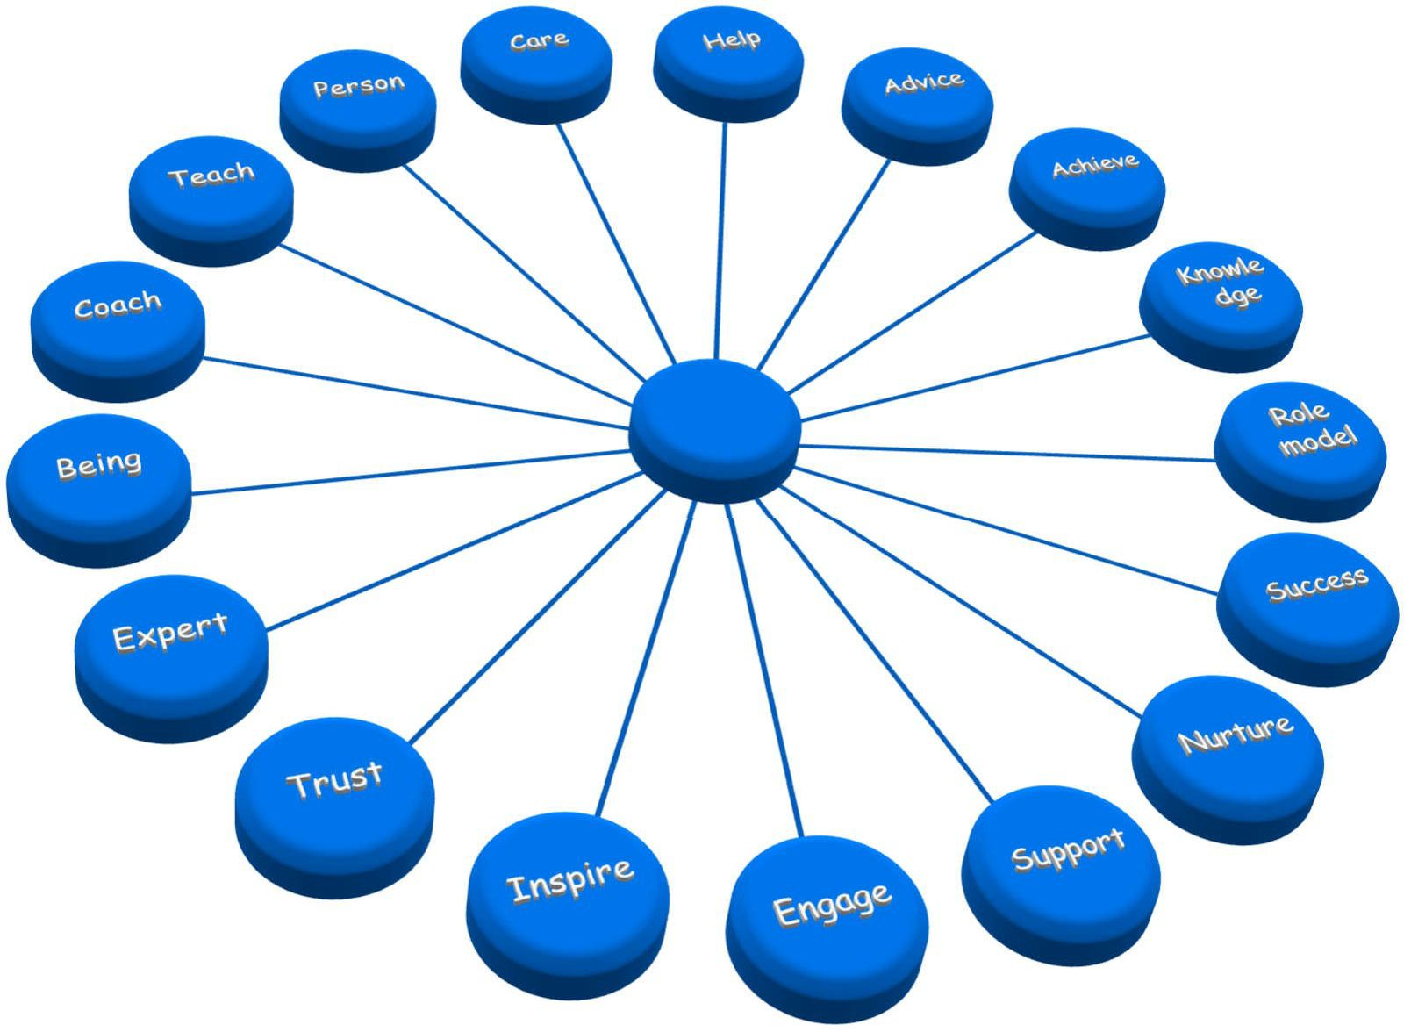
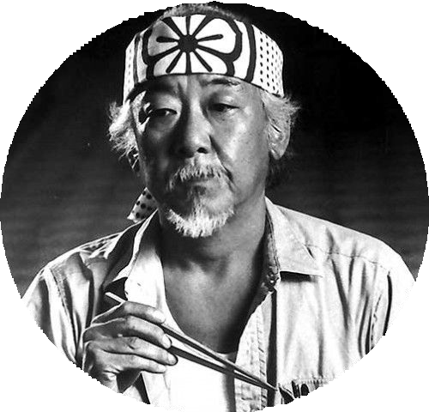
Mentor = Strongest advocate & Strongest Critic
B
theacademicconsultant.com

Slide 17
Skills assessment
Conduct an honest skills assessment
Identify the gaps needed to reach goals
Craft effective strategies to fill those gaps within a realistic timeframe
The trouble with most of us is that we would rather be ruined by praise than saved by criticism. Norman Vincent Peale
B
theacademicconsultant.com

Slide 18
Professional/Core competencies
Transferable skills
Teaching
Mentoring/mentee
Networking
Leadership
Time management
Priorities/goal setting
Meeting deadlines
Giving/accepting feedback
B
Teachers open the door, You enter by yourself. Chinese Proverb
theacademicconsultant.com

Slide 19
Professional/Core competencies
Communications
Oral/writing
Working with others
Conflict resolution
Trust
Reliability
Ability to work in a team
Collegiality
Collaboration
B
theacademicconsultant.com
Teachers open the door. You
enter by yourself. Chinese Proverb

Slide 20
Technical competencies
Creativity/experimental design
Critical analysis/data analysis
Statistical analysis
Computer skills
Problem solving
Critical reading of scientific literature
B
theacademicconsultant.com
Teachers open the door. You
enter by yourself. Chinese Proverb

Slide 21
Foundation knowledge
Biological sciences
Chemical sciences
Physics
Computer science
Engineering
Mathematics
English
B
theacademicconsultant.com
Teachers open the door. You
enter by yourself. Chinese Proverb

Slide 22
Setting goals for Success
Specific
Define precisely what you want to achieve
Measurable
Demonstrate that the goal has been met
Attainable
Within your ability and control to achieve
Relevant
Alignment with your mission
Time-bound
Establish milestones and timelines
B
theacademicconsultant.com

Slide 23
Individual Development Plan Steps
Mission statement
Self- assessment
Skills assessment
Short-term goals, ~1-5 years from now
Intermediate- term goals, 5-
10 years
Long-term goals, 10+ years
Immediate Goals
Now to ~6 month-1 year from now
The reason most people never reach their goals is that they don't define them, or ever seriously consider them as believable or achievable. Denis Watley
B
theacademicconsultant.com

Slide 24
Questions to help guide IDP Development
What is your Mission Statement?
2. What competencies and skills will you need to successfully reach your goals?
3. What activities and experiences will you engage in to gain the competencies and skills?
4. How will you assess your progress in mastering these competencies and skills?
5. Who will help you reach your goals and how?
B
theacademicconsultant.com

Slide 25
Assess, review, and update
Once you complete the IDP, establish when you will review and update it
Frequency
Every 6-12 months is recommended
Did things go as planned? Did you meet your deadlines
If not, why not?
Update and adjust IDP based on review
B
theacademicconsultant.com

Slide 26
Do not be a spectator in your life, be the driver; take ownership, responsibility, and accountability for your future.
Creating an effective IDP requires you to think about your big audacious goals and how to realistically reach them.
B
theacademicconsultant.com

