Slide 1
CITI Training Registration
Registering for RCR CITI Training
Adding a new course
How to Complete CITI Registration for Responsible Conduct of Research Training.

Slide 2
Registering for CITI Training can be found on the IRB website by selecting the link below.
CITI Training

Slide 3
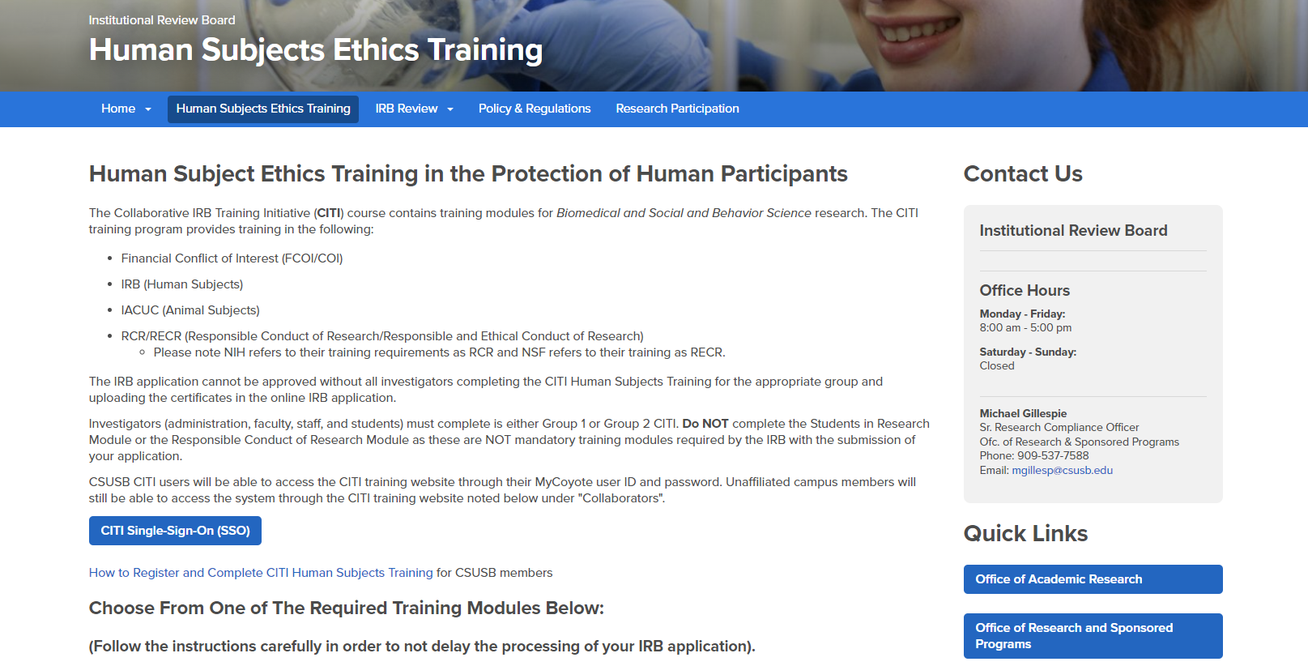
Step 1: Go to the IRB website for CSUSB
  http://irb.csusb.edu/
Step 2: Select the “HUMAN SUBJECTS ETHICS TRAINING” tab (see below)

Slide 4
Step 3: Select “CITI Single Sign-On SSO” Link

Slide 5
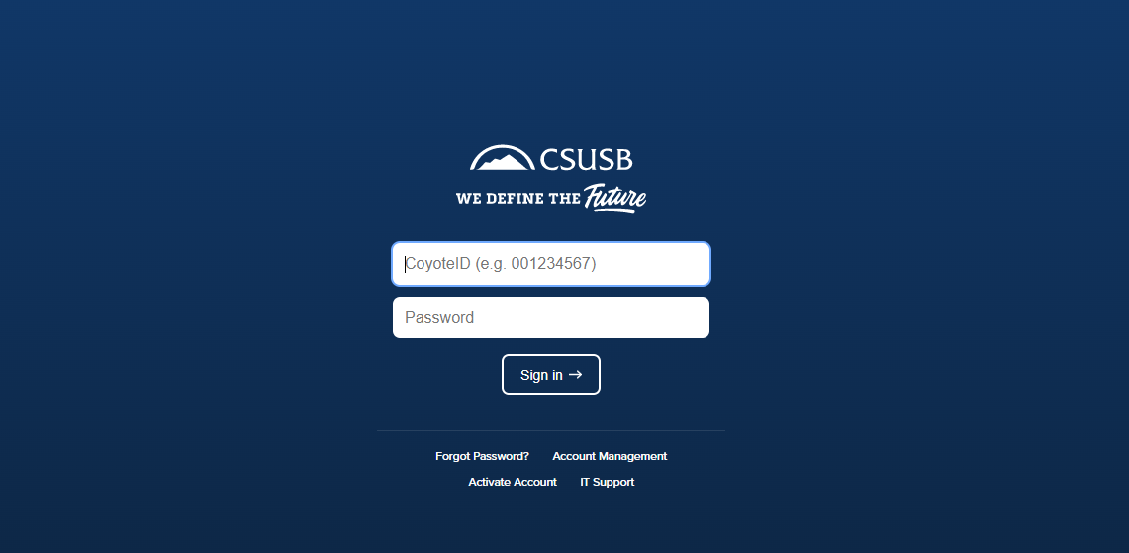
Step 4: A new screen will open and prompt you to enter your MyCoyote login information.

Slide 6
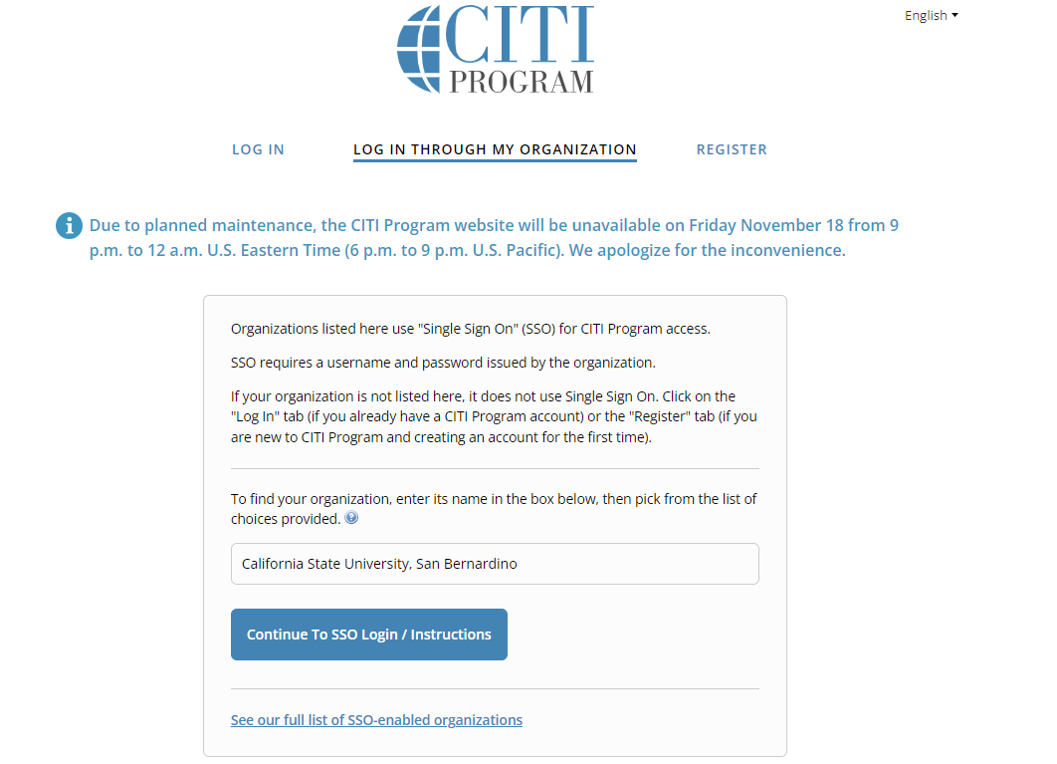
Step 5: A new screen will appear and should look like the picture below.
Step 6: Enter “CSUSB” into the organizational search field.

Slide 7
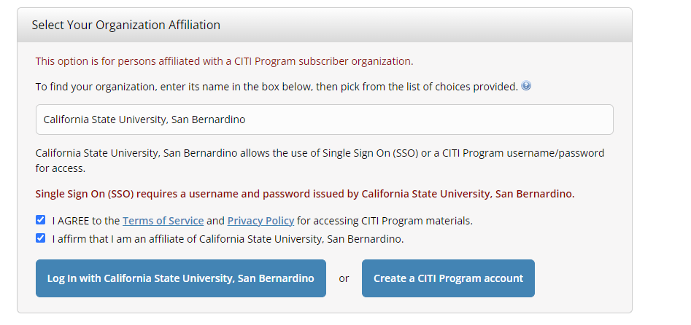
Step 7: After selecting the “I don't have a CITI Program account and I need to create one” the below screen will appear.
Step 8: Select the blue box that states “Create A New CITI Program Account”.

Slide 8
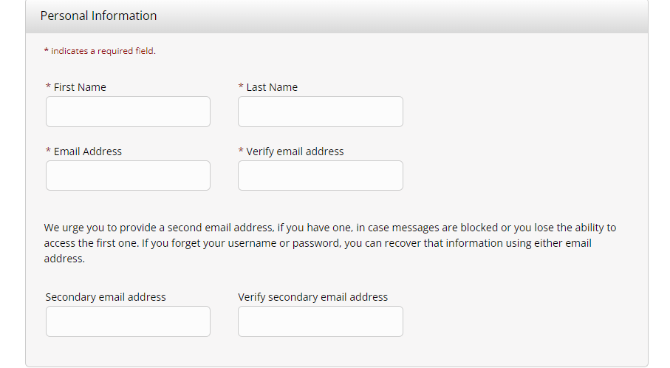
Step 9: A new window will appear and fill in your name and email address:

Slide 9
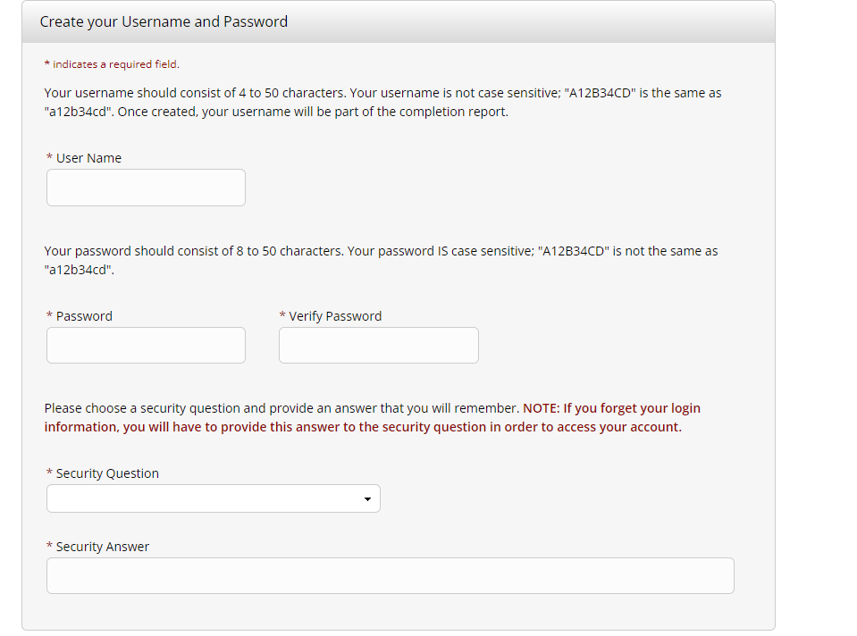
Step 10: Create username.

Slide 10
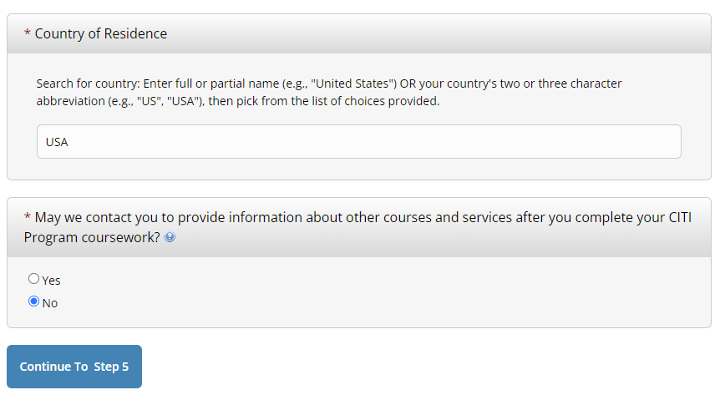
Step 11: Enter country of residence and the following question:

Slide 11
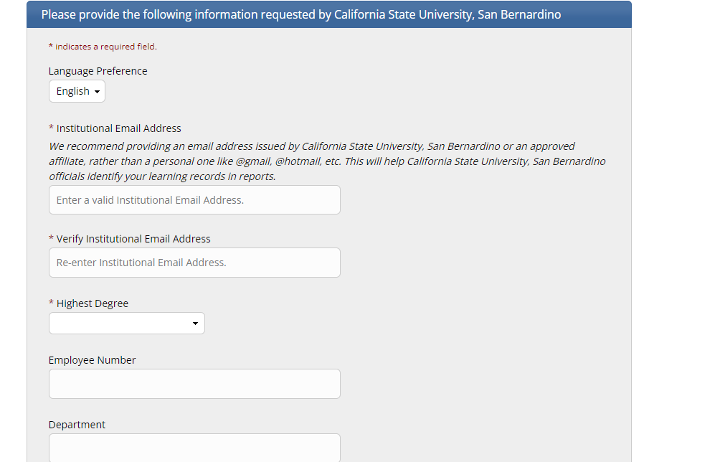
Step 13: Answer the demographics questions. Use CoyoteID for employee number.

Slide 12
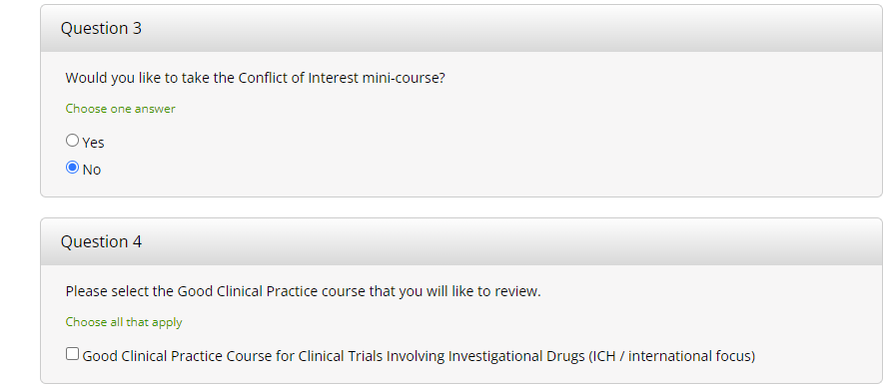
Step 14: Answer questions 3 with “no” and 4 can be left blank:

Slide 13
Step 15: Answer Question 5 by selecting the most appropriate RCR course (required):
Please make your selection below to received one of the courses in the Responsible Conduct of Research. Faculty grant awardees for NIH/PHS, DOE, NSF, USDA/NIFA, or NASA should complete the appropriate agency training below. For example, if you were awarded an NSF grant award, should complete the NSF Responsible and Ethical Conduct of Research (RECR) Training. Students should check with their faculty advisor/instructor for which training to complete.
NIH/PHS Responsible Conduct of Research (RCR) Training
DOE (Department of Energy) Responsible Conduct of Research (RCR) Training
NSF Responsible and Ethical Conduct of Research (RECR) Training
USDA/NIFA Responsible Conduct of Research (RCR) Training
NASA Responsible Conduct of Research (RCR) Training

Slide 14
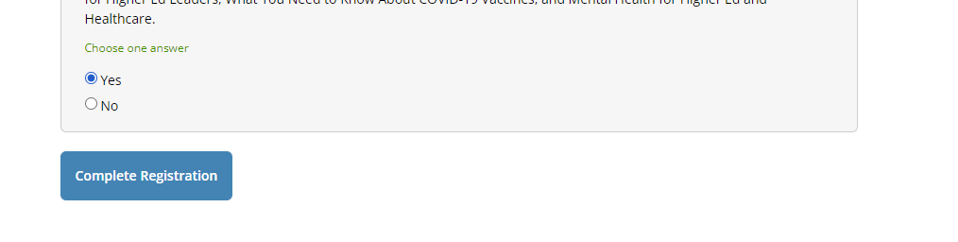
Step 17: Click “Complete Registration”:

Slide 15
Adding a New Course

Slide 16
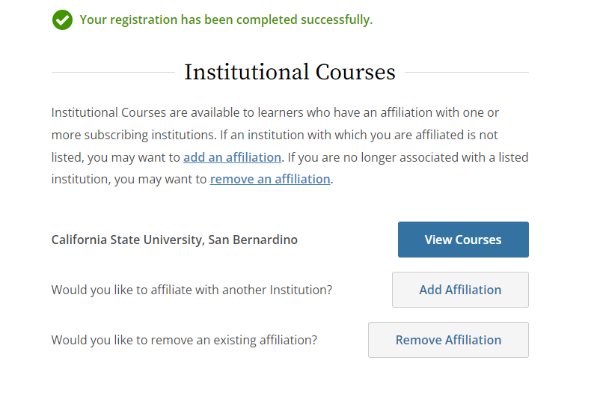
Step 1: Select “View Courses”

Slide 17
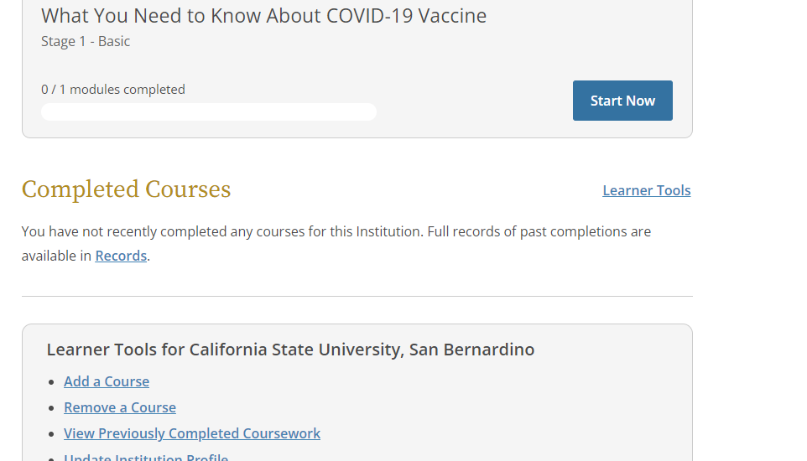
Step 2: Scroll to the bottom of the page, under “Learner Tools for California State University, San Bernardino”, select “Add a Course”

Slide 18
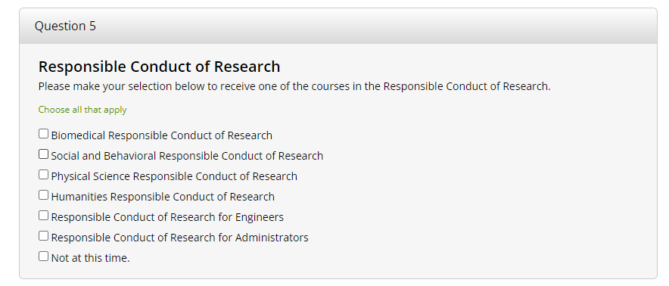
Step 3: Scroll to Question 5 and select the most appropriate RCR course for you. For example, nursing, biology, and health science students would complete the Biomedical RCR Course while psychology, sociology, & social work students would complete the Social and Behavioral RCR course.

Slide 19
How to Complete the RCR CITI Training

Slide 20
Requirements and recommendations to complete the CITI training.
Computer (fully charged or plugged in)
Pencil and paper to take notes
Ability to save the final completion certificate
2-3 hours to complete the full training
You may complete the training in multiple sessions

Slide 21
Requirements and recommendations to complete the RCR CITI training cont.
MUST complete all modules.
MUST pass all module quizzes with 100% to pass the training (5-10 questions each). You are able to retake the quizzes if you do not pass.
Final test uses same questions as the previous quizzes, but rearranges the questions to ensure your paying attention.
After completing all modules, you will receive a certificate. Save the certificate, email to the faculty member or Principal Investigator (faculty PI) who instructed you to complete the course.
  The faculty member or principal investigator must maintain the RCR certificates of completion in their files for record keeping and audit purposes.

Slide 22
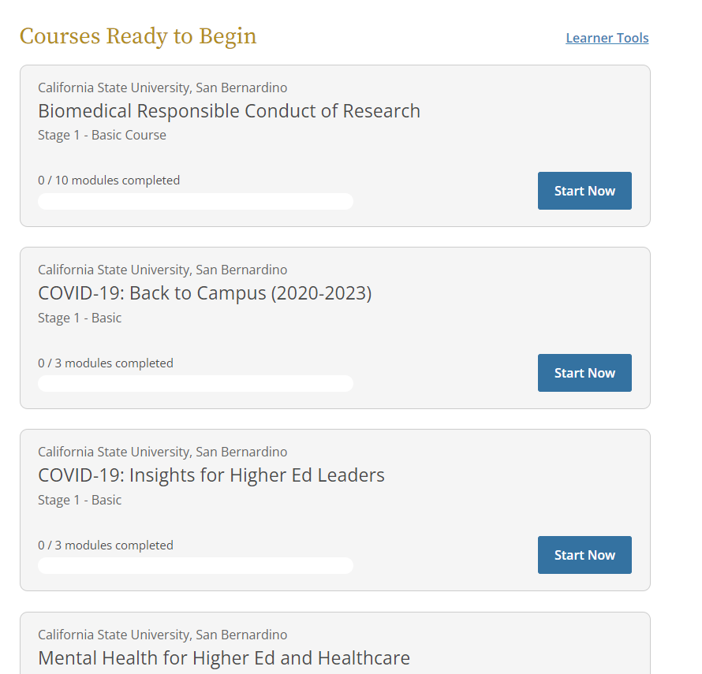
Step 1: Ensure the correct RCR course is added to your courses

Slide 23
Step 2: Select “start now”

Slide 24
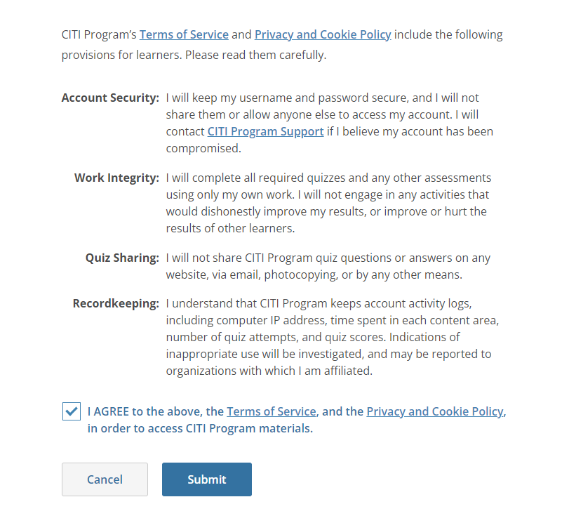
Step 3: Read and select to agree to the “Terms of Service” and select “Submit”:

Slide 25
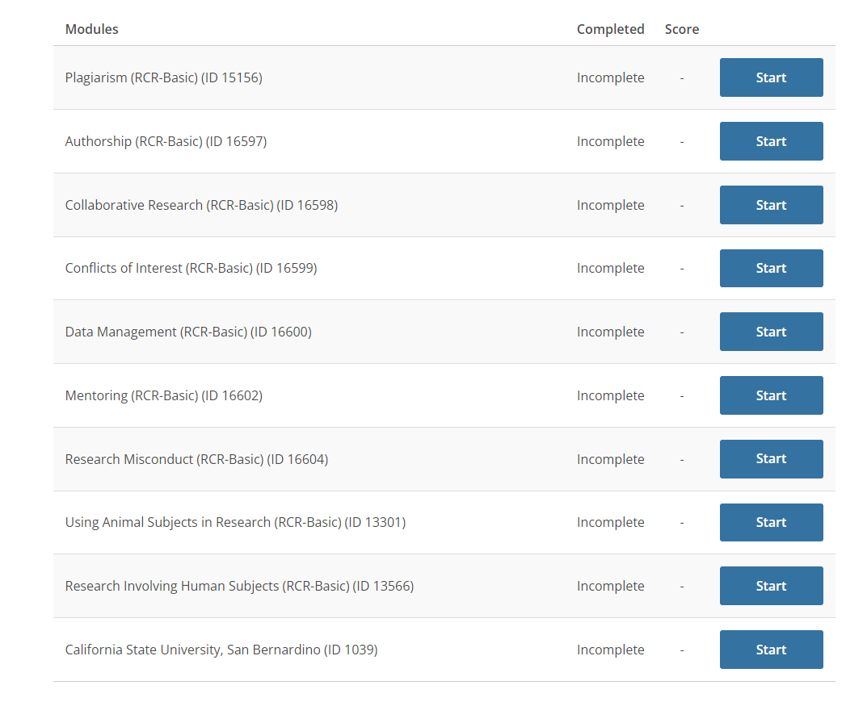
Step 4: After selecting the submit button, you will see the screen on the right.
To begin the training select the blue titles under the “Required Modules”.
Complete all the listed modules.
After completing all modules, you will receive a certificate/completion report. Save the certificate/report and upload it with your IRB application into the attachments section of the online Cayuse IRB application system.

