Slide 1
Federal
Work-Study (FWS)
YEAR END, SUMMER & FALL employment
Presented by:
Lizzet Lopez & Leslie Delgadillo

Slide 2
Agenda
Eligibility Requirements
Summer/Fall Employment
Job Codes: Bridge vs. Non-Bridge
FWS Hiring Instructions & Forms (online)
Background Check
Job Postings
Placement & Deadlines
Time Reporting
Termination/Separation

Slide 3
Student Eligibility Requirements
Enrolled at least half-time
Undergraduate = 6 units
Graduate = 3 units of graduate level coursework
Maintain Satisfactory Academic Progress
Demonstrate Financial Need
Awarded Federal Work-Study
23/24 for June 2024 employment
24/25 for July 2024 – May 2025 employment
Eligible to work in the United States
Complete FWS tutorial

Slide 4
FWS POLICIES & RULES
Adhere to
Work-Study Student Employment Policy & Terms of Employment
ISA Contract Letter/Description of Duties (ISA appointments only)
Labor Law
Provide orientation on job expectations, comfort breaks, training, phone usage, etc.
Monitor earnings and do not exceed FWS award
Do not exceed daily, weekly, monthly maximum hours
Adhere to 20 hour work week during session and breaks
Student must cease working on the last day of the academic year, if they drop to less than half-time, withdrawal, or graduate
Student must stop working if funding is exhausted by student or FWS program
Department may hire and pay as a regular Student Assistant through their department funding
Any change in the student’s employment or supervisor must be reported to the FWS Coordinator
Scan and submit timesheets, student listings, class schedules to FWS each month to: workstudy@csusb.edu. No late submissions!
Submit “Revised” and Final Hours
Verify enrollment each term
Failure to comply with FWS rules – may result in your eligibility to participate in the FWS program at CSUSB

Slide 5
Career Center: Handshake
All FWS positions must be posted on the Career Center website (Handshake)
Job postings are subject to approval
Determine hourly rate
  Minimum wage is $16.00/hour for Student Assistants
  $17.50/hour for Instructional Student Assistant – ISA
Justification required for all starting rates above minimum hourly rates
*Please ensure that jobs are posted by August 1st to ensure students are hired by October 7th placement deadline
Job listings will be removed by the Career Center
Do not post FWS jobs on the Campus or BB list serves
Continuing Re-hire positions do not need to be posted on Handshake

Slide 6
Background Check
The hiring department is responsible for determining whether their student will be in a position in which a background check is required by law
Human Resources will contact the student to schedule an appointment for a Live Scan
Students employed in the following areas will require a background check:
Regular or direct contact with minors
Access to patients, drugs or medication
Access to stored criminal offender records
Access to, or control on a regular basis of amounts greater than $10K in cash, checks, credit cards, and/or credit card account information
Requires access to Level 1 data
ISA background check will be initiated by the FWS team
*Rehire Exemption: not required for continuing students employed in the same position for 12 months

Slide 7
FWS Placement & Deadlines
June 2024 Employment:
First day of summer employment is June 1st
FWS students must have remaining funding from 2023-2024 FWS award to work June 1 – June 30
If no 2023-2024 funding available for June, students cannot begin working until July 1st under their 2024-2025 FWS award
Students must be enrolled in at least half-time units for Fall 2024
July-August 2024 Employment:
Based on summer session enrollment
Students must have a 2024-2025 FWS award to participate
Students must be enrolled in at least half-time units for Fall 2024
Incoming Freshman or Transfer students may not begin working until August 19,2024
First day of Fall employment:
  August 19, 2024
  Placement deadline: October 7, 2024
Instructional Student Assistants (ISA)
  Open until filled
FWS hiring forms must be initiated and submitted to Student Employment prior to start date
The FWS student must complete the entire hiring process before they may begin working
The FWS supervisor will receive the FWS Routing Slip from Student Employment that serves as confirmation that the student is hired and can begin working
If you allow your student to work before you receive the FWS Routing Slip, you will have to hire as a concurrent hire to pay the student from your department’s funds

Slide 8
Bridge vs. Non-Bridge Appointments:
Non-Bridge on-campus job code 1871
Non-Bridge off-campus job code 1872
ISA appointment job codes: 1151/1153
Bridge on-campus job code: 1875
Bridge off-campus job code: 1876
A bridge appointment occurs when there is a 5 week break in attendance based on student’s summer enrollment, student is subject to FICA and Medicare taxes

Slide 9
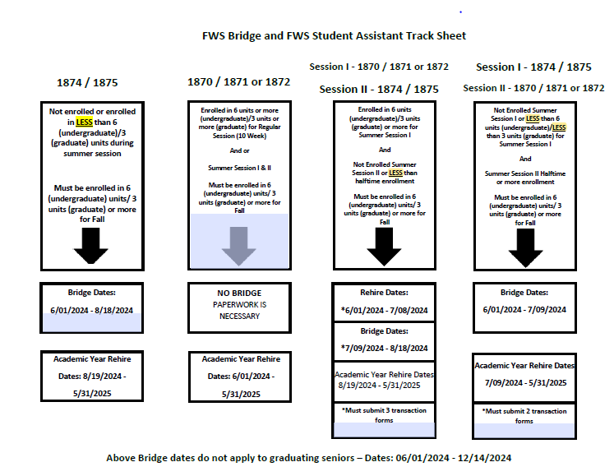
Bridge Summer Employment

Slide 10
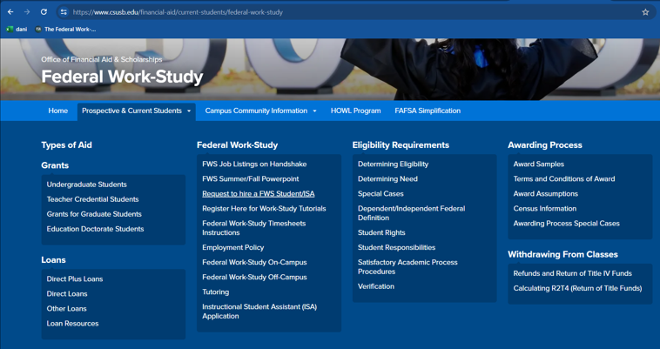
Request to hire a FWS student
http://csusb.az1.qualtrics.com/jfe/form/SV_2nw0pbSTLDs2QcJ

Slide 11
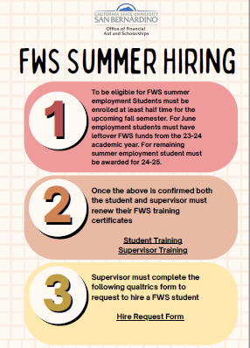
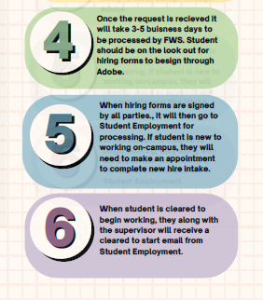

Slide 12
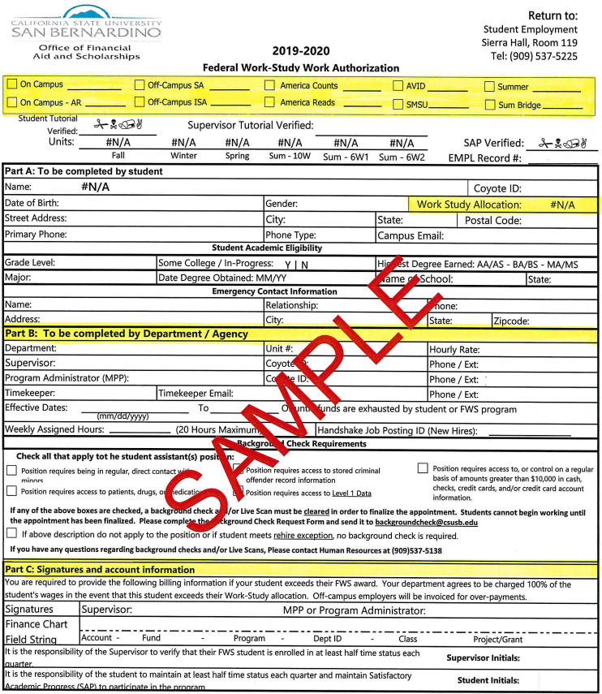
FWS WORK AUTHORIZATION
Part A
  Requests student’s demographic information
  FWS award
Part B
  To be completed by Lead/Supervisor
    Department
    Unit #
    Hourly rate
    Lead/Supervisor/MPP contact info.
    Timekeeper
    Effective and end date
    Weekly hours
    Handshake Job Positing ID
    Background Clearance
Part C
  Requests student’s initials that they are responsible for enrolling half-time, maintaining SAP
  Requests Lead/Supervisor’s initials that they agree to verify student’s enrollment each term
  Request Finance Chart Field String

Slide 13
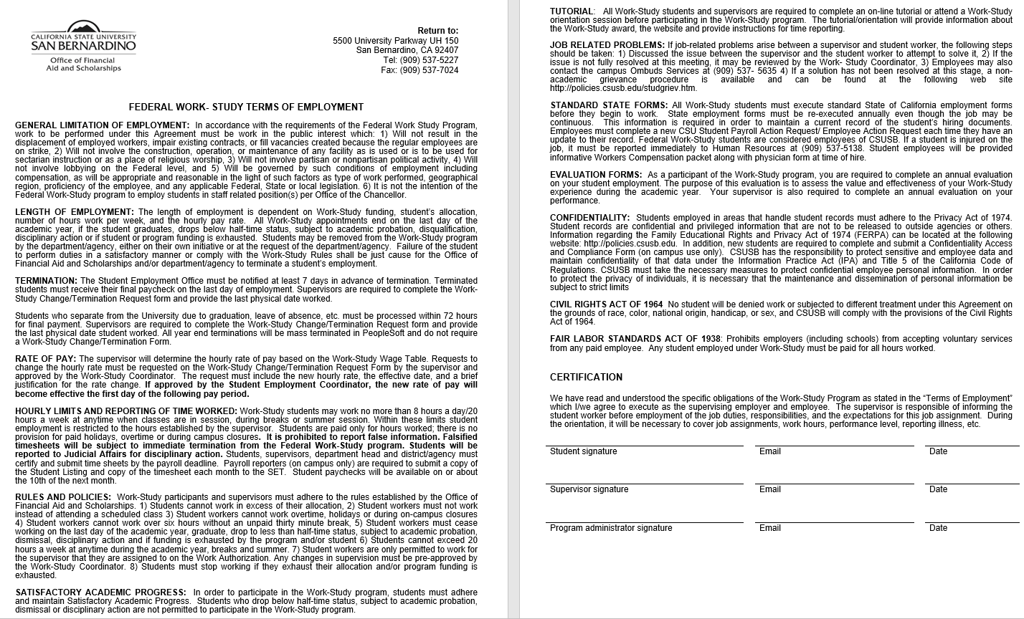
TERMS OF EMPLOYMENT
Requires student, lead/supervisor, MPP signatures
All must agree to the Terms of Employment to participate in the FWS program and follow the rules
Violation of the FWS rules may result in termination from the FWS program

Slide 14
ISA CONTRACT LETTER

Slide 15
DESCRIPTION OF DUTIES FORM (DOD)
Lead/Supervisor completes the following
  Term: Fall or Spring
  Lead/Supervisor’s name
  Location: department/district/tutorial agency
  Day/Time: ISA work schedule
  Employer
Check off job duties ISA will be performing
Answer Y/N if the lead/supervisor will perform class observation
Lead/Supervisor & ISA sign and date form
DOD must be completed at the beginning of each term

Slide 16
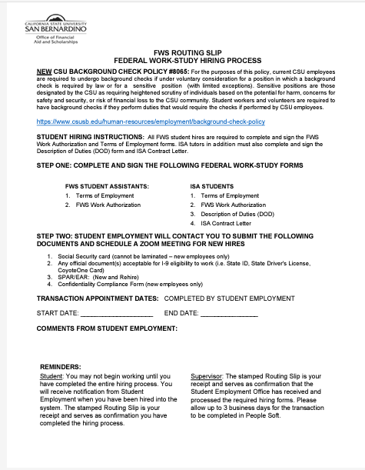
FWS ROUTING SLIP
The FWS Routing Slip serves as confirmation that the student has been hired into PeopleSoft and your FWS student may begin working
Do not permit your FWS student to work prior to receipt of the FWS Routing Slip or you will have to hire and pay out of your own department funds

Slide 17
Time Reporting - Payroll
Use electronic timesheet located on the Financial Aid & Scholarships website
Computes daily, weekly and monthly totals
Report hours in military time
New FWS timesheet includes Adobe Sign for student, supervisor and administrator to certify and sign FWS timesheets
Use Payroll Calendar on website for payroll deadlines & paycheck disbursement dates
Students are paid once a month – Pay day is around the 15th of every month
Report hours for correct pay period
Attached class schedule
Review timesheet for class conflicts, 6-hour rule, weekly/monthly maximum hours, required signatures
Students may not work during schedule class
Must have permission to work if,
CC = Class Cancelled
EE = Class Excused Early
WB = Winter Break
SB = Spring break
AC = Asynchronous

Slide 18
Time Reporting - Continued
MANDATORY - Scan and email copies of Student Listing, Timesheet and class schedule to workstudy@csusb.edu each month
20 hour a week maximum during sessions and breaks
8 -10 hour a day maximum
Students must take a 30 minute unpaid break after 6 consecutive hours
No overtime, holiday or work during campus closure
During campus closure, MPP must authorize FWS student to work on campus
Timesheets must be signed by student, lead/supervisor and program administrator (MPP)
Falsified timesheets are subject to termination and disciplinary action by Office of Student Conduct and Ethical Development
TURN IN TIMESHEETS BY POSTED DEADLINE - NO LATE TIME SHEETS WILL BE ACCEPTED – DEPARTMENT WILL BE RESPONSIBLE FOR PAYING THE STUDENT 100% OF THEIR WAGES

Slide 19
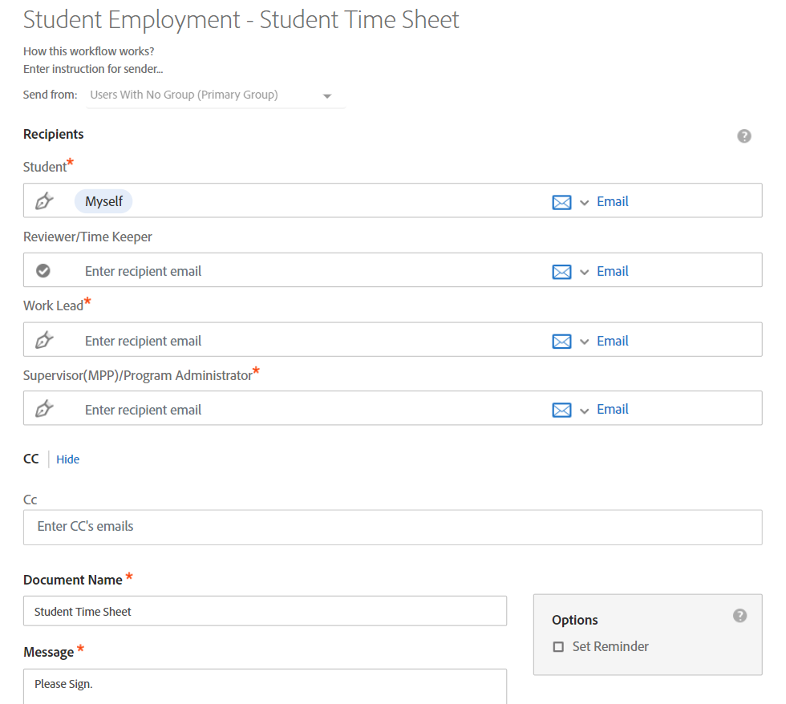
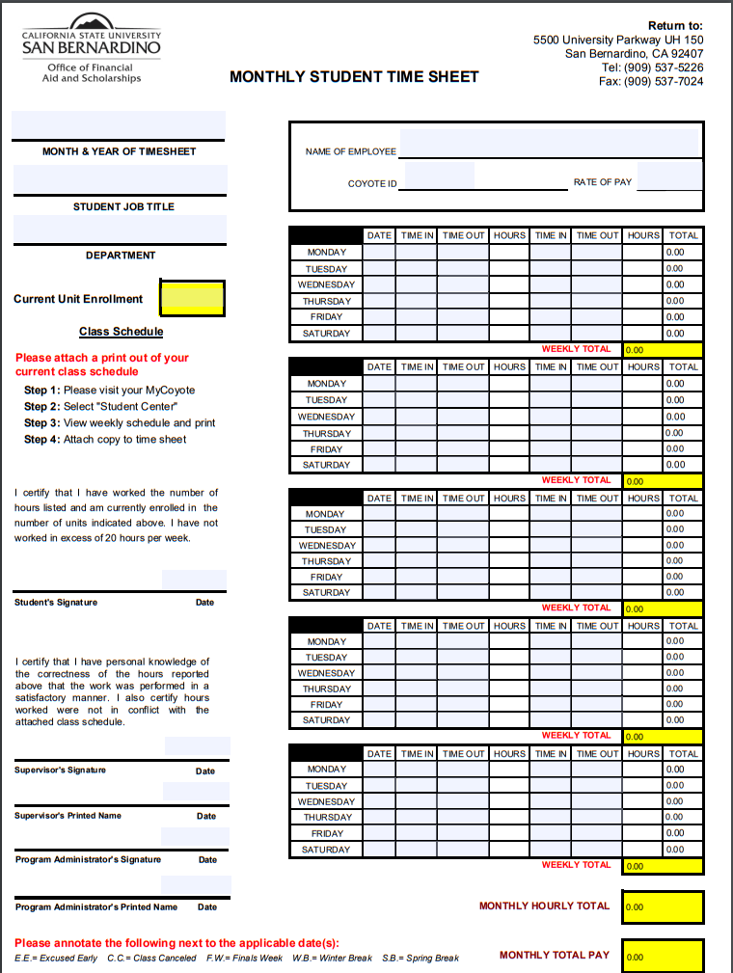
TIMESHEET EXAMPLE

Slide 20
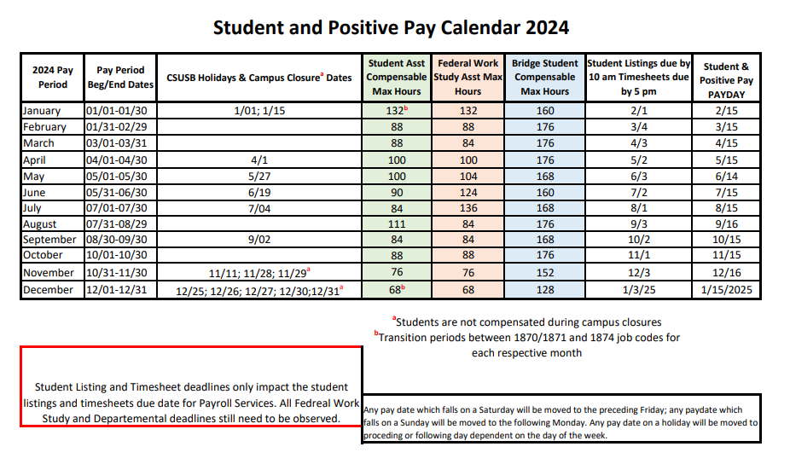
FWS Payroll Calendar
FWS Payroll is due every month to workstudy@csusb.edu
Email copies of student listing, FWS timesheet, class schedule to workstudy@csusb.edu
Submit “Revised” listing, timesheet & class schedule to workstudy@csusb.edu
FWS students are paid on the 15th of the month
Note maximum month hours
Note pay period dates
  Some months overlap
Note holidays and campus closures

Slide 21
TERMINATION/SEPARATION
  Final hours must be submitted to Payroll within 72 hours
    Separating or withdrawing from the university
    Graduating
    Resignations
    Send copy of final hours to FWS
  Per AB 2410, which amended Section 220 of the Labor Code, an employee who is discharged must be paid wages earned immediately
    Note: The student is entitled to receive pay for all hours worked at the time of separation. Failure to comply is violation of AB 2410 Section 220 and may result in fines to the department
  Notify FWS Lead prior to terminating (Involuntary Dismissal)
  Each termination will be evaluated on a case-by-case basis by FWS
    Student must receive final check on last day of employment
  Submit FWS Change/Termination form
    Report the last physical day worked

Slide 22
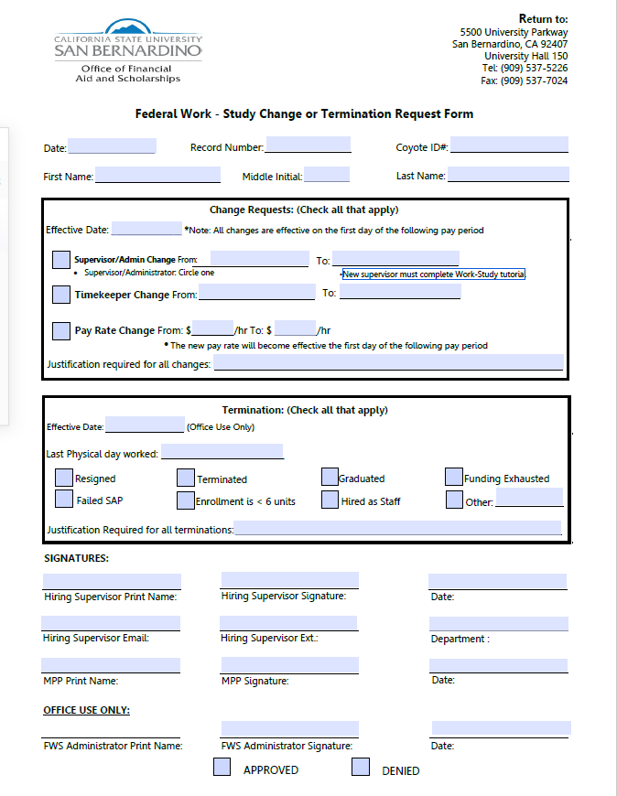

Slide 23
Work-Study Contact Information
Leslie Delgadillo
Federal Work-Study Coordinator
Leslie.Delgadillo@csusb.edu
909) 537-7149
Lizzet Lopez
Federal Work-Study Lead
Lizzet.lopez@csusb.edu
(909) 537-3433
Celeste Alcala
Job Location Developer
celeste.alcala@csusb.edu
(909) 537-7148
Office hours: Monday-Friday 8AM-5PM
Summer hours: Monday-Thursday 8AM-5:30 PM
Student line: (909) 537-5226
FAX line: (909) 537-7024
FWS EMAIL:
WORKSTUDY@CSUSB.EDU

Slide 24
Q and A?

