Slide 1

Emergency Substitute Teaching Permit For Prospective Teachers

Slide 2
About This Permit
The Emergency Substitute Teaching Permit for Prospective Teachers authorizes the holder to serve as a day-to-day substitute teacher in any classroom, including preschool, kindergarten, and grades 1-12 inclusive, or in classes organized primarily for adults. The holder may serve as a substitute for no more than 30 days for any one teacher and may only serve for a maximum of 90 days during the school year. In a special education classroom, the holder may serve for no more than 20 days for any one teacher during the school year. The permit is valid for one year and may be renewed only once.

Slide 3
Requirements
Individuals may submit their application packets directly to the Commission office or through their employing agency. The application packet must include all of the following:
Official transcripts showing completion of a minimum of 90 semester units of course work from a regionally-accredited four-year college or university. If a transcript shows units transferred from another institution, the letter verifying enrollment (see no. 2 below) must specify the number of units transferred that were accepted toward completion of a bachelor’s degree.
Verification of current enrollment in a regionally-accredited four-year California college or university. This may be verified by an original letter from the registrar of the office of admissions, or official transcripts showing current work-in-progress.
Satisfy the basic skills requirement. See Commission leaflet CL-667, entitled Basic Skills Requirement, for additional information.
Completed application (form 41-4), and, if not previously submitted to the Commission, a completed Live Scan receipt (41-LSOpen PDF in current window.). Out-of-state residents (with out-of-state addresses) must submit two fingerprint cards (FD-258) in lieu of a Live Scan receipt. If submitting fingerprint cards, current fingerprint processing fees must accompany the application packet.
Application processing fee (see Fee Information leaflet CL-659).
Updated July 01, 2024

Slide 4
Requirement 1:
Official Transcripts
Official transcripts are a requirement for most documents issued by the Commission. In order for transcripts to be considered official they must be:
Printed on security paper directly and/or displaying an official raised seal from the college or university, per the institutions standard practice.
OR
If the college or university uses a transcript clearinghouse agency for printed transcript copies, these must include a cover letter identifying the degree granting institution and show that the physical transcript copy was mailed directly to the educator.
OR

Slide 5
Requirement 1:
Official Transcripts Continue
Electronic transcripts submitted directly to the Commission from a digital credential service are considered official transcripts. The Commission currently accepts these direct transmissions from:
  Parchment - Educators must select the Commission as the authorized recipient of transcripts
  eScrip-Safe - Educator should enter etranscripts@ctc.ca.govMailto link. This opens in connected mail client." as transcript recipient
  TranscriptNetwork - Educator should enter etranscripts@ctc.ca.govMailto link. This opens in connected mail client." as transcript recipient
  National Student Clearinghouse - Educator should enter etranscripts@ctc.ca.govMailto link. This opens in connected mail client." as transcript recipient
  College/University - Educator should enter etranscripts@ctc.ca.govMailto link. This opens in connected mail client." as transcript recipient

Slide 6
Requirement 1:
Official Transcripts Continue
Additionally, the following applies to all official transcripts regardless of format:
Printed transcripts do not need to be kept in a sealed envelope. Opened transcripts are accepted so long as they follow the guidance listed here.
Transcripts must be issued from a regionally-accredited college or university. Further information can be found under Regional Accreditation Information.

Slide 7
Requirement 2: Verification of Current Enrollment
This may be verified by doing one of the following ways:
An original letter from the registrar of the office of admissions
OR
2. Official transcripts showing current work-in-progress

Slide 8
Requirement 3:
Satisfy the Basic Skills Requirement
Individuals may satisfy the basic skills requirement by one of the following methods:
Meet the Basic Skills Requirement by Degree (This Method CAN'T be complete for this Permit)
Meet the Basic Skills Requirement by Coursework
Meet the Basic Skills Requirement by Coursework and Exam
Achieve Qualifying Score on the SAT or ACT
Pass the CBEST
Pass the CSET: Multiple Subjects Plus Writing Skills Examination
Pass the CSU Early Assessment Program or the CSU Placement Examinations
College Board Advanced Placement (AP) Examinations
Pass a Basic Skills Examination from Another State
Updated July 01, 2024

Slide 9
Requirement 3 Continue:
Method 1
Most credentials require a bachelor's or higher degree from a regionally accredited institution, so the majority of applicants will meet the Basic Skills Requirement through their degree, except for the following documents which do not require a bachelor's degree:
Emergency Substitute Teaching Permit for Prospective Teachers
Exchange Certificated Employee Credential
The Sojourn Certificated Employee Credential
Designated Subjects Supervision and Coordination Credentials

Slide 10
List
Satisfy the Basic Skills Requirement
Individuals may satisfy the basic skills requirement by one of the following methods:
Meet the Basic Skills Requirement by Degree (This Method CAN'T be complete for this Permit)
Meet the Basic Skills Requirement by Coursework
Meet the Basic Skills Requirement by Coursework and Exam
Achieve Qualifying Score on the SAT or ACT
Pass the CBEST
Pass the CSET: Multiple Subjects Plus Writing Skills Examination
Pass the CSU Early Assessment Program or the CSU Placement Examinations
College Board Advanced Placement (AP) Examinations
Pass a Basic Skills Examination from Another State
Updated July 01, 2024

Slide 11
Requirement 3 Continue:
Method 2
Individuals may meet the requirement by providing official transcripts to a Commission-approved preparation program or submitted with their application packet to the Commission. The transcripts must show passage of courses in reading, writing, and mathematics as outlined below. Courses must have been taken at a regionally-accredited college or university for credit, passed with a grade of B or better, be degree applicable, and be at least 3 semester units or 4 quarter units. Qualifying coursework does not include professional development or continuing education units or in-service training or workshops. Qualifying coursework includes the following:
For reading proficiency: a course in critical thinking, literature, philosophy, reading, rhetoric, or textual analysis.
For writing proficiency: a course in composition, English, rhetoric, written communication, or writing.
For mathematics proficiency: a course in algebra, geometry, mathematics, quantitative reasoning, or statistics.
A course that does not fall within the indicated areas may still qualify with an additional letter of explanation. The letter must be from the registrar or the department chair that oversees the Mathematics or English department, as applicable. The letter must state that a course passed by the applicant covered reading, writing, or mathematics. Such a letter could also attest that a single course sufficiently indicates proficiency in reading and writing combined.
Online recommendations from a Commission-approved preparation program must include Form 41-BSR, entitled Verification of Basic Skills Requirement when choosing the coursework option. Form 41-BSR is available on the Credential Information Guide (CIG). Form 41-BSR is not required if CBEST or CSET scores are being used to meet the requirement.
Individual and LEAs without a Commission-approved program may use Form CL-130Open PDF in current window., entitled Basic Skills Requirement Evaluation Worksheet

Slide 12
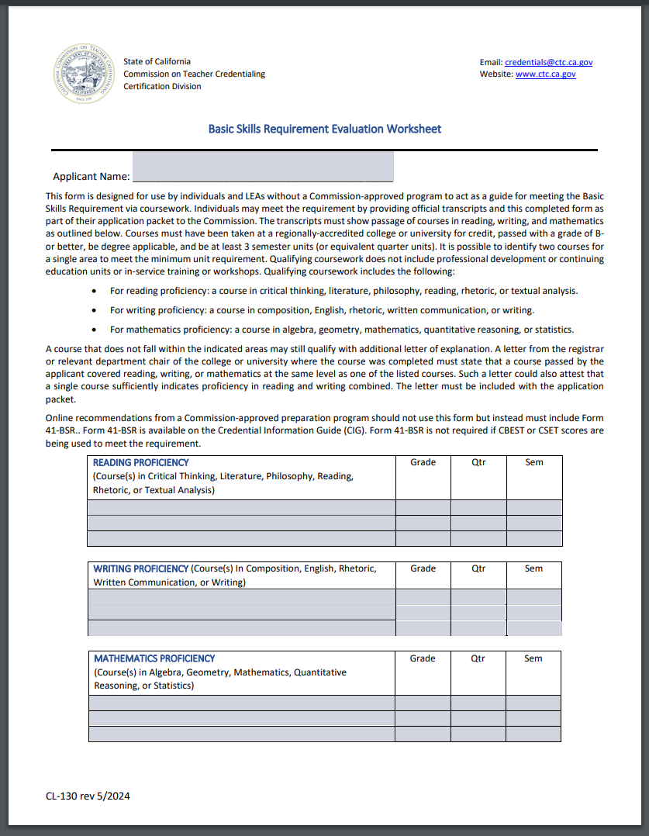
Requirement 3 Continue:
Method 2 Cont.
Form CL-130Open PDF in current window.

Slide 13
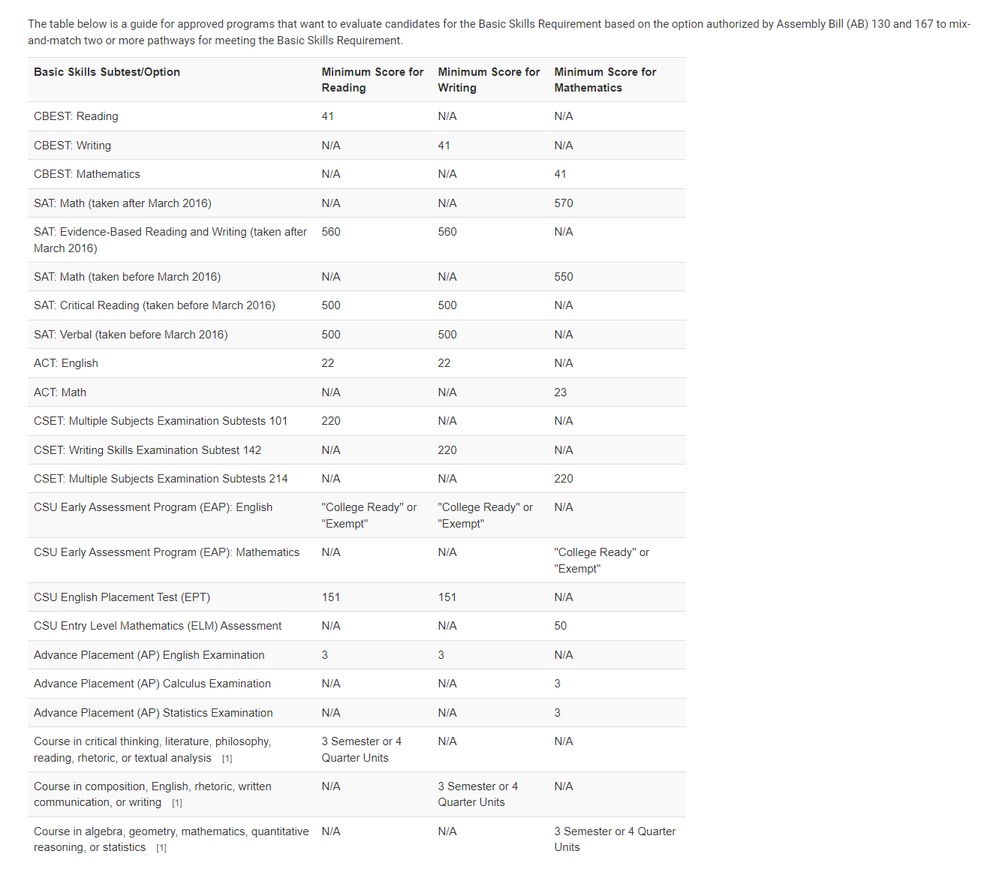
Requirement 3 Continue:
Method 3
The Basic Skills Requirement can be met through a combination of applicable courses and qualifying exams. Both Commission-approved programs and the Commission can determine basic skills proficiency through this combination option. The qualifying coursework must meet the requirements as describe above in item number 7. The mixing-and-matching of relevant component or components from all exam options permitted under current law is acceptable with the exception of out-of-state basic skills exams. The Guidance Chart for Mixing BSR Options can be used when determining acceptable combinations.
Online recommendations from a Commission-approved program sponsor must include Form 41-BSR, entitled Verification of Basic Skills Requirement when choosing the mixing-and-matching option. Form 41-BSR is available on the Credential Information Guide (CIG). Form 41-BSR is not required if CBEST or CSET scores are being used to meet the requirement.

Slide 14
Requirement 3 Continue:
Method 3 Cont.
Footnote 1: If using coursework to meet one or more component of the Basic Skills Requirement, the following rules apply:
The candidate must have earned a grade of "B" or better (“B-” is acceptable) in the qualifying coursework
The coursework must have been taken at a regionally accredited college or university
The coursework must provide 3 semester units or 4 quarter unit of college credit
The coursework must have been taken for academic credit (earned units)
The coursework must be AA or BA degree applicable
  For Reading, applicable coursework must be in the subject of critical thinking, literature, philosophy, reading, rhetoric, or textual analysis
  For Writing, applicable coursework must be the subject of composition, English, rhetoric, written communications, or writing
  For Mathematics, applicable coursework must be in the subject of algebra, geometry, mathematics, quantitative reasoning, or statistics
If taken at a college or university outside the United States, the courses must be English based courses and must be deemed as equivalent to coursework taken at a regionally-accredited college or university in the United States. Foreign-prepared educators must obtain an evaluation of their transcripts through a Commission-approved Foreign Transcript Evaluating Agency. See leaflet CL-635 for more information.

Slide 15
Requirement 3 Continue:
Method 3 Cont.
The following coursework is NOT acceptable:
Professional development or continuing education units
In-service training or workshops
Non-credit bearing courses
Courses where credits do not apply toward the requirements for an Associate degree, Baccalaureate degree, or higher degree
Note that out-of-state basic skills examination subtests cannot be used as a mix-and-match option.
Combination of BSR options
Must be approved by a Commission-approved program sponsor or the Commission
41-BSR form encouraged, but not required
Updated March 24, 2023

Slide 16
List
Satisfy the Basic Skills Requirement
Individuals may satisfy the basic skills requirement by one of the following methods:
Meet the Basic Skills Requirement by Degree (This Method CAN'T be complete for this Permit)
Meet the Basic Skills Requirement by Coursework
Meet the Basic Skills Requirement by Coursework and Exam
Achieve Qualifying Score on the SAT or ACT
Pass the CBEST
Pass the CSET: Multiple Subjects Plus Writing Skills Examination
Pass the CSU Early Assessment Program or the CSU Placement Examinations
College Board Advanced Placement (AP) Examinations
Pass a Basic Skills Examination from Another State
Updated July 01, 2024

Slide 17
Requirement 3 Continue:
Method 4
Previously, individuals having earned a score of 500 or higher on the Critical Reading (previously Verbal) section of the SAT exam combined with a score of 550 or higher on the SAT Mathematics exam are determined to have met the basic skills requirement.
A restructuring of the SAT Suite of Assessments has adjusted the qualifying scores on the revised Evidence-Based Reading and Writing and Mathematics examinations required to meet the basic skills requirement. The new scores listed have been deemed by the College Board as equivalent to the scores shown for the examinations as administered prior to this revision. See Appendix Tables 2-3.
An individual having earned a score of 22 or higher on the ACT English exam combined with a score of 23 or higher on the ACT Mathematics exam is determined to have met the basic skills requirement. See Appendix Table 4.

Slide 18
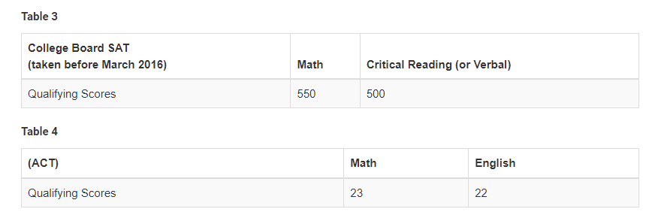
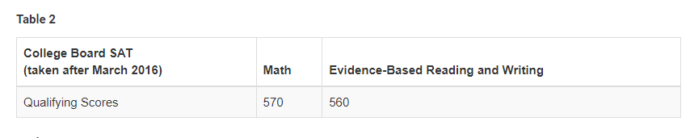
Requirement 3 Continue:
Method 4 Cont.

Slide 19
Requirement 3 Continue:
Method 5
Individuals only need to pass The California Basic Educational Skills Test (CBEST) once; CBEST passing scores remain valid indefinitely for all credential and employment purposes. To pass the CBEST, one must obtain a minimum scaled score of 41 in each of the three sections—reading, writing, and mathematics. However, a score as low as 37 on an individual section is acceptable if the total scaled score is at least 123.
Any or all sections of the CBEST can be repeated as many times as necessary to obtain a passing score, but the full registration fee is charged for each test administration. For more information, see CTC-Exam website.

Slide 20
Requirement 3 Continue:
Method 6
The California Subject Examinations for Teachers (CSET): Multiple Subjects examination has been modified, adding an assessment of basic writing skills. Passage of the CSET: Writing Skills examination (test #142) can be added to passage of the CSET: Multiple Subjects Examination (subtests #101, 214, & 225) to meet the basic skills requirement. Passing exam scores used to meet the basic skills requirement remain valid indefinitely. For more information, see CTC-Exam website.

Slide 21
List
Satisfy the Basic Skills Requirement
Individuals may satisfy the basic skills requirement by one of the following methods:
Meet the Basic Skills Requirement by Degree (This Method CAN'T be complete for this Permit)
Meet the Basic Skills Requirement by Coursework
Meet the Basic Skills Requirement by Coursework and Exam
Achieve Qualifying Score on the SAT or ACT
Pass the CBEST
Pass the CSET: Multiple Subjects Plus Writing Skills Examination
Pass the CSU Early Assessment Program or the CSU Placement Examinations
College Board Advanced Placement (AP) Examinations
Pass a Basic Skills Examination from Another State
Updated July 01, 2024

Slide 22
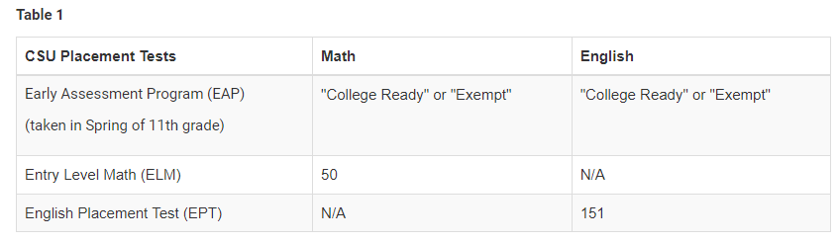
Requirement 3 Continue:
Method 7
Passing scores on the California State University (CSU) Early Assessment Program (EAP) (English and Mathematics sections) or the CSU Placement Examinations (English Placement Test [EPT] and Entry Level Mathematics [ELM]) are sufficient to meet the basic skills requirement. See Coded Correspondence 09-03 for additional information. Passing exam scores remain valid indefinitely for the purpose of meeting the basic skills requirement. See Appendix Table 1 for passing scores.

Slide 23
Requirement 3 Continue:
Method 8
As noted in Coded Correspondence 15-03, students who achieve a score of 3 or higher on the College Board AP English exam and AP Calculus or AP Statistics exam may also use these exam scores to meet the basic skills requirement. See Appendix Table 5 for how the scores may be applied.
https://www.ctc.ca.gov/docs/default-source/commission/coded/2015/1503.pdf?sfvrsn=38a1d62c_2

Slide 24
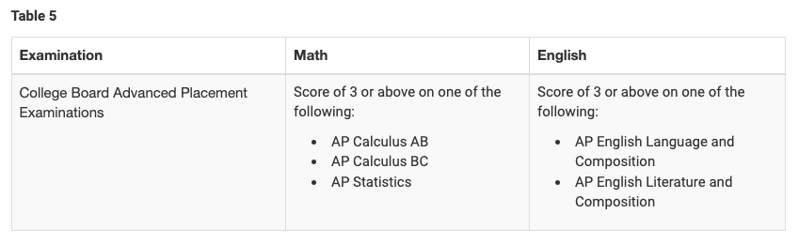
Requirement 3 Continue:
Method 8 Continue
Appendix Table 5 for how the scores may be applied.

Slide 25
Requirement 3 Continue:
Method 9
The Commission will accept basic skills examinations from other states. A photocopy of the score report or letter from the testing agency verifying passage of the examination must be submitted with the application packet. There is no recency requirement for the date the examination was passed. See the chart Out-of-State Basic Skills Exams Guide in the Appendix at the end of this leaflet for a listing of acceptable examinations from other states.

Slide 26
Requirement 4: Application and Live Scan
Completed application (form 41-4), AND, if not previously submitted to the Commission, a completed Live Scan receipt (41-LS). Out-of-state residents (with out-of-state addresses) must submit two fingerprint cards (FD-258) in lieu of a Live Scan receipt. If submitting fingerprint cards, current fingerprint processing fees must accompany the application packet.

Slide 27
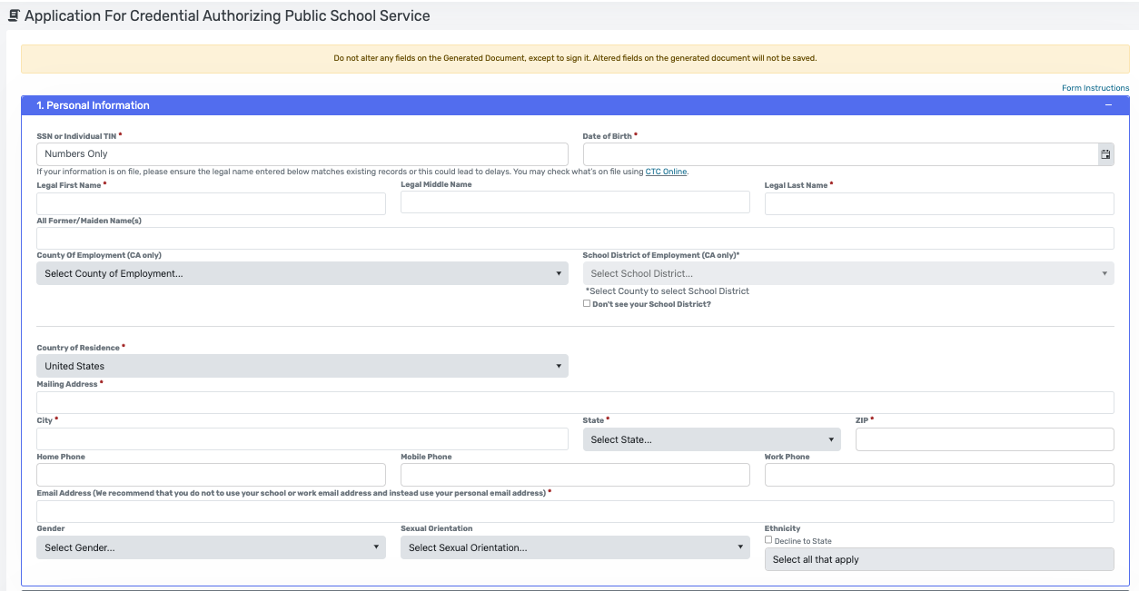
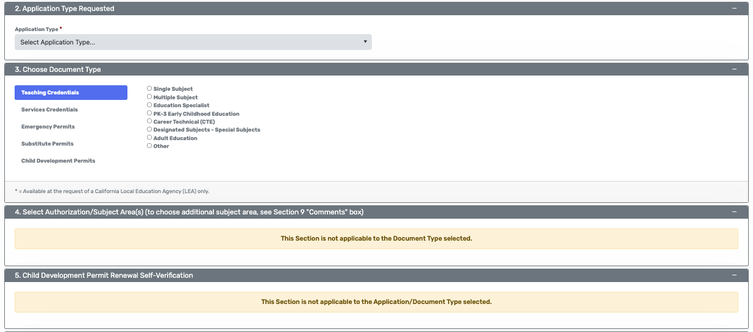
Requirement 4: Application and Live Scan Continue
Application (form 41-4)

Slide 28
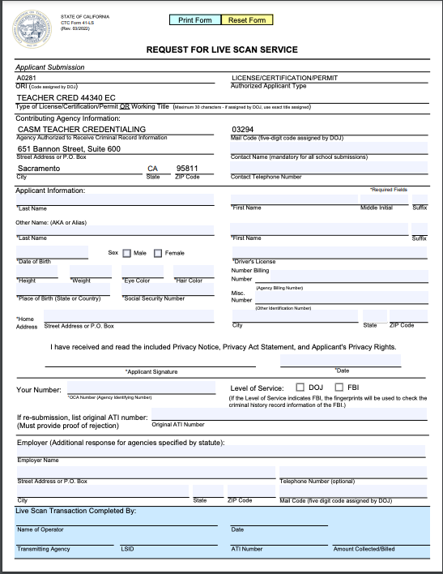
Requirement 4: Application and Live Scan Continue
Live Scan receipt (41-LS)

Slide 29
Requirement 5: Paying the Fee
Application processing fee (see Fee Information leaflet CL-659).
You can check the application through your Educator Login.

