Slide 1
Mileage guidelines and how to create mileage reports in Concur

Slide 2
Mileage Guidelines
For any planned business trips, a travel request must be submitted and approved in advance, even if the only expense being claimed is mileage. Planned business trips include attending conferences, training sessions, or workshops, travel related to research, and faculty assignments to teach at a campus other than their primary work location.
Faculty members assigned to teach at another CSU campus must submit a travel request for the entire semester they are scheduled to teach at the other campus. Once the request is fully approved, they can submit monthly mileage expense reports, referencing the approved request ID in the comment section of the report header.
Trips that involve infrequent off-campus meetings, last-minute requests for item pick-up or delivery, transporting candidates to and from airports and/or hotels, and similar situations, may submit an expense report without requiring an approved travel request.
For infrequent or sudden mileage trips that do not require an approved travel request, travelers must include a comment on each mileage expense entry in Concur to substantiate the business need.

Slide 3
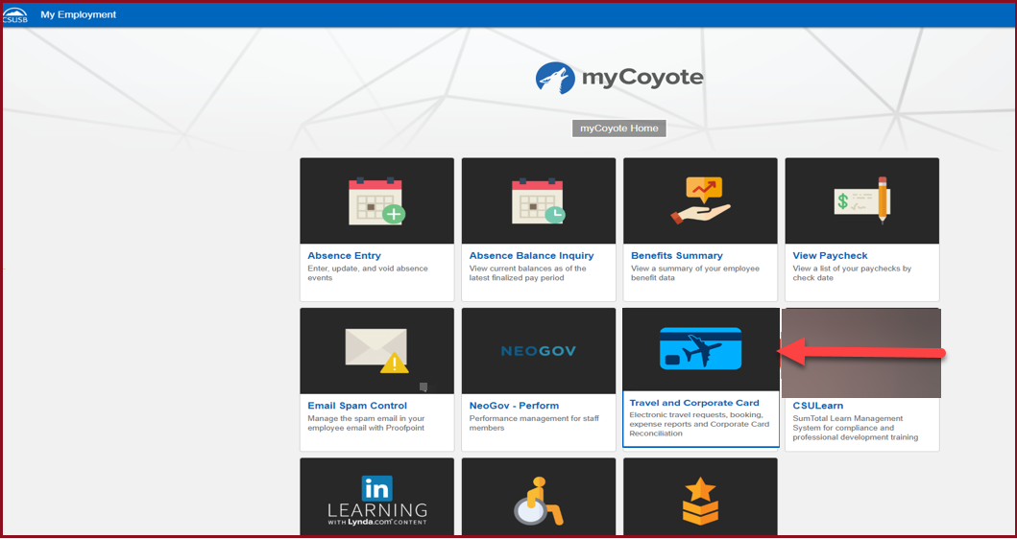
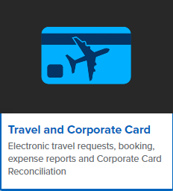
Planned Business Trips : Please see the following slides to create a Travel Request Approval
To log in to Concur, go to the single sign-on page and enter your My Coyote ID and password. Press Enter, then select either 'My Employment' or 'Administrative Systems,' and click on the Travel and Corporate Card icon, as shown below.

Slide 4
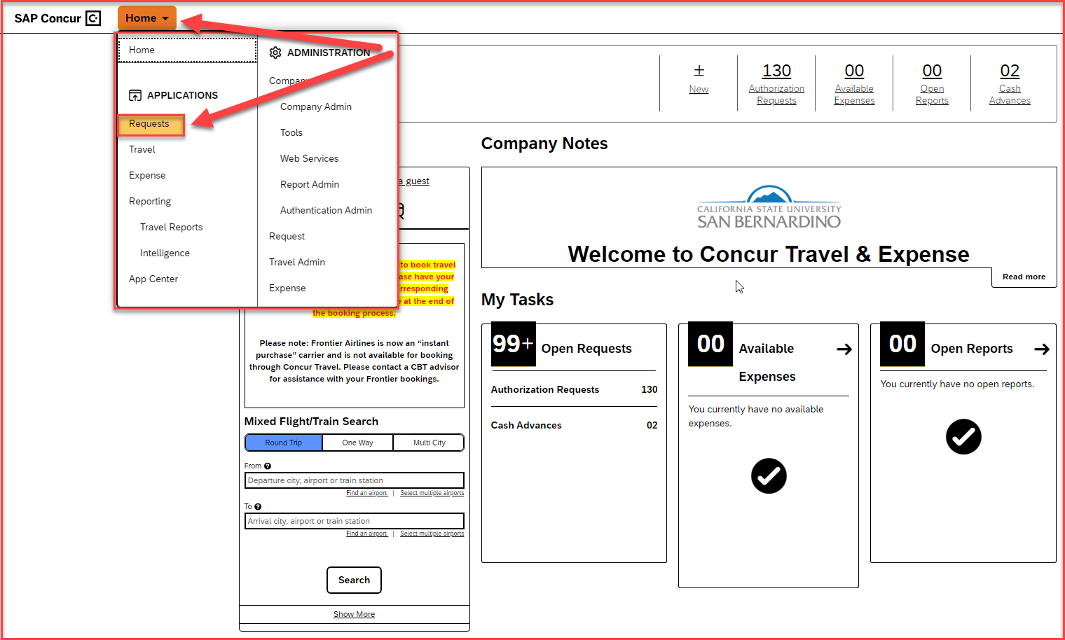
To begin creating a Travel request, click on Home and select Requests

Slide 5
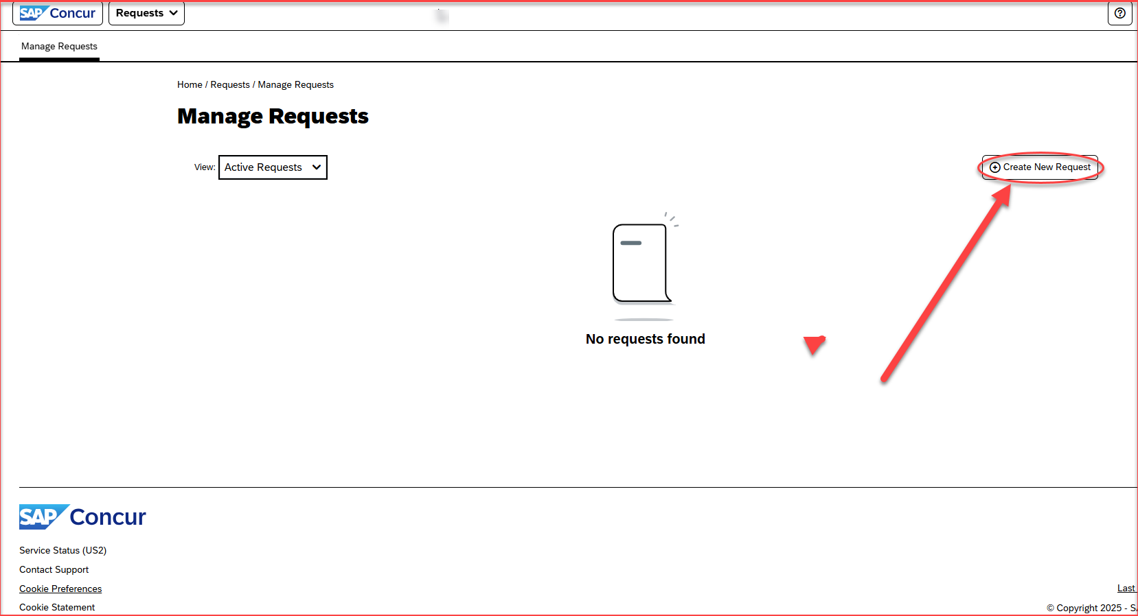
Click on Create New Request

Slide 6
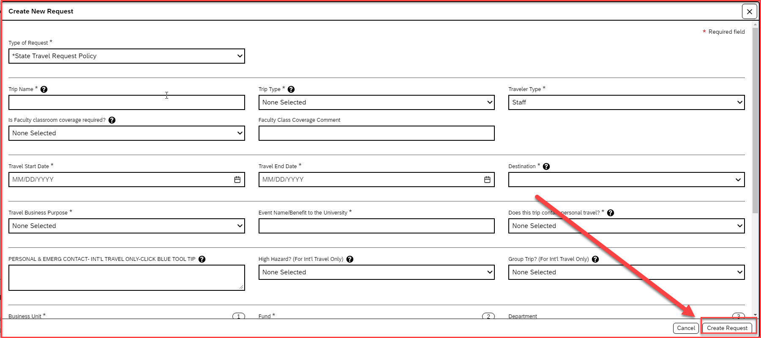
Fill in the details in the Travel Request Header
For planned business trips where mileage is the only expense, the travel start, and end dates must align with the actual travel period
Do not select the Business Purpose – 14. Mileage Only No Request. This is supposed to be used only on the expense side.
Once all the details are filled in, click on Create Request available on the bottom right-hand corner

Slide 7
Request Header Components
Once the "Type of Request" policy is added and saved, it becomes locked in the system and cannot be edited if an incorrect policy is selected. The user then will have to create a new Request and start over.
Type of Request This is the funding source of your trip, either it can be State Policy or Auxiliary Policy
Trip Name Please add a meaningful name based on your business trip
Trip Type For Travel within state - choose instate, outside the state - out of state, and out of the country - international
Traveler Type Group Travel – trips sponsored by staff/faculty consisting a group of students, Team Travel – Athletics Team trips
Travel Business Purpose Please choose the appropriate business purpose related to the trip
Event Name/Benefit to the University This can be the same as the Trip Name
Does this trip contain personal travel Answer Yes or, No . If answer is Yes, attach the comparison price to the Request
Personal & Emerg Contact/High Hazard/Group Trip Required to fill the 3 boxes, if the trip is international
Chart Field String Information The business unit, fund, department, program and project number is collectively known as chartfield string. Please reach out to the respective department to confirm the correct chartfield string
Approver Choose the budget approver of your department from the list that appears in the box. If the user is not aware of that information, please contact the respective department

Slide 8
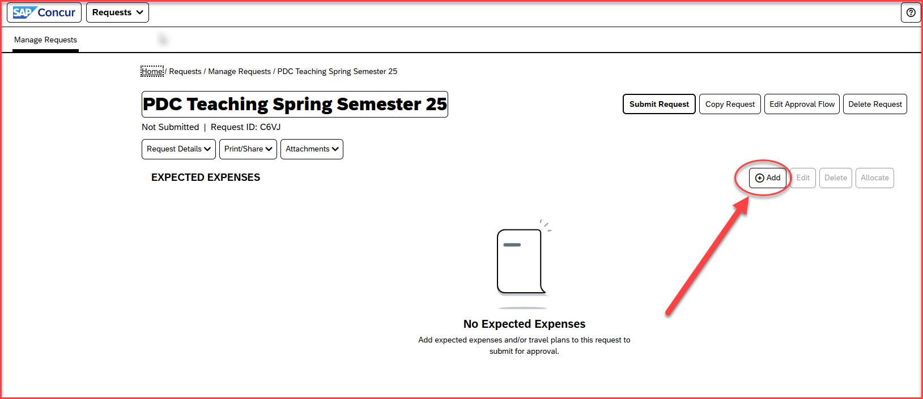
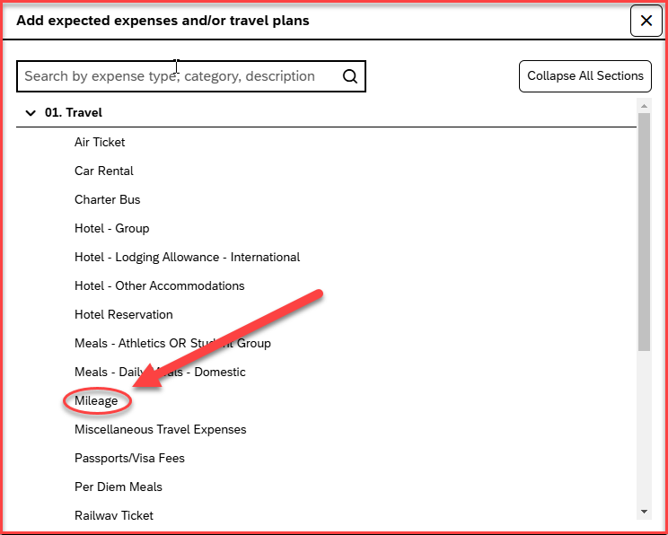
Adding the expenses
Click on Add and start adding the expenses
Select the expense type Mileage available under 01. Travel

Slide 9
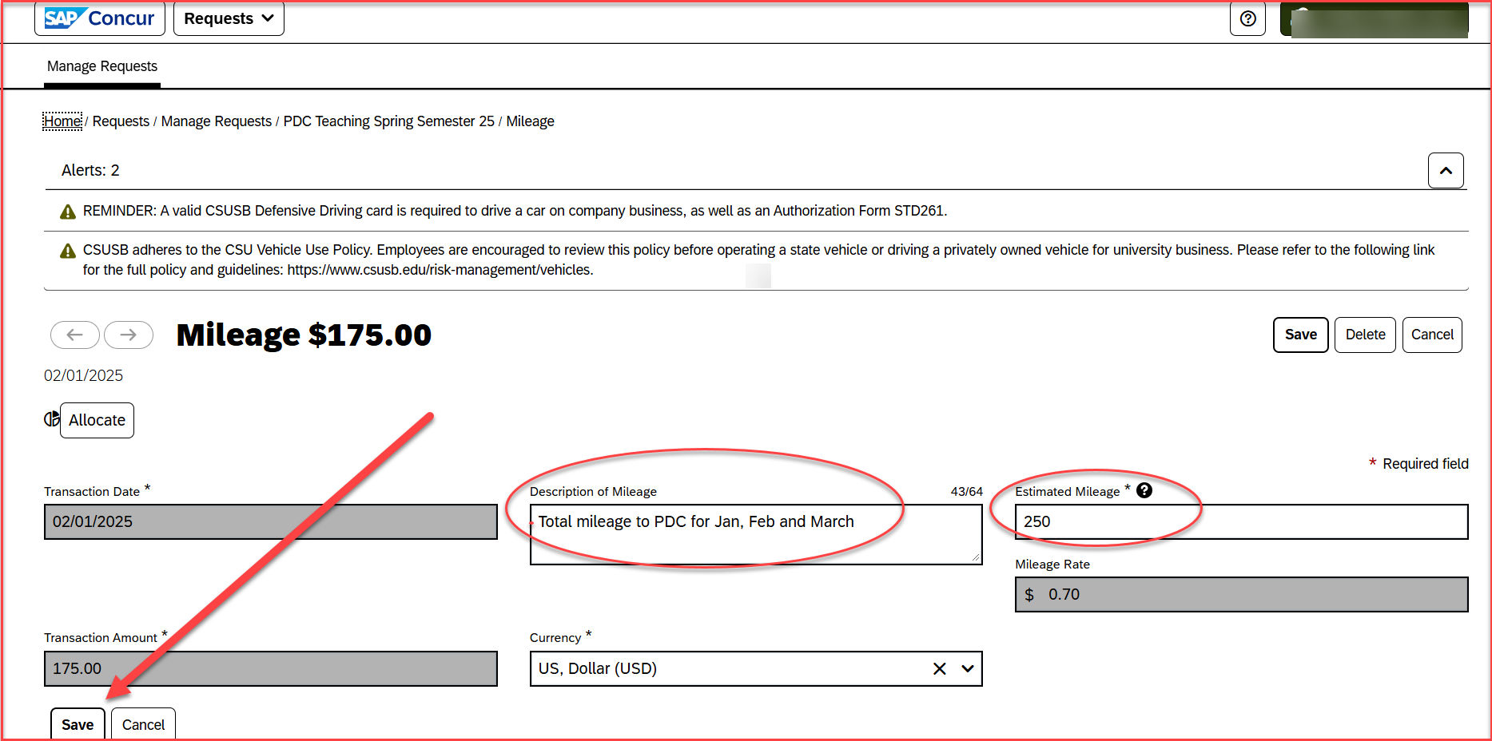
Adding the total estimated mileage
Add the total estimated mileage for the whole travel period in the Estimated Mileage box
Add a description of the mileage that will be undertaken in the Description of Mileage box
Once both the details are filled in, click on Save available in the left-hand corner bottom

Slide 10
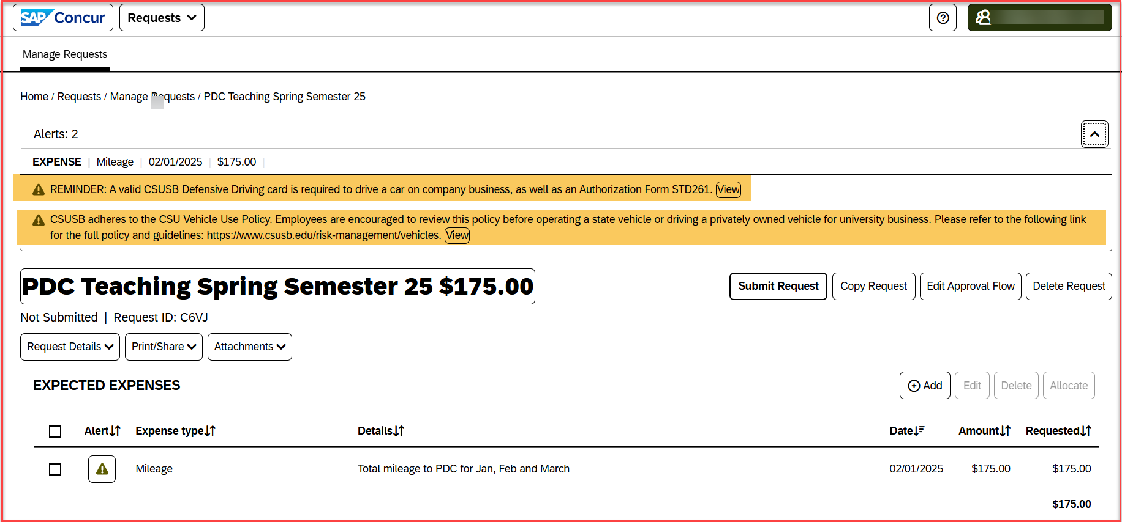
Alerts for Mileage
For mileage approval requests, there will always be two alerts, even if the traveler has completed those
The initial alert serves as a reminder for travelers to always carry a valid CSUSB Defensive Driving card while traveling and to complete the form STD 261
The second alert is to be aware of the policy and guidelines of CSU vehicle use policy.

Slide 11
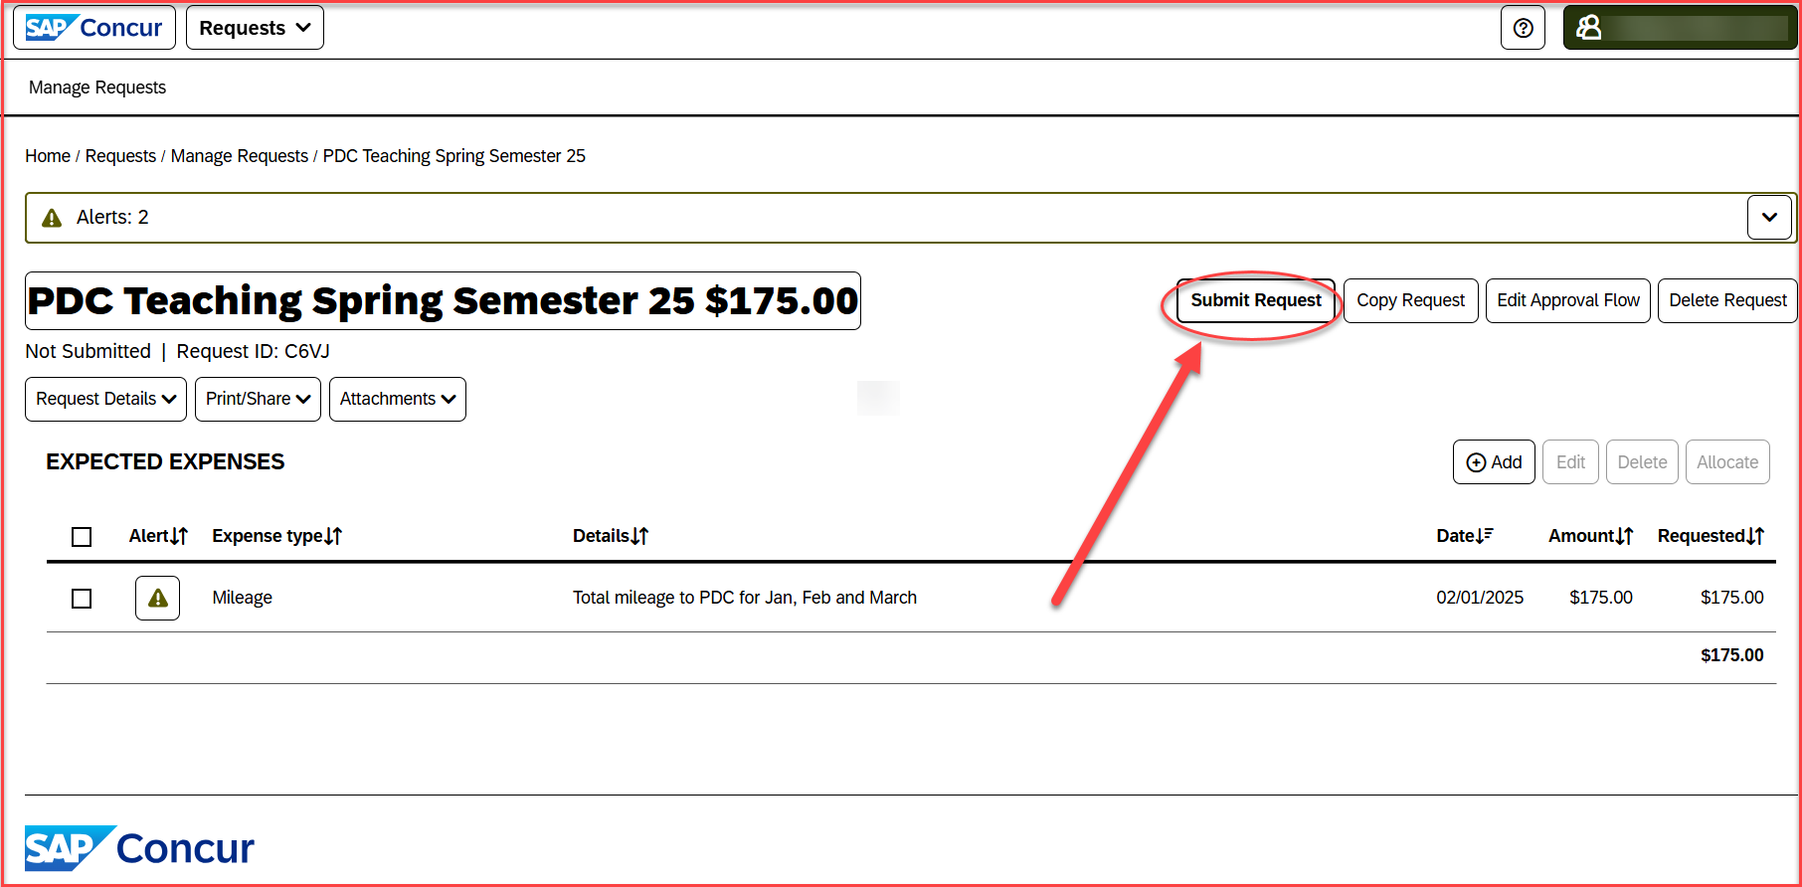
Request Submission
Once the total estimated mileage has been added and saved, and the alerts have been reviewed, the request is ready to be submitted
Click on Submit Request available in the right-hand corner top

Slide 12
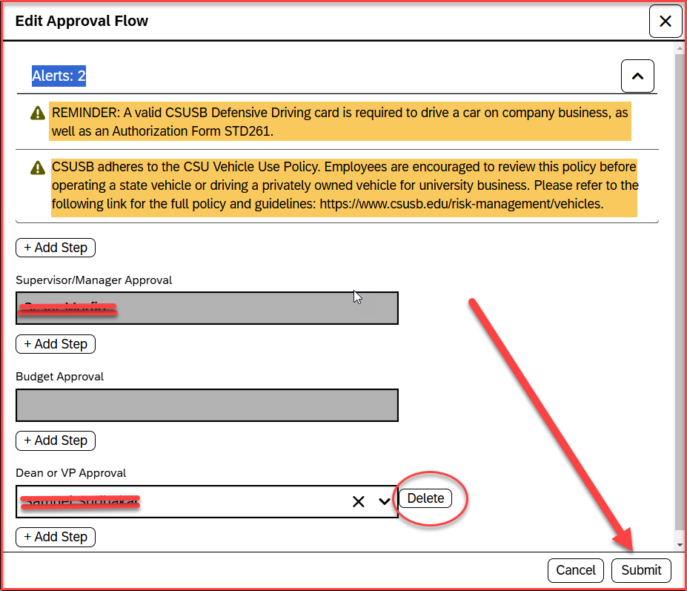
Approval Flow – The approval flow will consist of the below approvers
Supervisor/Manager – This approver is the employee’s default manager
Budget Approval – This is the approver that is added to the Request header, and the name will appear blank.
Dean or VP Approval – This approver is the VP or Dean for the department/division that is added on the request header. The VP or Dean will appear in the approval flow, only when the request is for 3 or more-night stays, for all out-of-state requests, and if the lodging stay exceeds the $275 limit per night.
Once the approval flow is reviewed, click on Submit, available on the right-side bottom corner
Please note: For some mileage approval requests if the VP/Dean approval is not needed, users may exclude that step by clicking on the Delete option.

Slide 13
Planned Business Trips : Please see the following slides to create a Mileage expense report
To log in to Concur, go to the single sign-on page and enter your My Coyote ID and password. Press Enter, then select either 'My Employment' or 'Administrative Systems,' and click on the Travel and Corporate Card icon, as shown below.

Slide 14
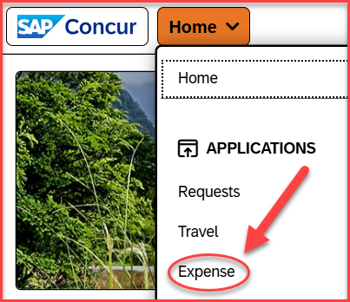
Once Logged in to Concur, click on Home > Expense

Slide 15
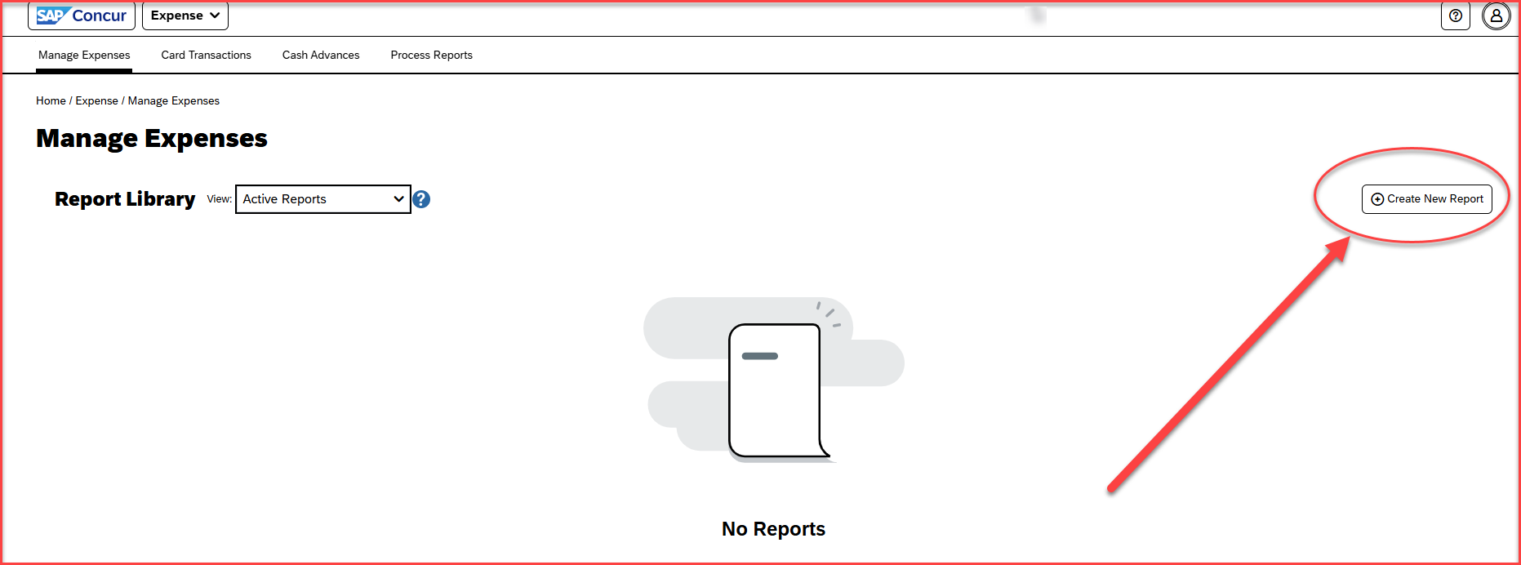
Click on Create New Report

Slide 16
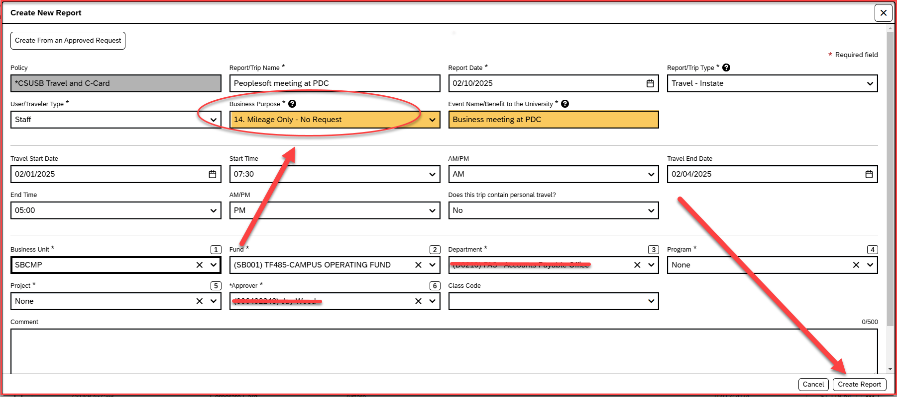
Report header
The Business Purpose should be : 14. Mileage Only – No Request
Event Name/benefit to the University : Please write the business need of the trip
The approver added on the header is the cost object approver
Add the 4-digit approved Travel request id number in the comment box
Once all the remaining details are filled in, click on Create Report, available at the right-hand corner down

Slide 17
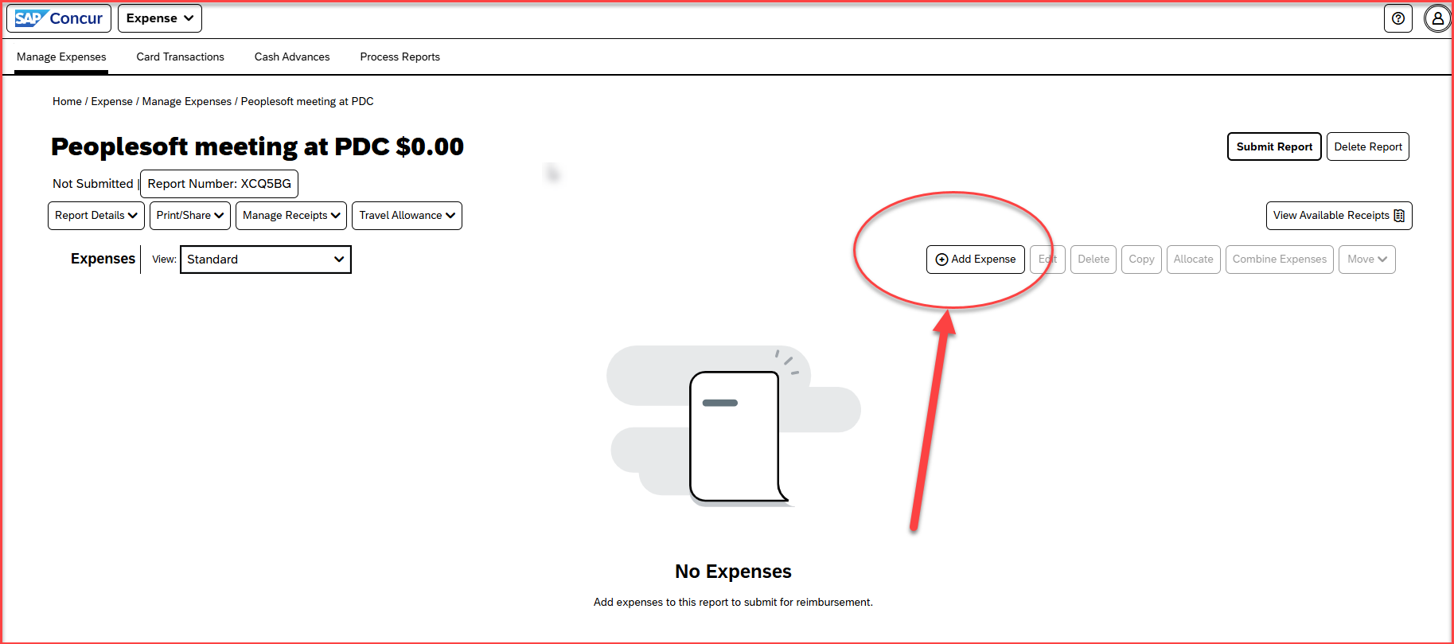
Click on Add Expense

Slide 18
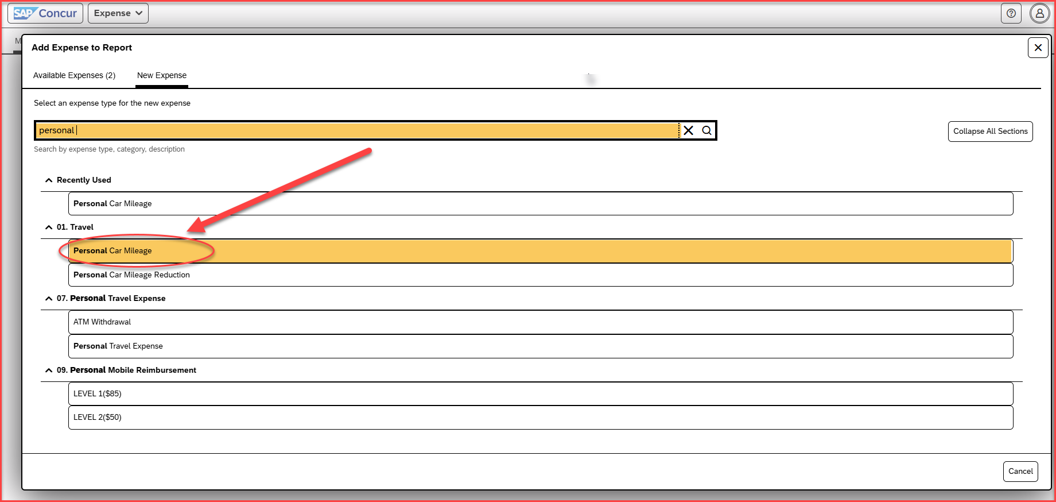
Add the expense type – Personal Car Mileage, available under the Parent type 01. Travel

Slide 19
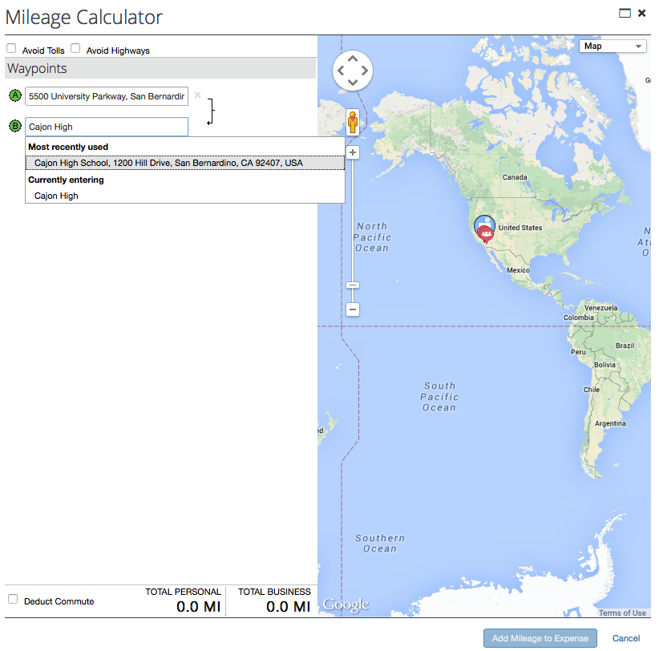
Adding the correct addresses on the Mileage Calculator
After clicking on Personal Car Mileage, a mileage calculator pops up. Please enter the beginning address and then add the locations visited. The system saves the most used destinations.
Mileage entries for separate days must be recorded individually, with each day entered as a separate expense entry.
Please note that the regular commute mileage between home and the headquarters is not reimbursable. The Deduct Commute box can be used to exclude that commute.

Slide 20
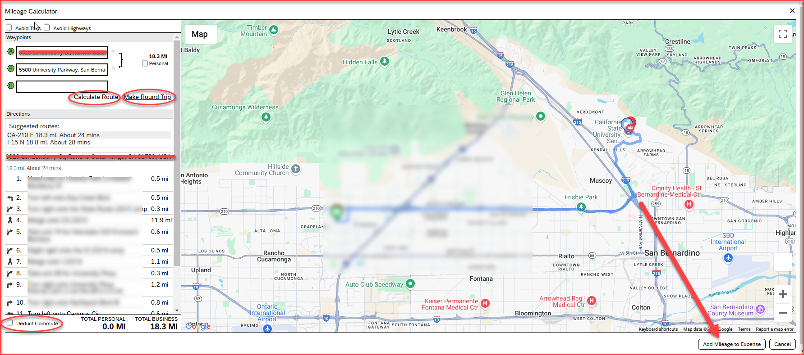
Adding the correct addresses on the Mileage Calculator
Once the Waypoints A and B are added, click on Calculate Route
For one day trips, users may click on – Make Round Trip
Once all the addresses are added, click on Add Mileage to Expense, available on the bottom of the right-hand corner

Slide 21
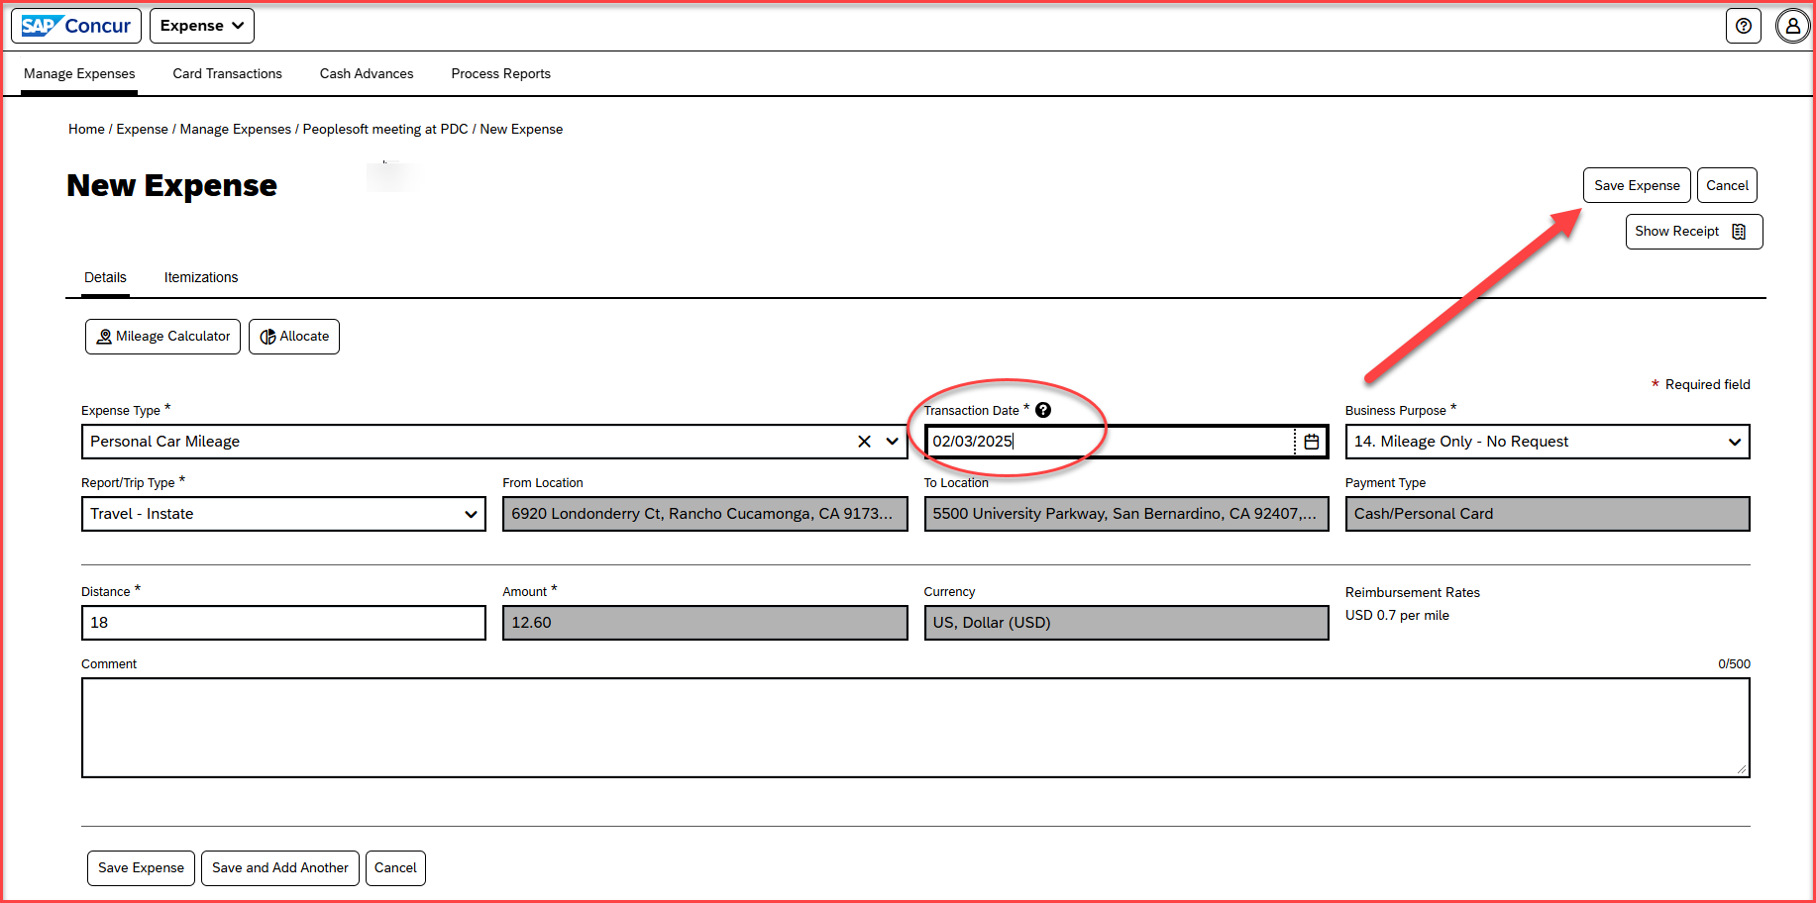
Adding the mileage entries
Add the Transaction Date, and this should align with the mileage date taken for that day.
If there are multiple mileage trips for several days, please add the entries separately for each day
Once all the mileage entries are added, click on Save Expense

Slide 22
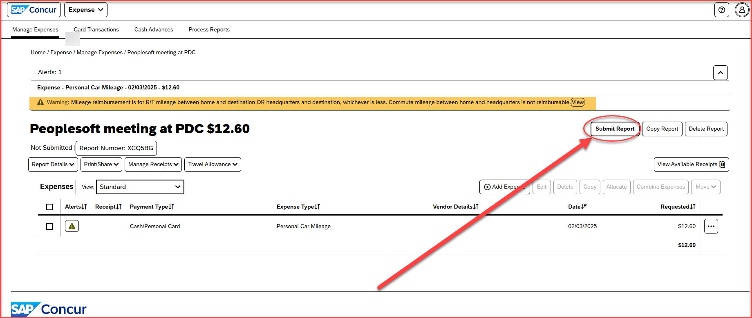
Mileage alerts
On an expense report, there will be only one soft alert that relates to the commute mileage policy
Once all the mileage entries are added, click on Submit Report

Slide 23
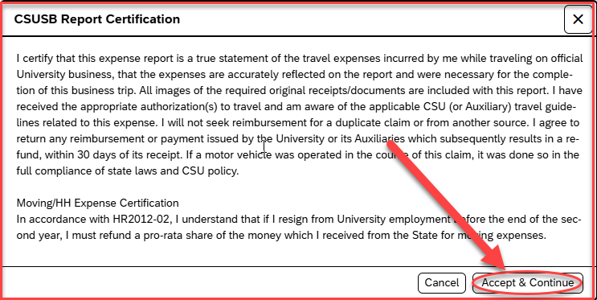
Certification page
The certification page will come up, click on Accept & Continue, available on the right-side bottom corner

Slide 24
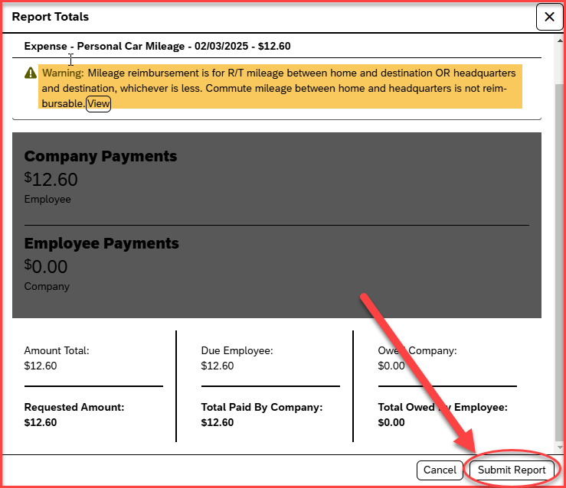
Report Totals
This page will show the amount total and the requested amount
This page will also show the soft alert warning message related to the commute mileage
Once the alert and the report total is reviewed, click on Submit Report available at the bottom right-side corner

Slide 25
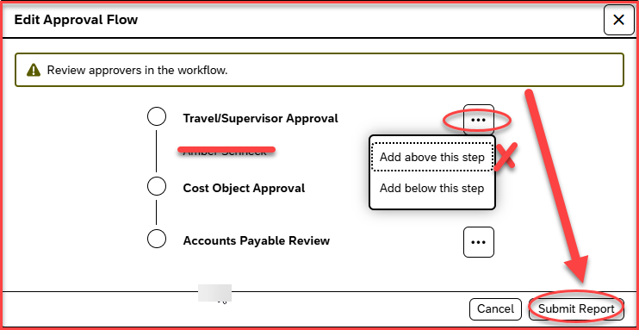
Approval Flow – The approval flow will appear and will consist of the below approvers
Travel/Supervisor Approval – This approver is the employee’s default manager
Cost Object Approval– This is the approver that is added to the Report header, and the name will appear blank.
Accounts Payable Review – All expense reports are reviewed and approved by accounts payable
Once the approval flow is reviewed, click on Submit Report, available on the right-side bottom corner
Please note: Do not add any approvers above the Travel/Supervisor Approval box and below the Accounts Payable Review box.

Slide 26
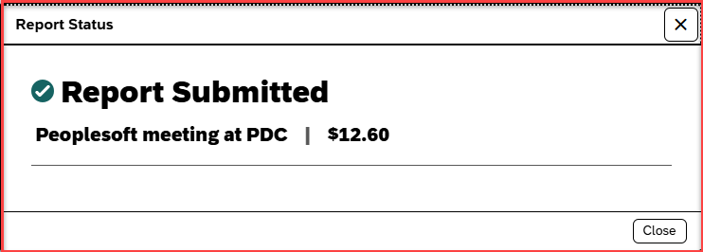
Expense Report Submission
Once the user clicks on Submit Report, a message will come up as Report Submitted

Slide 27
For Mileage only trips: Please see the following slides to create a Mileage only expense report (Trip-type examples would include, infrequent off-campus meetings, last-minute requests for pick up or delivery of items)
To log in to Concur, go to the single sign-on page and enter your My Coyote ID and password. Press Enter, then select either 'My Employment' or 'Administrative Systems,' and click on the Travel and Corporate Card icon, as shown below.

Slide 28
Once Logged in to Concur, click on Home > Expense

Slide 29
Click on Create New Report

Slide 30
Report header
The Business Purpose should be : 14. Mileage Only – No Request
Event Name/benefit to the University : Please write the business need of the trip
The approver added on the header is the cost object approver
Once all the remaining details are filled in, click on Create Report, available at the right-hand corner down

Slide 31
Click on Add Expense

Slide 32
Add the expense type – Personal Car Mileage, available under the Parent type 01. Travel

Slide 33
Adding the correct addresses on the Mileage Calculator
After clicking on Personal Car Mileage, a mileage calculator pops up. Please enter the beginning address and then add the locations visited. The system saves the most used destinations.
Mileage entries for separate days must be recorded individually, with each day entered as a separate expense entry.
Please note that the regular commute mileage between home and the headquarters is not reimbursable. The Deduct Commute box can be used to exclude that commute.

Slide 34
Adding the correct addresses on the Mileage Calculator
Once the Waypoints A and B are added, click on Calculate Route
For one day trips, users may click on – Make Round Trip
Once all the addresses are added, click on Add Mileage to Expense, available on the bottom of the right-hand corner

Slide 35
Adding the mileage entries
Add the Transaction Date, and this should align with the mileage date taken for that day.
If there are multiple mileage trips for several days, please add the entries separately for each day
Add the business need of the mileage trip on the comment section
Once all the mileage entries are added, click on Save Expense

Slide 36
Mileage alerts
On an expense report, there will be only one alert that relates to the commute mileage policy
Once all the mileage entries are added, click on Submit Report

Slide 37
Certification page
The certification page will come up, click on Accept & Continue, available on the right-side bottom corner

Slide 38
Report Totals
This page will show the amount total and the requested amount
This page will also show the soft alert warning message related to the commute mileage
Once the alert and the report total is reviewed, click on Submit Report available at the bottom right-side corner

Slide 39
Approval Flow – The approval flow will appear and will consist of the below approvers
Travel/Supervisor Approval – This approver is the employee’s default manager
Cost Object Approval– This is the approver that is added to the Report header, and the name will appear blank.
Accounts Payable Review – All expense reports are reviewed and approved by accounts payable
Once the approval flow is reviewed, click on Submit Report, available on the right-side bottom corner
Please note: Do not add any approvers above the Travel/Supervisor Approval box and below the Accounts Payable Review box.

Slide 40
Expense Report Submission
Once the user clicks on Submit Report, a message will come up as Report Submitted

Slide 41
THANK YOU!
If further information or assistance is needed, please do not hesitate to contact Accounts Payable/Travel at 909-537-3158
Notes:
Updated August, 2017 CL

