Slide 1

Chart of Accounts

Slide 2
Objectives
Identify and define elements of Chartfield strings
Understand the impact of chartfield strings on campus reporting and compliance
Present queries to aid in selecting Dept ID and Account chartfields

Slide 3
Chartfield string
Our accounting information system uses a Chart of Accounts (COA) . A COA is designed to:
  Comply with external financial reporting requirements (Chancellor’s Office, GAAP, State, Federal Government, etc.)
  Improve access to financial info in support of faculty and staff
  Provide flexibility for future growth
  Make available information needed for benchmarking and decision making (IPEDS, Budget, Surveys, etc)
In Peoplesoft, the Chart of Accounts is comprised of information fields that provide the basic structure to segregate and categorize transactional and budget data. Each informational field is called a "CHARTFIELD".
Combining a series of chartfields makes up a Chartfield String. A Chartfield String is used to define, identify, categorize and sort transactions.

Slide 4
Chartfield – Business Unit
Business Units identify separate legal entities
Different “financial worlds”
SBCMP: Campus
SBFDN: University Enterprises Corporation
SBPHL: Philanthropic Foundation
SBASI: Associated Students Inc
SBSUN: Santos Manuel Student Union

Slide 5
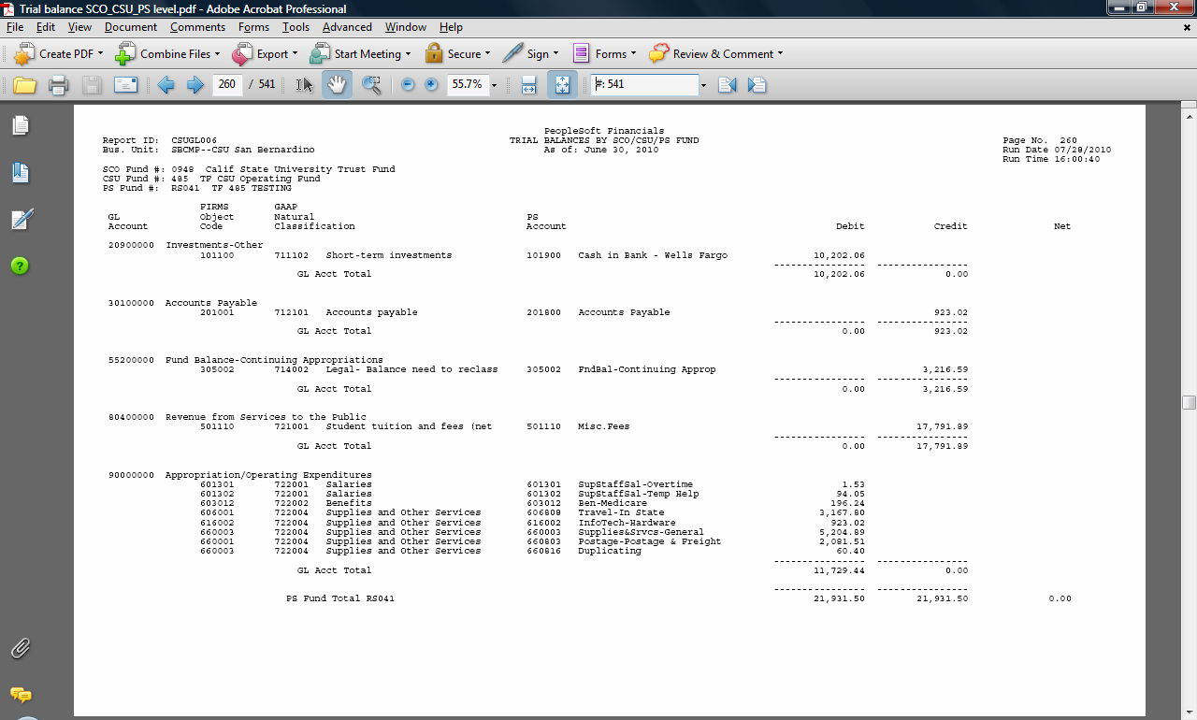
Chartfield – Account
6 digits -- numeric
Assets: 1xxxxxx
Liabilities: 2xxxxxx
Equity: 3xxxxxx
Revenues: 5xxxxxx
Expenses: 6xxxxxx
Notes:
If there is time, talk about different levels of accounts (PS accounts/ Object codes, etc)
Explain that depending on the type of funds they manage, they will focus on one or more of these account groups.

Slide 6

Chartfield – Fund
5 characters – alpha/numeric
CAPITAL OUTLAY
GENERAL FUND
TRUST
ENTERPRISE
LOTTERY
Notes:
Explain funds are like “buckets”. We have different types of buckets: General Fund, Trust, Lottery, Capital Outlay, etc. If time talk about CSU and SCO Funds

Slide 7
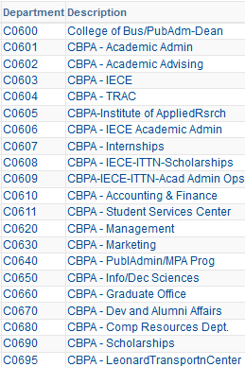
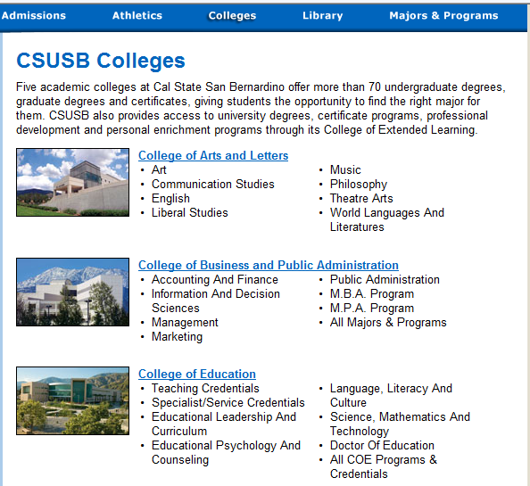
Chartfield - Dept ID
5 Characters – alpha/numeric (1/4)
Notes:
Departments are further segregation of buckets, only for revenues and expenditures, for management decision making, allocation of resources, etc

Slide 8
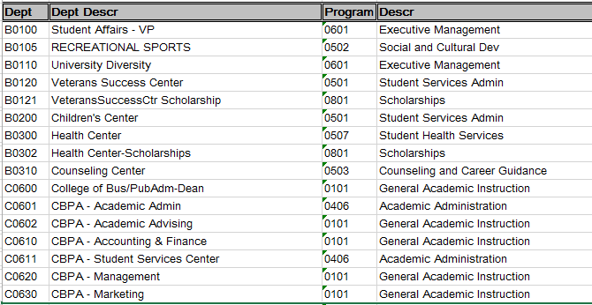
NACUBO Program Code …hidden!?
The NACUBO Program code is mapped to the DeptID Chartfield behind the scenes.
The Program code tells what type of general activity is performed by the DeptID it is mapped to.
Notes:
The National Association of College & University Business Officers (NACUBO) program codes (expenditure categories),
adopted by higher education for grouping budget and expenditures.
When you ask for a new DeptID, you will be asked what type of activity will occur there so that the correct NACUBO Program code can be mapped to it.
It is critical to choose the correct DeptID for the activity your department will be performing. Consult the Accounting or Budget offices for assistance if needed.

Slide 9
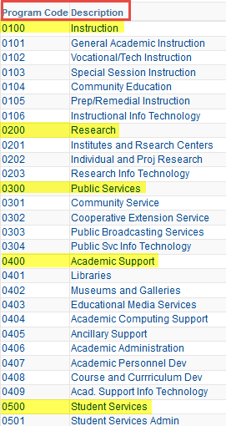
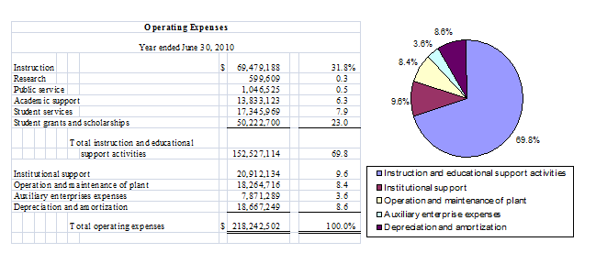
NACUBO Program Code
The Chancellor’s Office uses the NACUBO Program code to summarize and report on CSU systemwide data. Also to compare and report on campus activity within the CSU.
Notes:
Report shows use of NACUBO program codes in a campus OR systemwide report.

Slide 10
Chartfield strings tell a story…
So we said accounting is a language:
“The Biology department
purchased equipment
that will be used for instructional purposes
using funds allocated from the state”
619002 - SB001 - C0910 $15,230
C0910 is mapped to NACUBO Prog Code 0101-Gen. Acad. Instruction
Account
Fund
Dept ID

Slide 11
Chartfield strings tell a story…
So we said accounting is a language:
“The Printing department
provided services for payment to campus
that are revenues
to a specific Trust fund”
580094 – RT018 – D0810 ($5,000)
Revenues - Accounts that begin with 5x, will map to the NACUBO Program code 5000-Revenues regardless of the DeptID.
Account
Fund
Dept ID
Notes:
In some cases, such as Revenue transactions, it is the Type of Account that determines the NACUBO Program code that is mapped to the transaction, regardless of the DeptID.

Slide 12
Chartfield strings tell a story…
5 Characters – alpha/numeric
A class code is used to further breakdown, or separate by sub activity, the expenditures in a Fund/DeptID combo.
“The Chemistry department
use funds allocated from the state
for one of their Faculty – John Tate
for instructional Faculty development/training purposes”
660835 - SB001 - C0915 – 11143 (Tate, John) $5,000
Notes:
11143 is the Class Code, Tate,John is the Description
DRAFTNOTE-pick a different scenario than Fac dev. This activity may need to go to a new DeptID that maps to 0407 for each college/dept.

Slide 13
Chartfield – Project
15 Characters – alpha/numeric
The Project chartfield can be used instead of a Class code or combined with a class code to further differentiate expenses within a Fund/Dept cost center.
John Tate might ALSO have Special Project funds that are to be used for purchasing lab equipment that the Chemistry department wants to track separately.
660003 - SB001 - C0915 – 11143 – Special_Proj $2,000

Slide 14
Chartfield Strings
Why do chartfield strings need to be accurate?
For data integrity, compliance, better decision making
Minimize/eliminate audit findings
  Can I submit a transfer of expense (??) Yes but far better to have the correct chartfields first time.
Notes:
DRAFT--What is that last comment??

Slide 15
Chartfield Strings
Campus reports at different levels:
- Internal (campus / management reporting)
- External
      Chancellor’s Office – CSU System
      State of California
      Others
The main purpose of Chart of Accounts is to aid in reporting and ensuring the integrity of the data.
Notes:
Correctly categorizing each transaction so it can be transmitted and reported with accuracy as the data is summarized and analyzed at a variety of levels.

Slide 16
Chartfield Strings
State
Chancellor’s Office
Campus
State GL
Object Code
PS Account
Gen Cat
Prog Code
Dept ID
SCO Fund
CSU Fund
PS Fund
Notes:
Correctly categorizing each transaction so it can be transmitted and reported with accuracy as the data is summarized and analyzed at a variety of levels.

Slide 17
Chartfield Strings
State
Chancellor’s Office
Campus
90000000
660003
660816
06
0602
D0200
0948
485
SB001
Notes:
Correctly categorizing each transaction so it can be transmitted and reported with accuracy as the data is summarized and analyzed at a variety of levels.

Slide 18

Chartfield Strings
The PS Fund – is mapped to CSU and SCO funds -> indicate the funding source and associated spending restrictions and reporting requirements.
The DeptID – is mapped to the Program Code that tells the general type of activity within the fund as defined by NACUBO.
The Account - is mapped to a FIRMS Object code that categorizes and groups expenditures. It is the detail level of activity that is occurring within the the fund.

Slide 19
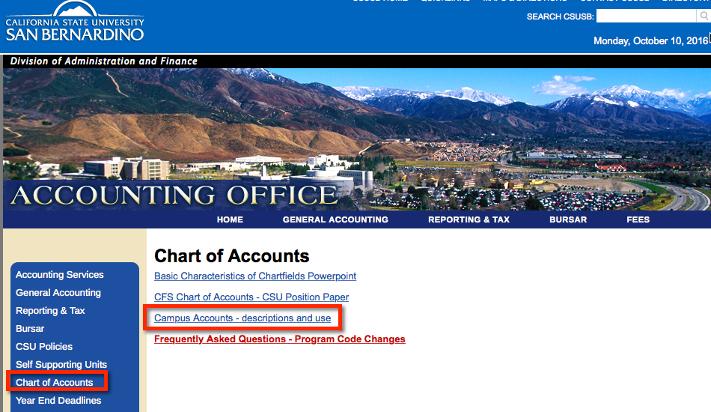
Chart of Accounts
Admnacct.csusb.edu
Choose Chart of Accounts – Campus Accounts
Notes:
Point out other properties of the web site.

Slide 20
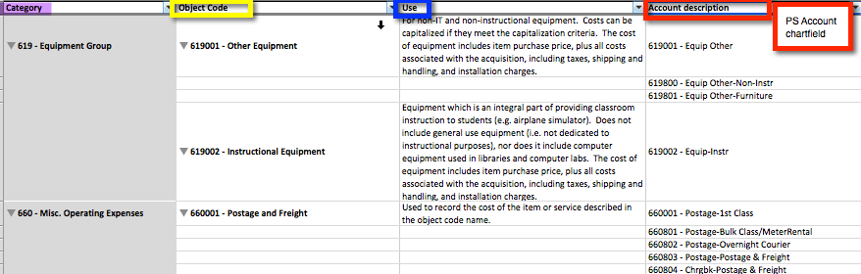
Chart of Accounts
The information on this link will describe the PS Account, and indicate the Object code attached to it. This will help the user determine the correct Account number to choose for the transaction.

Slide 21
Queries
CFS queries provide additional, current information to the Financial user.
The following queries show:
  The funds that are active with the selected DeptID as well as the Program code mapped to the DeptID.
  The Accounts available to campus users with the mapped Object code and SCO Account.

Slide 22
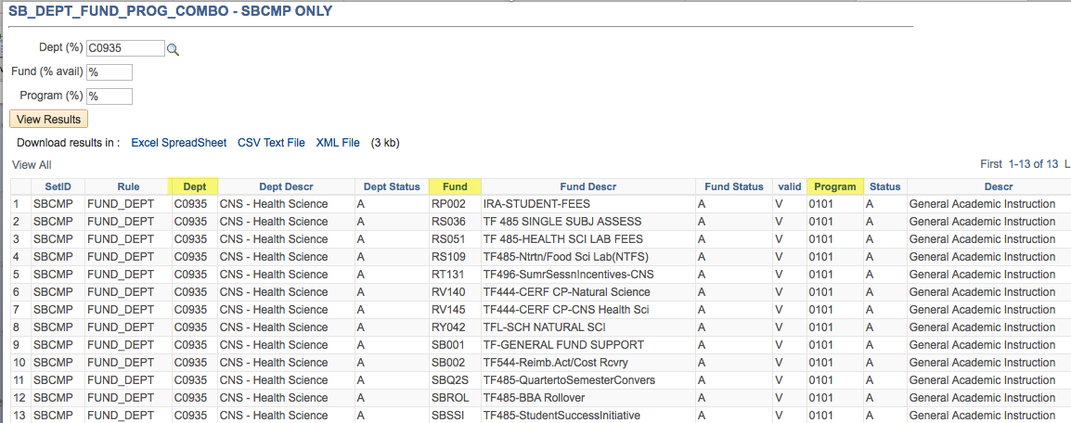
Queries
This CFS query will show all funds and the mapped Program code for a given Dept ID.
SB_DEPT_FUND_PROG_COMBO SBCMP ONLY
Notes:
Be sure each field has a value or the % before clicking View Results.
This query can also be used to determine the funds that are active with a given DeptID. Not all of the funds will be used by the DeptID. Consult with General Accounting or Budget for assistance.

Slide 23
Queries
This query will provide a list of all CSUSB PS Accounts, Their FIRMS Object and SCO account number. Only Accounts with the “Active” status can be used.
SB_DEPT_PS_ACCOUNT_LIST List PS Accts w F Obj & St Acc

Slide 24
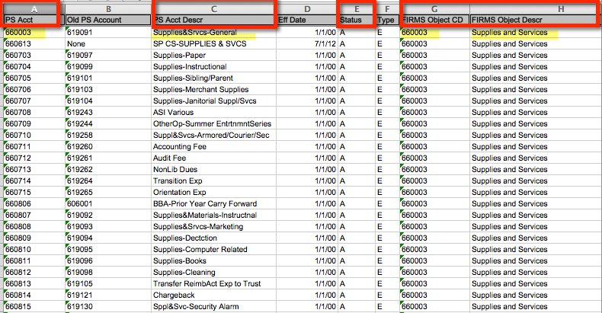
Sort this list by FIRMS Object code then PS Account.
If the Account Descr does not make any sense to you, don’t use it. Accounts are shared with all of the Business Units and some are specific to a particular BU and type of Fund.
When possible, choose the PS Account that matches the Object code.
Use the Object code to help you determine the correct PS Account to choose.
Notes:
Give tips on using this query with caution. All accounts are visible but not all apply to SBCMP business unit activity.
Save this query to your desktop for quick access. Re run and resave every couple of months.

Slide 25

Questions?

