Slide 1
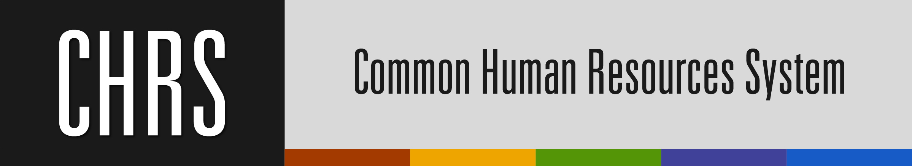
Adjusting to CHRS
Notes:
Welcome and thank you for joining us the Adjusting to CHRS presentation today
We are glad to meet with you CAMPUS: implementation team

Slide 2



We are CMCT, the Change Management and Communications Team for CHRS.
We are a cross-functional team of certified Prosci Change experts who work with campuses to lead change management efforts for CHRS adoption.
We work closely with your campus CHRS Change Manager, Chris Bradney.
Breauna Lewis, Assistant Director of CHRS Change Initiatives
Samantha Silfies, Wave 3 Change Manager - Manager of CHRS Communications and Change Management
Tammy Hines, Wave 1 & 2 Change Manager - Director, HRIS and CHRS Program Lead
Notes:
Who are we?
We are a team of cross-functional, certified Prosci change experts
We are change ADVISORS – for your CAMPUS Change Manager, Chris Bradney
We partner with her on change management efforts and adoption of CHRS...
OUR TEAM - Mention first name of team members

Slide 3

Nice to Meet You!
We are Project and Change Management team
for CHRS at CSUSB
Change Manager, Chris Bradney
Project Manager, Carly Hanson
Notes:
Christine

Slide 4

“Our very survival depends on
our ability…to adjust to new ideas, to remain vigilant and to face the challenge of change.”
Martin Luther King, Jr.
Notes:
This Martin Luther King quote could not be more relevant than what the entire world has been facing since March 2020.
Our world has changed in significant ways, and the ability to adapt is key.
Change management was and continues to be, a big, important topic at the CSU: given New leadership, new technology solutions, process improvements, etc.
One thing for sure, Change is constant and our ability to adapt will become more of a priority in the days/months/and even years to come as we seek to be more responsive, adaptable, and agile in our approach.
BUT How do you DO change management? What are the steps, activities, tools, resources, expected outcomes?
Successful change requires many roles from Sponsor of the change to employees who jobs are changing because of the change.
In today’s workshop we are going focus on the IMPLEMENTATION TEAM'S role during change.

Slide 5




Ready to engage with us?
Our goals today are:
To understand the change process
and the underlying concepts of
change management.
To learn some background about the Common Human Resources System (CHRS)
To apply change management concepts to help you with CHRS adoption
Notes:
Our Goals
This program has been designed to help THE IMPLEMENTATION TEAM understand the change process and the concepts of change management and the methodology – FOCUS ON ADOPTION
Normally, we discuss the background but many of you have been with us from beginning and so we wont focus on that today...

Slide 6


We will NOT be covering:
Setting expectations
for today
Training to use CHRS
Technical questions about the system
Notes:
We will NOT cover
The system features and functions
Training
Technical questions on how to use the system

Slide 7


A Few Housekeeping Items
Ready to engage with us?
Ask questions throughout the presentation
We want to hear your feedback – be ready with Zoom poll
Notes:
Before we get started, a few things to note:
We want to hear from you – feel free to ask questions throughout the presentation – you can type them into chat
We want your feedback so we will have poll questions for you – be ready with Zoom on your computer or phone

Slide 8
The Process of Change

Slide 9
A successful implementation requires both the Technical and People side to be aligned
Technical Side
Design
Develop
Deliver
Results
Outcomes
Success
Current
state
Transition
state
Future
state
People Side
Engage
Adopt
Today’s focus
Use
Notes:
There is a unified goal that requires support from both the technical and people sides of change.
No matter what the change is, planned or unplanned, our goal is to transition from our current state and arrive at the future state, achieving the results and outcomes intended.
So for any type of change, there is a technical component that designs, develops and delivers the mechanics of the change. Think project management side of the coin.
For example, developing a Covid-19 response strategy/plan and implementing at the campus is an example of the technical side of the change journey.
For successful change results and outcomes, concurrent and integrated with the technical side, the people side focuses on activities that enable and support people to embrace, adopt and use the change. This is the change management side of the coin.
Working from home wasn’t an easy change for me to get used to. I spent most of my days at home alone, so as a social creature, it was a difficult transition for me, even though I knew it was for the greater good of society and even for my own safety. However, once I connected with some more personal motivators, I really started to accept and thrive in this change.
Another example CHRS
Zoom develops and delivers AI notetaking tools.
For me, I’m usually pretty quick to click “download” on updates. But as far as AI goes, I haven’t gotten much further than that because I haven’t taken advantage of the support provided to help me along the change process to the point where I have adopted AI.

Slide 10

Journey to Adoption
Whether the change is welcomed or not…
Whether it is related to work, home or personal…
Whether it’s large or small…
People generally go through the SAME PROCESS to accept and adapt to a change.
The goal of Change Management is to help them go through this process faster.
Notes:
Working from home wasn’t an easy change for me to get used to. I spent most of my days at home alone, so as a social creature, it was a difficult transition for me, even though I knew it was for the greater good of society and even for my own safety. However, once I connected with some more personal motivators, I really started to accept and thrive in this change.
Another example CHRS
Zoom develops and delivers AI notetaking tools.
For me, I’m usually pretty quick to click “download” on updates. But as far as AI goes, I haven’t gotten much further than that because I haven’t taken advantage of the support provided to help me along the change process to the point where I have adopted AI.

Slide 11

Questions?

Slide 12

The Change Curve
Focuses on people’s natural reactions to change – they can be mild or intense
Acknowledges that reactions are not necessarily positive or negative, just part of the process
People will go through the phases at different speeds
Stages are not necessarily sequential – you may go back and forth
Facts about the system’s functionality are NOT equal to your perception! Emotions always play a part
Facts + Emotions = Your Perception
Notes:
The Kubler Ross change curve is a change method used to understand the process of change and how people respond to it.
There are 7 stages in Change Curve and its important to note a few things:
- individuals go through each stage at different speeds
-The stages are not linear and can overlap, with multiple feelings hitting you at once
-Facts about the system’s functionality are NOT equal to your perception! Emotions always play a part. For example, you may have an employee who goes to retrieve approvals once a week that may no longer may be needed so there may be some resistance because they’ll miss going to that building every week.

Slide 13
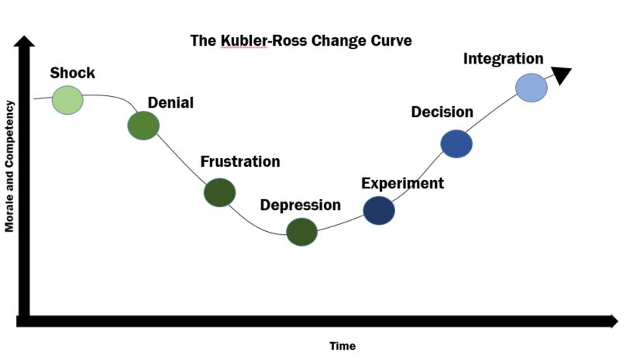
Kübler-Ross Change Curve Model
Notes:
This is the curve that many of you will go through as you begin to adopt CHRS, which may be a significant change to the way you perform HR tasks now.
I will illustrate this curve by telling you my own story of adapting to a very simple change:
My department had been set to move buildings for a few years, but it never happened. So one day while we were in our staff meeting my boss said hey team we finally have a moving date and I was in shock.
Because we had been talking about this for years I was in denial thinking this is never going to happen, they are always saying we are moving from the main building but not my team.
Then I received an email with my office floor and number and a date and time to pick up moving materials.
So I went and grabbed them, but Once I started packing and labeling my boxes, I began to get frustrated because I was basically voluntold to move and wasn’t given an option and it was creating more work for me. I now had to walk back and forth in between meetings and park at a further location than I was used to, so yeah I wasn’t the happiest camper.
But then I became depressed because I missed my friends in the main building. I missed the kitchen conversations and just being in the main hub.
But as a CM professional, I began to experiment with the change and focus on the WIIFM and decided that I was going to lead by example and make this move work…then it just naturally became integrated into my day to day life.

Slide 14







With CHRS, when the system goes live…
Morale and Competency
Shock
Denial
Decision
Integration
Why does it look different?
This isn’t going to affect me!
I can continue to do it this way
This is actually easier than the old way!
Frustration
Experiment
This is making my life harder!
Maybe I can try it this way…
Depression
This is never going to work.
Time
Notes:
Now lets talk about how this correlates to CHRS
As a Wave 3 campus, you have been with us for a while
Likely when you first joined the team, and understood CHRS features you were in SHOCK because the system did not meet your expectations. Perhaps there were gaps...
Or you may have had DENIAL – I know this project…it’s been going on for some years..It kicked off, but this isn't going to affect me. I'll just chug along
Later the project continued…after you got your hands on the system during preview, you noticed bugs /gaps and were even more FRUSTRATED
That lead you to DEPRESSION, because you didn't see how it could work
Once you get into testing you may begin to provide feedback to your PM, Carly and submit a few tickets and change controls (functional enhancements) you begin to think, OK, this eventually could work with a few tweaks...I have a few options…solutions to EXPERIMENT
Hopefully that will eventually lead to you DECIDING to continue to stay with the change...and you can imagine yourself INTEGRATING the change now and after go-live

Slide 15
Where do YOU feel you are at on this change curve right now in regards to CHRS?
Notes:
So now let’s apply this to CHRS. WHERE DO YOU FEEL YOU ARE IN THE CHANGE CURVE
Discusss results
Polls are anonymous
Everyone is on their own change journey, you’re going to move on your own speed

Slide 16
About CHRS
Notes:
A little bit about CHRS WHY are we doing it...
Who's involved

Slide 17

Poll: How much do you know about CHRS?
I am:
A fresh face to CHRS
A little familiar
Somewhat in the know
Fluent in CHRS
Capable of teaching a class
CHRS

Slide 18

What is CHRS?
The Common Human Resources System (CHRS) is a project to move all campuses in the CSU system to a standard HR platform. The core HR system is based on PeopleSoft 9.2 with modifications to make it work for campuses in the CSU system.
If you do any HR tasks at all – even entering your time off – you will be doing things a different way in CHRS.

Slide 19


Before CHRS
After CHRS
23 different versions of software across the CSU system, which is difficult and costly to maintain
Campuses using different HR processes
No ​common way of doing business or sharing of resources
Some campuses had much better “cake” than others
PeopleSoft 9.0 is not supported any​more
All campuses on one common system​
Efficient a​nd more cost-effective
Perform HR processes in a common way and can support other campuses
All campuses on PeopleSoft 9.2​​​
When new features come out, everyone gets them

Slide 20
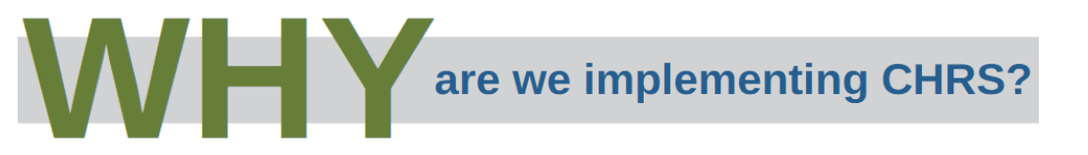
About CHRS
Streamline HR business processes and standardize best practices
Relieve the training burden from campuses by delivering systemwide training materials
Facilitate collaboration among HR personnel between campuses
Provide an improved user experience in HR applications, including future mobile access to HR services
Provide enhanced reporting with standardized data to assist decision-making

Slide 21

WHO
is behind CHRS?
The system was designed by HR experts from all 23 CSU campuses who came together to collaborate on best practices over a two-year period
The software modifications were written by the Chancellor’s Office CMS team
The CHRS Project Team at the Chancellor’s Office is working with an Implementation Team on each campus
CHRS is sponsored by executive leaders at the Chancellor’s Office and at your campus
Robin Phillips - Vice President, Human Resources and Co-Chief Diversity Officer
Sam Sudhakar Ph.D. - Chief Financial Officer and Vice President, Finance, Technology, and Operations
Ted Young Ph.D. - Associate Provost for Faculty Affairs and Development
Gerard Au - Chief Information Officer
Notes:
WHO is backing CHRS – The entire CSU system...
The CHRS system was designed, developed, and implement for and by the CSU
We designed with CSU experts, developed in house with CMS and now are implementing – with all of YOU, the campus implementation team
And let's not forget – Your campus leaders: REFERENCE SPONSORS
AND the CSU Execute leadership including the Chancellor
To reiterate, Steve Relyea said CHRS was # for cost saving efficiencies

Slide 22
Impacts
Notes:
Welcome and thank you for joining us the Adjusting to CHRS presentation today
We are glad to meet with you CAMPUS: implementation team

Slide 23

How will you be impacted
by CHRS?
The system will look and feel different
CHRS will bring changes in the way you do some facets of your job
Processes and procedures are changing
Training materials will be provided by the campus and CO
Communication will take place throughout the process so you know what to expect
Notes:
Encourage questions

Slide 24
Self Service – All Employees
Personal Data Changes
Standardized Employee ID numbers will replace CSUSB CWID in CHRS only.
Changes to personal data will be made in CHRS. This includes address, phone number, emergency contacts, and preferred name for display in campus systems except where legal name is required.
Benefits
New self service look and feel for benefits
View historic, current and future-dated benefit enrollments
View your dependents
Employees can perform new hire/newly benefit-eligible enrollment online. They can update, enroll and make changes to their benefits for themselves and dependents for specific life events
Generate the Dependent Re-Verification Affidavit​
Training Dates to be announced soon!
Notes:
San Jose
Green: CMS

Slide 25
Self Service – All Employees
Absence Management
Absence Management will now be a “request system”
All employees can enter their own absences, including faculty in academic-year classifications during academic work periods
Student Employees will enter time directly into PeopleSoft
Employees can key absences up to 12 months in advance and 12 months prior
Forecasting will be implemented to support leave planning based on projected balances
No Leave Taken will be entered on its own page
Manager approvals must occur by the 3rd calendar day of each month (systemwide standard).
Timekeepers
Will be able to modify non-finalized absences
New page for Timekeeper to modify absences
Approvers
Approvers will be able to enter comments on the adjustments
Absence cancellation process for non-finalized absences
Training Dates to be announced soon!
Notes:
San Jose
Green: CMS

Slide 26
Self Service – All Employees
Time & Labor
Enter time worked. Can enter time via mobile device.
Enter earn and take of Compensatory Time Off (CTO)
Temporary Academic Employment (for temporary faculty, TA, GA, and ISA appointments)
Appointment notifications are automatically generated. The review and acknowledgement will be performed electronically and stored in the appointee's self-service page. No signature required.
View list of courses assigned
Training Dates to be announced soon!
Notes:
San Jose
Green: CMS

Slide 27

Workforce Administration
Position Management
Implementation of standardized position management practices will maintain integrity of position history and improve reporting capability.
Standardized position numbers will replace CSUSB position numbers (renumerated).
Student Processes
Used to concurrently appoint and reappoint non-represented student employees
  Newly appointed non-represented student employees will continue to be hired via CSU Recruit.
Paperless
Student assistants will be able to start working sooner
More data will be available to support this work
MPP approvals for these appointments will be tracked outside the module
Notes:
San Jose
Green: CMS

Slide 28

Temporary Academic Employment
This module manages appointment data and notifications for more employment types
Mass Processing allows hiring departments and approvers the ability to process multiple appointments on a single page
Departments receive notification when entering appointment data if an employee might exceed 125% limit in all positions in CHRS, including other campuses using CHRS (excludes auxiliary)
Appointment notifications are automatically generated and sent to appointee’s self-service page.
Departments no longer need to provide individual appointment notifications to faculty or collect signatures
Notes:
In addition to lecturers, TAs, GAs, ISAs, and some additional employment, employment types have been expanded to include faculty additional employment for full and part-time faculty, substitute appts, special session, winter and summer.

Slide 29
Temporary Academic Employment
Built-in workflow and approvals will help the flow of data from one unit to another
Custom reports are available to assist in the management of TAE data
4660 will no longer be used for faculty additional employment in summer
MPP approvals will be entered in the system by employee group
Paperless – No more spreadsheets and wet signatures
​

Slide 30

Questions / Overflow on Jamboard
Questions
Notes:
*Pause recording*

Slide 31

Reflection Activity: Rose, Bud, Thorn
Please use Zoom whiteboard to indicate:
Something positive about CHRS
Something you are looking forward to with CHRS
Something you are worried or anxious about with CHRS
You will have 2 minutes to post your responses.
Let's Reflect!

Slide 32
Adopting CHRS
Notes:
Bree

Slide 33


Using Change Management Methodology to Move Through CHRS Adoption
+
Notes:
The Change Management methodology that we primarily use at the CO is Prosci, which stands for Professional science research.

Slide 34

The Five Building Blocks for Successful Change
A
Awareness
D
Desire
K
Knowledge
A
Ability
R
Reinforcement®
Notes:
The ADKAR model provides sequential steps to the change process to get individuals from current state to future state
The plan for the portion of the presentation is to walk you through each step and apply it to the adoption of CHRS.
Before we start I have an Announcement:
We are going to engage you with a number of polls so I would like to grab a piece of paper, open up the notes section of your phone and/or computer and write down the letters ADKAR and I will tell you what to from there...

Slide 35

Change Begins with Understanding
Awareness
"I understand that when we go live with CHRS, aspects of how I do my work may change"
"I know what CHRS is and why it is necessary for our campus to implement it"
“I know what the CHRS acronym stands for”
Notes:
A is Awareness
Awareness is more than being aware of the change, it is understanding the WHY behind the change.
For example, if you’ve ever been around little kids, and you tell them to do something, what’s the first they ALWAYS say? WHY?
It is human nature to want to know the underlying reason for why any change is occurring. In the book, Start with the Why, the author stresses the importance of communicating “WHY” we are changing, “Why Now” and “What happens if we don’t change early on in the project to create stakeholder awareness early in the change process
…and this should be delivered by the executive sponsor.
Unfortunately, many messages about a change are heavy on the WHAT or HOW and skip the why. And that lack of awareness is a primary reason employees resist change.
So now, I want you to pull out that piece of paper or open you notes. Samantha is going to launch a poll asking you these three questions and I want you to write down your responses, either 1-5 for each question under that first A.
If you score a 3 or below for any of these questions…I want you to circle the letter A because this is considered your barrier and is the area that needs to be focused on in order for you to successfully adopt CHRS.

Slide 36

If you scored a 3 or below, your Barrier Point is: Awareness
How to get past the Awareness Barrier Point to adoption?
Learn all you can about the project through the website, presentations, newsletters, etc.
Listen to the CSU Executive Sponsors discussing CHRS, as well as your Campus Sponsors
Find out how CHRS will affect your job tasks
Discuss with your supervisor
Notes:
If you scored a 3 or below for any of the questions, here are some strategies to help with awareness.
This may require a bit of homework/research on your end such as reviewing past content or even talking to your boss or colleagues about how your job will change.

Slide 37

Change Requires Desire / Acceptance
Desire
"I look forward to learning more about CHRS and seeing how our work will adapt to the new system"
"I want to see how CHRS will benefit my campus and the CSU"
"I understand the efficiencies that CHRS will bring in the future"
Notes:
Desire is typically one of the most difficult phases because it requires individuals to make their own, personal decision: “I am going to make this change.” In this case, I am going to adopt CHRS.
When building Desire, employees ask:
"What's in it for me (WIIFM)?"
"What are the benefits of change management for the organization?"
"Why should I get on board?“
We already reviewed the benefits for the CSU and your campus, but the organization can’t make this transition without YOU. So ask yourself: What is in it for ME?
What does being a part of the core implementation team mean to you?
What efficiencies will this bring to your day-to-day?
How does your leadership make you feel about this change?

Slide 38

If you scored a 3 or below, your Barrier Point is: Desire
How to get past the Desire/Acceptance Barrier Point to adoption?
Understand why CHRS is a crucial project to the CSU
Focus on the long-term efficiencies it will bring to your campus – cost efficiencies, resources and time
Remind yourself that we are positioning the entire CSU system for the future
Align with your leaders and their support for CHRS

Slide 39

Change Requires Knowing How
Knowledge
"I know how to refer to the training resources (CSUSB CHRS website & the CHRS Knowledge Base) if I need them"
"I have received the training I need to do my job"
"I understand how the system works"
Notes:
Change requires the KNOW how
You might say
I received the training I need
Or, you know where to look for information - I know how to refer to the training resources in the Campus Training Page/CHRS Library if I need them
Or you may feel like an expert - I understand how the system works

Slide 40

If you scored a 3 or below, your Barrier Point is: Knowledge
How to get past the Knowledge Barrier Point to adoption?
Take advantage of all the training materials on the Campus Training Page/CHRS Knowledge Base
Attend campus-based training sessions and ask questions
Take the time to practice and get to know the system
Notes:
If you scored a 3 or below - KNOWLEDGE is a barrier for you
What can you do to help with adoption? SEEK OUT INFORMATION
Take advantage of all the training materials on the Campus Training Page/CHRS Library
Attend campus-based training sessions and ask questions – details will be shared soon
Take the time to practice and get to know the system

Slide 41

Change Requires Having the Ability to Make the Change
Ability
"I'm confident my manager understands and will support my work in CHRS"
"I have sufficient time and resources to do my job in CHRS"
"I feel comfortable with using CHRS"
Notes:
Describe how this is different from knowledge

Slide 42

If you scored a 3 or below, your Barrier Point is: Ability
How to get past the Ability Barrier Point to adoption?
The system will become easier with more familiarity – give it time
Share information with your colleagues
Let your supervisor know if something is preventing your ability to use the system
Know that you are supported by university leadership
  Training: Adjusting to CHRS for MPPs
  Sharing Communications: MPP meeting updates
  Testing: Some MPPs are serving as testers

Slide 43

Change Must Be Reinforced to Be Sustained
Reinforcement®
"The people I work with are comfortable using the new system"
"I am ready to move over to the CHRS system permanently"
"I feel comfortable letting go of the old way of doing things"
Notes:
And the last stage is Reinforcement. You can’t simply implement a change, and then assume it’s going to stick. You need to reinforce that change in some way to ensure its integrated into folks lives.
Ask yourself: what steps can I take to ensure I will continue with this change?
Celebrate the wins! Keep engaging with CHRS

Slide 44

If you scored a 3 or below, your Barrier Point is: Reinforcement
How to get past the Reinforcement Barrier Point to adoption?
Focus on the future of CHRS instead of looking back at the past – be an early adopter
Think of ways to help bring your teammates along
Consider change as a constant

Slide 45
To create an ADKAR® profile bar graph, mark your score
for each element and shade the area below the mark to create each “bar.”
The example on the right
is of a profile with:
A=4, D=5, K=2, A=1, R=4.
Notes:
ADKAR model is sequential … but not always linear
In my Office Move example, since our team was all familiar with the ADKAR model, My boss was able to meet with us individually and ask where we were at ADKAR wise.
The first area that has a score of 3 or less…is considered the barrier point and the area that you should focus on with that employee.
Most of out team had a 3 or less on Desire which told her that we were all aware of the WHY for the move… but she needed to help us be okay with it. However, that often takes time and sometimes it takes a personal appeal from the manager, asking the employee to be an advocate for the change for the good of the organization.
Now that we’ve taken all the polls, lets pull out your paper/or your phones and identify what your barrier point is……what element did you FIRST score a 3 or below at.
Poll text: "What is the area that you first scored 3 or less in (your barrier point)?"

Slide 46
People move through ADKAR at different paces
Awareness
Desire
Knowledge
Ability
Reinforcement
Person A
Person B
Person C
Person D
Person E
Person F
Person G
Person H
Person I
Time
Notes:
This exercise really illustrates an important point: that people go through the change process at different paces for various reasons.
This is YOUR CHANGE JOURNEY, and it won’t look like anyone else’s …but fear not, you have the fabulous Shannon to help you get through this change.

Slide 47

Your Change Manager is here to help:
Identifying those who are impacted
Communicating to various groups around campus
Measuring the success of adoption
Sustaining the change through coaching and resistance management
Assisting the project sponsor in promoting CHRS
Letting people know how their jobs will be changing
Notes:
CO has plans and tools to make your journey to CHRS less painful. Your Change Manager is partnering with the CO to deliver these items
List plans and tools here
Not just hanging you out to dry

Slide 48
Wrap Up
How will you work on your barrier points? What is your action plan?
Learn about CHRS: Become familiar with the CHRS project by visiting the San Bernardino CHRS website and the Chancellor’s Office website.
Stay Informed: Actively seek information related to the project by attending team meetings and asking questions.
Communicate: If you have suggestions or concerns, be sure to communicate them to the CHRS team or submit them via the CHRS suggestions and feedback form.
Invest time in your training: Plan to invest time in reviewing the CHRS training page, with job aids and video tutorials, attend live demonstrations and/or attend open lab sessions.
Remember, you are part of the Coyote Pack: Give yourself grace in adjusting to this change—and remember the campus CHRS team is here to help you. We are here to support each other!

Slide 49

Helping Employees Adjust to CHRS
  Help us improve
  Take the feedback poll

Slide 50
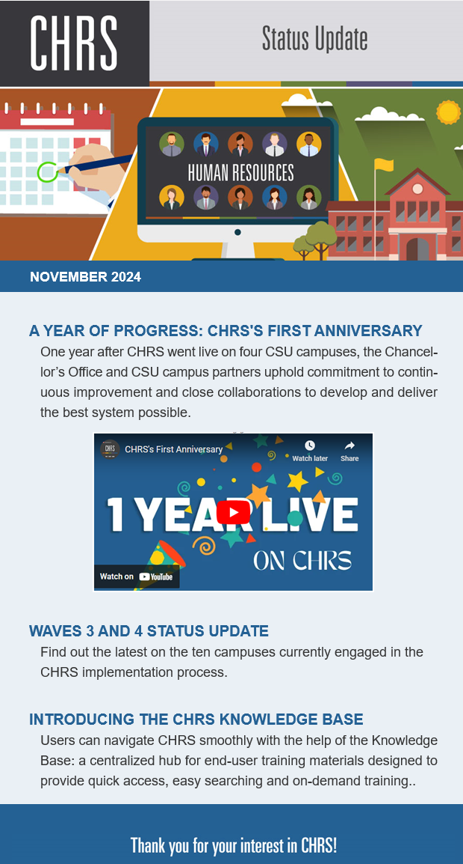
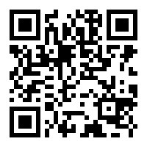
CHRS Communications
Newsletter
If you are not on the list, scan QR to sign up!
Send email to subscribe
Notes:
The QR code will generate a blank email. Just send to subscribe

Slide 51
Questions / Overflow on Jamboard
Questions
Notes:
*Pause recording*

Slide 52

Thank You!
#CHRSIsHappening

