Slide 1
AI in Education
Ali Powell Vice President
Microsoft Customer Success

Slide 2
“
The future of AI in education is likely to see increasing use of AI
technologies such as machine learning, natural language processing, and computer vision to personalize learning experiences, provide real- time feedback and assessment , and facilitate more effective teaching and
learning . AI can also help automate administrative tasks , allowing
educators to focus on delivering high- quality instruction and providing
individualized support to students. Additionally, AI can help analyze student data to identify areas for improvement and provide insights into how
students learn best . However, it is important to note that AI should be
used as a tool to augment and support human teachers, not replace
them , and the responsible and ethical use of AI in education will be key to
realizing its full potential.
”
ChatGPT
11/15/2023
2

Slide 3
There is no better time to reimagine education and how technology can support that transformation.”
Satya Nadella
February 2023

Slide 4
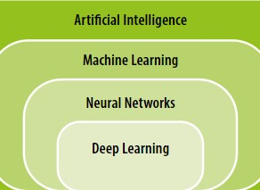
WHAT IS AI?
Artificial intelligence is a field of science concerned with building computers and machines that can reason, learn, and act in a way that would normally require human intelligence or that involves data whose scale exceeds what humans can analyze.
THE RELATIONSHIP BETWEEN ARTIFICIAL INTELLIGENCE, MACHINE LEARNING, NEURAL NETWORKS AND DEEP LEARNING
BRIEF HISTORY OF AI
11/15/2023

Slide 5
WHY SHOULD WE CARE?
Implementing AI in a responsible way is a path to realize our mission to help everyone in the world achieve more.
Just like introducing any other technology in education, the goal of AI in education is to improve student learning and offload administrative tasks that take up teacher and administrator time.
11/15/2023

Slide 6
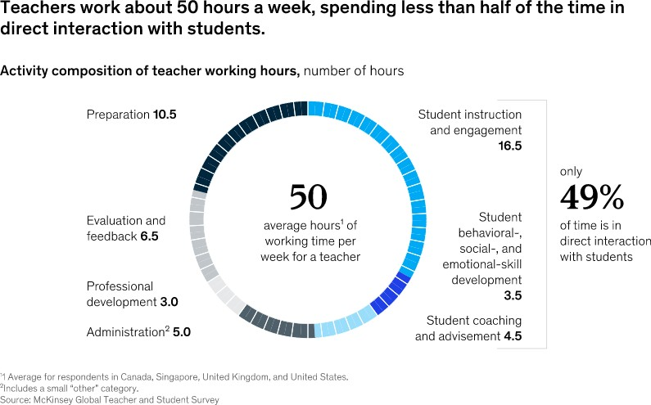
How teachers spend their time
20 to 40 percent of current teacher hours are spent on activities that could be automated using existing technology. That translates into approximately 13 hours per week that teachers could redirect toward activities that lead to higher student outcomes and higher teacher satisfaction.
6

Slide 7
AI ENHANCING EDUCATION
EDUCATION
MANAGEMENT
AUTOMATE ASPECTS OF SCHOOL
ADMINISTRATION SUCH
AS ADMISSIONS,
TIMETABLING,
ATTENDANCE & SCHOOL INSPECTIONS.
LEARNING &
ASSESSMENT
PROVIDE EVERY LEARNER ACCESS TO
PERSONALIZED &
LIFELONG LEARNING.
ENHANCE TEACHING
REDUCE TEACHER
W ORKLOADS BY AUTOMATING TASKS LIKE ASSESSMENT, PLAGIARISM DETECTION,
ADMINISTRATION &
FEEDBACK.
FACILITATE NEW APPROACHES TO ASSESSMENT LIKE AI- ENABLED ADAPTIVE &
CONTINUOUS ASSESSMENT.
LEARNING ANALYTICS TO ANALYZE DATA TO
PROVIDE INFORMATION FOR TEACHERS, ADMINISTRATORS AND STUDENTS.
8

Slide 8
AI FOR ADMINISTRATORS
Identifying situations for intervention
AI not only flags when a student shows warning signs of academic struggle but can help design appropriate interventions to
increase academic resilience. Newer systems use machine learning models to track different predictive indicators, such as student performance, gender, socioeconomic background, and school infrastructure, to more accurately identify students at a higher risk of dropping out.
Admissions & enrollment management
Common enrollment systems, also known as universal or unified enrollment systems, use student placement algorithms to
assign students to schools like AI applications that enhance admissions in college.
Enhancing school operations
Numerous applications of AI can enhance school operations, such as optimizing bus schedules, cleaning procedures, and building energy management.
11/16/2023

Slide 9
AI FOR STUDENTS
Intelligent Tutoring Systems (ITS)
ITSs use AI to deliver personalized instruction to students. ITSs consist of three parts: a knowledge base, with the relevant subject matter knowledge; a pedagogical model, with rules to determine the best teaching strategy; and a student model, which tracks a student’s knowledge and comprehension.
Intelligent Digital Assistants & Chatbots
Intelligent digital assistants like Siri, Alexa, Cortana & Google Assistant can be used for personal enrichment and assist with information retrieval. These devices use natural language processing to communicate naturally with individuals using spoken language, allowing even students who cannot read or use a computer access to information.
Chatbots are computer programs individuals interact with conversationally. They assist students by allowing them to ask questions outside classroom hours and receive real-time answers and advice.
Educational Virtual and Augmented reality
VR has been used in the teaching of many subjects, across K-12 and beyond to provide an immersive experience that shuts out the physical world, enabling users to feel as if they have been transported into a range of real-world or imagined environments. AR, on the other hand, overlays computer-generated images on the user’s view of the real world.
11/16/2023

Slide 10
AI FOR STUDENTS
Intelligent Textbooks
Intelligent textbooks use AI to provide customized and interactive content. It can suggest questions and concept summaries
based on a user’s reading progress, helping boost comprehension and retention. They also alleviate the need for rote
memorization by presenting comprehension questions throughout the reading to test the reader’s understanding of factual
knowledge.
School Counseling
Natural language processing and machine learning can pick up on cues that indicate a variety of mental health issues and assist in identifying suicidal ideation or the potential for violent behavior. AI can detect keyword indicators for mental health problems and flag vocal patterns that indicate emotional distress.
Learning Equality
AI-enabled technologies such as intelligent tutors, intelligent textbooks, and wearable assistive technology can greatly enhance the school experience for students with special needs. AI apps allows visually impaired users to recognize faces, identify money, read handwriting, and differentiate between products.
11/16/2023

Slide 11
AI FOR EDUCATORS
Decreasing teacher workload
AI applications can help teachers reduce workload by automating tasks such as assessment, plagiarism detection, administration, feedback, sending out automated reminders for students and parents about assignments and forms, generate a list of missing assignments for a student and create personalized progress reports for parents.
Chatbots can help teachers answer questions outside working hours, enabling them to create work-life boundaries while still providing support with assignments.
Learning Analytics
Collect, measure, analyze and report data about learners and their interactions with educational material that equips teachers with data and insights to make informed decisions about what strategies work best for their students. This data includes student performance, educational background data, student characteristics, and more.
Student Evaluation
Educators have long used technology to automate the grading of multiple-choice tests and there are now tools that can generate new test questions, thereby saving teachers time while creating assessments each year. Improved detection of plagiarism and student cheating in test administration is another time saver.
11/16/2023

Slide 12
SUMMARY
Technology, when used correctly, can facilitate
good teaching, but it will never replace teachers.
Many of the attributes that make good teachers great are the very things that AI or other technology fails to emulate - inspiring students, building positive school and class climates, resolving conflicts, creating connection and belonging, seeing the world from the perspective of individual students, and mentoring and coaching students. These things represent the
heart of a teacher’s work and cannot—and
should not—be automated.
11/16/2023
13

