Slide 1


PIQE MISSION
To provide families with the knowledge and skills to partner with schools and communities to ensure their children achieve their full potential.
Joshua Hernandez, Associate Director
Karla Rosenbery, Deputy Director
Parent Institute for Quality Education (PIQE)
#PIQE #PIQEStrong #PIQEProud
Notes:
Workshop Room: Marriott room - Franklin 1

Slide 2
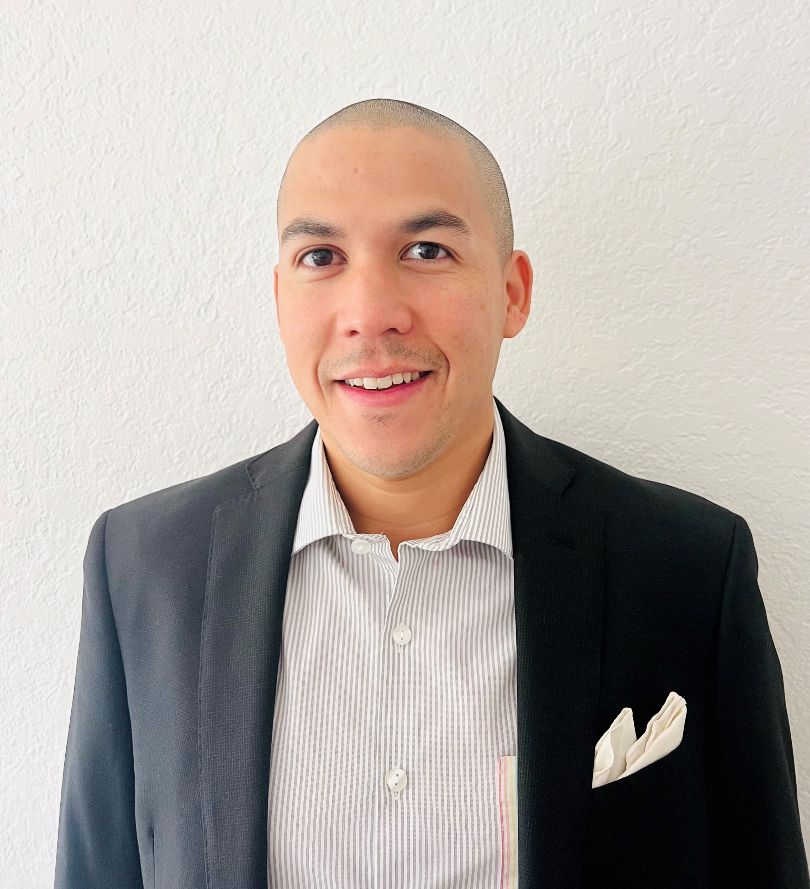
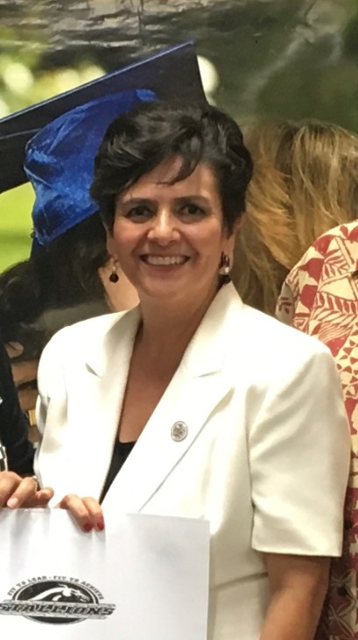
PRESENTERS
Josh Hernandez
Karla Rosenbery
Associate Director, IE Regional Office
Deputy Director, Inland Empire Regional Office

Slide 3
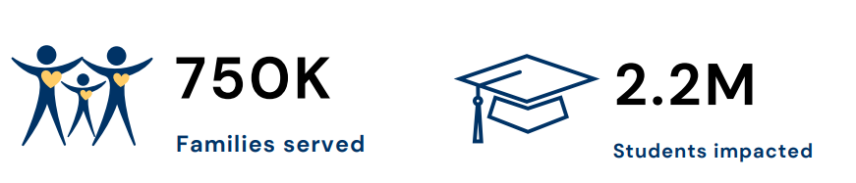
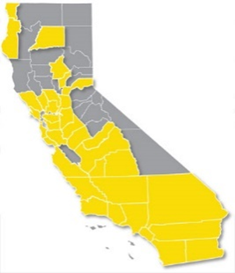
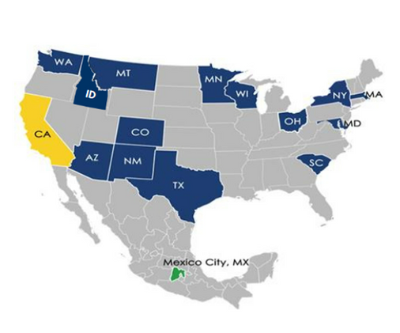


Impact
Since 1987
36 Counties
130 School Districts
400 Schools
96%
Students of PIQE participants graduate high school
spanning
14 States & Mexico City
70%
Students of PIQE participants enroll in college

Slide 4
Key Elements Of PIQE’s Methodology
Our curricula has been designed with the purpose of guiding parents through an empowerment parents using these 3 key elements:
Raising the parent’s level of concern regarding their children’s education.
Providing parents with relevant information.
Moving parents into positive action.

Slide 5
PIQE OBJECTIVES
To encourage and support parents of Pre-K, Elementary, Middle and High School children, to take a participatory role in their children’s education by:
Creating a supportive
home learning
environment.
Learning how to navigate the school system.
Collaborating with teachers, counselors and principals.
Encouraging college attendance beginning in Kindergarten
Supporting their child’s Emotional & Social Development.

Slide 6
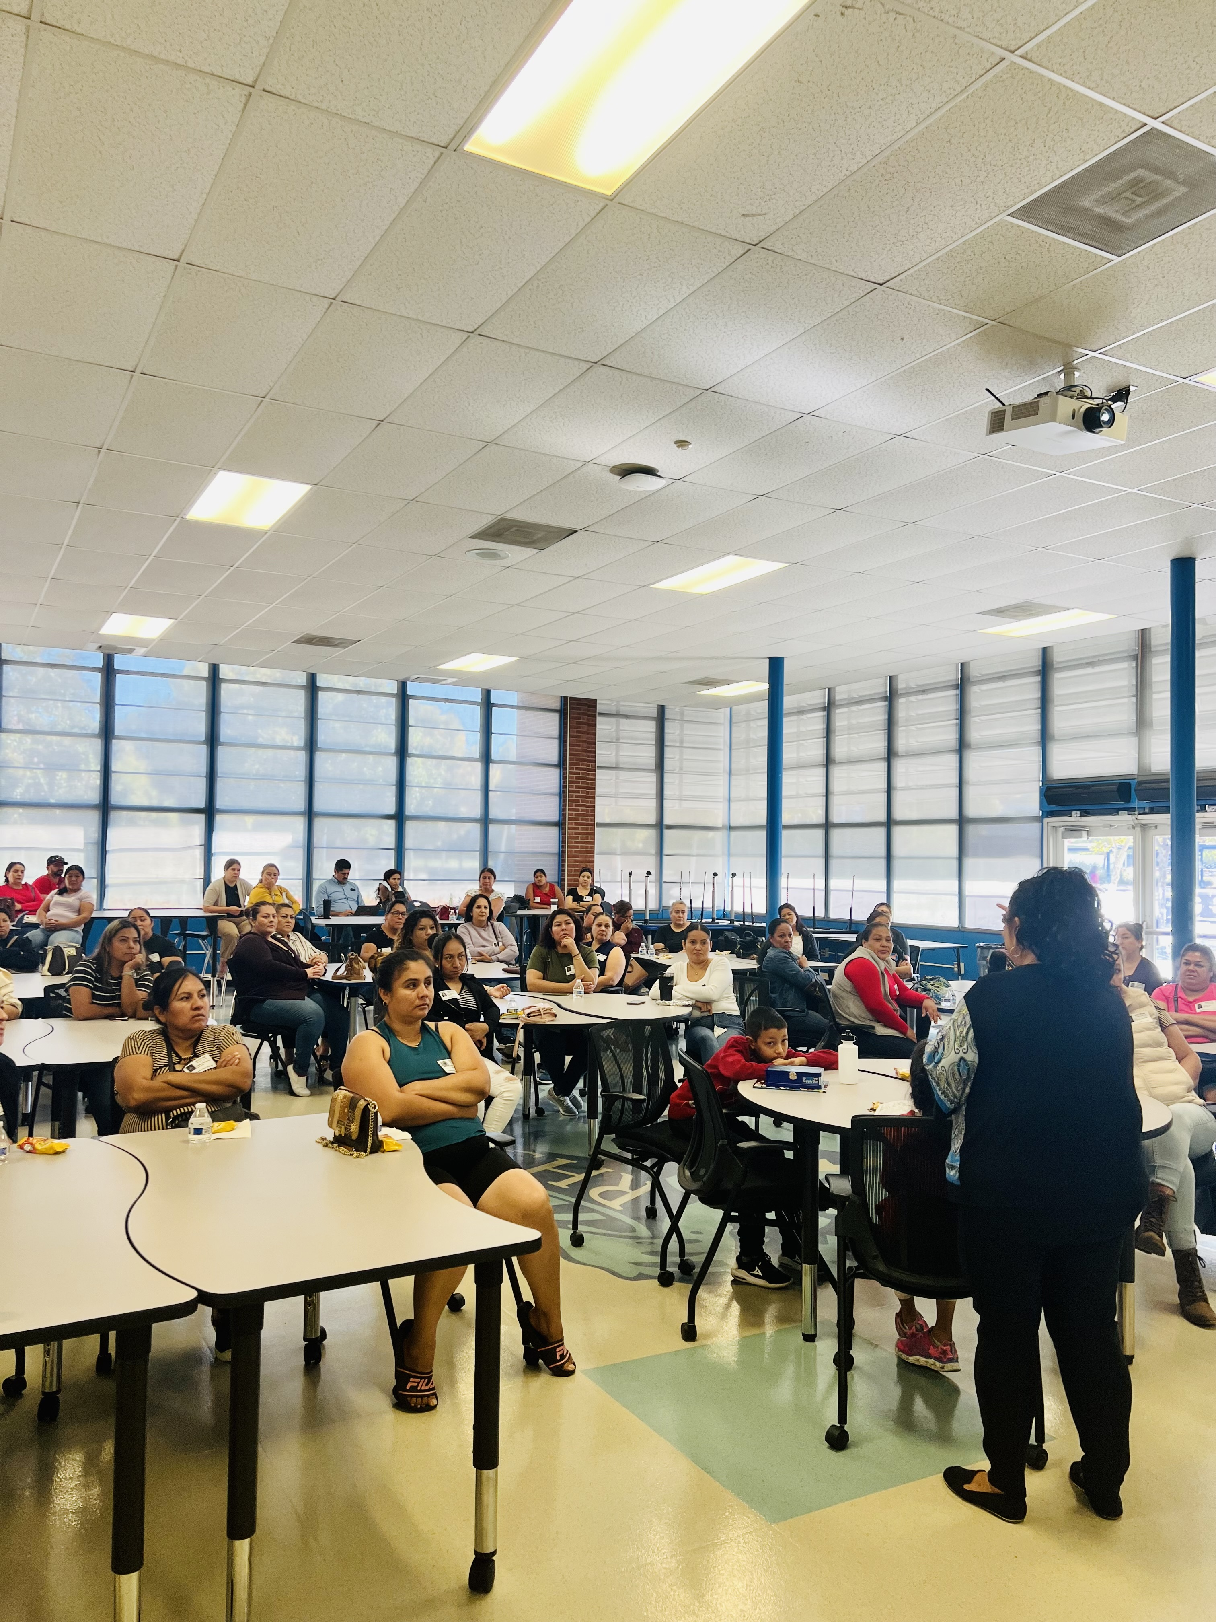
PIQE'S Work in Family Engagement
  Partnership – Develop constructive relationships with schools, districts, principals, teachers, and families
  Active family involvement –Educate and empower families to navigate the school systems to take full advantage of resources for their children
  Principal Dialogue – families work with the principal to develop solutions to school-based issues
  Parents Graduation – Program culminates with a Grad. Ceremony.

Slide 7
PIQE'S Work in the Inland Empire
Education: Year-long model to strengthen participating families’ ability to positively engage with their children’s education
Community Needs: Help improve student academic performance and support their children’s social-emotional needs
Partnership: Build collaborative and positive partnerships with the principal, families, and educators
PIQE in the Inland Empire Services :1999-2023
Schools served from FE: 1,141
Districts served: 34
Total of Graduates 68,736
Programs Offered:
Signature Family Engagement Program (K-12)
◻ Social Emotional Learning (K-12)
◻ Early Childhood Development Program (0-5)
◻ Family Literacy Program (P-3rd)
◻ STEM Program (K-12)
◻ Bridge to College (9-12)
◻ Family Leadership Program (K-12)
-

Slide 8
PIQE PARENTS
Ms. Susana Zamudio
Ms. Myra Vera-Rizo
Mr. Ruben Lomeli
Ms. Perla Melchor
Ms. Aimara Rabago
Ms. Miriam Flores
Notes:
Lead participants through dialogue: What are the characteristics of parent leaders? What does it take for parent leaders to emerge?

Slide 9
REFLECTION
Why is Family Engagement important?
Why are Parents important at school?
Notes:
Lead participants through another reflection.

Slide 10
QUESTIONS?
Josh Hernandez
Karla Rosenbery
PIQE
jhernandez@piqe.org
krosenbery@piqe.org
www.PIQE.org | @PIQEUSA
#PIQE #PIQEStrong #PIQEProud
Notes:
Allow some time for Q&A
Share the presenter’s contact information.

