Slide 1

Office of Financial Aid and Scholarships
University Hall 150
Phone (909) 537-5227
Fax (909) 537-7024
Email financialaid@csusb.edu
Phone Hours: Monday - Friday 8:00 am – 5:00 pm

Slide 2
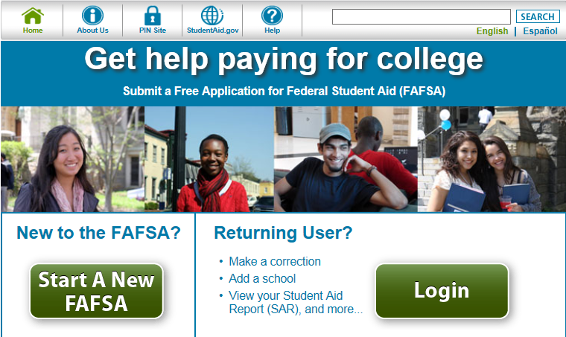
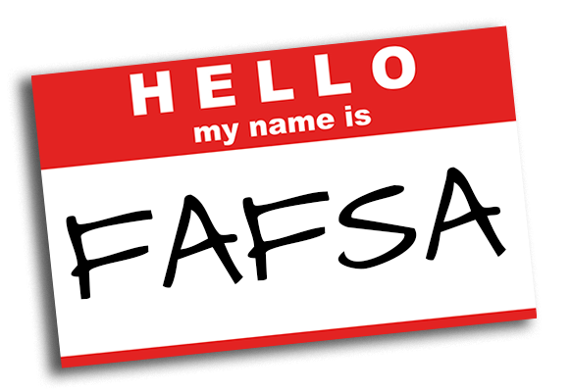
What is the FAFSA?
The FAFSA is the Free Application for Federal Student Aid
  www.fafsa.ed.gov
  Application is available every October 1st
Priority Deadline: March 2nd
  Used to determine eligibility for federal, state and institutional aid, grants, work-study and federal student loans

Slide 3
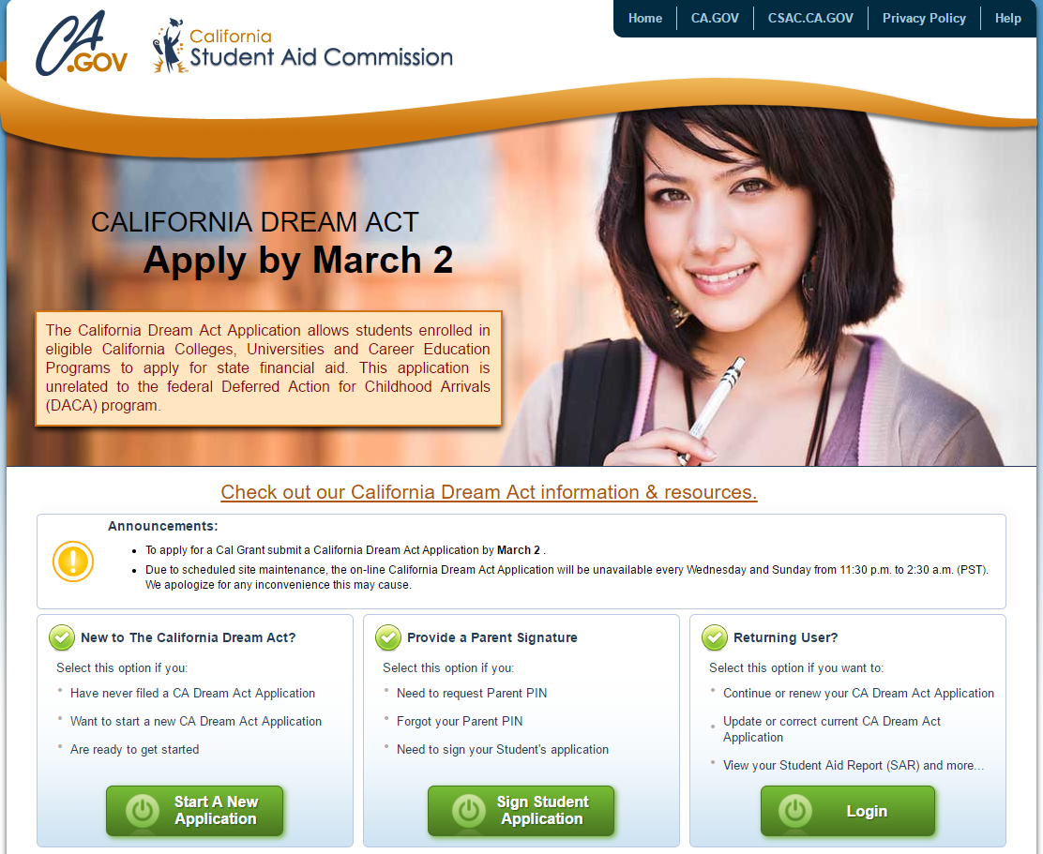
California Dream Act
Allows students at eligible California colleges and universities to apply for state financial aid
The application is available every October 1st and the priority deadline is March 2nd
https://dream.csac.ca.gov/

Slide 4

Financial Aid Timeline
October 1st –March 2nd - Students complete financial aid and scholarship applications to meet the priority deadline
February/March - Students are notified of any additional documents needed to process financial aid
March/April - Financial aid awarding begins for the upcoming school year
May/June - CSUSB Scholarship recipients are notified and awarded
August - Financial Aid is disbursements begin 10 days before the first day of the semester

Slide 5

Student Loan information
Loan borrowers must accept their loan on myCoyote portal every academic year
First time loan borrowers at CSUSB must complete a Master Promissory Note (MPN) and complete a Loan Entrance Counseling
    https://studentaid.gov/h/complete-aid-process
If you previously borrowed at a different campus, you will need to complete a new MPN

Slide 6
DIFFERENCE BETWEEN LOANS & GRANTS
Students are eligible to borrow student loans if additional funds are needed to pay for tuition
Since this is a loan it will have to be repaid
A student enters repayment on their loan either 6 months after graduation or 6 months after falling below half-time status (this means enrolled in less than 6 units)
On the other hand a grant is free money, this is money that does not have to be repaid
You would need to meet Satisfactory Academic Progress and have a need in order to be eligible for some grants

Slide 7
Federal work-study Program
Federal work-study provides a part-time jobs for undergraduate and graduate students with financial need
This allows the student to earn money to help pay education expenses
The program encourages community service work and work related to the student’s course of study
Federal work-study is a form of financial aid. Like scholarships and grants
This does not have to be paid back

Slide 8

CSUSB Financial Aid Quick Tips
Apply early each year:
  Federal Aid (FAFSA)
  CA DREAM Act
Applications are available beginning every October 1st and the priority deadline is March 2nd
CSUSB Scholarship Application opens on November 1st and closes on March 2nd of each year
Check your myCoyote email and student portal often for official information and to review and clear “Holds” and “To Dos”
Respond to document requests as soon as possible- documents can be faxed, mailed or dropped off in the drop box located at the entrance of University Hall.

Slide 9
CSUSB Financial Aid disbursements
If aid does not cover all your fees, you are responsible for paying the balance by the due date to avoid being dropped from the term
Most disbursements occur 10 days before the 1st day of class each term
      If you have no holds!
You are encouraged to apply for direct deposit
All disbursed aid is credited to each student’s account. If there are remaining funds, a refund will be send either by direct deposit or mail. Allow 5 - 10 working days to receive your refund.

Slide 10
Financial Aid
COVID-19 Updates
As we continue to monitor and meet established safety guidelines in response to the novel coronavirus (COVID-19) outbreak, our offices are still open and operating in a virtual format. You can reach us by phone at (909) 537-5227 or via email at financialaid@csusb.edu. You are encouraged to apply for direct deposit
You can reach us by phone Monday through Friday 8:00 am - 5:00 pm at (909) 537-5227 or by emailing financialaid@csusb.edu.
Financial aid documents can be submitted by mail, fax at (909) 537-7024, or in the Enrollment Management Dropbox located at the front entrance of University Hall. For students at the Palm Desert Campus, financial aid documents can be dropped off in the RG building in parking services.

Slide 11
Financial Aid Resources
Free Application for Federal Student Aid (FAFSA)
  www.fafsa.ed.gov
California DREAM Act Application
  www.dream.csac.ca.gov
Federal Student Aid
  www.studentaid.gov
CSAC Webgrants (for Cal Grants, Middle Class Scholarship, and Chafee Grant)
  www.mygrantinfo.csac.ca.gov

Slide 12
Financial Aid
ResourcES, CONT.
Office of Financial Aid & Scholarships
  Any questions or concerns regarding your financial aid please visit visit our website or call us at (909) 537-5227
  https://www.csusb.edu/financial-aid

Slide 13



Questions?

