Slide 1
Banking Fees
Presenter: Veronica Medina
Financial Aid Wellness Coordinator

Slide 2
Learning Objectives
You will be able to:
Identify common banking fees and how to avoid them
Explain how overdraft protection works
The impacts of overdraft fees
Read a Checking Account Summary

Slide 3
Common Banking Fees/How to Avoid These Fees
Checking account fee = It is recommended that you speak with your bank to learn more about its service fees (approximate fee $12.00 +).
  Some banks may still offer a checking and savings account free of charge, verify with your bank prior to opening an account.
Minimum Balance Charge = Double check if there is a minimum balance required. This could be regulated by making sure your balance meets the required threshold whether measured on average as monthly balance, at the end of month, or at any moment during the month.
  Choose an account that has a minimum balance requirement in line with your budget and how much you intend to keep at the bank.
  Sign up for direct deposit. Set up with your employer.
Overdraft Charge = An overdraft fee is charged when you make a check or debit card charge and you can’t fulfil. What this means is that you spent more than what is in your account.
  Keep close tabs on how much is in your account. You have a check register which is a small pad you can use to record transactions and maintain an accurate checkbook. By being up to date with your check register, including debit transactions, you can work to prevent these fees from happening. You can also use technology there are many budgeting apps available to you.

Slide 4
Common Banking Fees/How to Avoid These Fees
Returned Deposit Charge = This is a fee you can incur if you deposit a check that ultimately bounces. This can happen for many reasons, including insufficient or unavailable funds, stop payment, closed account, or incomplete checks.
  This is sometimes hard to control. One way you can prevent this from happening is knowing you is giving you the check and asking if funds are available.
Hard Copy Statement Fee = Your bank may charge you if you choose to receive a paper statement, because of the administrative and postage costs. Ask your bank about electronic statements, or going paperless.
ATM Fee = If you use an ATM that is not affiliated with your bank, the ATM owner will charge you a fee in addition to your bank potentially charging you a fee as well.
  Use only ATMs owned by or affiliated with your bank. If you must use an ATM not affiliated with your bank, take out a larger withdrawals to avoid having to go back multiple times. Try to carry enough cash in your wallet this way you avoid using an ATM and potentially getting a charge if not affiliated ATMs are the only ones available near you. You can also pay with your debit card and get cash back this could save you the fee.
Foreign Transaction Charge = Each time you withdraw money from an ATM, you incur a fee. You usually get a charge every time you withdrawal money. Example: First time you get charged $5.00, and if you use it again another $5.00 within the same week. You have already been charged $10.00 that week. There are three solutions:
  Pick a bank in the Global ATM Network, which is a network of large banks that have come together and waived fees for ATM withdrawals
  Choose to bank with a bank that charges you either little or no ATM fees (even internationally) per month
  Carry cash as frequently as you can, though this may be a higher risk.

Slide 5
Common Banking Fees/How to Avoid These Fees
Los Card Fee = You are most likely liable for a fee if you lose your debit card and the bank needs to send you another one. Fees may be higher if you require a rush order.
Inactivity Fee = Even if you do not use your checking or savings account, you may incur maintenance costs to keep an account. Speak to your bank to learn more about inactivity charges and how you can avoid them.
Accounting Closing Fee = Some banks require you to open your account for a certain amount of time before closing it. Contact your bank to see its account termination procedures and the amount you would have to pay were you to close your account.
As a last resort, ask for the fee you’ve incurred to be waived by your bank

Slide 6
How Does Overdraft Protection Work
This is an option offered in the bank accounts that prevents check, ATM, or debit card transactions, as well as wire and electronic transfers, from causing the account’s balance to fall below zero and triggering an overdraft fee or non-sufficient fund (NSF) Fee.
To use overdraft protection for debit card and ATM card transactions, you must opt into your bank’s coverage. With this protection your bank will allow debit and ATM transactions to go through even if you don’t have enough funds in your account.
The good thing about overdraft protection is that if you don’t have enough money in your checking account, the check will clear; the ATM will give you cash or debit card transaction will go through.

Slide 7
The Impacts of Overdraft Fee
The banks overdraft fees cause financially vulnerable consumers to leave the banking system.
Studies show that 31% of consumers without a bank account reported high or unpredictable account fees as one reason for not having an account.
While 13% cited it as the primary reason for not having a bank account.
Most banks charge a fee if you overdraft your account, usually between $25-$40, plus some have daily fees that are incurred for each day your account is overdrafted.
You’ll be responsible for paying this in addition to the negative balance on your account.
Fortunately, bank overdrafts won’t affect your credit score as long as you resolve them within a timely manner.
If you don’t resolve the debt collect will report the account to the credit bureaus and it will be added to your credit report.

Slide 8
Read a Checking Account Summary
You will get all the information you need to know regarding the bank of your choice by reading this important information.
All charges and the amounts that you will be charged are outlined in this very important document.

Slide 9
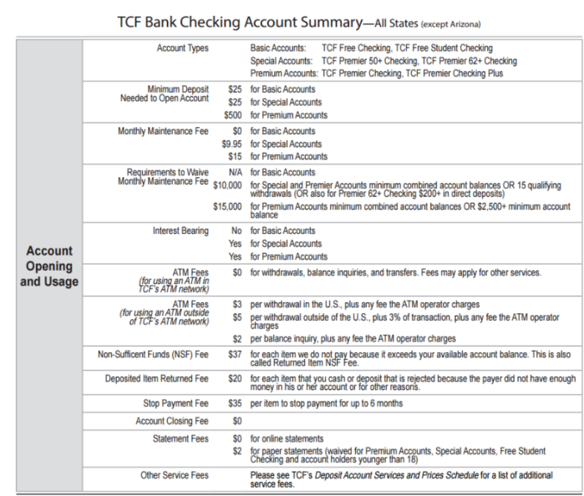
Account Opening and Usage - Summary

Slide 10
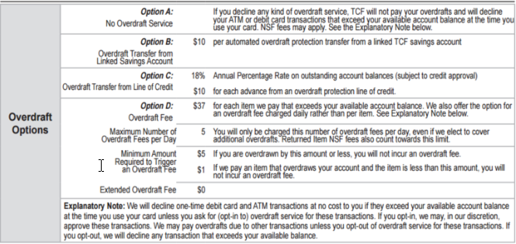
Overdraft Options - Summary

Slide 11
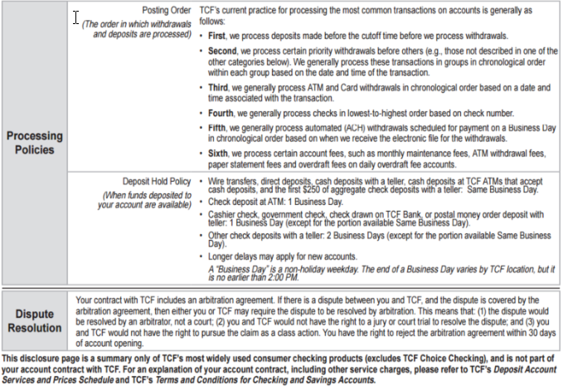
Processing Policies - Summary

Slide 12
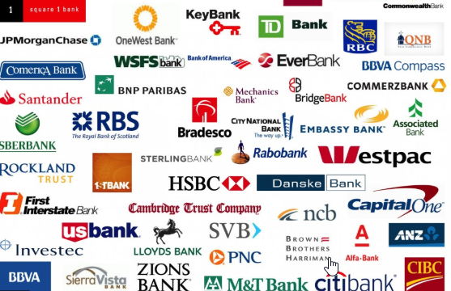
Bank Logos

Slide 13
Q & A Time
Open for any questions

Slide 14
Presenter Contact Information
Veronica Medina, Financial Aid Wellness Coordinator
Department: Office of Financial Aid & Scholarship
Telephone: (909) 537-3438
Email Address: Vmedina2@csusb.edu

