Slide 1
7 Things You Need Before You Fill Out the 2020–21 FAFSA® Form
2020-2021
Presenter: Veronica Medina, Office of Financial Aid & Scholarship

Slide 2
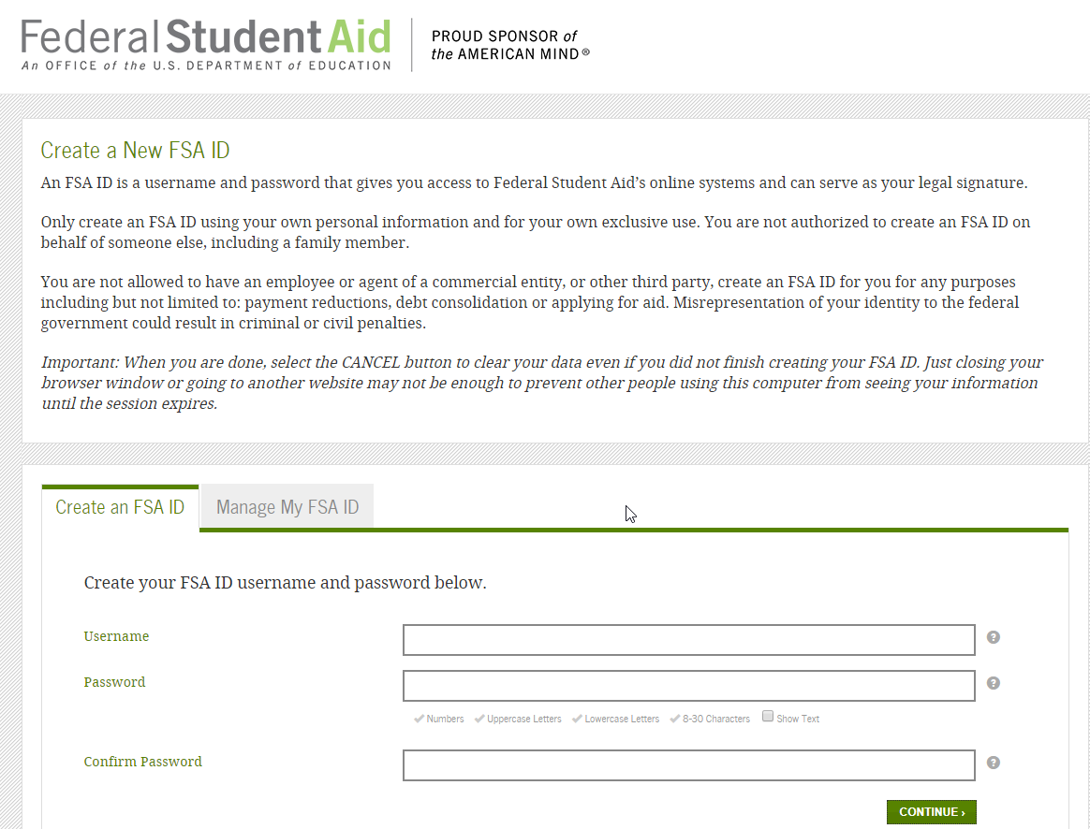
1. Your FSA ID
An FSA ID is a username and password that you can use to log in to certain U.S. Department of Education (ED) websites. Each student, and one parent of each dependent student, will need an FSA ID to complete the FAFSA process on studentaid.gov. We recommend creating your FSA ID early—even before you’re ready to complete the FAFSA form—to avoid delays in the process. Visit fsaid.ed.gov to create one.

Slide 3
Summarizing FSA ID Steps
Anyone who plans to fill out the 2020–21 FAFSA form should create an FSA ID as soon as possible.
If you are required to provide parent information on your FAFSA form, your parent should create an FSA ID too.
Because your FSA ID is equivalent to your signature, parents and students each need to create their own FSA IDs using their own email address and phone number. Parents should not create an FSA ID for their child and vice versa.
In some situations, you may need to wait up to three days to use your FSA ID after creating it. If you want to avoid FAFSA delays, create your FSA ID now

Slide 4
2. Your Social Security Number
3. Your Driver’s License Number
You can find the number on your Social Security card. If you don’t have access to it, and don’t know where it is, ask your parent or legal guardian or get a new or replacement Social Security Card https://www.ssa.gov/ssnumber/ from the Social Security Administration. If you are not a U.S. citizen, but meet Federal Student Aid’s basic eligibility requirements, you’ll also need your Alien Registration number.
If you don’t have a driver’s license, then don’t worry about this step.

Slide 5
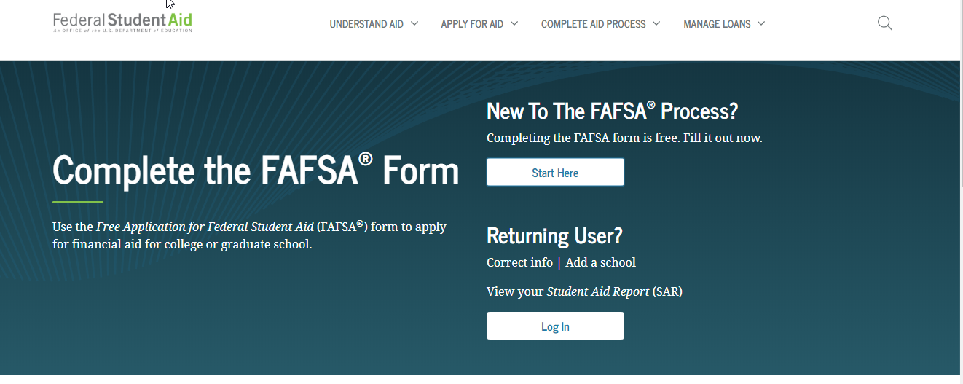

Slide 6
4. Your 2018 Tax Records
On the 2020–21 FAFSA form, you (and your parents, as appropriate) will report your 2018 income information, rather than your 2017 income information.
Since you’ll probably already have filed your 2018 taxes by the time the FAFSA form launches, you’ll be able to import your tax information into the FAFSA form right away using the IRS Data Retrieval Tool (DRT). (No more logging back in to update after filing taxes!)
Not everyone is eligible to use the IRS DRT; and the IRS DRT does not input all the financial information required on the FAFSA form. Therefore, you should have your 2018 tax return and 2018 IRS W-2 available for reference.
You cannot use your 2019 tax information. We understand that for some families, 2018 income doesn’t accurately reflect your current financial situation. If you have experienced a reduction in income since the 2018 tax year, you should complete the FAFSA form with the info it asks for (2018), and then contact each of the schools to which you’re applying to explain and document the change in income. They have the ability to assess your situation and make adjustments to your FAFSA form if warranted.
You cannot update your 2020–21 FAFSA form with your 2019 tax information after filing 2019 taxes. 2018 information is what’s required. No updates necessary; no updates allowed.
The IRS DRT is the fastest, most accurate way to input your tax return information into the FAFSA form. To address security and privacy concerns related to the IRS DRT, the tax return information you transfer from the IRS will not be displayed on fafsa.gov or the IRS DRT web page. Instead, you’ll see “Transferred from the IRS” in the appropriate fields on fafsa.gov.

Slide 7

5. Records of your Untaxed Income
20XX
The FAFSA questions about untaxed income may or may not apply to you; they include things like child support received, interest income, and veterans noneducation benefits. On the 2020–21 FAFSA form, you’ll report 2018 tax or calendar year information when asked these questions.

Slide 8
6. Records of your assets (money)
This section includes savings and checking account balances, as well as the value of investments such as stocks and bonds and real estate (but not the home in which your family lives). You should report the current amounts as of the date you sign the FAFSA form, rather than reporting the 2018 tax year amounts.
Note: Misreporting the value of investments is a common FAFSA mistake. Please carefully review what is and is not considered a student investment and parent investment to make sure you don’t over- or under-report. You may be surprised by what can (and cannot) be excluded.

Slide 9
7. List of the School(s) you are Interest in Attending
Be sure to add any college you’re considering, even if you haven’t applied or been accepted yet.
Even if there is only a slight chance you’ll apply to a college, list the school on your FAFSA form. You can always remove schools later if you decide not to apply, but if you wait to add a school, you could miss out on first-come, first-served financial aid.
The schools you list on your FAFSA form will automatically receive your FAFSA results electronically. They will use your FAFSA information to determine the types and amounts of financial aid you may receive.
If you add a school to your FAFSA form and later decide not to apply for admission to that school, that’s OK! The school likely won’t offer you aid until you’ve been accepted anyway.
You can list up to 10 schools at a time on your FAFSA form.

Slide 10
THANK YOU!
Contact Information:
Veronica Medina, Financial Aid Wellness Coordinator
Phone: (909) 537-3438
Email: Vmedina2@csusb.edu

