Slide 1

2021-2022 Financial Aid Workshop
Financial Aid Office
California State University, San Bernardino

Slide 2

Topics to be Covered
What is the FAFSA?
Obtaining a FSA ID
FAFSA Application
DREAM Application
Types of Financial Aid
Cal Grant
Scholarship Application

Slide 3
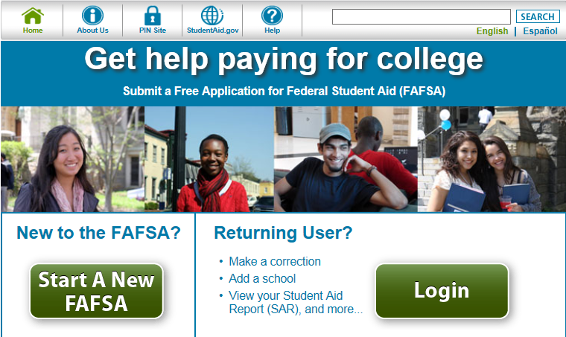
What is the FAFSA?
The FAFSA is the Free
Application for Federal
Student Aid
www.fafsa.ed.gov
2021-2022 available
starting October 1st
Priority Deadline: MARCH 2
Used for federal, state and institutional aid
Grants, Work-Study and Federal Student loans

Slide 4
Collects demographic and financial information
Information used to calculate the expected family contribution (EFC)
Colleges use EFC to award financial aid
Available in English and Spanish

Slide 5


Federal Student Aid ID
FSA ID-a username and password-you will need to have a social security number to obtain a FSA ID.
Each person must obtain a FSA ID , if you cannot obtain a FSA ID send in signature page
Save FSA ID to file the FAFSA, make corrections and access other federal websites.
Only the owner of the FSA ID should create and use the account. Never share your FSA ID

Slide 6





Various Application Formats
FAFSA on the Web (FOTW)
myStudentAid mobile app
Paper or PDF FAFSA
FAFSA on the Phone (FOTP)
FAA Access to CPS Online

Slide 7
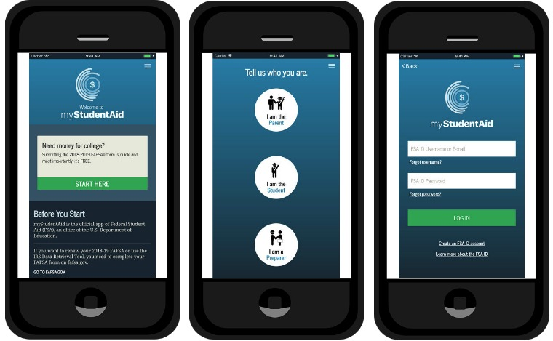
*NEW* myStudentAid Mobile App
You can now complete your FAFSA on the myStudentAid mobile app
Download through your appstore or Google Playstore

Slide 8
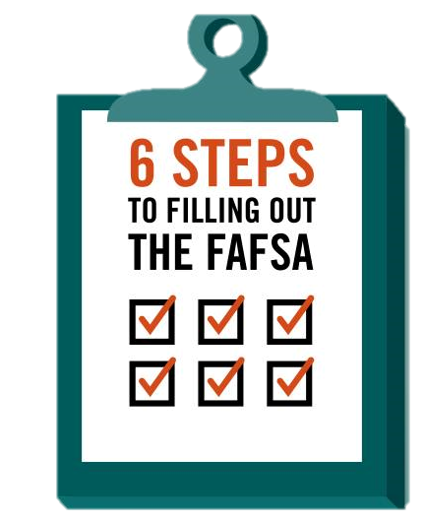
FAFSA Application
Step 1 - Student Demographics
Step 2 - Student Financial Information
Step 3 - Dependency Status
Step 4 - Parent Information
Step 5 - Student Household
Step 6 - School Selection
Step 7 - Signatures
Notes:
If no SSN for parents, they will need to print a signature page to mail.

Slide 9
Dependency Status
FAFSA asks questions to determine dependency status for Title IV federal student aid (not IRS) purposes:
If all “No” responses, student is dependent
If “Yes” to any question, student is independent

Slide 10
IRS Data Retrieval Tool
Allows for certain tax return information to be transferred from the IRS database
Participation is voluntary and student chooses whether or not to transfer data to FOTW
IRS will authenticate taxpayer’s identity
If tax record is found, IRS transfers information to populate the FAFSA
Reduces documents requested by financial aid office

Slide 11
Frequent FAFSA Errors
Social Security Numbers (SSN) If parents do not have a SSN please put 000-00-0000 under their information
Divorced/widowed/remarried parental information
Income earned by parents/stepparents
Untaxed income
U.S. income taxes paid
Household size
Number of household members in college
Real estate and investment net worth

Slide 12
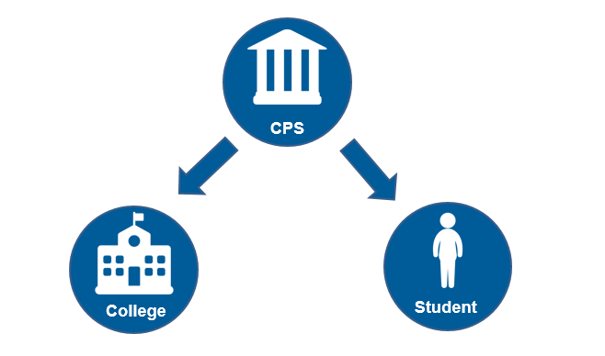
FAFSA Processing Results

Slide 13
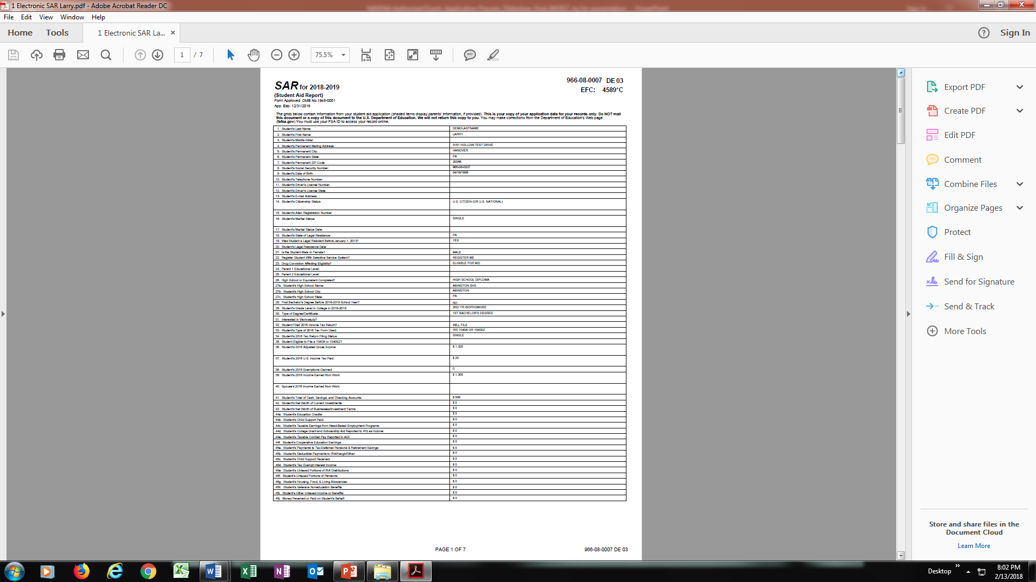
Email Notification of SAR Processing
If valid email address is provided on FAFSA
Provides access to electronic SAR at www.fafsa.gov
Review for any errors in order to make corrections.

Slide 14

What is Financial Aid?
Financial aid consists of funds provided to students and families to help pay for postsecondary educational expenses

Slide 15




What is Cost of Attendance (COA)?
Estimation of expected costs
Direct Costs
Indirect Costs
Tuition and fees
Transportation
Miscellaneous
personal expenses
Room and board
Books and supplies

Slide 16
What is Expected Family Contribution (EFC)?
Student contribution
Measurement of student’s and family’s ability to pay postsecondary educational expenses
Parent contribution
(for dependent students)

Slide 17
What is Financial Need?
Cost of attendance (COA) – Expected family contribution (EFC) = Financial need

Slide 18

California Dream Act of 2011
Allows students who meet certain criteria to apply for financial aid, such as:
Private Scholarships
State University Grant (CSU)
Cal Grants, EOP Grants
Middle Class Scholarship
Applicants include:
AB 540 or AB 2000 students
Undocumented students
Deferred Action for Childhood Arrival (DACA) students

Slide 19
California Dream Act Application
Application opens October 1st
https://dream.csac.ca.gov
Eligibility
Attended a CA school for 3+ years AND graduated from a CA HS or equivalent
Attend a CA college or university
File affidavit with college or university of interest
Priority Deadline: March 2nd
Submit GPA Verification

Slide 20

Types of Financial Aid
Gift Aid
Grants or scholarships that do not need to be repaid
Work-Study
Part-time employment
Federal Student Loans
Low interest loans that must be paid back

Slide 21

Federal Aid Programs
Pell Grant
Supplemental Education Opportunity Grant (SEOG)
Federal Work-Study
Federal Direct Student Loans
Subsidized - Need Based
Unsubsidized – Non Need Based
Federal Direct Parent Loans for Undergraduate Students (PLUS)

Slide 22

State Aid Programs
Cal Grant A, B or C
CHAFEE Grant
Middle Class Scholarship (MCS)
California Dream Loan

Slide 23

Cal Grant Program
Deadline: March 2nd
www.calgrants.org
Must meet GPA, income and assets ceilings
Required Documents
FAFSA
GPA Verification Form
School will file your GPA (check with your school)
Student can obtain a Cal Grant GPA Verification Form. Must be certified by a school official and mailed to CSAC

Slide 24

Middle Class Scholarship
Students attending a CSU or UC with family income up to $177,000
U.S. citizen, permanent resident or have AB 540 status
CA resident
2.0 GPA
Complete FAFSA or Dream Act Application
Meet certain income and other financial standards

Slide 25
Other Aid Programs
Vocational Rehab
Fee Paying Programs
External Scholarships
Veteran’s Benefits
Contact Veteran’s Affairs representative

Slide 26
Scholarships
ONE online application used for a variety of on campus scholarships determined by various committees
Deadline: March 2
Needs to file a FAFSA by March 2 to be considered for need based scholarships
Check for off-campus scholarships
Parent’s Employers
Business
Internet

Slide 27
CSUSB Scholarships - Recommendations
At least one recommendation is required for an application to be considered complete.
NOTE: You may want to get more than one to make sure at least one is completed.
To be completed by teacher or professor. (Supervisor may be used in special circumstances)

Slide 28
CSUSB Scholarships – Essay Tips
Your autobiographical essay should be a reflection of your personal and academic life. Some scholarships require a separate essay and are noted in the application. Things to include:
Family history/background
First generation college student
How you overcame adversity
Community Service
Give examples
Educational information
Degree objective
Professional/career goals
Be specific if possible

Slide 29

Special Circumstances
Secondary school tuition
Unusual uncovered medical/dental expenses
Extraordinary dependent care
Student cannot obtain parental information
Parent or spouse death
Loss of employment
Divorce

Slide 30
Special Circumstances
Conditions exist that cannot be documented with the FAFSA
Contact your student’s expected college/university financial aid office to discuss
Send written explanation and documentation to your college’s financial aid office
College will review and request additional information if necessary
Decisions are final and cannot be appealed to U.S. Department of Education

Slide 31



CSUSB Financial Aid Office
www.finaid.csusb.edu
909-537-5227 (phone)
909-537-7024 (fax)
University Hall-150
CSUSB FAO
@CSUSBFA
@CSUSBFA
Hours
Mon-Thurs 8:00AM-6:00PM
Friday 8:00AM-5:00PM

Slide 32

Questions

