Slide 1


WHAT’S NEXT AFTER GRADUATION?
Valentina Felix, Career Counselor vfelix@csusb.edu

Slide 2

Career Center Information
San Bernardino Campus
University Hall 329
Phone: 909-537-5250
Email: careercenter@csusb.edu
Website: www.csusb.edu/career-center
Palm Desert Campus
Indian Wells 111
Phone: 909-537-8243
Email: pdccareercenter@csusb.edu
Website: https://pdc.csusb.edu/current-students/career-service

Slide 3
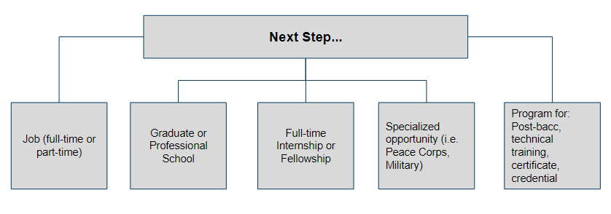
POST-GRADUATION PATHWAYS
Notes:
Typical destinations students strive toward after graduation. Tie this into major decision-making and career planning.
Is your post graduation pathway represented in this.

Slide 4
CAREER PLANNING:
Gaining experience
Job
Internship
Volunteer
Campus and or community involvement
Student and or professional organization involvement
Research
Study Abroad

Slide 5
CAREER PLANNING:
Implementation
This step involves taking action to fully achieve career pursuit
Examples:
  Intentional searching & networking
  Preparing application materials, interview practice
  Applying for targeted position or program
  Gaining acceptance, landing position
  Moving forward

Slide 6
GRADUATE & PROFESSIONAL
SCHOOL PREPARATION
Before attending graduate school it is important to have a clear understanding of what you want to do with your career and how earning a graduate degree will help you reach that goal. Not all career paths / jobs require a graduate degree!
A few tips / things to think about:
  Research your prospective field
  Evaluate the various graduate programs
  Prepare for the admissions process
  Finance your education
Helpful Websites:
  https://www.csusb.edu/graduate-studies
  https://www.calstate.edu/gradprograms/choose_program.shtml
  https://www.petersons.com
Notes:
Talk about how this is necessary for some careers but that there are a lot of jobs that do not require going to graduate or professional school. That is why it is important to know what you want to do with your major early on so that you can plan for this option. Mention CA Graduate diversity Forum here and plug grad studies and one of helpful website to explore grad and professional schools.List some steps they would have to take. Use information from grad school prep resource.

Slide 7
GRADUATE & PROFESSIONAL
SCHOOL PREPARATION
Preparing for admissions process
Complete any prerequisites
Complete your bachelor’s degree (may be in-progress at time of submitting application)
Admissions tests: In most cases, an entrance exam will be required, i.e. Graduate Records Exam (GRE), Graduate Management Admission Test (GMAT), Law School Admission Test (LSAT), Medical College Admission Test (MCAT)

Slide 8
GRADUATE & PROFESSIONAL
SCHOOL PREPARATION
Preparing for admissions process
Aim for minimum of 3.0 GPA
  Some schools average your last 2 years of school, or the courses in your field of concentration
2-3 letters of recommendation: Choose individuals who know you academically and/or professionally and will give you the best recommendation.
Personal statement: This is a qualitative way to show your eligibility, not quantitative like GRE scores, transcripts, and grades.

Slide 9
GRADUATE & PROFESSIONAL
SCHOOL PREPARATION
Financing your education
Fellowships & Scholarships
Loans
Assistantships
Grants
Work Study
Job
Loan Forgiveness

Slide 10
JOBS & INTERNSHIPS
Getting prepared: What are you looking for?
Position type (part-time, full-time, contracted, per diem)
Location
Industry focus (entertainment, education, healthcare)
Sector (private, non-profit, government)
Salary
Work values
Company culture
Ultimate purpose/goal

Slide 11
JOBS & INTERNSHIPS
Strategies & tips
Research
  Glassdoor.com, Vault.com, LinkedIn, Handshake
  Identify job and internship titles of interest
Review company websites
  Values, vision, mission
Network
  Faculty, professional associations, LinkedIn, campus clubs/orgs., peers, job/internship fairs

Slide 12
JOBS & INTERNSHIPS
Strategies & tips: Get recruited through...
Handshake
LinkedIn
Career & internship fairs
On-campus interviews and information sessions
Conferences
Hands-on experiences (i.e. volunteering, campus or community involvement)

Slide 13
JOBS & INTERNSHIPS
Strategies & tips: Search process
Online
  Handshake
  www.linkedin.com
  www.indeed.com
  www.simplyhired.com
  www.glassdoor.com
  www.edjoin.org
  www.governmentjobs.com
  Online.goinglobal.com
Company/organization websites

Slide 14
JOBS & INTERNSHIPS
Strategies & tips: Search process
Contact companies directly
  Inquire via email, phone, or in-person about opportunities
Job and internship fairs
  Provide excellent opportunity discover job information, speak directly with employers, submit resume(s), and learn more about your field of interest
Consider a temp/employment agency
  Matches employers to viable candidates
  Some employers use this service to do initial screening of applicants

Slide 15
Entry-Level Jobs
Requirements: 1-2 years experience plus a degree, related or otherwise.
Job related experience does not need to be obtained through paid employment.

Slide 16
internship
the position of a student or trainee who works in an organization, sometimes without pay, in order to gain work experience or satisfy requirements for a qualification.

Slide 17
Internship Basics
Time commitment: 10-15 hrs per week vs 40 hrs/week
Paid vs Unpaid
Securing your first unpaid internship may lead to landing a paid competitive internship or job
Credit vs No Credit
Formal vs Informal

Slide 18
Benefits
Develop skills employers are seeking and grow as a professional
Confirm or explore field, industry and functional area interest
Apply knowledge, skills and concepts learned in the classroom to experience
Build relationships and create a professional network, a source for mentors and recommenders

Slide 19
JOBS & INTERNSHIPS
Strategies & tips: Search/application organization
Search log (Example)
Company | Position Title | Date Applied | Contact Name | Date of follow-up | Outcome
CSUSB | IT Intern | 11/15/2018 | John Smith | 11/30/2018 | Interview set for 12/5/2018

Slide 20
Finding an Internship
Online
Network – Make sure everyone in your network knows you are looking for an internship
DIY / Cold Call (email)
Faculty/Department/College Resources
Informational Interview

Slide 21
Make the Most Of Your
Internship Volunteer Shadowing Experience
Ask Questions
Make meaningful connections
Volunteer to assist on various projects
Treat your internship like a long job interview
Keep a log and update your resume with your new skills
Send a thank you note
Stay in contact. You may need LOR or a reference

Slide 22
NETWORKING &
DEVELOPING YOUR
LinkedIn PROFILE

Slide 23
What is Networking?
Talking with people who will learn about you and your interests, and then help you gain insight into your career options and goals
It is a two-way process that involves developing and maintaining connections with individuals, and mutually benefitting from the relationship
Is an ongoing process that takes time and attention; it is not something you do only when you are looking for a job

Slide 24
What is Networking?
Successful networking requires preparation and practice
Networking can be done in-person and online. A valuable tool for online networking is LinkedIn
Remember, when you network, you are asking for information and advice—not a job. It’s not just what you know; it’s also whom you know… or can connect to

Slide 25
Why is Networking important?
Will be the single most effective method of advancing your career
While networking may not “get you a job,” it does play a role in the majority of hiring decisions
Many job vacancies are never advertised, but instead filled through some form of personal or professional referrals
Employers prefer to hire candidates they have met, or those referred by a trusted source

Slide 26
Build Your Network
Networking opportunities occur on a daily basis and can include a brief conversation with someone on an elevator to an arranged meeting with a professional
Identify all the people whom you come in contact with through your activities. These can include:
  Your friends, classmates, their parents and family members, neighbors.
  Your relatives and extended family.
  Former and current employers and co-workers.
  Members and alumni of professional associations, clubs, and organizations.
  Coaches, staff, faculty, or academic advisors.
  Alumni of any schools you’ve attended.

Slide 27
Expand Your Network
Attend campus career events and fairs, alumni presentations, and workshops
Introduce yourself to any guest speakers you encounter on campus
Obtain an internship and maintain contact with colleagues and supervisors
Take advantage of job-shadowing programs
Identify contacts by researching LexisNexis, industry/trade publications, employer websites, alumni magazines, and library resources
Create a LinkedIn profile; connect to your contacts and join groups as appropriate

Slide 28
What is LinkedIn?
https://youtu.be/ZVlUwwgOfKw

Slide 29
Features and Benefits of LinkedIn
Establish your professional profile and control one of the top search results for your name.
Build and maintain your professional network.
Find and reconnect with colleagues and classmates.
Learn about other companies, and gain industry insights.
Find other professionals in the same industry using groups.
Share your thoughts and insights through LinkedIn's long-form publishing platform.
Tap into the knowledge of your network.
Discover new career opportunities by searching for jobs.

Slide 30
Steps in Profile Development
Sign-up: Name, email address, password
Add location information
Add profile photo (background image optional)
Create a headline
Write a summary statement
Other key sections to complete: Showcase your unique professional story through your experience, skills, and education
LinkedIn tips for students: https://students.linkedin.com/

Slide 31
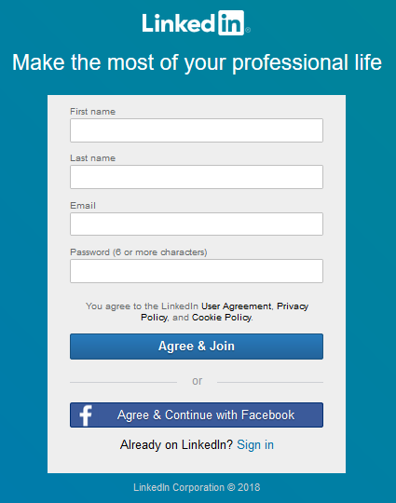
Getting Started
Go to the sign-up page at https://www.linkedin.com/start/join
You can sign-up via your Facebook or Email account

Slide 32
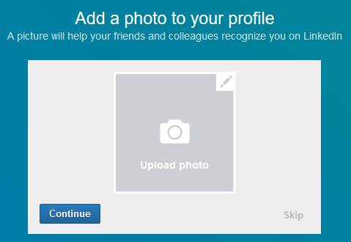
Profile Photo
Having no LinkedIn profile photo means your profile is not 100% complete
According to LinkedIn, profiles with photos receive 21 times more views and 9x more connection requests
LinkedIn Profile Photo Help: https://www.linkedin.com/help/linkedin/topics/6042/6059
Notes:
An engaging profile photo and background create a personal relationship with your viewers.
You will be more likely to be contacted by many recruiters.
People will see you as friendly and professional.
People will be encouraged to read more about you.

Slide 33
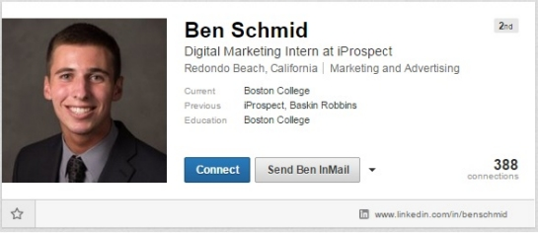
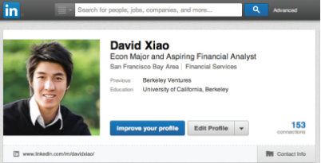
Profile Photo Samples & Tips
Professional head shot (is recommended)
Plain background
No distractions in view
If taken outside, natural light works well
Make sure you portray yourself as you want to be seen by your intended audience
Notes:
Depending on your industry, you might choose to post a more or less formal photo.
Privacy concern: As an alternative to posting your photo publicly, you can change your connections or only to your network. This step may deter someone from asking for a connection based on visual interests alone, if that is a concern.
Concern about discrimination such as age or race: Would you want to work for a company that doesn’t contact you because of something they see in your picture? If they are going to discriminate, chances are they will do it in the interview if they don’t have a chance to make judgements based on your photo and you may be overlooked if you don’t have one at all.

Slide 34



Background Image
LinkedIn has a standard option available to use or as a premium user you have access to LinkedIn stock images
Another option is to create a custom background image using one of the following online tools:
  www.canva.com
  www.fotor.com
  www.picmonkey.com
Background Image Help: https://www.linkedin.com/help/linkedin/answer/49960?query=background%20image
Notes:
Get a professional head shot with a plain background, natural light is also good, smile and look directly at camera
If your photo includes a dog, cat, husband, or a lot of unnecessary objects in the background, viewers might think you’re immature or unprofessional, or simply be distracted

Slide 35

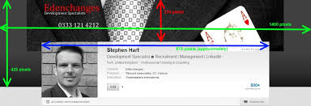
Ideas For Background Images
LinkedIn stock image
Your product or service in the making
Your product or service in action
The skyline of your current city
Design your own
A personal image
Article: Seven ideas for an effective LinkedIn background image: https://www.linkedin.com/help/linkedin/answer/49960?query=background%20image
Notes:
Get a professional head shot with a plain background, natural light is also good, smile and look directly at camera
If your photo includes a dog, cat, husband, or a lot of unnecessary objects in the background, viewers might think you’re immature or unprofessional, or simply be distracted

Slide 36
Profile Content Tips
“The first hurdle is to get found (to make sure you come up in the right kind of searches by recruiters).”
-Catherine Byers Breet, Longtime recruiter and adopter of LinkedIn (member since 2005)
Use industry-relevant job titles and keywords
Once you identify your top keywords, add as many of them to the following sections: Headline (most important), Current Job Title, Summary, Interests
The LinkedIn search tool searches entire profiles, so insert your keywords throughout!

Slide 37
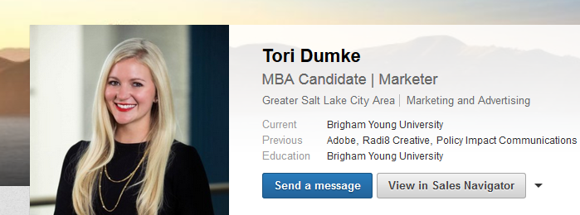
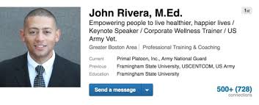
Headline
Examples
Depends on your LinkedIn profile goals
Can be general and straightforward
Can also tell viewers what makes you unique and includes as many keywords as possible
Headline Help: https://www.linkedin.com/help/linkedin/topics/6042/6043/2901

Slide 38
Summary Statement
Main place for you to stand out; adds a ‘story’ element to your experience and your aspirations
Be concise about your experience, qualifications, and goals – with a compelling narrative weaved throughout (if possible)
Describes what motivates you, what you’ve done and are skilled at
Use keywords and phrases that recruiters might search for (i.e. product management, graphic design, data analysis)
https://www.linkedin.com/pulse/10-tips-students-new-grads-linkedin-omar-garriott

Slide 39
Summary Statement
How to write a stellar summary:
Set the scene:
  What is your ideal audience? What do you want them to know, learn, or do?
  How do you want to make them feel?
Collect content
  What you do, accomplishments, values and passions, your “superpowers”, interesting stats, differentiation, validation (back up what you’re saying)
Source: https://www.forbes.com/sites/williamarruda/2017/07/09/how-to-write-a-stellar-linkedin-summary/2/#271686b3067a

Slide 40
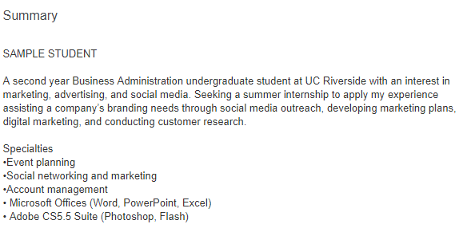
Summary Statement
https://www.linkedin.com/in/studentsample

Slide 41
SPECIALIZED OPPORTUNITIES
Military https://www.military.com/
AmeriCorps https://www.nationalservice.gov/programs/americorps
Peace Corps https://www.peacecorps.gov/
Teach for America https://www.teachforamerica.org/
Earth Corps https://www.earthcorps.org/

Slide 42
Education
Education is the foundation!
  Members who list a school get 10x more views on average
    Add your school, major, and degree name
    Include clubs you lead and honors you have earned

Slide 43
Experience
When listing your experience:
  Avoid listing only duties and responsibilities
    Use action words and accomplishments
  Examples:
    Analyzed materials….
    Conducted individual….
  List projects, organizations, classes, etc.
    Similar to resume
    Most related at the top
    41% of hiring managers consider volunteer experience equally as valuable as paid work experience

Slide 44
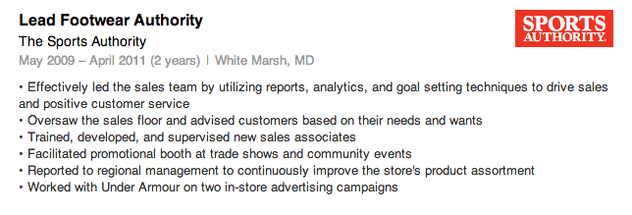
Experience

Slide 45
Skills
List tangible skills that you are comfortable using in the workplace
Skills can be acquired on the job or in school
  Speak Mandarin?
  Know JAVA programming?
  17% more profiles views with 5+ skills listed

Slide 46
Tips to get you started
Complete your profile
Claim your unique URL
Participate in groups
Connect with people you know:
  Friends, family, classmates, mentors, teachers, and
  professors
Use the alumni tool
Actively update your profile

Slide 47
Participate in Groups
LinkedIn Groups are hubs on LinkedIn which provide a “place for professionals in the same industry or with similar interests to share content, find answers, post and view jobs, make business contacts, and establish themselves as industry experts.”
“Being an active participant in a group can help you network with other professionals in your field, especially those outside your immediate circle…”
https://blog.hootsuite.com/linkedin-groups/

Slide 48
Final Words...use LinkedIn to:
Browse job descriptions
Set up job alerts
Follow
  Companies
  Influencers
  Industries---trends and news

Slide 49

HOW TO ACE AN INTERVIEW
Notes:
Minimalist Grey Brand Guideline Presentation

Slide 50




THE INTERVIEW PROCESS
PRE-INTERVIEW
POST-INTERVIEW
INTERVIEW

Slide 51

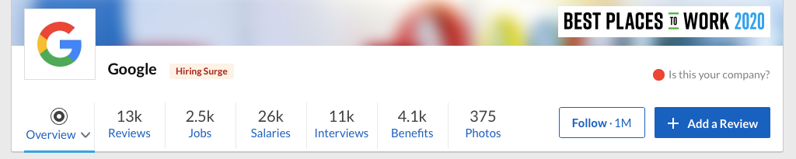
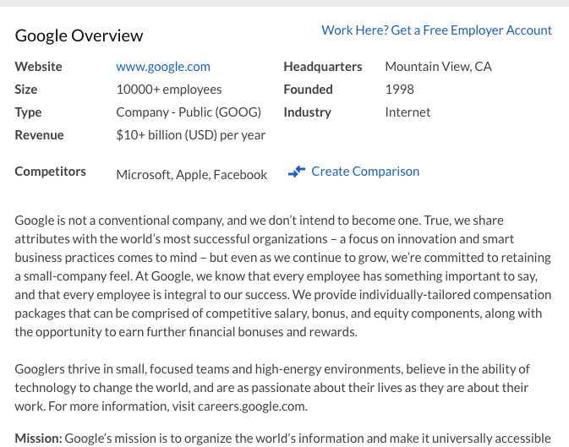
RESEARCH
HISTORICAL AND FINANCIAL BACKGROUND
  Origins-founding principles & mission and vision of the company
  How well is the company doing financially?
MACRO (THE BIG PICTURE)
  How well is the company doing in its respective industry?
MICRO (MORE SPECIFIC)
  What is it like working for the company?
  Number of employees
  Employee rating
    Glassdoor
    Indeed
PRE-INTERVIEW

Slide 52

PREPARATION
FAMILIARIZE YOURSELF WITH VIDEO CHAT PLATFORMS
Google Meet, Zoom, Microsoft Teams, etc.
PREPARE YOUR TECHNOLOGY
Test your technology the day before. You may consider doing a test run with a friend so they can provide feedback about the quality of your video and sound.
PREPARE YOUR BACKGROUND
Add a professional virtual background if your computer allows.
If not, tidy your space or choose a blank wall.
PRE-INTERVIEW

Slide 53


FIRST IMPRESSION
SKILLS:
Dress for Success!
REASONS
  More presentable and professional.
  When you are dressed your best, you tend to feel more confident.
CUT
  Shirts and attire should be modest
  No slits in the front of skirts/dresses
PRINT
  Minimal print to solid (no print) is best
COLOR
  Dark Blue
  Black
  Gray
PRE-INTERVIEW

Slide 54
How to Answer the
"TELL ME ABOUT YOURSELF"
Question
EDUCATION
WORK EXPERIENCE
KEY STRENGTHS
FUTURE
  Begin with your year in school, major (and minor), and how you became interested in the field.
  Skills you have learned through school projects.
  Mention on campus membership/s and organizations (especially if in a leadership position).
  Discuss your current position, if you are currently working.
  Mention past jobs.
  Focus on transferable skills that would be valuable to employers in the field, professional accomplishments, or recognition you received.
  Based on your research of the organization, mention two key strengths of yours that match the requirements of the organization.
  End with why you are interested in working for the organization.
  State that you look forward to learning more about how you might be able to contribute your skills, talents, and experience in the future.
INTERVIEW

Slide 55

The CARR Technique
CONTEXT
  Describe a specific event or situation.
  Give enough detail & context for the interviewer to understand.
  Draw from campus, work, or community experiences
ACTION
  Describe the action that you took to address the situation.
  If you are describing a group project, focus on your role.
RESULT
  What did you accomplish?
  If not success, what did you learn?
RELATE
  How does this relate to the position you're applying for?
INTERVIEW

Slide 56


ASKING THE RIGHT QUESTIONS
The interview is a two-way communication process
Asking meaningful questions will demonstrate that your interest extends beyond seeking employment.
What types of questions should you ask?
Please describe an average day on the job?
What is the next step in the hiring process?
If you freeze, ask questions about what you would like to know about the job
INTERVIEW

Slide 57

Interview Summary
EXPAND
SHARE
KNOW
PREPARE
  Expand on key items listed on your resume/cover letter.
  Be sure to reference related, past experiences that fit the requirements of the position.
  Share your CARR stories that showcase past experiences.
  Know your strengths & weaknesses.
  Show how you have overcome at least
ONE weakness.
  Prepare a closing statement & questions.
INTERVIEW

Slide 58



AFTER THE INTERVIEW
Thank
you!
SEND A THANK YOU NOTE OR EMAIL TO THE INTERVIEWER/S TO THANK THEM FOR THEIR TIME
  Only 20% of candidates do this.
  Send a letter or email to each person who interviewed you.
  Use this letter to add info you thought of later that will advance you as a candidate of choice.
POST-INTERVIEW

Slide 59

MAKE AN ONLINE APPOINTMENT
OFFICE HOURS
Monday-Friday
8:00am-5:00pm
DROP-IN HOURS
Monday-Thursday
11:00am-1:00pm
CONTACT INFORMATION
Email: careercenter@csusb.edu

Slide 60

THANK YOU
VFELIX@CSUSB.EDU

