Slide 1

Apples to Apples:
Utilizing Case Control Matching in Institutional Research
Tanner Carollo, Assistant Director
Mariela Monge, Research Technician

Slide 2
Overview of the Presentation
CSUSB at a Glance
Matching
Examples from CSUSB
SPSS case-control matching
Q-and-A

Slide 3

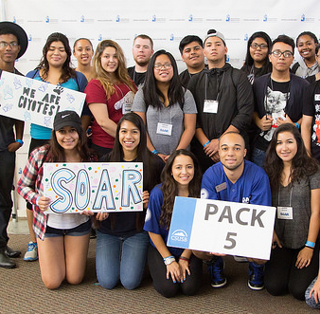


About our Campus
Four-year graduation rate is 25%
Six-year graduation rate is 59%
19,404 students enrolled in
Fall 2020
One of the 23 campuses in the California State University System
87% of our students are from San Bernardino and Riverside counties

Slide 4
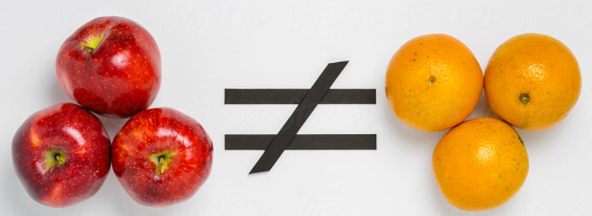

What is a Matched Sample Analysis
A matched sample analysis is a technique in which each member of a sample is match with a member of a separate sample on certain characteristics.
Through this method, a control group is created based on a one-to-one match.

Slide 5

Student A
Received Treatment/Participant
Student B
Control/Non-Participant
Student C
Control/Non-Participant
Matched
Gender: Male
Ethnicity/Race: Hispanic
Pell Recipient: Yes
High School GPA: 3.30
Gender: Male
Ethnicity/Race: Hispanic
Pell Recipient: Yes
High School GPA: 3.33
Gender: Male
Ethnicity/Race: White
Pell Recipient: No
High School GPA: 3.30

Slide 6
Why Match in Institutional Research?
Services, programs, and activities on campus that IR offices are tasked to evaluate do not randomly select students for participation.
Space is available for any interested student, or participation is offered to a subpopulation meeting eligibility criteria.
This methodology works well when a target sample is relatively small compared to their comparison group and when differences in other factors (e.g., demographics) are known to impact the outcomes.
The process is easily understood by stakeholders.

Slide 7
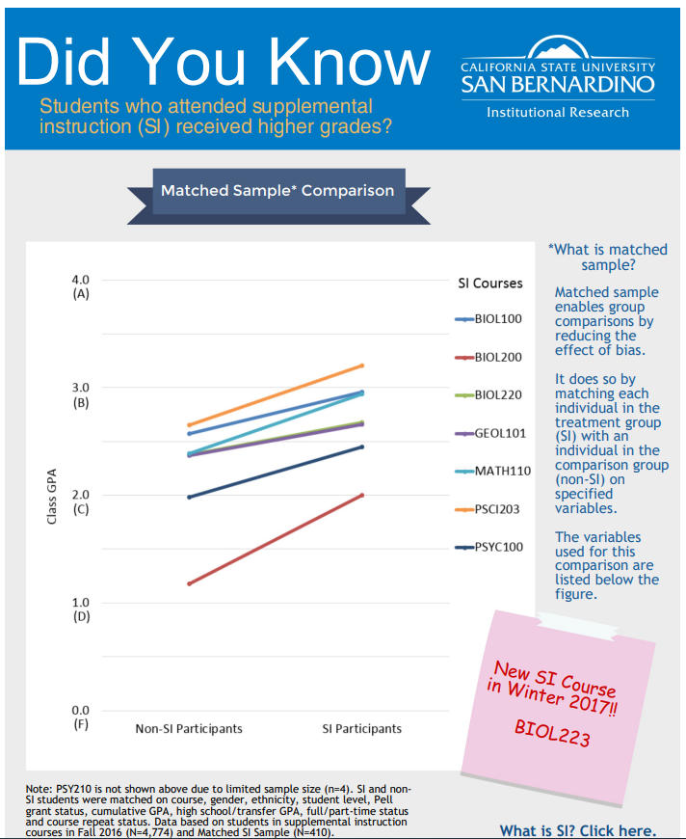
Course Grade Comparisons for SI vs non-SI Students
SI and non-SI students were matched on:
Course
Sex
Ethnicity
Student level
Pell status
Cumulative GPA
High school/transfer GPA
Full vs part-time status
Number of course repeats

Slide 8
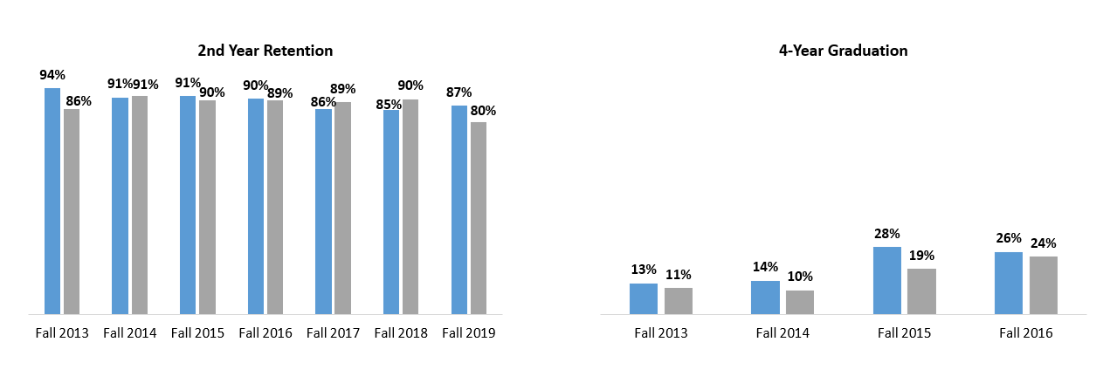
Retention & Graduation Rates: Matched Sample
Note: Group 1 and Group 2 were matched on six variables: cohort, first-generation status, Pell status, URM status, gender, and high school GPA.

Slide 9
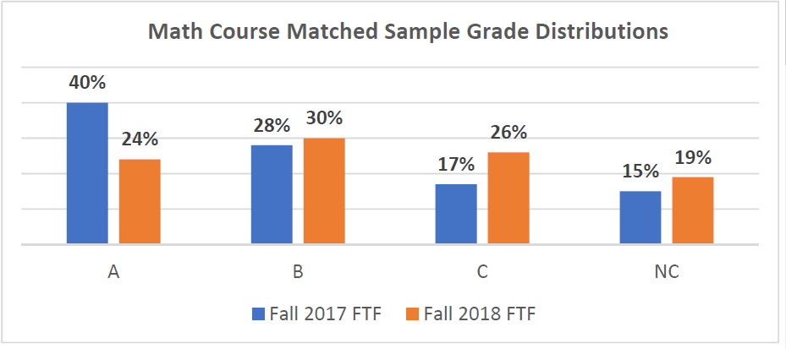
Math Course Match Sample
Note: Cohorts were matched on six variables: Pell status, first-generation status, URM status, high school GPA (.15), SAT math (30), Term unit load (3)

Slide 10
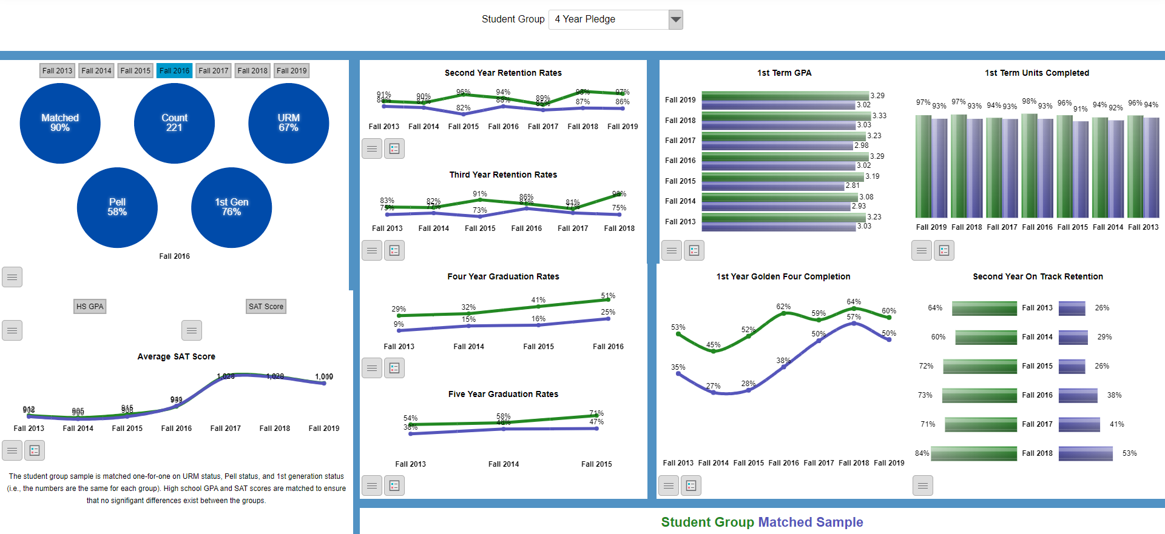
Student Groups Match Sample Dashboard

Slide 11
Stakeholder Feedback
“For many years, our student population was being compared with other students that did not have comparable characteristics. We did not feel that the available data accurately provided a true comparison, nor the added value of our program and services provided for the population that we serve. With the introduction of the Case Control Matching technique, our department is now able to measure and compare students with similar attributes. This allows us to truly assess the significant impact our services and interventions have on the students that participate in our program.”
“Match sample data allows me as a dean to use a more contextual lens when viewing student data and the impact of academic support programming in a way that is more nuanced and rich.”

Slide 12
Case-Control Matching in SPSS
Demonstration

Slide 13
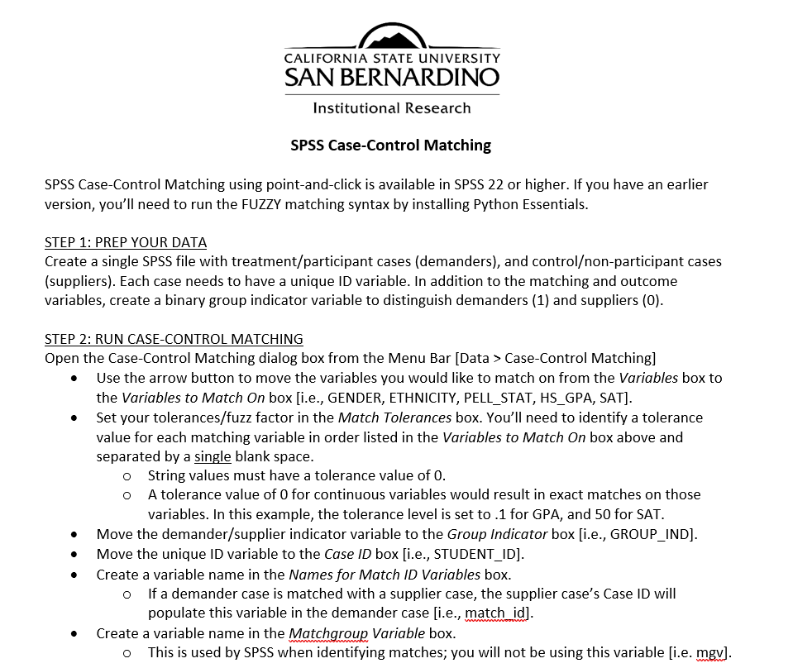
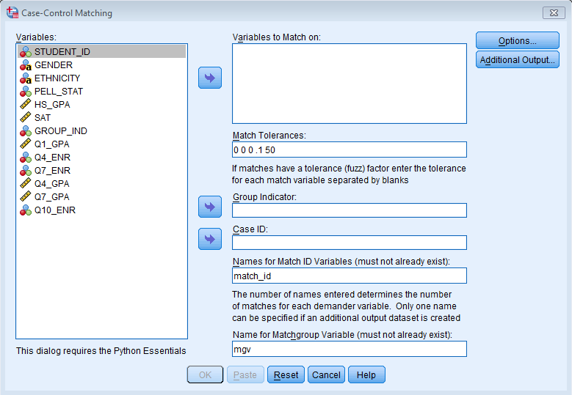
Method 1: Using the dialog box from the menu bar

Slide 14
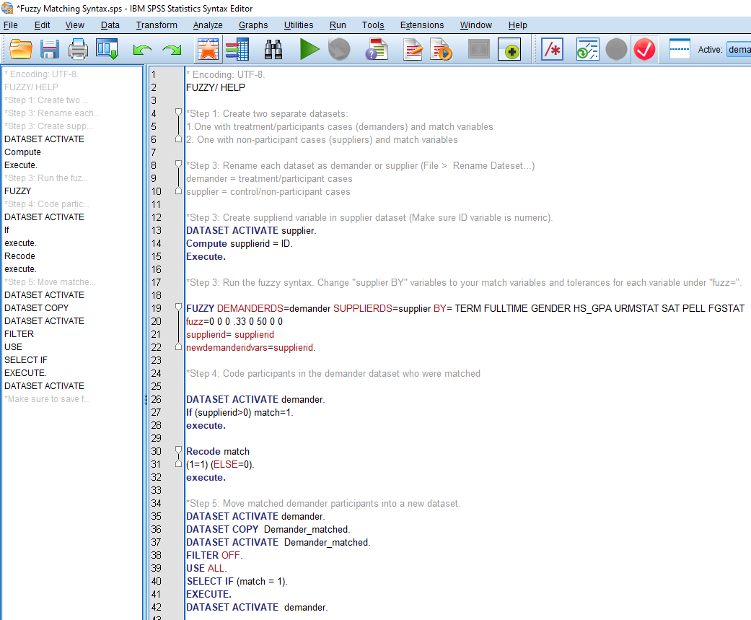
Method 2: Using syntax

Slide 15

Thank you!
Questions?
Contact us!
  institutional_research@csusb.edu
  909-537-5052

