Slide 2
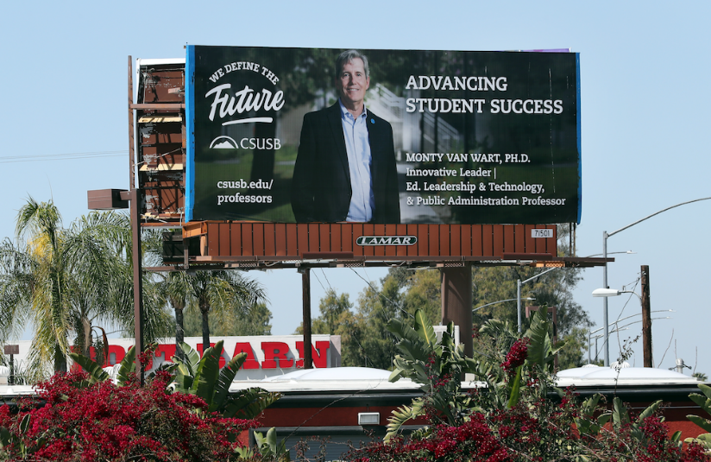
Types and Functions of Presentations in Online Classes
Facilitator: Monty Van Wart
JHBC Director of Faculty Development

Slide 3
The Basic Purposes of Instructor Presentations in any Medium

Slide 4
The Basic Purposes of Instructor Presentations in any Medium

Slide 5
Initial Input
Learners read—textbooks, articles, written lectures, documents or cultural artifacts, etc.

Slide 6
Initial Input
Learners read—textbooks, articles, written lectures, documents or cultural artifacts, etc.
People learn by direct exposure to the content.

Slide 7
Initial Input
Learners read—textbooks, articles, written lectures, documents or cultural artifacts, etc.
People learn by direct exposure to the content.
The third type of input is direct instruction—lectures, facilitated discussions, question and answer sessions, etc.

Slide 8
Technology and Direct Instruction
Pluses: easier, more reliable, more tools available, high-quality and high-impact now possible in online settings
Negatives: more work to learn new tools and skills
So the question becomes: Is the time put into mastering online presentation/facilitation tools and skills worth it?

Slide 9
Strengths of input types: reading materials
Convenience
Amount of detail conveyed
Ease of reviewing
Strength as visual-cognitive learning

Slide 10
Strengths of input types: instructor input
Immediacy
3 dimensionality
Sense of a leaning community
Opportunity to ask questions
Strength of oral-aural learning

Slide 11
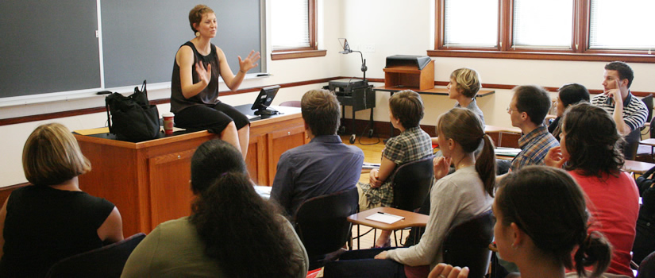
What is the ideal?
The ideal learning environment for learning is to have both types of input.
It tends to embed the material better, be more interesting for student, and enable more detailed learning.

Slide 12
What does direct instruction depend on in the online teaching environment?
instructor’s interest in providing a richer experience for students.
instructor’s willingness to learn presentation technology.
how many presentation technologies one wants to master.
instructor’s willingness to put time into each presentation.

Slide 13
Functional Types of Online Lectures | Description
Live videoconference lectures | Synchronous lectures mediated by technology
Lecture capture | Lectures “captured” during a live session for a secondary audience
Pre-recorded video lectures | Lectures recorded with a focus on enhancing video production quality to some degree (from a little to a great deal)

Slide 14
Functional Types of Online Lectures | Description
Live videoconference lectures | Synchronous lectures mediated by technology
Lecture capture | Lectures “captured” during a live session for a secondary audience
Pre-recorded video lectures | Lectures recorded with a focus on enhancing video production quality to some degree (from a little to a great deal)

Slide 15
Functional Types of Online Lectures | Description
Live videoconference lectures | Synchronous lectures mediated by technology
Lecture capture | Lectures “captured” during a live session for a secondary audience
Pre-recorded video lectures | Lectures recorded with a focus on enhancing video production quality to some degree (from a little to a great deal)

Slide 16
The various commonly available software types at CSUSB

Slide 17
Zoom Live and Zoom Lecture Capture

Slide 18
Zoom Live and Zoom Lecture Capture

Slide 19
Pre-recorded Lectures: Zoom

Slide 20
Pre-recorded Lectures: VoiceThread & PlayPosit

Slide 21
Pre-recorded Lectures: Camtasia

Slide 22
Review of strengths and weaknesses of 4 types of presentation tools
 | Videoconference lectures, e.g., Zoom | Lecture-capture, e.g., Zoom | Pre-recorded lectures, e.g., Zoom, VoiceThread, PlayPosit, Camtasia
Lecture convenience for students | Low (requires synchronous attendance) | High | High
Ease of use for instructor | Easy | Easy | Easy (Zoom without an audience)
 |  |  | Moderately easy (VoiceThread, PlayPosit)
 |  |  | Difficult to master (Camtasia)
Interaction (faculty-student) | Good | None | None (Zoom without an audience); None with other programs when the interaction features are not utilized
 |  |  | Good when the interaction features are used: VoiceThread (embedded discussion threads), PlayPosit (embedded quizzes), Camtasia (embedded quizzes)
Perceived lecture succinctness by students | Moderate (interaction and immediacy are high but some loss of media richness) | Poor (feels like an afterthought, poor production quality) | High (almost nothing is extraneous thus shorter lectures, higher quality production value)

Slide 23
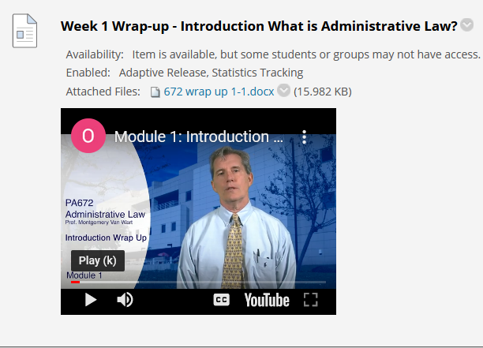
Which software program is right for your presentation requirements as an instructor?
It depends on your current ability and goals are.
There should be at least one video presentation medium be used in every course extensively.
To achieve high-quality, two presentation formats are generally desirable.

Slide 24
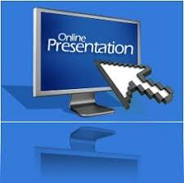
Final tips
be prepared to take the time to study and practice them initially
one-time effort to master a software program affects dozens of classes
SOTES are significantly affected
let’s live up to our mission!

