Slide 1
Travel Request and Expense Report Approval Workflow

Slide 2
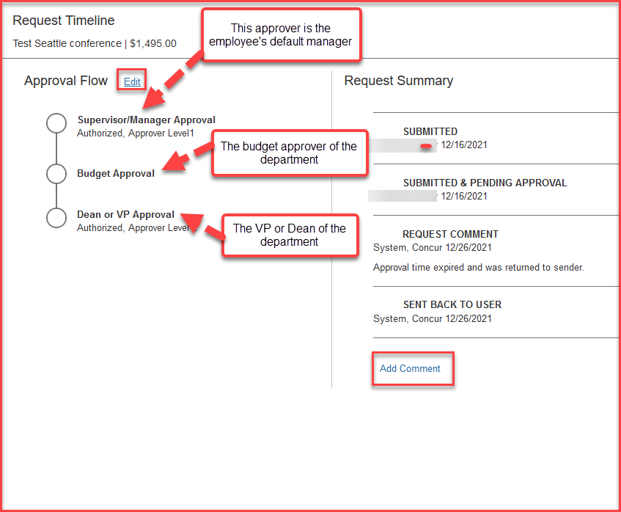
Travel Request Workflow The Request workflow goes through the below approvers
Supervisor/Manager Approval –This is the employee’s default manager
Budget Approval – The budget approver of the department. The user must add the approver on the Request header
Dean or VP Approval – The VP or Dean of the department
The employee can also add additional approvers by clicking on the Edit option next to Approval Flow and add a comment as well. All these changes can be done, only before the request is submitted.
Please note: each approvers have 9 days to approve a Request, otherwise the Request will time out, and the user will have to resubmit the Request

Slide 3
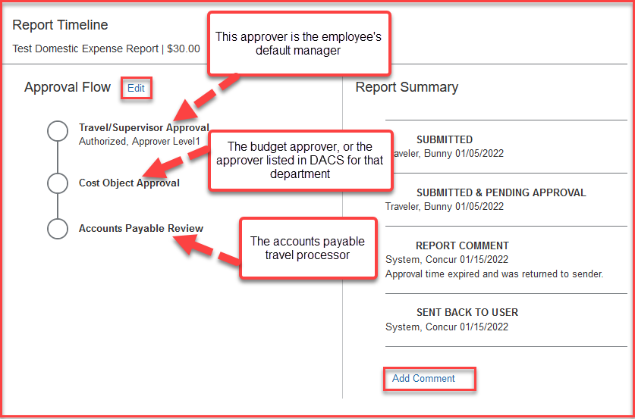
Expense Report Workflow The Expense Report goes through the below approvers
Travel/Supervisor Approval –This is the employee’s default manager
Cost Object Approval – The budget approver, or the approver listed in DACS for that department. The user must add this approver at the Report header
Accounts Payable Review – The accounts payable travel processor
The employee can also add additional approvers by clicking on the Edit option next to Approval Flow and add a comment as well. All these changes can be done, only before the request is submitted.
Please note: each approvers have 9 days to approve a Request, otherwise the Request will time out, and the user will have to resubmit the Request

