Slide 1
Sponsored by the National Institute of Health
TIPS FOR MANAGING YOUR GRANT
Presenters
Yolanda Meyer – Research Analyst – Sponsored Programs Administration (ymeyer@csusb.edu)
Walid Wahba – Research Analyst – Sponsored Programs Administration (Walid.Wahba@csusb.edu)
Ingrid Valdez, HR Liaison for Sponsored Programs Administration (Ivaldez@csusb.edu)
Julie Wessel, Sr. Research Analyst – Sponsored Programs Administration (jwessel@csusb.edu)
Diane Trujillo, Director for Sponsored Programs Administration (Dianet@csusb.edu)

Slide 2
Sponsored by the National Institute of Health
Overview
Provide PI’s with tips for managing your grant
What you need to know about managing your grant

Slide 3
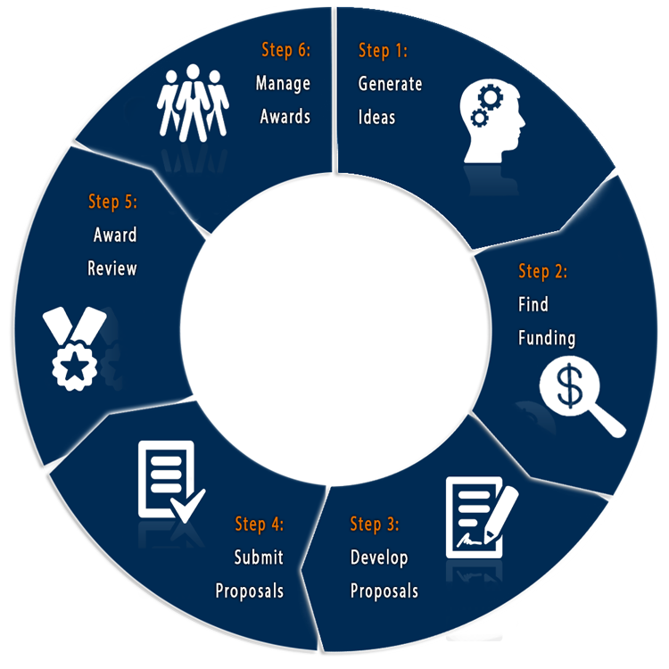
Sponsored by the National Institute of Health
OFFICE OF ACADEMIC RESEARCH
Office of Research Development
Office Research and Sponsored Programs (Pre-Award)
Office of Sponsored Programs Administration (Post-Award)
Related office:
Office of Research Compliance
(IRB, IACUC, Conflict of
Interest, etc.)

Slide 4
Sponsored by the National Institute of Health
You got a GRANT!!
NOW WHAT??

Slide 5
Sponsored by the National Institute of Health
Rules of the Road
You can find these by reviewing your Notice of Grant Award (aka NOA) and Terms and Conditions.
This is the document you received from the funding agency letting you know you received your grant.
You may also receive from your Research Analyst (RA ).
t

Slide 6
Sponsored by the National Institute of Health
TIP #1 – Things to note
Highlight reporting deadlines ~ set up reminders in your calendar
Are there special terms/conditions?
restrictions on spending on specific items
are funds allowed to roll over
does agency have to approve budget revisions
does agency have to approve out of state or international travel

Slide 7
Sponsored by the National Institute of Health
TIP #2 – Be familiar with policies and forms
https://www.csusb.edu/university-enterprises-corporation
Sponsored Programs Administration
Financial Services
UEC Human Resources
UEC Payroll

Slide 8
Sponsored by the National Institute of Health
TIP #3 –Plan ahead for spending & VEVO!
Visit Early - Visit Often
When do you need a purchase order
Do you need a P-card
How do you get reimbursed for purchases
Independent Contractors/Consultants – qualifying and getting them paid
https://www.csusb.edu/university-enterprises-corporation

Slide 9
Sponsored by the National Institute of Health
TIP #4 – Know what costs are…
Allowable
Allocable
Refer to your Notice of Grant Award (NOA) and the terms and conditions

Slide 10
Sponsored by the National Institute of Health
TIP #5 Pay yourself from your grant
Request…..
Release time from teaching obligations during an academic period
Additional pay/compensation during non-academic periods (summer, spring & winter intersession)
125% rule

Slide 11
Sponsored by the National Institute of Health
TIP #6 – Review your spending every month
Learn to use online financial reports - Data Warehouse
Computerized Information Access (CIA)Financial
Reporting for Grant Managers
https://www.csusb.edu/its/training
Look for: overdrawn accounts, old POs, balances on contracts

Slide 12
TIP #7 Plan ahead for hiring employees or independent contractors
UEC is the employer for Sponsored Project personnel –staff, students, faculty additional compensation
Timelines for job postings and hiring paperwork
Payroll – approve time sheets – timely!
Monitor employee vacation accruals.

Slide 13
Sponsored by the National Institute of Health
TIP #8 You can request a no cost extension (NCE)
Wait, I’m still working on it!
Most federal awards allow a one-time no-cost extension of up to 12 months if you ask before your project’s end date
Check with your Research Analyst about deadlines and procedures

Slide 14
Sponsored by the National Institute of Health
TIP #9 Close-out your project
As you near the end of your project work with your RA for close out
Spend all grant funds
Disencumber purchase orders
Submit all final outstanding invoices and reimbursement requests
Submit all timesheets and absence reports
Ensure employees take accrued vacations to avoid overages
No payroll commitments past the end date
Complete all programmatic reports required by the funding agency

Slide 15
Sponsored by the National Institute of Health
TIP #10 Learn to love the red tape!
PI’s on federally funded projects spend an average of 42% of their time on associated administrative tasks (National Science Board, 2014).

Slide 16
Sponsored by NIH
QUESTIONS?
We would greatly appreciate you
completing our survey
THANK YOU!
The Post Award Team

