Slide 1
Steps to graduate school Angie Arteaga career counselor
career.csusb.edu 909.537.5250 University Hall 329

Slide 2
Grad School Process
Research
Evaluate
Prepare
Finance
career.csusb.edu 909.537.5250 University Hall 329
Notes:
Ask the students what they think each one means
Research: prospective field
Evaluate: various programs
Prepare: admissions process
Finance: education

Slide 3
Research
Your field and what you want out of a program
Practical or theoretical base?
Informational interviews
Current students
Alumni
Professors
Start a list
List school type, pros, cons, cost, etc.
www.petersons.com
career.csusb.edu 909.537.5250 University Hall 329

Slide 4
Evaluate
Well-known and respected programs
Accreditation
Philosophy
Research area
Facilities and size
Requirements
Units, clinical, exams, candidacy, comps, thesis, dissertation
Completion
career.csusb.edu 909.537.5250 University Hall 329

Slide 5
Prepare
Aim for a 3.0 GPA or higher
Gather information about deadlines and place them on calendar, list, etc.
Network!
2-3 letters of recommendation
Work on statement of purpose
Admissions Tests
GRE
GMAT-MBA
LSAT-Law
MCAT-Medical

Slide 6
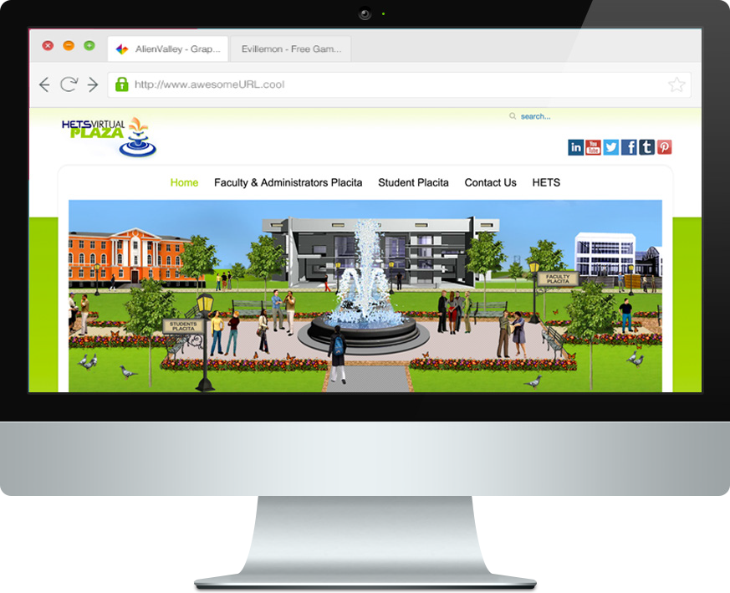
Practice Tests
Visit: www.hets.org/virtualplaza
Under the Student Support tab click on the “Testing & Education Reference Center”.
To access the full suite of resources, please login at bitly.com/CSUSBHETS and enter code: calstate2013.

Slide 7
Finance
Fellowships
Loans
Assistantships
Grants
Outside employment

Slide 8
Checklist
Senior Year
September: submit applications
October: submit applications
November: start collecting letters of rec & write personal statement
December-apply for scholarships/fellowships
January-file your taxes and FAFSA
February-practice interviewing with the Career Center
March-May: follow up, submit commitment forms, pay fees, and send THANK YOU letters

Slide 9
Personal Statement
Two Categories:
General comprehensive statement
Response to specific questions
Step-by-Step Guide:
Step 1: Review what the application is asking for
Step 2: Ask yourself questions before you write
Step 3: Get it started---it will take several drafts
Step 4: Get it reviewed!

Slide 10
Personal Statement
Questions to ask yourself:
What is special about your story?
What details about your life have shaped your goals?
How did you become interested in the field?
What have you learned through work, school, or volunteering?
What are you academic/career goals?
Do you have any academic gaps?
Have you experienced any unusual obstacles?
What are some of your personal characteristics and skills?
What makes you a strong candidate?
How do you give back to the community?

Slide 11
Personal Statement

Slide 12
Personal Statement
Getting Started Exercise:
Think about:
A memorable accomplishment. What did you do and how did you accomplish it?
What important activities have you engaged in? With whom? What role did you play?
What work experiences have you had? What was your job? Responsibility? How did you carry it out?
Jot these down on a piece of paper
5 minutes
If willing, please share with the group

Slide 13
Letters of Recommendation
Ask, do not demand
Choose people who know you the best
Assure that they will give you a positive recommendation
Before you ask, meet with them to discuss goals
Provide them with a résumé or list of accomplishments
Let them know where you are applying
Send them a THANK YOU!

Slide 14
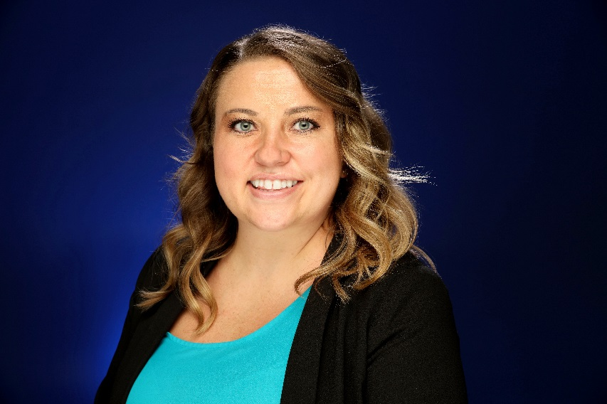
Angie Arteaga
Career Counselor
Angela.Arteaga@csusb.edu
(909) 537-3258
career.csusb.edu
UH-329

