Slide 1
SUSTAINABILITY IN ACTION:
The Case of CSUSB,
“Walking the Talk”
Presented to the
International Conference on Management & Sustainability
September 2018
Institute of Management Technology, Nagpur, India
Breena E. Coates, Ph.D., Professor of Corporate Strategy
Jack H Brown College of Business & Public Administration

Slide 2
AN IMBALANCE BETWEEN SUPPLY & DEMAND
PRESERVING & CONSERVING THE RESOURCES THAT NATURE PROVIDES US (FOR FREE IS) NECESSARY FOR THE SURVIVAL OF PLANET EARTH ……
SUPPLY
DEMAND

Slide 3
The triple bottom line—business focus: PLANET, PEOPLE AND PROFIT

Slide 4
THE UNITED NATIONS DEFINITION OF SUSTAINABILITY
“development that meets the needs of the present without compromising the ability of future generations to meet their own needs.” (World Commission on Environment and Development, 1987).

Slide 5
CORPORATE GOVERNANCE leadership strategy
CSU—System-wide Mission
The First Assessment of the 2014 Sustainability Policy (2014-2017)
CSUSB—Strategic Values
Resilient CSUSB Plan
Jack Brown Business College--Strategic Mission
Mission Statement
Partnership with U.N. Global Compact

Slide 6
Strategic linkages to sustainability
SUSTAIN.
CSU
HQ
CSUSB
UN GLOBAL COMPACT
JHB COLLEGE

Slide 7
The sustainability show on CSUSB Coyote Talk Radio IS BORN!

Slide 8
THREE PILLARS OF THE SUSTAINABILITY RADIO TALK SHOW
ENGAGE
EDUCATE
SUSTAIN-
ABLITY .SHOW
ENTERTAIN

Slide 9
The CONTENT
Each show is calibrated with themes and guest appearances on a variety of subjects, with at least three experts—on such topics as:
ETHICAL
LDRSHP
E-WASTE
PLASTIC PESTILENCE
CLEAN ENERGY
CONSCIOUS CAPITALISM
OUR ECOLOGICAL FOOTPRINT
OTHER…
FOOD WASTE
ETHTICAL FINANCE

Slide 10
The radio platform in action

Slide 11
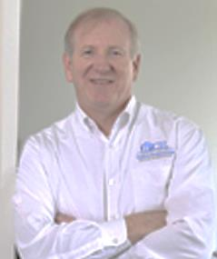
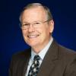
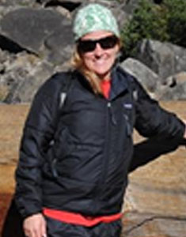
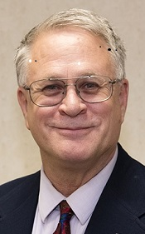
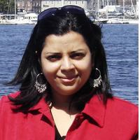
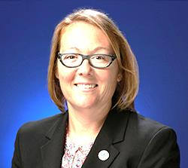
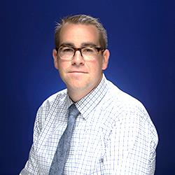
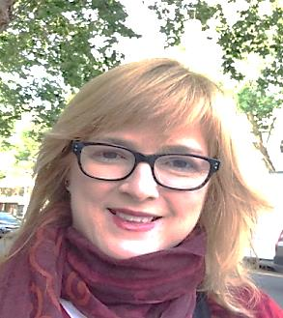
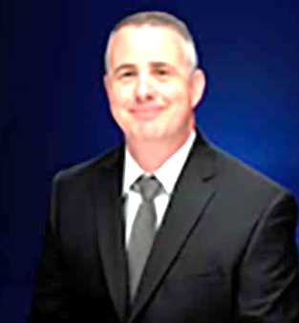
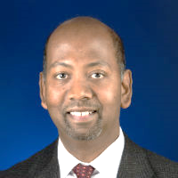
GUESTS:
Experts from academic research and clinical practice, and operations management on our campus show how these themes play out in the classroom, and on campus facilities management. Some examples are shown below of academic faculty and campus operations executives who who have shown how they walk the SUSTAINABILITY talk in their particular niches. MBA students will participate in 2018-and beyond.

Slide 12
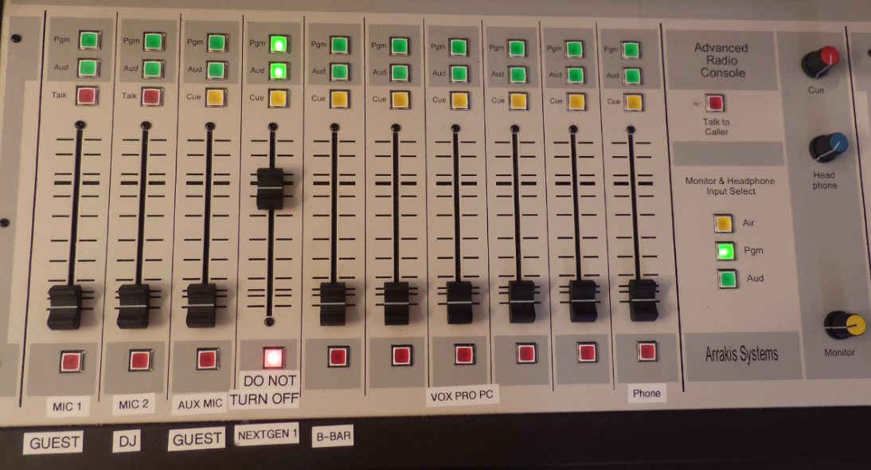
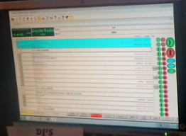
RADIO-ENGINEER--Graduate Student Involvement
Merlyna Na
Radio Eng.
Radio Console
Next Gen Monitor

Slide 13
THE SUSTAINABILITY SHOW IS ARCHIVED IN THE SOUND CLOUD
https://soundcloud.com/user-83979802/sustainability-show
All 2017-18 shows are uploaded above

Slide 14
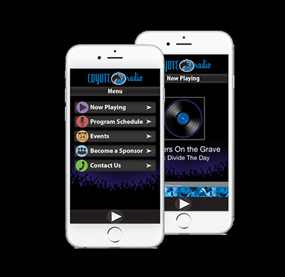
HOW TO REACH THE SUSTAINABILITY SHOW in Real time
Tune into www.radio.csusb.edu or download the Coyote Radio App from the App Store, or Google Play store.
Coyote Radio Request Line: (909) 537-5617,
*Email: coyote-radio@csusb.edu

Slide 15
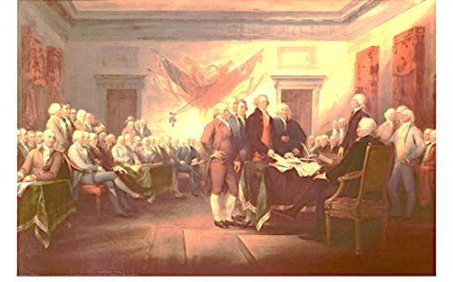
SYSTEM OF SUSTAINABILITY
Our natural world is a system—an integrated earth in a system of interrelated parts that includes, the Environment, Equity, and Economics for “Life, Liberty and the Pursuit of Happiness”(American Declaration of Independence)

Slide 16
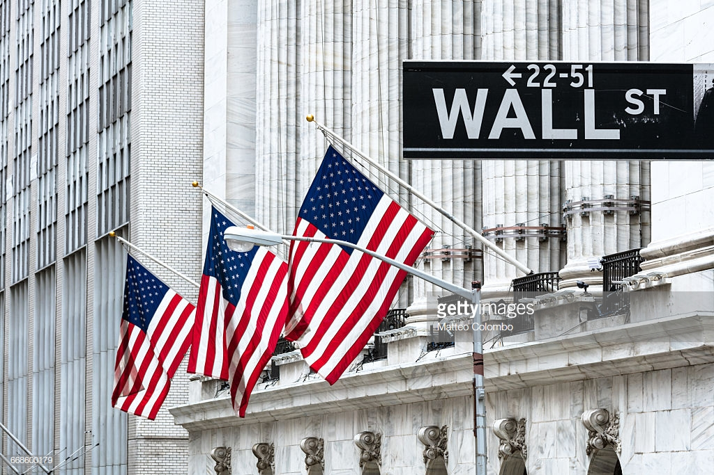
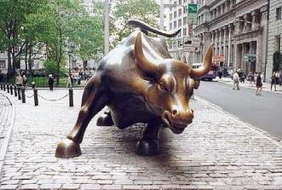
CAPITALISM & SUSTAINABILITY—is a “CONSCIOUS CAPITALISM”
Capitalism and the “The Triple Bottom Line” are congruencies that have no tension between them.Capitalism when done conscientiously can be is a gift to uplift humanity, done with pure self-interest in mind, it destroys value, prosperity and happiness for humankind.

Slide 17
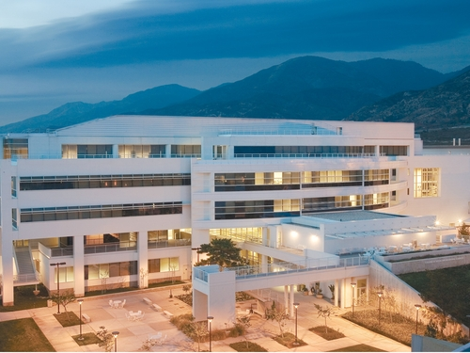
SUSTAINABILITY & BUSINESS COLLEGES
Educational institutions in general and business schools in particular in the last several years have been at the forefront of creating a new paradigm for “Defining the Future” for “Conscious Capitalism” through various kinds of academic programs.

Slide 18
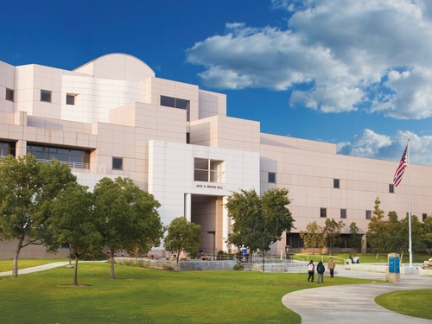
SUSTAINABILITY AT CSUSB
.
We are developing a sustainability campus here in the Inland Empire that can serve as a leader for institutional strategy on the environment.
The Jack H. . Brown College of
Business & Public Administration

Slide 19
SUSTAINABILITY =
Bringing A Closer Balance Between
Supply & Demand
Through a University Communications Initiative
SUPPLY
DEMAND

Slide 20
THANK YOU!
Breena E. Coates, Ph.D., Professor of Corporate Strategy

