Slide 1
Resume, Cover Letter & More
SPRING 2020: Career Readiness Workshop Series

Slide 2
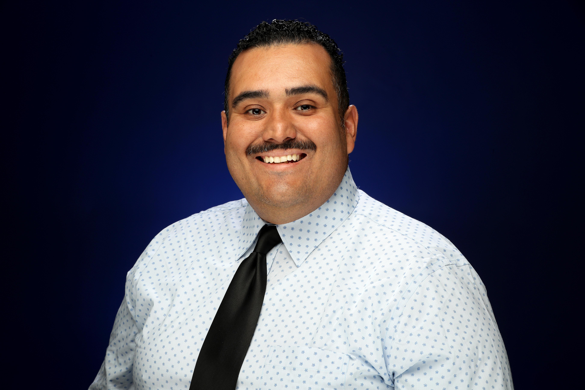
Presented by
Oscar Fonseca, Career Counselor
Career Center, Division of Student Affairs
Email: oscar.fonseca@csusb.edu
Phone: 909-537-8243

Slide 3
Workshop Overview
Resume, Cover Letter & More
A resume is a brief, informative document summarizing your abilities, education, and experience. It should highlight your strongest qualities and differentiate you from other candidates. In this workshop you will learn how to:
Identify and articulate transferable skills
Customize a cover letter and resume for targeted positions
Develop a resume with the format that aligns best with your career goals

Slide 4
What Should Your Resume Include
STATEMENT OF CAREER GOALS
Create a master statement of career goals that relate to the position for which you're applying.
HIGHLIGHT KEY SKILLS
Include a list of skills related to the workplace and the current job opening in particular. List software competencies, research specialties, social media aptitude and programs, and foreign languages.
https://www.learnhowtobecome.org/career-resource-center/grads-get-hired-guide/

Slide 5
What Should Your Resume Include
HIGHLIGHT EDUCATION ACCOMPLISHMENT.
If students have no career-related experience, they can cite their education, academic accomplishments and grade-point average (if it's a high score, of course).
HIGHLIGHT CAREER-RELATED ACTIVITIES
Include practical experience, internships, volunteering, professional or student associations, leadership positions, travel abroad or military service.

Slide 7
Career Center Resources and Links
CSUSB Career Center
Resume
Cover Letter
JobsScan
Over 90% of large companies use Applicant Tracking Systems.
Learn How to Become
Grad’s Guide to Getting Hired
Indeed
Indeed YouTube
COVID-19 Resources

Slide 8
Career Counseling
Appointments (30 mins.)
SPRING 2020: ONLINE AND PHONE ONLY
Counselors help with:
Major & career exploration
Career & educational planning
Resumes, cover letters, & CV’s
Job & internship search
Networking
Graduate school preparation
LinkedIn profile building
Interview skills & practice
Salary negotiation
www.csusb.edu/career-center/students-alumni/meet-career-counselor

Slide 9
Spring 2020: Drop-ins Cancelled

Slide 10
Free Professional Clothing
How it works:
All attire is Free to students and alumni
Stop by Mon. - Fri. from 8am - 5pm
Sign in with your student ID# at the front desk
After you find what you need, bring items to the front desk for checkout
Inventory arrives on a regular basis
Consider building your professional wardrobe before it is needed

Slide 11
Spring 2020 Events

Slide 12
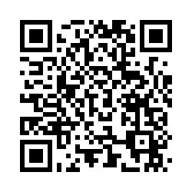
If you would like to provide feedback on the workshop please complete the brief online survey by using this link: https://bit.ly/2K7acUO
Your feedback is greatly appreciated!

Slide 13
Presented by
Oscar Fonseca, Career Counselor
Career Center, Division of Student Affairs
Email: oscar.fonseca@csusb.edu
Phone: 909-537-8243

Slide 14
Career Center Information
Main Campus
University Hall 329
Phone: 909-537-5250
Email: careercenter@csusb.edu
Website: www.csusb.edu/career-center
Palm Desert Campus
Indian Wells 111
Phone: 909-537-8243
Email: pdccareercenter@csusb.edu
Website: https://pdc.csusb.edu/current-students/career-service

