Slide 1
R.A.F.T.S WRITING PROMPTS
MINI LESSON
LIT CENTER

Slide 2
RAFT STYLE WRITING PROMPTS
ROLE ➔ Point of view taken by writer
AUDIENCE ➔ For whom the writing is meant
FORMAT ➔ Story, letter, persuasive piece, essay, etc.
TOPIC ➔ Specific focus, topic
STRONG VERB ➔ Powerful word choices

Slide 3
TOUGH BORIS
MEM FOX

Slide 4
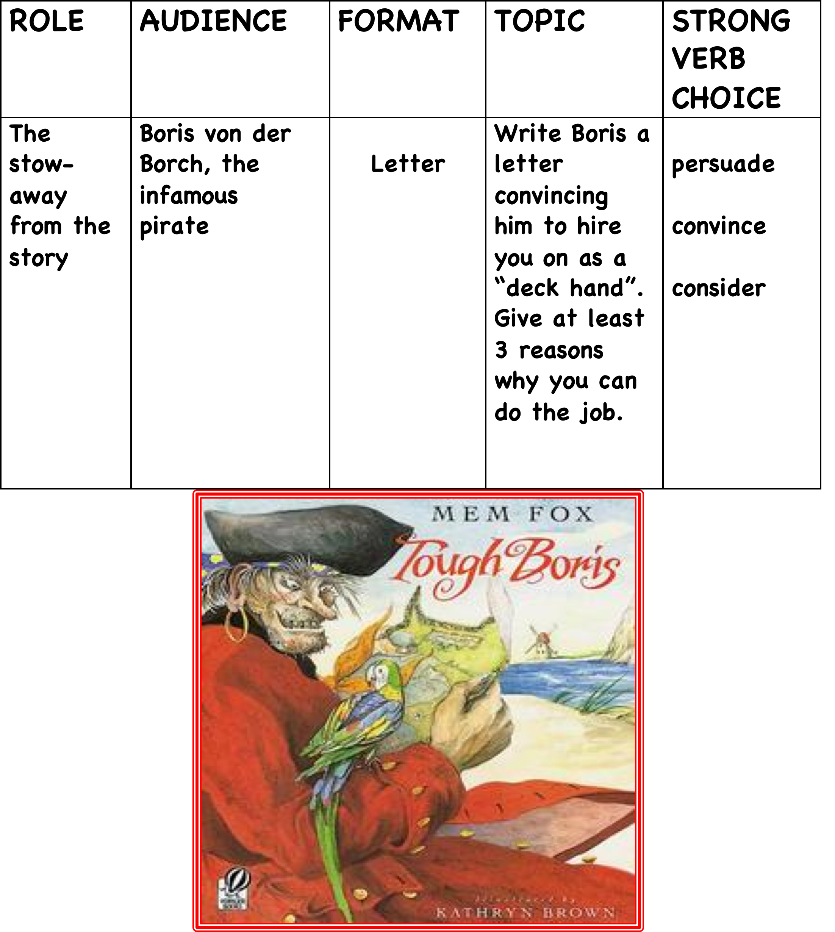

Slide 5
ROLE | AUDIENCE | FORMAT | TOPIC | STRONG VERB CHOICE
Boris von der Borch, the infamous pirate | Members of the pirate ship’s crew | A speech | Argue that the crew should share their treasure with the stow-away | demand convince distribute persuade

Slide 6


Slide 7
s
ROLE | AUDIENCE | FORMAT | TOPIC | STRONG VERB CHOICE
Brian Robeson, the protagonist in Hatchet | Brian’s father and mother | Persuasive letter | Argue that you have matured over the summer and feel that you should be allowed to begin flying lessons | convince persuade induce implore

