Slide 1

Quarter to semester (Q2S) advising for Biology majors
The university will be switching to the semester system in Fall 2020
You will have the following options regarding your Biology degree…
  Switch to the Biology BS semester degree requirements
  Stay with your current Biology BS or BA quarter degree requirements
If you take no action, you will stay on your current quarter degree requirements
In most cases, you will likely benefit by switching to the Biology Semester BS!
How can you switch?
  Visit the Office of the Registrar in University Hall
  Through some (but not all) advisors
  On-line form
  Note: You can switch NOW, if you want, or wait until spring, summer or fall
Should you switch?
  See following slides for more details
  Talk to a Biology faculty or PAC advisor!

Slide 2
Things to consider regarding the Quarter to Semester (Q2S) conversion:
Should you switch to semester Biology degree or stay on quarter catalog?
If you are a Biology major and have not started taking upper division Biology courses yet, then you are strongly recommended to switch to the semester degree requirements!!!
Upper division Biology majors that have recently or are currently taking Biol 300 are in a situation where it may be advantageous to switch to the Biology BS semester catalog requirements. However, the advantages and disadvantages of switching will vary from student to student, depending on individual student goals, desired graduation deadlines, and courses that have already been completed. The following slides and links will hopefully help you make an informed decision.
A few general notes:
All or nothing: If you choose to switch to semester requirements for the Biology degree, ALL of your requirements (for other majors, minors, and GE) have to switch as well.
You can’t easily go back: If you switch to the semester catalog requirements, it may not be easy to switch back to quarter requirements.
Changes to GE: Even if you don’t switch, there will be changes (mostly, a decrease in units) in GE requirements, specifically in Groups C, D, and E…see following slides.
  Because of these changes, try to take the “writing requirement” course (NSCI 306 or other 306 course) before Fall 2020 if you have not already done so.
Two major considerations covered on the next two slides involve the upper division required courses you have taken and how soon you want to graduate (# units required)
Don’t panic!
  You don’t need to decide immediately. You can switch now or wait until spring, summer or Fall 2020 (but switching currently is free of charge, and my not be after Fall 2020).
  You can switch to the semester degree requirements now (through an advisor, at the Office of the Registrar in U Hall, or online.

Slide 3
Things to consider: Required upper division Biology courses
The Biology BS semester degree was designed partly to more flexible in terms of the required upper division Biology courses:
  Semester system: 1 course each from Groups A, B, C and D
  Quarter system: Biol 300, 400, 423, 450 and 1 course each from Groups A and B
  (note that the "Groups" are different between quarter and semester).
Because of this, if you have not yet taken 400, 423 and/or 450, then switching to the semester Biology BS will allow you to take advantage of this flexibility.
However, if you have already taken all or most of these courses (400, 423, 450) or their equivalents, then switching to the semester Biology BS won't necessarily give you increased flexibility.
  Note that in the semester system, Biol 300, 400 and 423 are all "Group A" courses. So if you have already taken Biol 300, then you will have fulfilled the Biology BS semester Group A requirement, and 400 and 423 will count as elective courses.
Summary: From the perspective of required Biol courses and flexibility…
If you are currently taking Biol 300 or still need to take it, switching to the semester Biology BS will give you increased flexibility.
If you have already taken Biol 300 and have taken 400, 423, and/or 450, then there is less of an advantage to switch to the semester requirements.

Slide 4
Things to consider: Total units required
The semester Biology BS will require fewer total units of upper division Biol courses than the quarter BS, but more units than the quarter BA.
Upper division Biol units required for Biology major (including Biol 300, seminar, and all other required and elective Biol courses)
The unit conversion is: 1.5 quarter units = 1 semester unit
Summary: From a “total units” perspective…
If you are currently a Biology BS major, switching to the semester BS requirements would decrease the units/courses to graduate. ALSO, you might want to consider switching from the BS to the BA quarter requirements before Summer 2020!
If you are currently a Biology BA major, switching to the semester BS requirements would increase the number of units/courses to graduate (but still potentially offer more flexibility)
 | Quarter units | Semester units
Biology BS (quarter system): | 52 | 34.67
Biology BA (quarter system): | 37 | 24.67
Biology BS (semester system): | 45 | 30

Slide 5
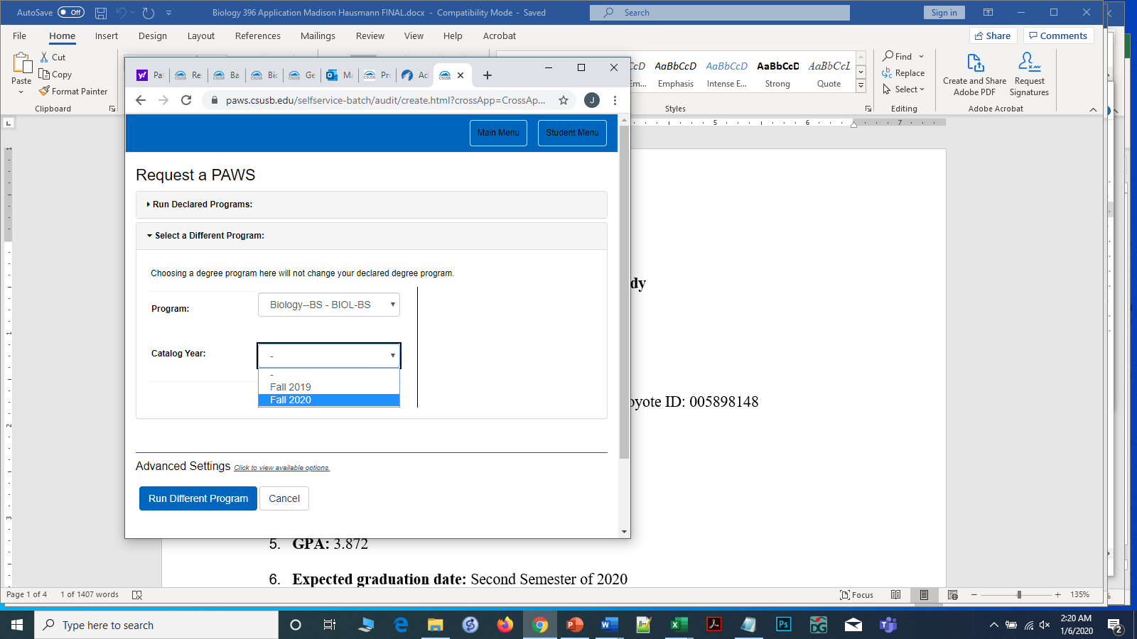
Using PAWS to compare progress to degree on Biology quarter BA/BS and semester BS
You can now run your PAWS report using the semester Biology BS requirements and see how it compares to the Biology BS/BA in the quarter system.
Go to the PAWS page through the CSUSB MyCoyote website.
In the "Request a PAWS" window, click on the "Select a Different Program" menu (below the "Run Declared Programs").
In the menu that pops up, select "Biology--BS - BIOL-BS" as Program and "Fall 2020" as the Catalog Year in the pull-down menus.
Click on the blue "Run Different Program" button at the bottom of the page.
The resulting PAWS that appears will show your progress to completion of the Biology BS semester degree based on classes you have completed or are currently enrolled in.
NOTE: If you have taken Math 192 as your calculus course, this will NOT show up as counting for the Biology degree Math requirement. Don't panic: your Math 192 WILL count for this, but it will have to be manually changed as a course substitution...see Drs. Chao or Dodsworth for this and other potential substitutions.

Slide 6
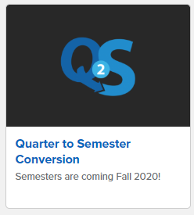
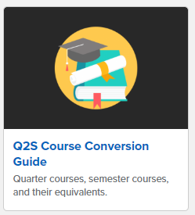
Resources
Tentative course offerings for Biology
Spring 2020: Slide 7 below
Fall 2020 and Spring 2021 (semesters): Slide 8 below
Comparison of Biology BS/BA quarter system and Biology BS semester system requirements
See slides 9-12 below
General Education (GE) advising and Q2S conversion tables
See slides 13-16 below
Biology semester courses and quarter equivalents (on Biology Q2S webpage)
https://cns.csusb.edu/sites/csusb_cns/files/Biology%20Semester%20and%20Quarter%20course%20equivalency%20table.pdf
Additional Q2S information on the Biology website
https://cns.csusb.edu/biology/biology-q2s-information
Semester system GE program
https://www.csusb.edu/general-education/general-education-program
Q2S GPA and unit conversion calculators
https://www.csusb.edu/semester/students/advising-students/q2s-calculator
Tiles on On MyCoyote: Q2S information and Course Conversion Guide
Q2S info
Conversion Guide

Slide 7
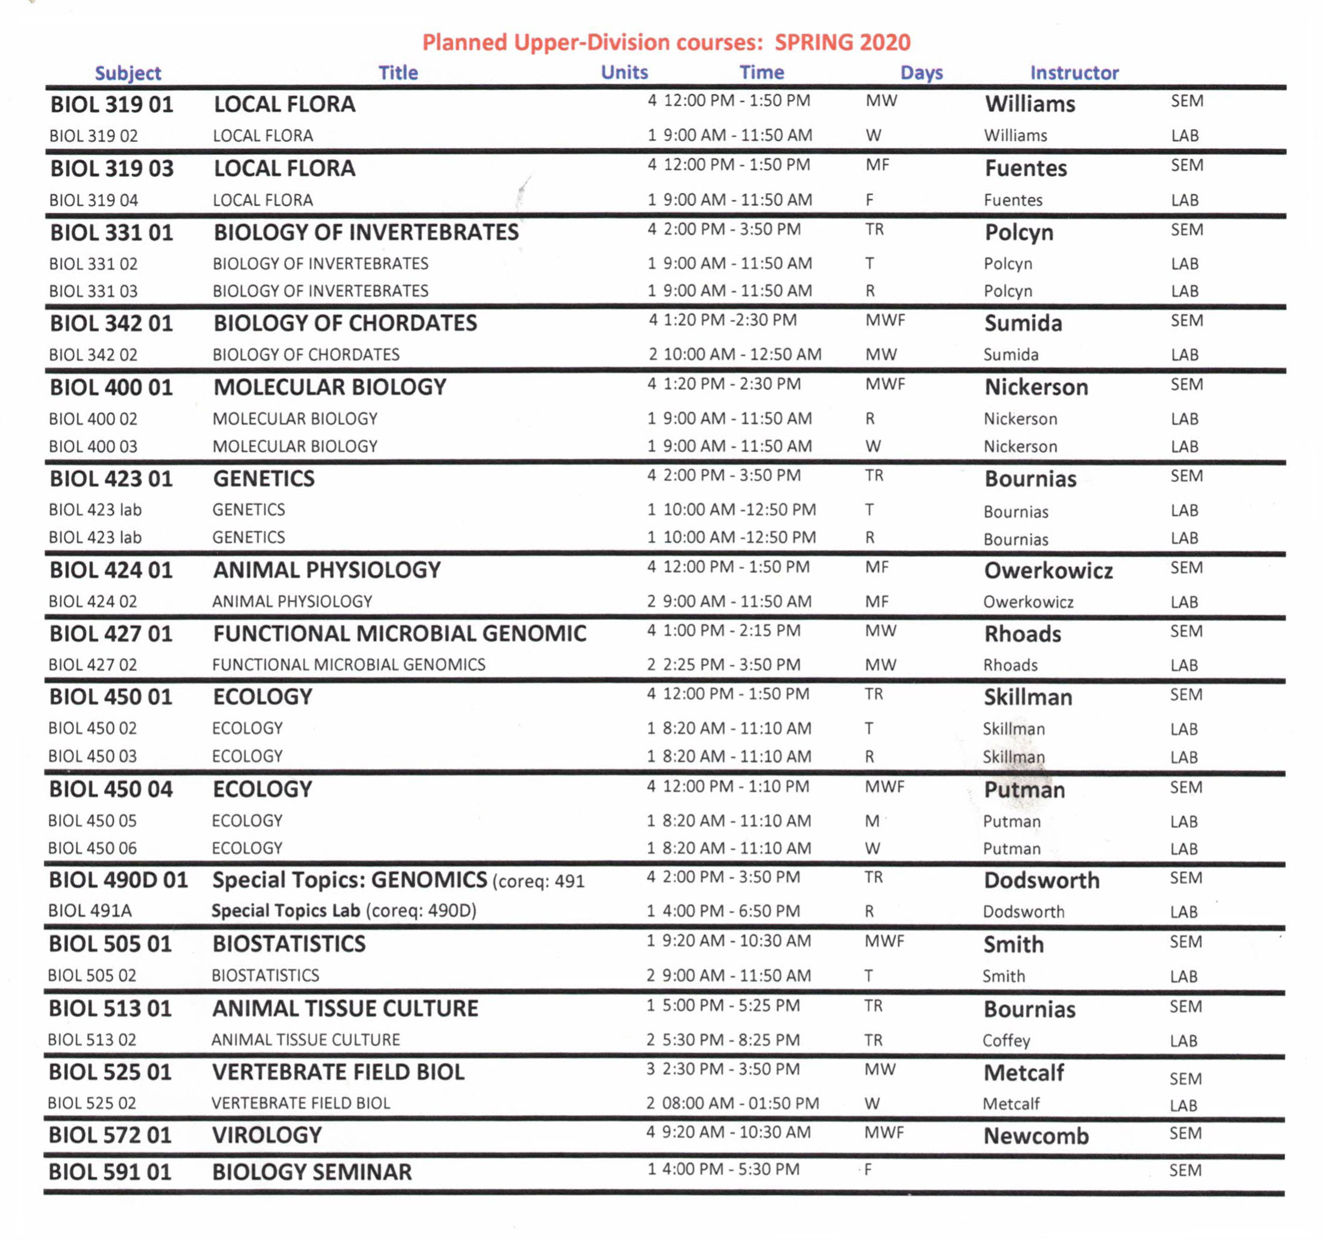
Upper division Biology course offerings for Spring 2020

Slide 8
Tentative upper division Biology course offerings for the 2020-2021 academic year
Fall 2020
Cell Biology (3100) | Lec MW 9:00 -10:15; Labs M&W 1:00 - 3:50
Molecular Biology (3120) | Lec TR 9:00-10:15; Labs T&R 1:00-3:50
Biol of Stem Cells (3130) | M 5:30 - 7:20
Microbiology (3200) | Lec MW 10:30-11:45; labs M&W 1:00-3:50
Genetics (3300) | Lec TR 1:00-2:15, Labs T&R 9-noon
Invertebrates (3410) | Lec MW 4:00-5:15; Labs M&W 12:00-2:50
Plant Biol/Diversity (3540) | Lec TR 10:30-11:45, Labs T & R 1:00-3:50
Animal Phys I (3630) | MW Lec: 9:00 - 10:15, Lab: W 10:30-1:20
Ecology (3800) | Lec TR 2:30-3:45; Labs T&R 8-11
Plant Phys (4510) | Lec MW 10:30-11:45, Lab MW 1:00-3:50
Human A&P I (4630) | Lec TRF 9:00-10:15, TR Lab 1:00-3:50
BIOL 5000 (Seminar) | F 12:00-12:50
Biostatistics (5050) | TBA
Animal Tissue Culture (5130) | Lec TR 4:00-4:25; Lab:TR 4:35-6:25
Genomics (5260) | Lec MW 2:30-4:00; Lab W 4:00-6:50
Conservation Biology (5840) | MW 9-10:15
Senior Sem Ecol (5905) | F 10:00-11:50
History of Biol (5911) | T 1:00-2:50
Spring 2021
Cell Bio (3100)
Molecular (3120)
Microbiology (3200)
Genetics (3300)
Herpetology (3440)
Local Flora (3520)
Animal Phys II (3640)
Evolution (3700)
Ecology (3800)
Ecology (3800)
Microbial Ecology (3820)
Med Micro (4200)
Med. and Economic Botany (4580)
Human A&P II (4640)
Ethics in Biol Reserch (5010)
Human Embryonic Stem cells (5170)
Intro to Regulatory affairs (5160)
Animal Tissue Culture (5130)
Virology (5320)
Course times for Spring 2021 are not yet determined

Slide 9
B.A. in Biology quarter degree requirements
Arrows indicate prerequisites
Math 110 and/or 120
Completion of or enrollment in Math 110, 111B, 112C, 120, 192, 211, or 212
1 yr General Chem.
1 yr Intro. Biol.
Calculus
Chem 215
Chem 216
Biol 200
Biol 201
Biol 202
Math 192 or 211
General Ed. (GE) classes
1 yr Organic Chem.
1 yr General Physics
Chem 221A (or 321)
Chem 222A (or 322)
Chem 223A (or 323)
Phys 121 (or 221)
Phys 122 (or 222)
Phys 123 (or 223)
Cell Physiology
Biol 300
Note: Biochemistry (Chem 436A/B) does NOT count toward Biology BA upper division electives…only for BS
Molecular Biol.
Biol 400
Biol 423
Biol 450 or 455
Biol 591
Selected upper division
Biology classes (16 units):
- One class from each of
Groups A and B**
- Other electives
(Genetics)
(Ecology)
(Seminar)
** Group A and B Biology courses
Group A: Biol 319, 354, 431
Group B: Biol 320, 331, 335, 340, 342, 420, 424, 440, 516, 517, 524, 573
If you have trouble getting a Group B course, please see Drs. Chao or Dodsworth about possible waivers
http://bulletin.csusb.edu/colleges-schools-departments/natural-sciences/biology/biology-ba/

Slide 10
B.S. in Biology quarter degree requirements
Arrows indicate prerequisites
Math 110 and/or 120
Completion of or enrollment in Math 110, 111B, 112C, 120, 192, 211, or 212
1 yr General Chem.
1 yr Intro. Biol.
Calculus
Chem 215
Chem 216
Biol 200
Biol 201
Biol 202
Math 192 or 211
General Ed. (GE) classes
2nd yr Chem.
1 yr General Physics
Chem 221A,B (or 321)
Chem 222A,B (or 322)
Chem 223A,B (or 323)
Phys 121 (or 221)
Phys 122 (or 222)
Phys 123 (or 223)
Cell Physiology
Biol 300
Biochemistry
Molecular Biol.
Chem 436A,B*
Biol 400
Biol 423
Biol 450 or 455
Biol 591
Selected upper division
Biology classes (31 units):
- One class from each of
Groups A and B**
- Other electives
(Genetics)
*Biochemistry 436A,B can count for
5 upper division Biol. elective units.
(Ecology)
(Seminar)
** Group A and B Biology courses
Group A: Biol 319, 354, 431
Group B: Biol 320, 331, 335, 340, 342, 420, 424, 440, 516, 517, 524, 573
If you have trouble getting a Group B course, please see Drs. Chao or Dodsworth about possible waivers
http://bulletin.csusb.edu/colleges-schools-departments/natural-sciences/biology/biology-bs/

Slide 11
B.S. in Biology semester degree requirements
Arrows indicate prerequisites
(Years 1-4)
Math 1401, 1403, or
suitable placement score
Completion of or enrollment in Math 1301, 1303, 1401, 1403, 1601, 2210, or 2220
General Ed. (GE) classes
Calculus (Year 1)
General Chemistry (Year 1)
Math 211
(192 by waiver)
Math 2210
Chem 2100 + 2100L
Chem 2200 + 2200L
Chem 215
Chem 216
Intro. Biol. (Year 2)
If you have already taken Math 192, it will count for the calculus requirement
Biol 2010
Biol 2020
Biol 200, 201, 202
2nd year Chemistry (Year 2):
Choose from the following
Biol. Seminar (Year 3 or 4)
General Physics (Year 2 or 3):
Choose from the following
1 yr Organic Chemistry
591
Biol 5000
Chem 2400 + 2400L
Chem 2500 + 2500L
Chem 2300 + 2400L
Chem 4100 + 4100L
Chem 2300 + 2400L
Chem 3200
Phys 2000 + 2000L
Phys 2010 + 2010L
Phys 2500 + 2500L
Phys 2510 + 2510L
Phys 2700
Chem 221, 222, 223
29 units upper division Biology, including at least one class from each of Groups A, B, C and D (Years 3-4)*
Phys 121, 122, 123
or
Group A (Cell/Molecular)
Biol 3100, 3120, 3200, 3300
Group B (Zoology)
Biol 3410, 3420, 3430, 3440, 3450, 3460, 3630, 3640
Group C (Botany)
Biol 3520, 3540, 4510, 4580
Group D (Populations and Ecosystems) Biol 3700, 3800, 3820
or
Organic + Biochemistry
300
400
320
423
Phys 221, 222, 223
Chem 436A, B
or
331
342
343
344
345
Organic + Quantitative Chem.
335
424
424
*Some upper division Biology classes may have Organic Chemistry, Biochemistry, or Calculus as prerequisites.
Chem 345
319
354
431
380
Quarter equivalent classes shown in red
321
450
Biol 3820, Microbial Ecology, is new on the semester system

Slide 12
B.S. in Biology semester degree requirements
Arrows indicate prerequisites
(Years 1-4)
Math 1401, 1403, or
suitable placement score
Completion of or enrollment in Math 1301, 1303, 1401, 1403, 1601, 2210, or 2220
General Ed. (GE) classes
Calculus (Year 1)
General Chemistry (Year 1)
Math 2210
Chem 2100 + 2100L
Chem 2200 + 2200L
Intro. Biol. (Year 2)
If you have already taken Math 192, it will count for the calculus requirement
Biol 2010
Biol 2020
2nd year Chemistry (Year 2):
Choose from the following
Biol. Seminar (Year 3 or 4)
General Physics (Year 2 or 3):
Choose from the following
1 yr Organic Chemistry
Biol 5000
Chem 2400 + 2400L
Chem 2500 + 2500L
Chem 2300 + 2400L
Chem 4100 + 4100L
Chem 2300 + 2400L
Chem 3200
Phys 2000 + 2000L
Phys 2010 + 2010L
Phys 2500 + 2500L
Phys 2510 + 2510L
Phys 2700
29 units upper division Biology, including at least one class from each of Groups A, B, C and D (Years 3-4)*
or
Group A (Cell/Molecular)
Biol 3100, 3120, 3200, 3300
Group B (Zoology)
Biol 3410, 3420, 3430, 3440, 3450,
Group C (Botany)
Biol 3520, 3540, 4510, 4580
Group D (Populations and Ecosystems) Biol 3700, 3800, 3820
or
Organic + Biochemistry
Cell Biol.
Micro.
Genetics
Mol. Biol.
or
Inverts
Comp. Vert. (5)
Mammol. (3)
Herp. (3)
Ornith. (3)
Organic + Quantitative Chem.
3460, 3630, 3640
Entomol. (3)
Animal Phys. I, II
*Some upper division Biology classes may have Organic Chemistry, Biochemistry, or Calculus as prerequisites.
Local Flora (3)
Plant Biol.
Plant Phys. (5)
Med/Eco Botany (3)
Evolution
Ecology
Micro. Ecol.
Units for Biol courses shown in parentheses; if not shown, the course is 4 units.

Slide 13
GE Advising for Transitional Students (page 1 of 2)
*For students who start their CSUSB career on the Quarter Calendar but will finish taking coursework on the Semester Calendar, regardless of which calendar catalog year they finish on.
All GE codes are listed in Quarter categories
GE-A (Basic Skills)- Required. No Change
GE-B (Natural Sciences)
GE-B1 (Mathematics) – Required. No Change
GE-B2 (Life Sciences) / GE-B3 (Physical Sciences) –No change for Biology majors (other majors only need one lab course, but this doesn’t affect Biology majors.
GE-B4 (Special Topics in Science and Technology)
Beginning Fall 2020, this category will not be required in the Quarter or Semester GE.
*suggestion: do not take if graduating after Fall 2020
GE-C (Humanities)
GE-C1 (Arts) – Required. No Change
GE-C2 (Literature) / GE-C3 (Foreign Language or Literature in Translation) / GE-C4 (Philosophy)
One course from GE-C1 is required.
Beginning Fall 2020, only 1 course in GE-C2, GE-C3 or GE-C4 is required.
An additional course in GE-C1, GE-C2, GE-C3, or GE-C4 will also be required.
A total of 3 courses required.
*suggestion: take one course from GE-C1; take one course from GE-C2, GE-C3 or GE-C4; and take a 3rd course from GE-C1, GE-C2, GE-C3, or GE-C4 if graduating after Fall 2020

Slide 14
GE Advising for Transitional Students (page 2 of 2)
*For students who start their CSUSB career on the Quarter Calendar but will finish taking coursework on the Semester Calendar, regardless of which calendar catalog year they finish on.
All GE codes are listed in Quarter categories
GE-D (Social and Behavioral Sciences)
GE-D1 (American History and Civilization) / GE-D2 (American Institutions) – Both required. No Change
GE-D3 (World Cultures) / GE-D4 (Discipline Perspectives)
Beginning Fall 2020, only 1 course between GE-D3 or GE-D4 will be required.
*suggestion: take only 1 course from GE-D3 or GE-D4 if graduating after Fall 2020
GE-E (Lifelong Understanding)
GE-E1 (The Whole Person – Physical and Physiological Issues) / GE-E2 (The Whole Person – Social and Psychological Issues) / GE-E3 (Physical Education Activity)
Beginning Fall 2020, only 4 units between GE-E1, GE-E2 and GE-E3 will be required.
2 units must be from GE-E1 or GE-E2.
*suggestion: take 2 units from GE-E1 or GE-E2 and 2 units from GE-E1, GE-E2, or GE-E3 if graduating after Fall 2020
Upper Division Writing Requirement
*suggestion: take UD writing (designated 306 class) prior to fall 2020 if class level is junior or senior.

Slide 15
GE quarter and semester system conversion table (page 1 of 2)

Slide 16
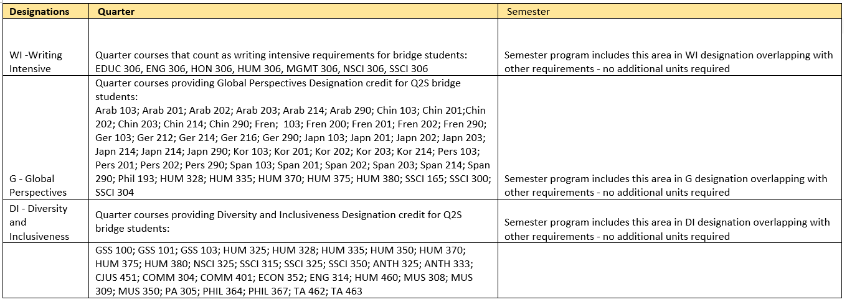
GE quarter and semester system conversion table (page 2 of 2)

