Slide 1
CAMPUS BUDGET FORUM May 24, 2021
CALIFORNIA STATE UNIVERSITY, SAN BERNARDINO
1

Slide 2
INSTITUTIONAL OVERVIEW
Dr. Tomás D. Morales
President
2

Slide 3
GOVERNOR’S 2021-22 PROPOSED BUDGET FOR THE CSU
May Revise
Recurring Additional Allocations
$185M Additional Base Budget Increase
$325M Deferred Maintenance
$299M Full Restoration of 2020/21 cuts
One-Time Allocation
California State Budget for 2021-22 is scheduled to be finalized and approved in mid-June.
3

Slide 4
2021/2022 PROJECTED ENROLLMENT
Resident
No enrollment growth funding for CSU
CSUSB Target 15,889 FTE
Non-Resident
Continued decline systemwide
CSUSB Target 279 FTE for 2021/22
Unit Load
Reduced average unit load in 2020/21 lowered our overall enrollment and impacted student progress to degree
Affects of pandemic still present
4

Slide 5
HIGHER EDUCATION EMERGENCY RELIEF FUNDS (HEERF) FEDERAL SUPPORT TO CSUSB
Institutional Support Student Support
HEERF I (May 2020) $14,989,067 $13,121,891
HEERF II (February 2021) $32,006,221 $13,121,891
HEERF III (May 2021) $39,548,842 $37,117,309
----------------- ------------------
Total $86,544,130 $63,361,091

Slide 6
HEERF STUDENT SUPPORT DISTRIBUTIONS ($63.4 million)
All registered students received HEERF student support on a sliding scale based on household income.
$26.3 million distributed to date (HEERF I and II)
$1.9 million in additional campus funds for international, undocumented, and DACA students.
HEERF III student support ($37.1 million) will be distributed proportionally in Summer 2021, Fall 2021, Winter Intersession 2022, and Spring 2022.
Undocumented and DACA students will qualify for direct distributions from HEERF III
6

Slide 7
HEERF INSTITUTIONAL SUPPORT ALLOWED USES ($86.5 million)
Offset demonstrated lost revenues due to the COVID-19 pandemic
Expenses and health/safety mitigations specifically in response to the COVID-19 pandemic
COVID-19 Testing and Vaccination
Administrative cost recovery for allowed expenditures
Additional student support grants
7

Slide 8
BUDGET ALLOCATION PROJECTIONS
Dr. Douglas R. Freer
Vice President, Administration & Finance
8

Slide 9
2021-22 CSUSB BASE BUDGET (ESTIMATED)
(In Millions)
Description | Current Year | Governor’s May Revise
State Appropriation | $129.7 | $143.4
Tuition/Fees | 103.1 | 106.7
Total Baseline Budget | $232.8 | $250.1
Difference from Current Year |  | $17.3
SUG Adjustment |  | 1.7
Mandatory Costs (Benefit Costs, Insurance, Utilities, etc.) |  | (3.7)
Strategic Plan 2015-2022 |  | (1.0)
Estimated Baseline Difference |  | $14.3
9

Slide 10
BUDGET RESTORATIONS (ESTIMATED)
Category | Original Reduction | Planned Restoration
Personnel | $10,955,370 | $11,005,283
Supplies | 923,074 | 923,074
Travel | 636,032 | 610,032
Reserve | 357,866 | 341,262
Other | 224,520 | 224,520
Hospitality | 100,000 | 100,000
Training | 87,500 | 87,500
Contract Services | 57,000 | 57,000
Postage/Duplicating/Telephone | 50,056 | 42,747
Info Tech Software/Hardware | 25,500 | 25,500
Total | $13,416,918 | $13,416,918
10

Slide 11
2021-22 CSUSB BUDGET PROJECTED ALLOCATIONS
Estimated Funds Available | $14,300,000
Division/College Budget Restoration | ($13,416,918)
Estimated Balance | $883,082
ADDITIONAL BUDGET PLANNING PRIORITIES
Restoration of the University Reserves
Capital Development Project Obligations
11

Slide 12
BUDGET TIMELINE
Late April
April/May
Mid-May
Late June
Late July
CO Releases Initial Budget Memo
UBAC Meets
Governor Releases May Revise
CO Releases Final Budget Memo
Mid-January
Governor Releases Budget Plan
State Budget Finalized
COMPLETED
COMPLETED
COMPLETED
COMPLETED
PENDING
PENDING
12

Slide 13
CSUSB HEERF Institutional Funds
Estimated Funds Available | $86,544,130
Approved Proposals | 75,955,805
Estimated Balance | $10,588,325
13

Slide 14
Approved HEERF Proposals
Area | Amount
Student Affairs | $21,846,938
Administration & Finance | 19,513,220
Campus Central | 18,240,608
ITS | 8,759,576
Academic Affairs | 7,407,212
University Advancement | 188,251
Total Approved | $75,955,805
14

Slide 15
Approved HEERF Proposals
Expense Category | Student Affairs | Academic Affairs | Admin & Finance | University Adv | ITS | Central | Total
Lost Revenue | 18,597,954 | 3,721,025 | 10,020,510 | 95,840 |  | 9,700,000 | $42,135,329
Faculty/Staff Equipment | 19,144 | 736,787 | 50,220 | 26,934 | 862,694 |  | $1,695,779
Student Equipment |  |  |  |  | 270,905 |  | $270,905
IT Infrastructure/Software |  |  |  | 50,000 | 2,035,027 |  | $2,085,027
Faculty Prof. Development |  | 294,174 |  |  |  | 1,161,500 | $1,455,674
Faculty Classroom Support |  | TBD |  |  |  |  | TBD
Student Advising/Tutoring |  | 1,959,292 |  |  |  |  | $1,959,292
Indoor Space Enhancement | 107,600 | 70,000 | 95,321 |  | 5,302,500 |  | $5,575,421
Outdoor Space Enhancement | 20,000 |  | 3,807,198 |  |  |  | $3,827,198
Additional Salary/Benefits | 105,846 | 529,111 |  |  | 288,450 | 400,899 | $1,324,306
Additional Operating Exp | 49,235 | 96,823 | 1,395,851 | 15,477 |  |  | $1,557,386
COVID Testing | 2,947,159 |  | 4,144,120 |  |  |  | $7,091,279
Admin Cost Recovery (26%) |  |  |  |  |  | 6,978,209 | $6,978,209
Total | $21,846,938 | $7,407,212 | $19,513,220 | $188,251 | $8,759,576 | $18,240,608 | $75,955,805
15

Slide 16
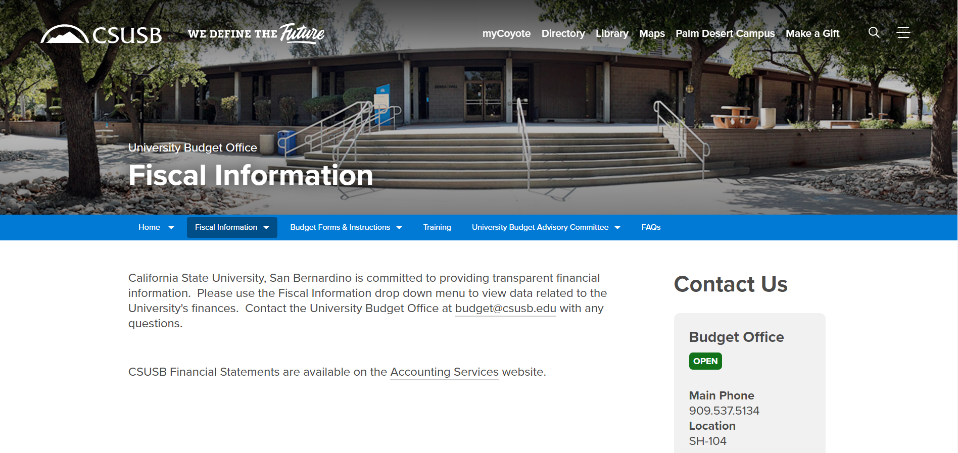
BUDGET RESOURCES budget.csusb.edu
16

